Slide 1
hardware is (stupid) simple
@sarajchipps
september 15, 2013
jsconfeu

Slide 2
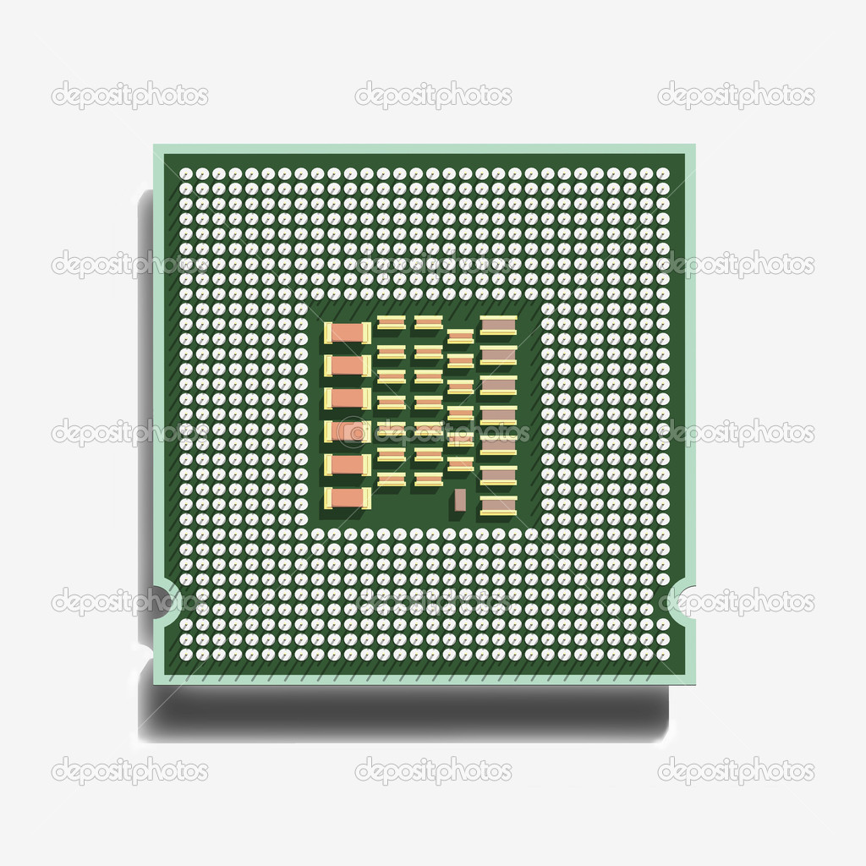
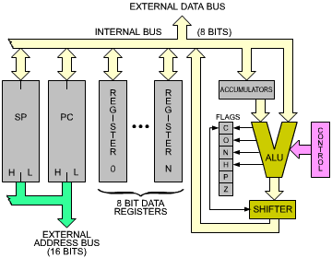

the old wackness

Slide 3

the new hotness

Slide 4
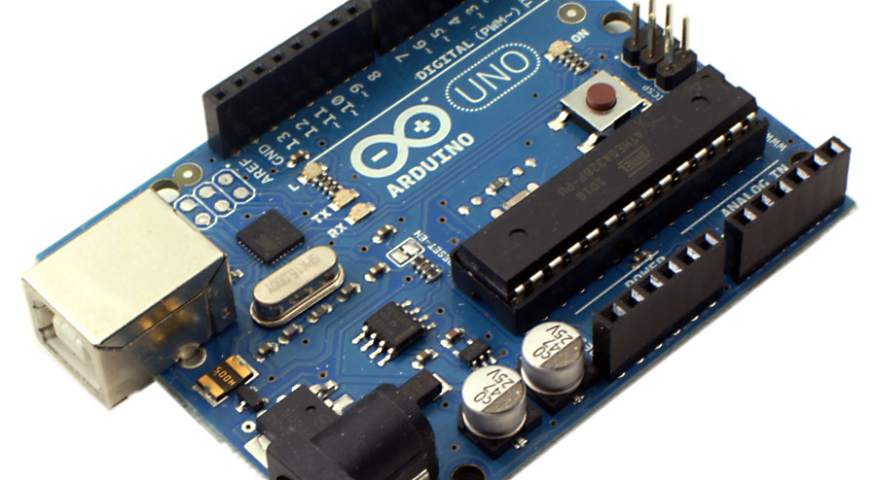
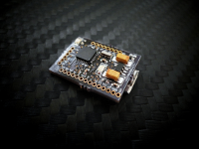
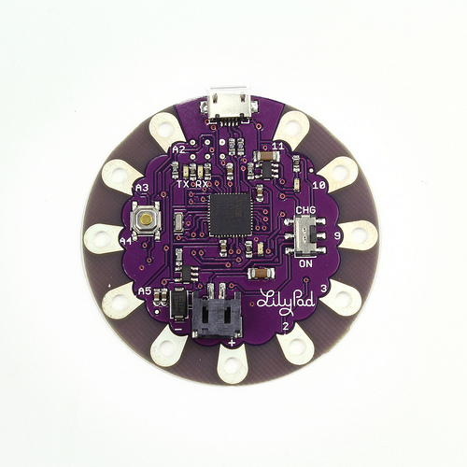
lots of different kinds
€20
€15
€19

Slide 5

all kinds of parts

Slide 6
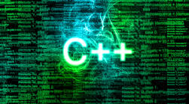
coding an arduino

Slide 7

enter: nodebots!

Slide 8
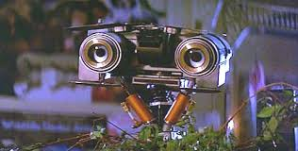

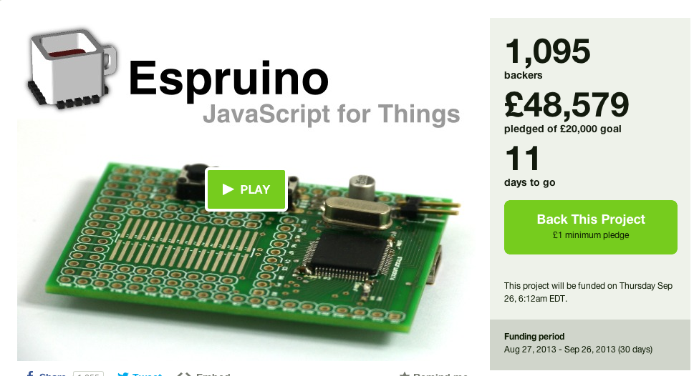
lots of it

Slide 9
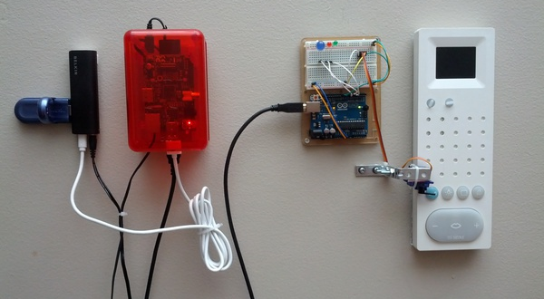
sweet hack

Slide 10
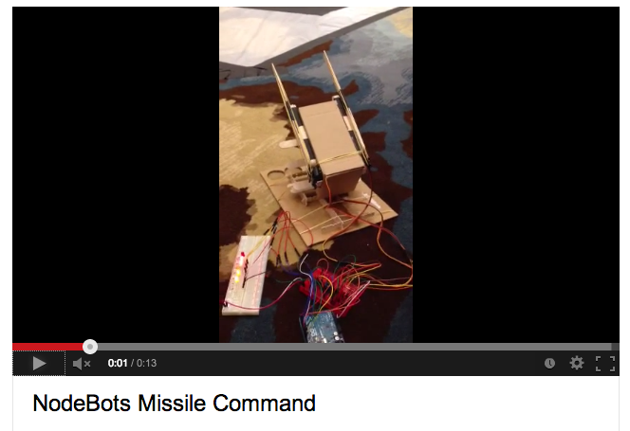
sweet hack

Slide 11

team nodebots

Slide 12
team nodebots
Educate
Inspire
Organize

Slide 13
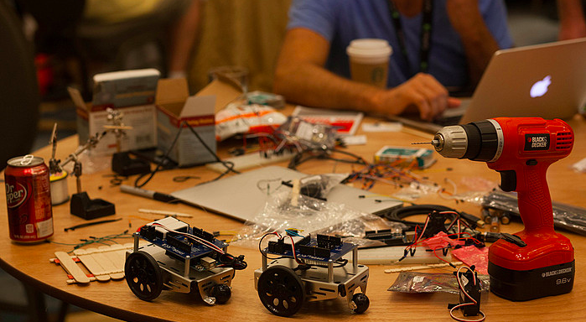
nodebots day
https://medium.com/geek-empire-1/ab02970d74e1

Slide 14
demo
https://github.com/SaraJo/repo_build_status

Slide 15
thank you!
http://nodebots.io
http://www.meetup.com/nodebots/
https://github.com/SaraJo/repo_build_status

