Slide 1
FLOWISE
Real-Time IoT & Machine Learning Water Leak Detection System
Technical Funding Proposal for Physical Pipeline Test-Bed
Project Team:
Sara Khan (NUML-F22-31354) | Batool Tariq (NUML-F22-16916)
Supervised by:
Ms. Qurat-ul-Ain Raja
Department of Computer Science | Faculty of Engineering & CS
National University of Modern Languages (NUML), Islamabad

Slide 2
PROJECT FLOWISE
The Water Scarcity & Infrastructure Challenge
Traditional Detection Drawbacks
• Manual Inspection: Slow, labor-intensive, and highly error-prone.
• Delayed Reporting: Leaks detected only after visible surface flooding.
• Water Contamination: Low-pressure pipe cracks draw in sewage contaminants.
The Flowise Automation Advantage
• Automated & Continuous: 24/7 edge-to-cloud monitoring.
• High-Latency Warnings: Triggers alerts to managers in under 10 seconds.
• Preventative Insights: Detects minor pressure drops before major pipe bursts.
NATIONAL EMERGENCY
30% - 40%
Of municipal water is lost as Non-Revenue Water (NRW)
Pakistan is approaching absolute water scarcity.
Pipes waste millions of gallons daily due to delayed, manual, and reactive leak reporting.

Slide 3
PROJECT FLOWISE
Core Technical Objectives
TO DESIGN
IoT Edge Telemetry Node
Assemble high-frequency sensor acquisition modules on the controller to capture flow rate and pipeline pressure data at regular intervals.
TO DEVELOP
Real-Time Data Pipeline
Construct an data transmission model linking the sensing node to a centralized cloud database.
TO TRAIN
Machine Learning Model
Train a high-recall Machine Learning model using custom rolling-window feature engineering to isolate leak events from transient noise.
TO DEPLOY
Mobile App & Cloud
Deploy the model on a cloud server and create a cross-platform mobile application with live charts and instant notifications.
TO VALIDATE
Physical Test-Bed Validation
Construct a pressurized PVC pipeline prototype to verify system latency, noise resilience, and prediction accuracy in physical trials.

Slide 4
PROJECT FLOWISE
Flowise End-to-End Architecture
01
02
03
04
Edge Telemetry
Sensing Node
Reads flow rates and pipeline pressure from sensor modules.
Unit: Edge Controller
Process: Periodic Sampling
Cloud Bridge
Central Database
Stores structured, timestamped telemetry data. Serves as active sync hub for cloud & mobile app.
Unit: Cloud Database
Process: Telemetry Streams
ML Inference
Cloud Server
Cloud background worker runs Machine Learning model. Computes rolling trends and applies temporal voting.
Unit: ML Classifier
Process: Real-Time Processing
User Alerting
Mobile Dashboard
Listens to data updates, displays interactive live charts, and triggers system alerts.
Unit: Mobile App
Process: <10s Total Latency
➔
➔
➔

Slide 5
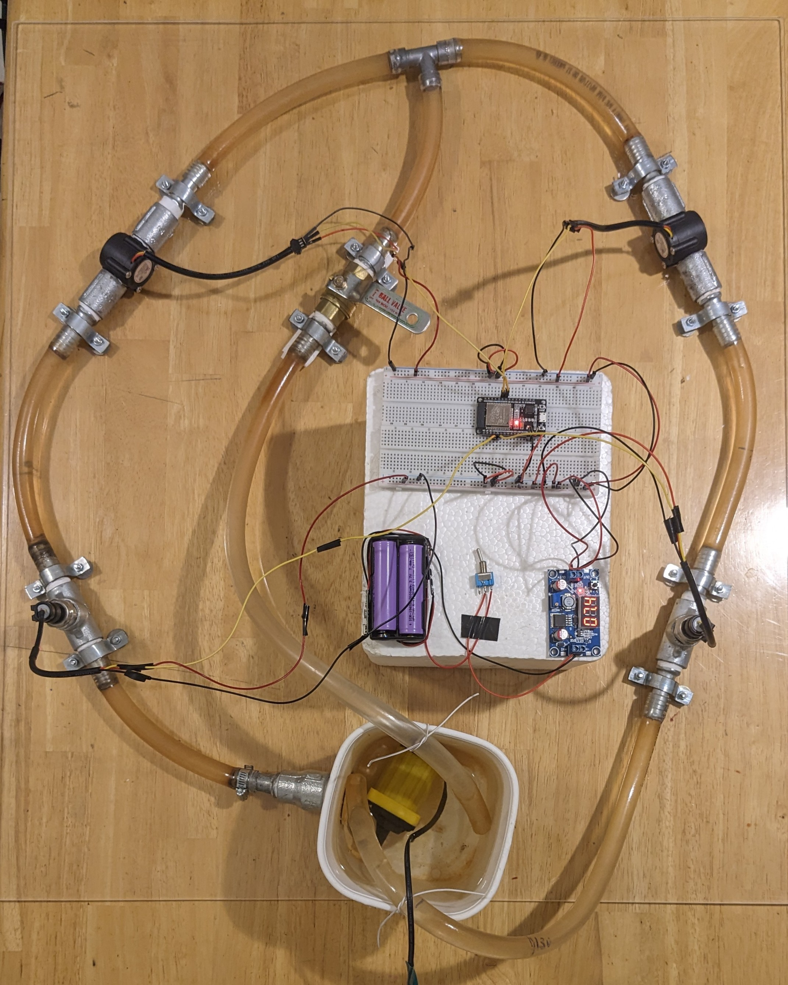
PROJECT FLOWISE
Full-System Integration & Software
System Components Overview
We have built and validated a fully integrated system across physical hardware, cloud analysis, and mobile monitoring.
Key Features & Functionality:
• Physical Testbed (Hardware): Closed-loop pressurized PVC pipeline rig with flow sensors, pressure transmitters, and rechargeable battery power management to capture real-world data.
• Leak Classifier (Machine Learning): Real-time analysis of flow differences and pressure changes using an intelligent model, stabilized by a voting filter to prevent false alarms.
• User Dashboard (Mobile Application): Live telemetry visualization, secure user login, daily consumption logging, and instant push notification alerts when leakages occur.
Fig: Labeled Flowise Hardware Prototype

Slide 6
PROJECT FLOWISE
Technical Funding Request & Cost Breakdown
Component Category / Items | Cost (PKR)
Pipeline Infrastructure & Acrylic Mounting Base | 9,980
Sensing Module (Flow & Pressure Sensors) | 7,900
IoT & Processing Unit (Microcontroller, Battery, BMS) | 2,120
Signal Conditioning & Voltage Regulators | 1,250
Circuitry & Auxiliary Hardware (Wires, Switches) | 1,516
Fluid Dynamics Hardware (12V Water Pump, Adapter) | 760
Logistics (Shipping and Cumulative Taxes) | 1,524
Funding Justification
• Financial Constraints: As a two-student team, self-funding the total prototype development has cost 30,000 PKR, representing a heavy burden of 15,000 PKR per student.
• Grant Application: Requesting a technical grant of 25,050 PKR from the university to offset hardware expenses.
• Academic Return: Provides the Computer Science department with a robust, physical IoT-ML water monitoring apparatus for future research projects.
Total Grant Request:
25,050 PKR

Slide 7
PROJECT FLOWISE
Expected Deliverables & Project Impact
Project Deliverables
1. Calibrated Physical Prototype: A functioning pressurized pipe testbed with flow and pressure logging.
2. Cloud Inference Pipeline: Live Machine Learning inference running 24/7 on a cloud server.
3. Mobile Application: User-ready mobile app with live charting and real-time alert notifications.
4. Labeled Physical Dataset: Clean flow and pressure training dataset representing standard and simulated leak states.
Socio-Economic Impact
• Combating Water Scarcity: Directly targets the 30-40% Non-Revenue Water loss in Pakistani municipal pipes.
• Infrastructure Safety: Immediate alert under 10s prevents soil erosion, road damage, and building foundation risks.
• Health Hazard Prevention: Prevents drinking water contamination caused by sewage seepage during pipe pressure drops.
• Public Utility Optimization: Transition from slow manual reporting to automated digital audits, saving millions in repair overheads.

Slide 8
PROJECT FLOWISE
Future Scalability & Commercialization
1. Multi-Node Leak Localization
Upgrade the single-segment prototype to a multi-node mesh network. By analyzing pressure differential curves and flow differences across nodes, the system can localize the exact leak coordinates within a larger network.
2. Municipal Enterprise Dashboards
Develop centralized platforms for municipal bodies (like WASA, KWSB, or CDA) to monitor city mains, automate leak alerts, and audit water distribution metrics.
3. Smart Housing Society Integration
Market the solution as a smart infrastructure amenity for private housing developers (e.g., DHA, Bahria Town) to audit internal water billing and minimize leak damages.
4. Edge Intelligence
Quantize the Machine Learning classifier to run directly on the edge controller. This enables localized inference, reducing connectivity dependence, latency, and cloud database costs.

Slide 9
CONCLUSION & FINAL APPEAL
Flowise: Conserving Pakistan's Water Reserves
• End-to-End System Readiness: The software core (machine learning models, database, and mobile application) is fully functional and ready.
• Physical Prototype Necessity: Deploying on a physical pipeline is critical to calibrate our models against real-world environmental noise and sensor variance.
• Financial Feasibility: Departmental funding of 25,050 PKR will cover physical sensor and pipeline overheads, making this student project viable.
• Social Value: Demonstrates a low-cost, smart water leak detection model optimized for public utility infrastructure in Pakistan.
Sara Khan | Batool Tariq
FYP Project Team, BSCS 8-A (Morning)
Endorsed by Supervisor:
Ms. Qurat-ul-Ain Raja
Department of Computer Science, NUML, Islamabad

