Slide 1

German Credit Card
Group Members:
Kevin Maciver Riquelme, Ry. Id: 500992873
Lanzo Siega, Ry. Id: 500994422
Natalia Yuka Hiratani, Ry. Id: 500999281
Sara Kmair, Ry. Id: 500991323

Slide 2
Problem
In order to provide loans to customers, a bank needs to make right decision in determining who should get the approval and who should not.
Develop a data analytics based strategy for the bank managers that can help them in making a decision about loan approval for the prospective applicants.

Slide 3
Data
1000 clients
20 Attributes
Account Balance
Duration of Credit
Payment Status of Previous Credit
Purpose
Credit Amount
Value Savings Stocks
Length of Current Employment
Instalment Percent
Sex & Marital Status
Guarantors
Duration Current Address
Most Valuable Available Asset
Age
Concurrent Credits
Type of Apartment
N⁰ Credit in this Bank
Occupation
N⁰ of dependents
Telephone
Foreign Worker
Class (Creditability)

Slide 4
Data Cleaning Process
Data Structure
Check Data Types
17 Categorical Attributes
Check data Distribution
Imbalanced Class
Outliers for Numeric Attributes
Check Consistency
Missing values
No outliers with “wrong” values
Check Range
Normalization for numeric attributes
Check Relationships
Relations between attributes and Class

Slide 5
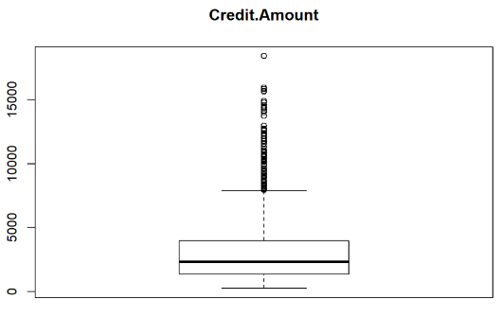
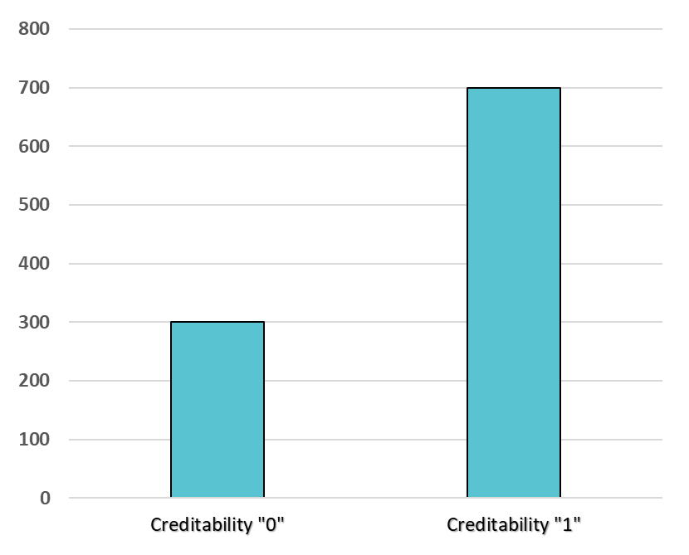
Data Cleaning Process
Data Structure
Check Data Types
18 Categorical Attributes
Check data Distribution
Imbalanced Class
Outliers for Numeric Attributes
Check Consistency
Missing values
No outliers with “wrong” values
Check Range
Normalization for numeric attributes
Check Relationships
Relations between attributes and Class

Slide 6

Data Cleaning Process
Data Structure
Check Data Types
18 Categorical Attributes
Check data Distribution
Imbalanced Class
Outliers for Numeric Attributes
Check Consistency
Missing values
No outliers with “wrong” values
Check Range
Normalization for numeric attributes
Check Relationships
Relations between attributes and Class

Slide 7
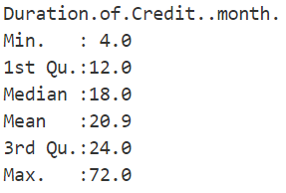
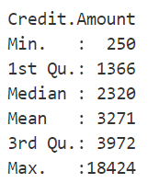
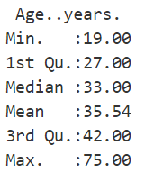
Data Cleaning Process
Data Structure
Check Data Types
18 Categorical Attributes
Check data Distribution
Imbalanced Class
Outliers for Numeric Attributes
Check Consistency
Missing values
No outliers with “wrong” values
Check Range
Normalization for numeric attributes
Check Relationships
Relations between attributes and Class

Slide 8
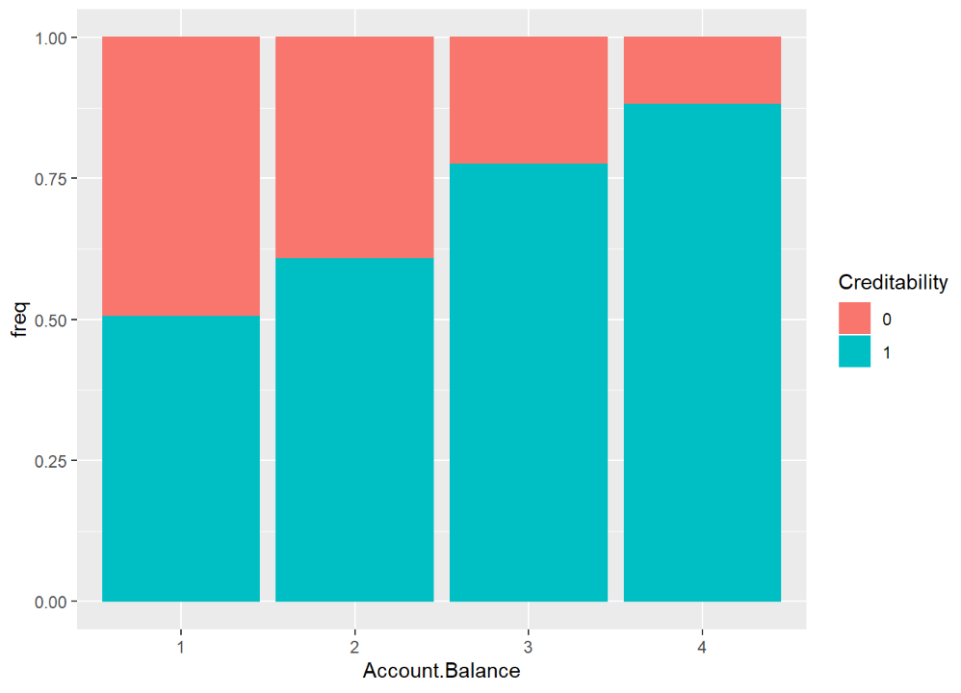
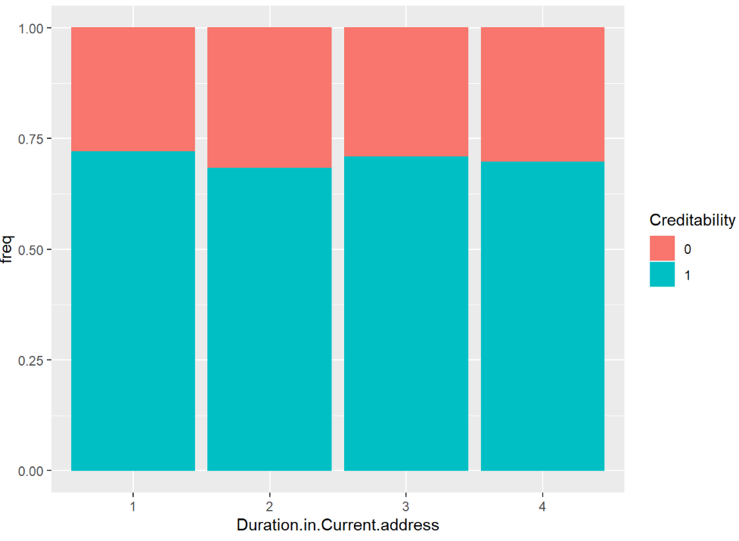
Data Cleaning Process
Data Structure
Check Data Types
18 Categorical Attributes
Check data Distribution
Imbalanced Class
Outliers for Numeric Attributes
Check Consistency
Missing values
No outliers with “wrong” values
Check Range
Normalization for numeric attributes
Check Relationships
Relations between attributes and Class

Slide 9

Supervised Algorithms – Approach to Analysis
Filter
Class Imbalance present – 700 classified as 1, 300 classified as 0
Class imbalance could introduce bias to the predictive model
Class Balancing filters address this problem
Raw Data
Algorithms:
- Logistic Regression
- Naïve Bayes
- Decision Tree
- Random Forest
Processing:
- 66% split
- 10 fold CV
Output
Notes:
Machine Learning algorithms are designed to improve accuracy by reducing the error, but does not take into account class distribution

Slide 10
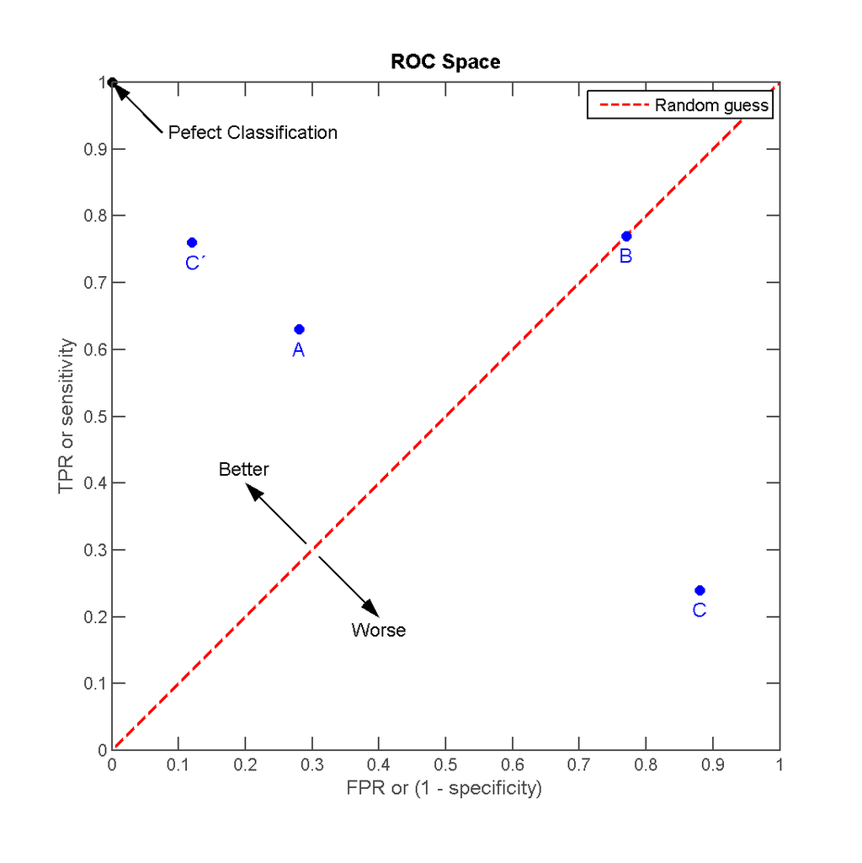

Supervised Algorithms – Approach to Analysis
ROC Curve: Receiver Operating Characteristic
TPR = $\frac{TP}{TP+FN}$
FPR =$\frac{FP}{FP+TN }$
Notes:
The term ROC stands for Receiver Operating Characteristic. Used to find out the accuracy of the classifiers. It’s x axis represents the False Positive Rate (FPR) and its y axis represents the True Positive Rate (TPR).

Slide 11
Supervised Algorithms- Logistic Regression
Logistic Regression
Logistic Regression does not require a linear relationship between the dependent and independent variables
4 iterations of the algorithm
10 fold cross validation on Clean Dataset.
Recall: 87.67%
Precision: 84.21%
False Positive: 44.44%
Accuracy: 79%

Slide 12
Supervised Algorithms- Naïve Bayes
“Naïve” Assumption:
Attributes are independent of each other
13 iterations of the algorithm
Best iteration:
Resample Filter
KernelEstimator
10-Fold Cross Validation Test
79% Accuracy
79% Recall
22% False Positive Rate
Notes:
Steps:
Apply filter on data set
Measure the probability of each value of the class occurring.
Calculate the probabilities of each instance in the training set given their assigned class
Calculate the probabilities of a class being assigned for each unclassified instance in the test set
Classify each instance in the test set based on the class with the higher probability of being assigned to that instance

Slide 13
Supervised Algorithms- Decision Tree
Class Balancer
Test Option: 10-Cross Fold Validation
Attribute Removal
Best Result
Recall – 62%
Precision – 67%
False Positive Rate – 31%
Total Accuracy – 65%

Slide 14
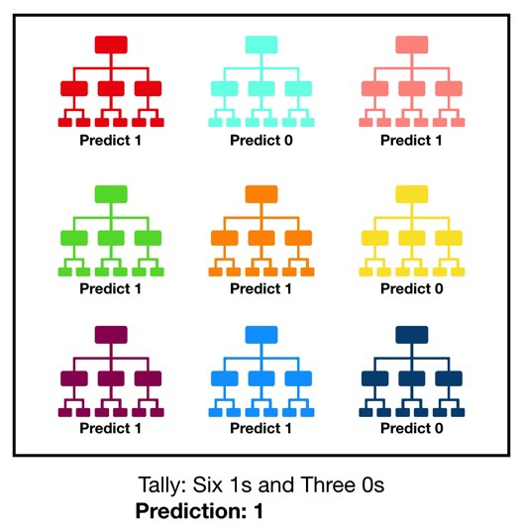
Supervised Algorithms- Random Forest
Random forest
Resample Filter
Test Option: 10-Cross Fold Validation
Factoring the numerical Attributes
Attribute removal
Max depth and number of iteration
Best Results
Recall – 86%
Precision – 91%
False Positive Rate – 9%
Total Accuracy – 88%

Slide 15
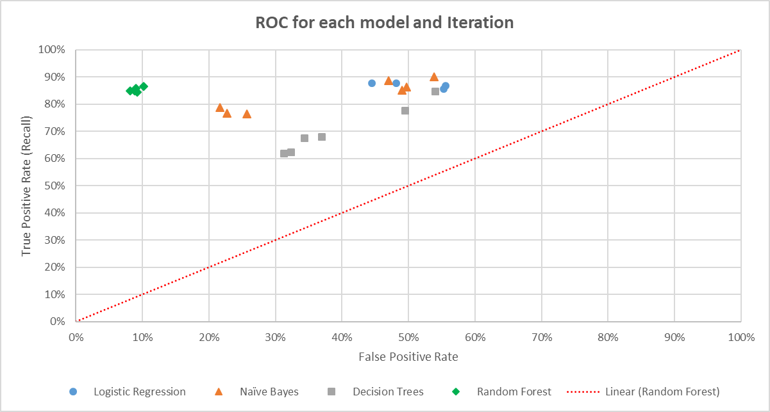
Supervised Algorithms - Results
Comparing Method: ROC Curve
Best Result: Random Forest

Slide 16
Unsupervised Algorithms- Approach
Preparation
Deciding Number of Clusters
Setting Attributes to Categorical values

Slide 17
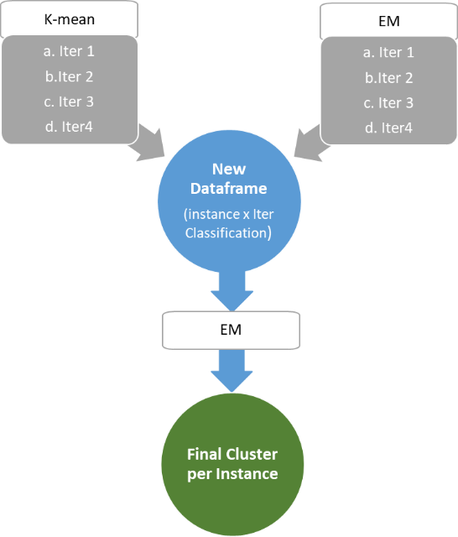
Unsupervised Algorithms- Approach
Preparation
Deciding Number of Clusters
Setting Attributes to Categorical values
Clustering the data
K-means and EM

Slide 18
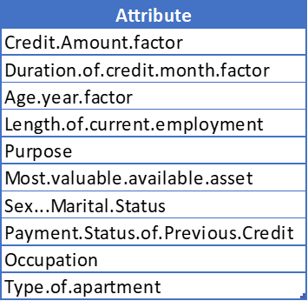
Unsupervised Algorithms- Approach
Preparation
Deciding Number of Clusters
Setting Attributes to Categorical values
Clustering the data
K-means and EM
Feature Selection

Slide 19
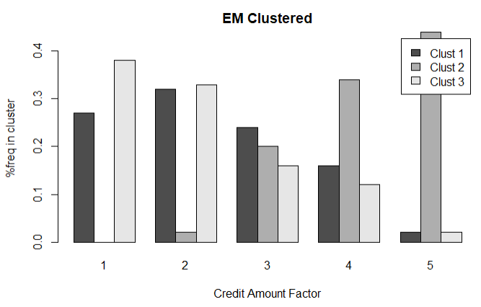
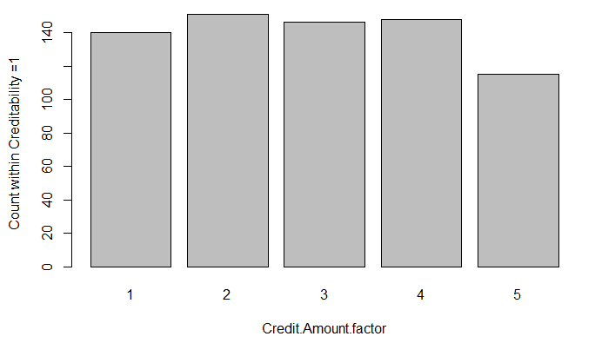
Unsupervised Algorithms- Approach
Preparation
Deciding Number of Clusters
Setting Attributes to Categorical values
Clustering the data
K-means and EM
Feature Selection
Cluster Analysis

Slide 20
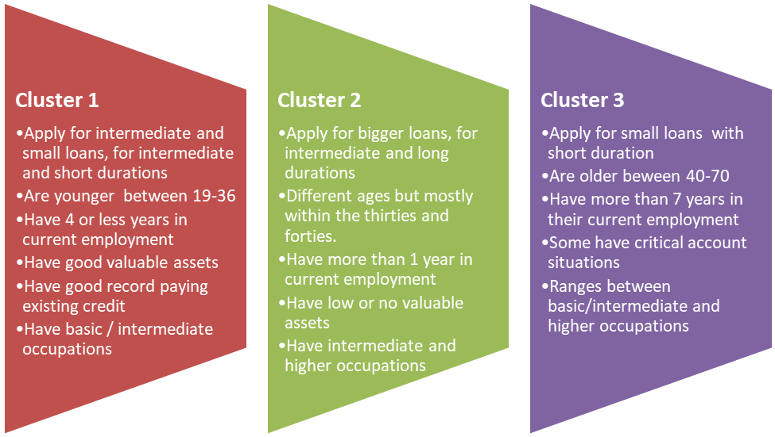
Unsupervised Algorithms- Results
Client Segmentation

Slide 21
Conclusions & Recommendations
Supervised Algorithms
Best results: Recall – 86% / Precision – 91% / False Positive Rate – 9% / Total Accuracy – 88%
Improve results with different Algorithms
Use further data to improve the results
Reduce time between client analysis
Post-prediction
Client segmentation for a 3 cluster option
This profiles can now be used for different business strategies such as, target marketing, increase different profiles market share or improved fees to yield more revenue
Future analysis can be done increasing cluster numbers to see if a clearer profile can be generated

Slide 22

Questions

