Slide 1
Quora Question Similarity
Student: Sara Kmair
ID: 500991323

Slide 2
Case Study
Identify which questions on Quora are duplicates of questions that have already been asked.
The main objective is to give the reader and writer a better experience by finding the most suitable and related answers to their questions quickly and efficiently.

Slide 3
Dataset
The dataset contains of 404290 rows and 6 attributes
Id: Unique Id number for each pair of questions
qid 1 : Unique id number for question1
qid 2: Unique id number for question2
question1: unstructured data of the actual text of question1
question2: unstructured data of the actual text of question2
Is_duplicate: the label that we are trying to predict whether or not the two questions are duplicates of each other

Slide 4
EDA
Text Preprocessing
Feature Engineering
Classification Modeling and Evaluation
Approach

Slide 5
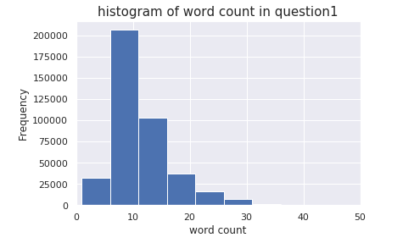

Exploratory Data Analysis (EDA)
Steps included
Checking the missing values
Counting the words in each questions
Checking the distribution of the word count
Counting the number of unique words in the pair of questions
Checking the ratio of common words between two questions

Slide 6
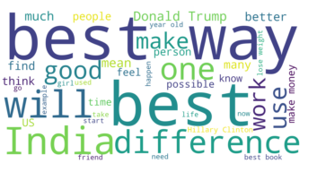
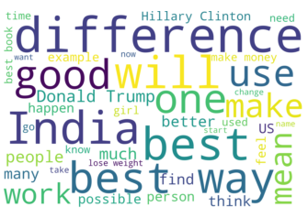
EDA
Counting the number of stop words
Checking the words with high frequency
word cloud for question 1
Word cloud for question2

Slide 7
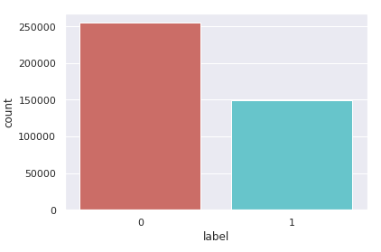
EDA
Checking for imbalance in the dependent variable ‘label’
63%
37%

Slide 8
Text Preprocessing
Text Cleaning
Convert to lower case
Replace shortcuts
Remove punctuations
Remove questions with less than 8 characters
Remove stop words
Remove invalid questions
Drop questions with more than 50 words
Text normalization Stemming

Slide 9
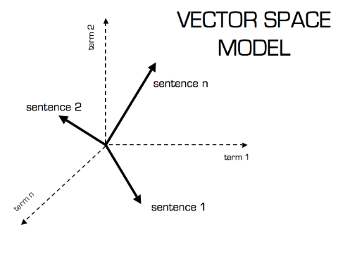
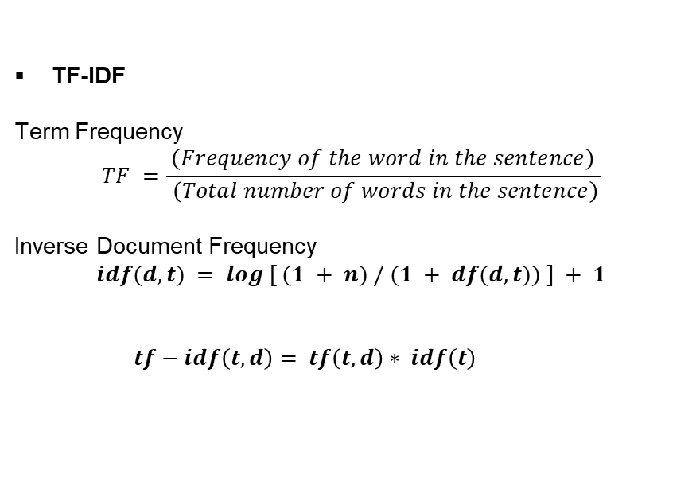
Text Preprocessing
TF-IDF
Term Frequency
$$TF =\frac{ \left(Frequency of the word in the sentence\right) }{ \left(Total number of words in the sentence\right)}$$
Inverse Document Frequency
$$idf(d, t) = log [ (1 + n) / (1 + df(d, t)) ] + 1$$
$tf−idf\left(t, d\right)= tf\left(t, d\right)∗ idf\left(t\right)$

Slide 10
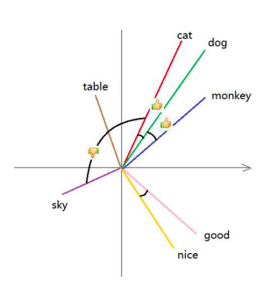
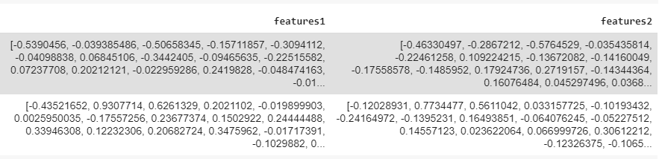
Text Preprocessing
Word Embedding representing words as vectors of real numbers
Averaging the words vectors
Document vectors
Each document vector (question vector) will be represented with 300 features

Slide 11
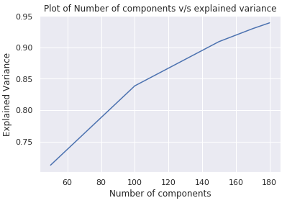
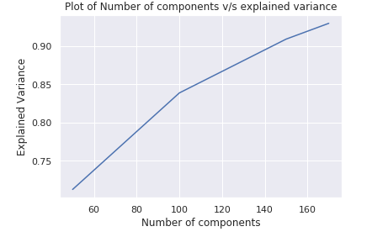
Dimensionality Reduction
Principal Component Analysis (PCA)
Unsupervised linear dimensionality reduction technique that takes large data dimension and returns lower data dimension by using clustering. it keeps thecomponents with high variance
Applying PCA on document vectors reduced the features number from 300 to 180

Slide 12
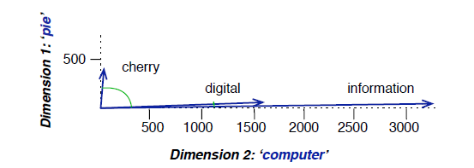

Feature Engineering
Cosine Similarity
Measures the cosine of the angle between two vectors by looking at their directions
Cos(θ)$=\frac{A.B}{||A|||\left|B\right||}$
Extract feature Cosine similarity between two TF-IDF vectors
Pic source: Speech and Language Processing. Daniel Jurafsky & James H. Martin.

Slide 13
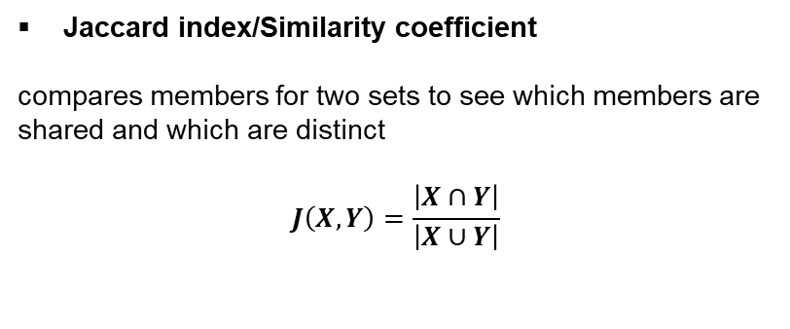
Feature Engineering
Jaccard index/Similarity coefficient
compares members for two sets to see which members are shared and which are distinct
$$J\left(X,Y\right)=\frac{\left|X∩Y\right|}{\left|X∪Y\right|}$$
Extract feature Jaccard similarity between two document vectors

Slide 14
Feature Engineering
Euclidean distance
Is the line distance between two points
d(p, q) = $\sqrt{{\left(q1−p1\right)}^{2}+{\left(q1−p1\right)}^{2}+ …{+\left(qn−pn\right)}^{2 }}$
Extract feature Euclidean distance between two document vectors

Slide 15
Classification
Predicting dependent variables from number of independent variables
Binary classification
Independent Variables:
count1
count2
char_count1
char_count2
avg_word_len1
avg_word_len2
stopwords_count1
stopwords_count2
common_words
unique_words
cosine_similarity
euc_dist
Jac_sim
Dependent Variable:
Label

Slide 16
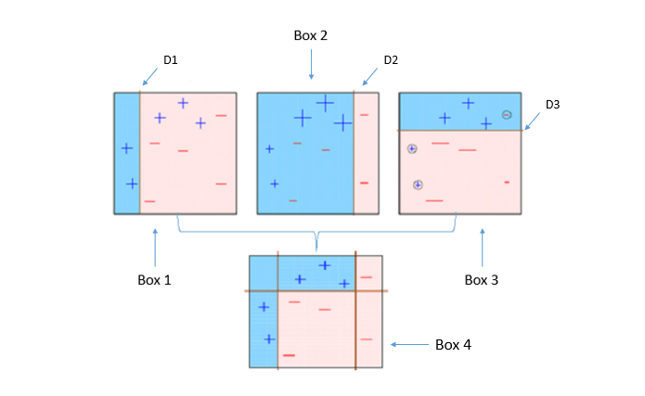
Extreme Gradient Boosting (XGBoost)
It is an ensemble of decision trees algorithm where new trees fix errors of those trees that are already part of the model.
Trees are added until no further improvements can be made to the model

Slide 17
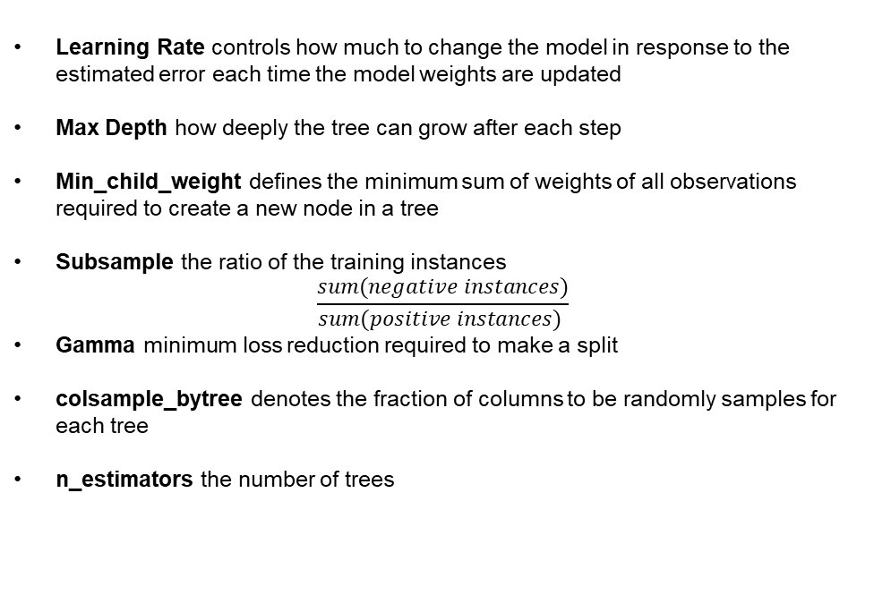
XGBoost Hyperparameter
Learning Rate controls how much to change the model in response to the estimated error each time the model weights are updated
Max Depth how deeply the tree can grow after each step
Min_child_weight defines the minimum sum of weights of all observations required to create a new node in a tree
Subsample the ratio of the training instances
$$\frac{sum(negative instances)}{sum(positive instances) }$$
Gamma minimum loss reduction required to make a split
colsample_bytree denotes the fraction of columns to be randomly samples for each tree
n_estimators the number of trees

Slide 18
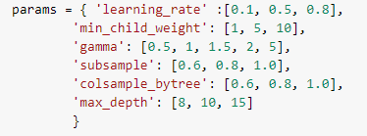
XGBoost Hyperparameter Tuning
Choose the parameter that fit the data the best or our model the best
Random search
10-fold cross validation
scoring was conducted with roc-auc
Accuracy Result: 75%

Slide 19

Naïve Bayes
Supervised Learning Algorithm
Bayes’ Theorem
$$P\left(c | x\right)=\frac{P\left(x | c\right)P(c)}{P(x)}$$
Accuracy Result: 64%

Slide 20
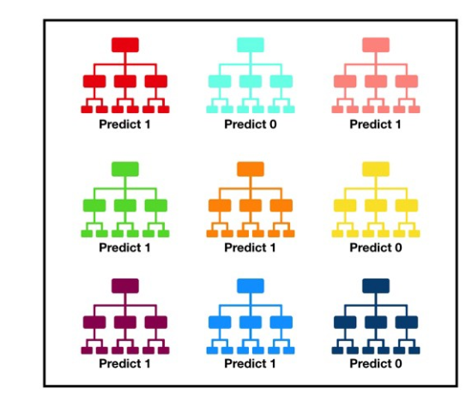
Random Forest
Supervised Learning Algorithm
Accuracy Result: 73%
Predict 1 : 6
Predict 0 : 3
Random forest prediction 1

Slide 21
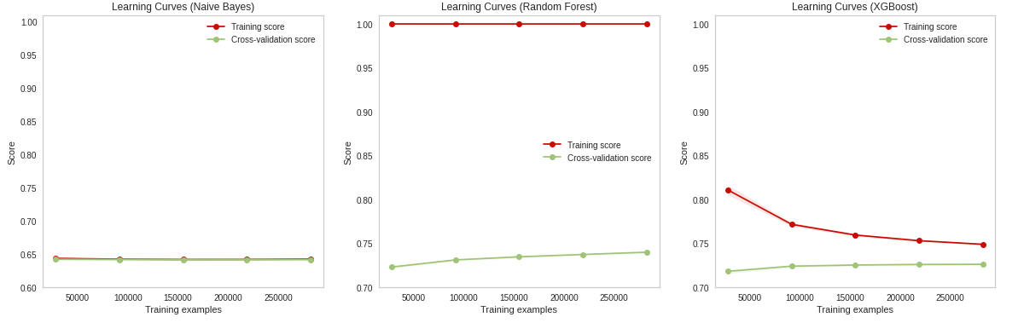
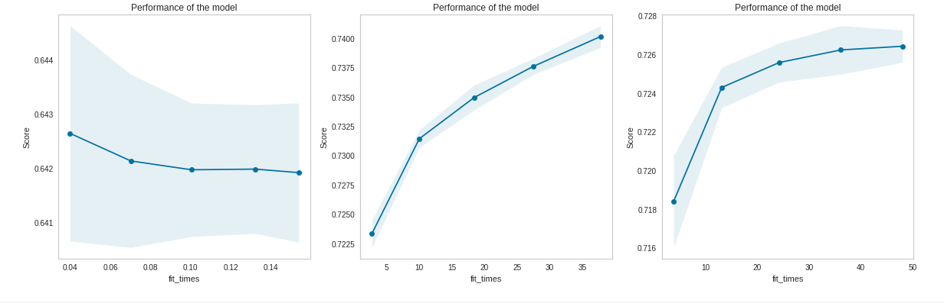
Evaluating the Model
Learning Curves
Underfitting
Overfitting

Slide 22
Recommendations
By using XGBoost model we can predict the similarity of the questions with 72% accuracy.
Implementing the model will give Quora users
Better experience in navigating the website looking for answers and questions quickly and efficiently
Reduce the redundancies of the duplicates questions on the Quora website

Slide 23
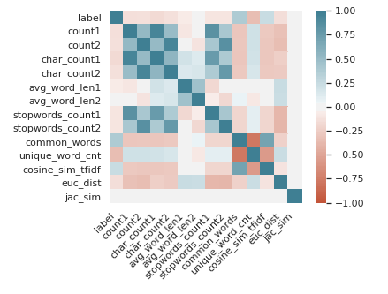
Future Improvements
Feature selection to exclude highly correlated attribute
Extracting more features from the dataset
Applying hyperparameter tuning on Naïve Bayes and Random Forest

Slide 24

Questions

