Slide 1
4th Year Project
Sara Kosciuczuk
C00251415

Slide 2
Introduction
2D Platformer game created with Unity C# and pixel art with Aseprite.
The player collects collectibles throughout the game to continue onto the next levels.
The player has to avoid or shoot enemies along the levels to progress.

Slide 3

Why?
F
Why Unity?
I wanted to learn a game engine and something new. From research, Unity was a great game engine to start in for creating your own games with many tutorials.
Why Aseprite?
Again something new. Pixel art felt more suitable for my game as I chose to use tile maps.
Aseprite thought me how to create pixel art and animations with ease.

Slide 4
Milestones
Bug fixes.
Research
Different project ideas.
Basics
Basic movement.
Enemies
Basic enemy movement and collisions.
Sprites for player, enemies, levels, backgrounds.
Additions
Aesthetics
Environments and biomes.
Characters, enemies and collectables
Camera following the player.
Ground and player collisions.
Collectibles with simple UI after collection.
Background music.
Animations.
Invisible door to pass to next level.

Slide 5
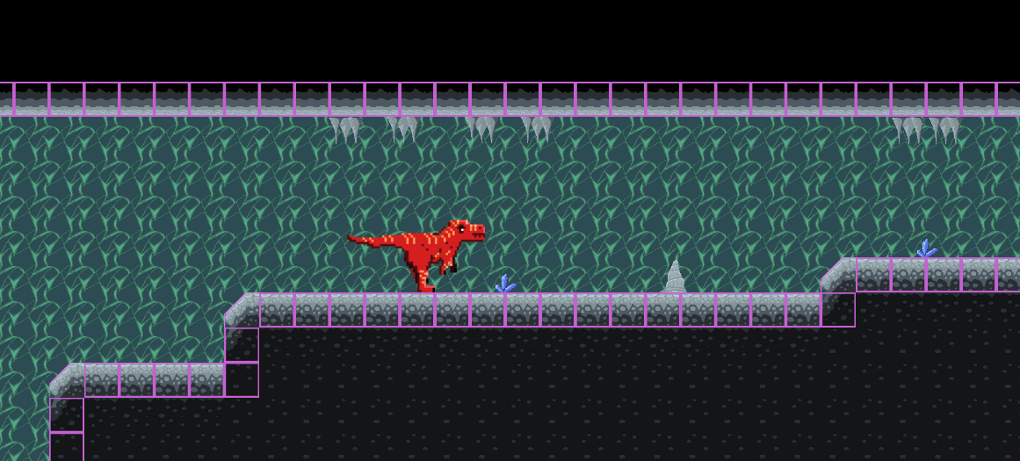
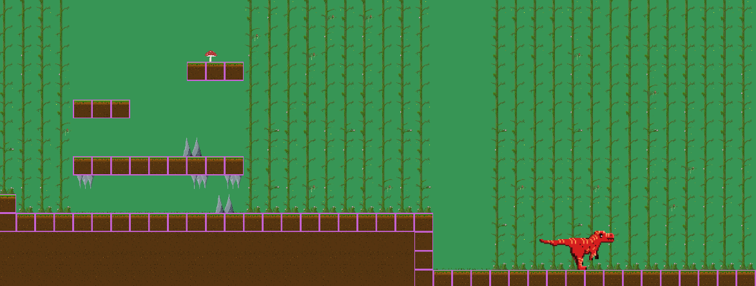
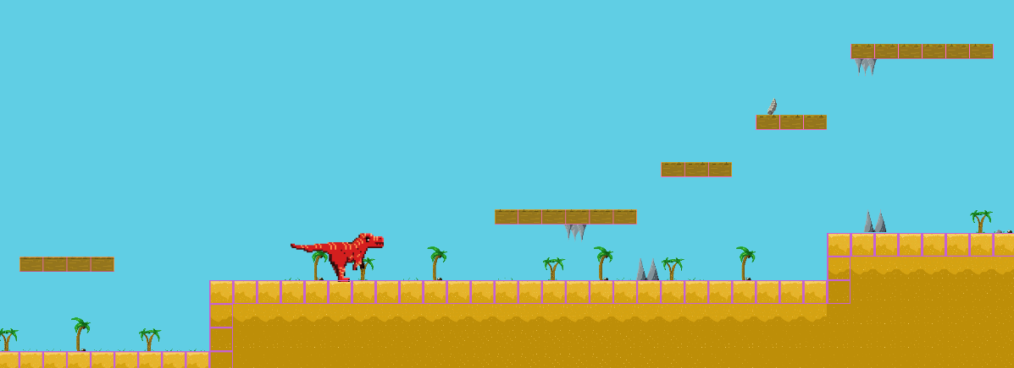

Slide 6
Research
F
Art
Art styles.
Environments, biomes, level design.
Players, enemies, animations.
Pinterest, DeviantArt (inspirations).
Coding / Game Mechanics
YouTube tutorials (Brackeys, Kap Koder, BMO).
Unity forums.
Stack Overflow.

Slide 7
What did I learn?
F
Unity and Aseprite
Game mechanics, implementing features and functionalities.
Working with 2D assets and managing scenes and levels.
Player movement, enemy behaviour, collectibles.
Working with pixel art and pixel art animations.
Project Management
Managing and setting goals and milestones.
Defining requirements and priorities.
Adapting to changes and challenges.

Slide 8
What I could do differently?
F
Allocate more time for testing and bug fixing.
Allocate more time for animations and level design.
Creating a project plan with milestones and deadlines.

Slide 9
Outstanding Bugs
Player colliding with the second enemy, making the enemy bounce or fly.
Between the second and third level, after collecting correct amount, player is still unable to pass onto the next level.

Slide 10
Summary
The main objective of the game was for the player to collect items and progress through different levels while avoiding or shooting enemies.
Use of Unity and Aseprite allowed for the creation of visually appeaing game with smooth animations.
Some features had to be scaled down or removed due to time constraints such as sound effects and additional levels.

Slide 11
Thank you
Sara Kosciuczuk​
C00251415

