Slide 1
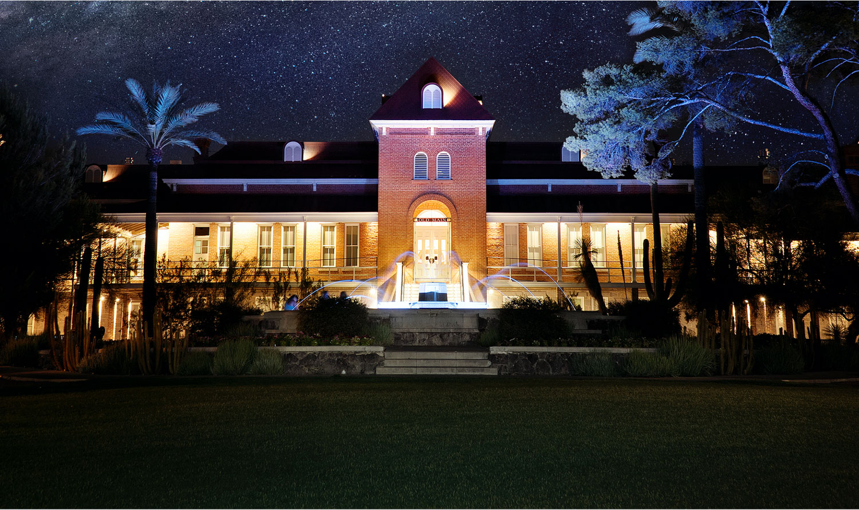

Introduction To Containers on HPC
2023

Slide 2


Contents What is a container Docker and Apptainer Building / Using Containers GPUs MPI BioContainers

Slide 3
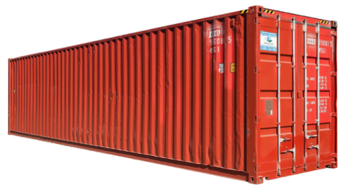
Why Use Containers?
Verifiable reproducibility
An immutable image
Mobility of compute
Limits user privileges
Make use of GPU’s and high-speed networks

Slide 4

Docker vs Apptainer
Docker containers are very popular particularly in bioinformatics
Docker runtime is not secure on shared clusters
Create the container using Docker and then containerize with Apptainer
Note: Apptainer was rebranded from Singularity, but it is the same software

Slide 5

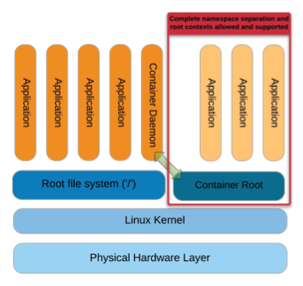
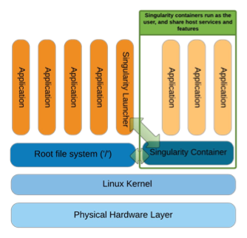
title
Docker vs Apptainer
Apptainer has better security and performance

Slide 6
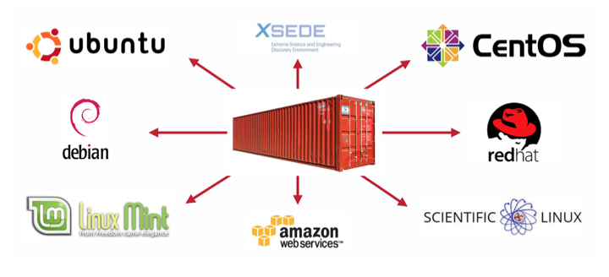
Where it runs

Slide 7
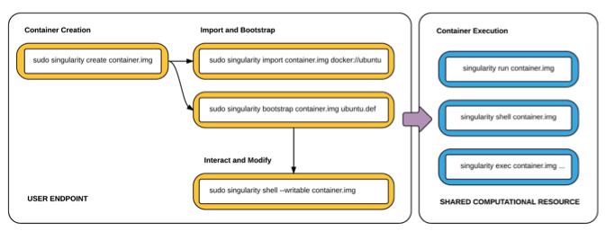
title
How it works

Slide 8
Apptainer on HPC – Compute Node
laptop $ ssh netid@hpc.arizona.edu
netid@gatekeeper $ shell
(puma) netid@wentletrap $ elgato
(elgato) netid@wentletrap $ interactive –a PI
netid@cpu9 $ apptainer help
netid@cpu9 $ apptainer help build
https://ua-researchcomputing-hpc.github.io/Apptainer-Examples/

Slide 9
Apptainer on HPC - Creating
$ apptainer pull docker://godlovedc/lolcow
pulls from docker registry
less reproducible – image can change
$ apptainer pull library://sylabsed/examples/lolcow
pulls from a container library
more reproducible
$ apptainer build lolcow.sif docker://godlovedc/lolcow
more options
converts to latest format
needs a name
* Look for temporary files in ~/.apptainer

Slide 10

Apptainer on HPC - Running
$ apptainer shell lolcow_latest.sif
Apptainer>
Apptainer> exit
$ apptainer run lolcow_latest.sif
or
$ ./lolcow_latest.sif
$ apptainer run library://sylabsed/examples/lolcow
INFO: Using cached image
* Look for cached files in ~/.apptainer

Slide 11

Apptainer on HPC
SingularityHub for building containers
- developed by Vanessa Sochat at Stanford’s Research
Computing Group
- supported by Google
It’s gone now ..
So now what?

Slide 12

Build on HPC
Apptainer examples at our Github
https://ua-researchcomputing-hpc.github.io/Apptainer-Examples/
Hello World Docker Build Tensorflow
Find the Basic Build Example
use a recipe to build a container on HPC
run the container using a Slurm script

Slide 13
Apptainer on HPC – Running Batch
#!/bin/bash
#SBATCH --job-name=lolcow
#SBATCH --ntasks=1
#SBATCH --nodes=1
#SBATCH --mem=1gb
#SBATCH --time=00:01:00
#SBATCH --partition=standard
#SBATCH --account=YOUR_GROUP
cd /path/to/container
apptainer run example.sif

Slide 14
Singularity on HPC – File paths
Access to your files outside the container: Binding
You automatically get /home and /tmp and $PWD
$ echo "Hello from inside the container" > $HOME/hostfile.txt
$ apptainer exec lolcow_latest.sif cat $HOME/hostfile.txt
Hello from inside the container
$ echo "Drink milk (and never eat hamburgers)." > data/cow_advice.txt
$ apptainer exec --bind data:/mnt lolcow_latest.sif cat /mnt/cow_advice.txt
or implement these general descriptions:
$ apptainer shell –bind /data my-container.sif
$ export APPTAINER_BINDPATH=/data

Slide 15
GPUs and Containers
We show four ways to run tensorflow containers on HPC. We just use Tensorflow as an example
Containers as modules: caffe, pytorch, rapids, tensorflow and theano.
Tensorflow examples from our Github
Tensorflow directly from Nvidia
Tensorflow from Docker Hub

Slide 16
GPU and Containers
Apptainer fully supports using GPUs with the –nv flag
A collection of containers with GPU support are available that were pulled from Nvidia’s service called NGC
“module whatis tensorflow/nvidia”
tensorflow/nvidia/2.0.0 : Name: Tensorflow
tensorflow/nvidia/2.0.0 : Version: nvidia-tensorflow_2.0.0-py3
tensorflow/nvidia/2.0.0 : Description: 'tensorflow' is an alias for apptainer exec
--nv /contrib/singularity/nvidia/nvidia-tensorflow_2.0.0-py3.sif python3'
tensorflow/nvidia/2.0.0 : Description: So typically 'tensorflow xxx.py'

Slide 17

Apptainer on HPC – Complex Example
Build Custom Tensorflow
https://ua-researchcomputing-hpc.github.io/Apptainer-Examples/
Building a Tensorflow container with Cuda and Python 3.6
Identify which version of Tensorflow you need.
Identify a compatible version of Cuda.
Find a Cuda container on Docker Hub to bootstrap from.
Design your recipe.
Build!

Slide 18
GPUs and Containers
Apptainer Using SLURM
#!/bin/bash
#SBATCH --job-name apptainer-job
#SBATCH --account=your_pi
#SBATCH --partition=standard
#SBATCH --nodes=1
#SBATCH --ntasks=1
#SBATCH --gres=gpu:1
#SBATCH --time=01:00:00
cd /path/to/python/script
module load tensorflow/nvidia
tensorflow /contrib/singularity/nvidia/tensorflow_example.py

Slide 19
Github and Containers
Singularity Examples at our Github
https://ua-researchcomputing-hpc.github.io/Singularity-Examples/
Hello World Docker Remote Build Tensorflow
Run this command from your test directory to get the examples:
wget https://ua-researchcomputing-hpc.github.io/Apptainer-Examples/Tensorflow-Example/Tensorflow-Example.tar.gz
tar zxvf Tensorflow-Example.tar.gz

Slide 20

GPUs and Containers
Register with Nvidia at https://ngc.nvidia.com/signin
From an interactive session on a compute node in a subdirectory of /HOME:
(literally $HOME refers to /home/uxx/netid which are directories starting u and your netid)
$ singularity build tensorflow-20.08-tf2-py3.simg docker://nvcr.io/nvidia/tensorflow:20.08-tf2-py3
From the same /HOME subdirectory
$ cp /contrib/singularity/nvidia/TFlow_example.py . # Note the “.” at the end
$ CONTAINER=$HOME/tensorflow-20.08-tf2-py3.simg #optional – set the path of container
$ singularity exec --nv $CONTAINER python TFlow_example.py

Slide 21

GPUs and Containers
Go to Docker Hub and review Tags and copy Pull Command
https://hub.docker.com/r/nvidia/cuda
Create a recipe file, and modify Pull command:
Bootstrap: docker
FROM: nvidia/cuda:11.2.2-cudnn8-runtime-ubuntu18.04
Create container:
singularity build tflow20.sif tflow20.recipe
Test:
$ singularity shell tflow20.sif
$ python3
>>> import tensorflow as tf
>>> tf.test.is_gpu_available()
. . .
True

Slide 22
MPI and Containers
Singularity containers support MPI for multiple nodes
But the MPI type and version must match
The interconnect must match – infiniband or ethernet
Build the container with OpenMPI/3 or Intel/MPI
Using MPI reduces portability
sylabs.io/guides/ has a tutorial using MPI

Slide 23
BioContainers
A community driven project based on Docker focused on Proteomics and Genomics
A set of containers for the bioinformatics community
Specifications to build standardized containers
Guidelines for reproducible pipelines
Containers that can be pulled into Singularity for HPC use

Slide 24
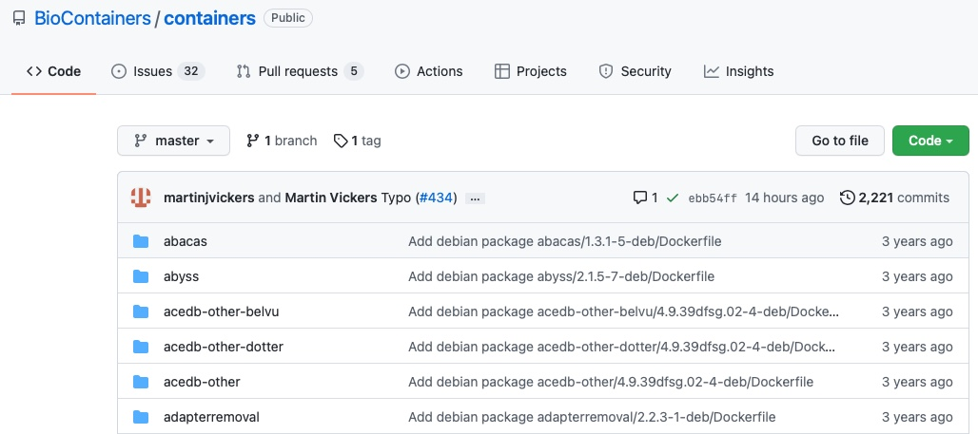
BioContainers on GitHub

Slide 25
References
https://public.confluence.arizona.edu/display/UAHPC/Containers
https://ua-researchcomputing-hpc.github.io
https://hpc.nih.gov/apps/singularity.html
https://sylabs.io/guides/3.5/user-guide/introduction.html
https://github.com/sylabs/examples
https://containers-at-tacc.readthedocs.io/en/latest/
https://cyverse-container-camp-workshop-2018.readthedocs-hosted.com
https://www.tensorflow.org/tutorials/quickstart/beginner

