Slide 1
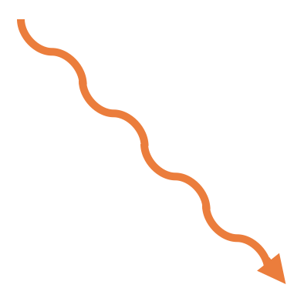
e⁻
2p
2p
2s
2s
hv = 399.1 eV
1s
1s
1s²2s²2p³
1)
2)
1s²2s²2p³ → (1s2s²2p³)*
e⁻
hv*
2p
2p
2s
2s
e⁻
1s
1s
3)
(1s²2s²2p²)* → (1s²2s²2p)
(1s2s²2p³)* → (1s²2s²2p²)*
4)

Slide 2
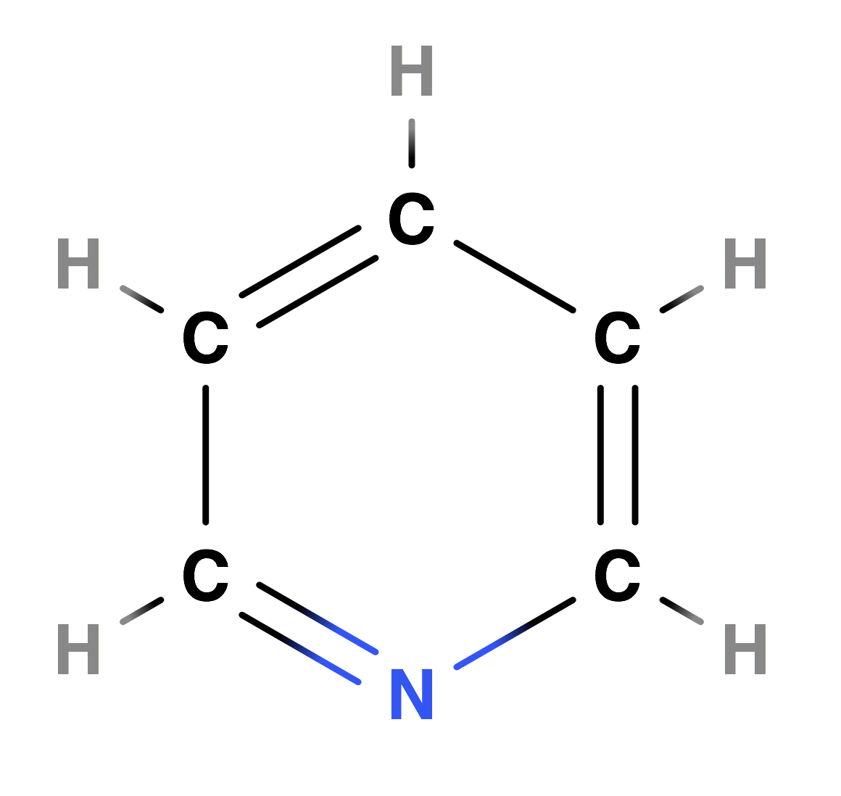
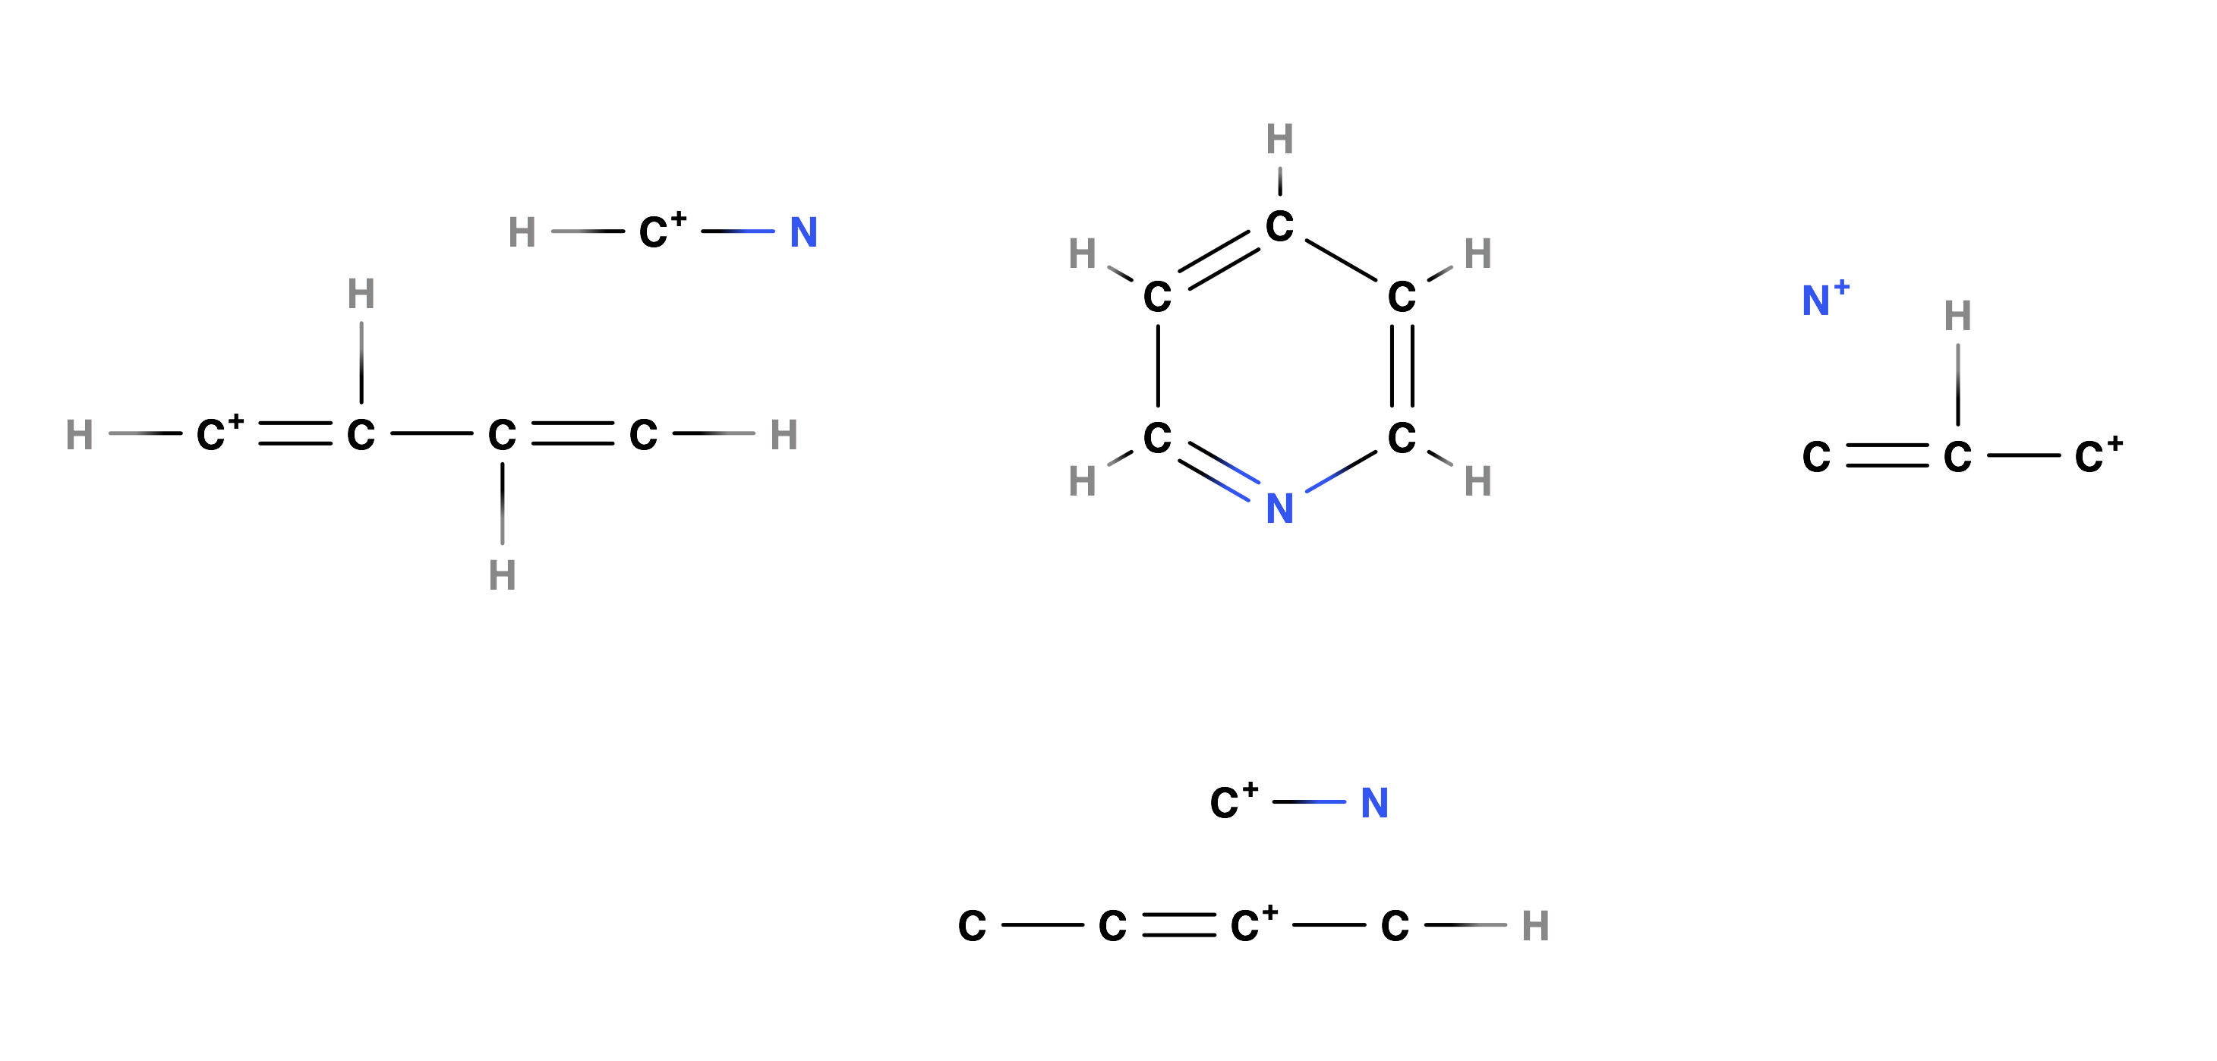
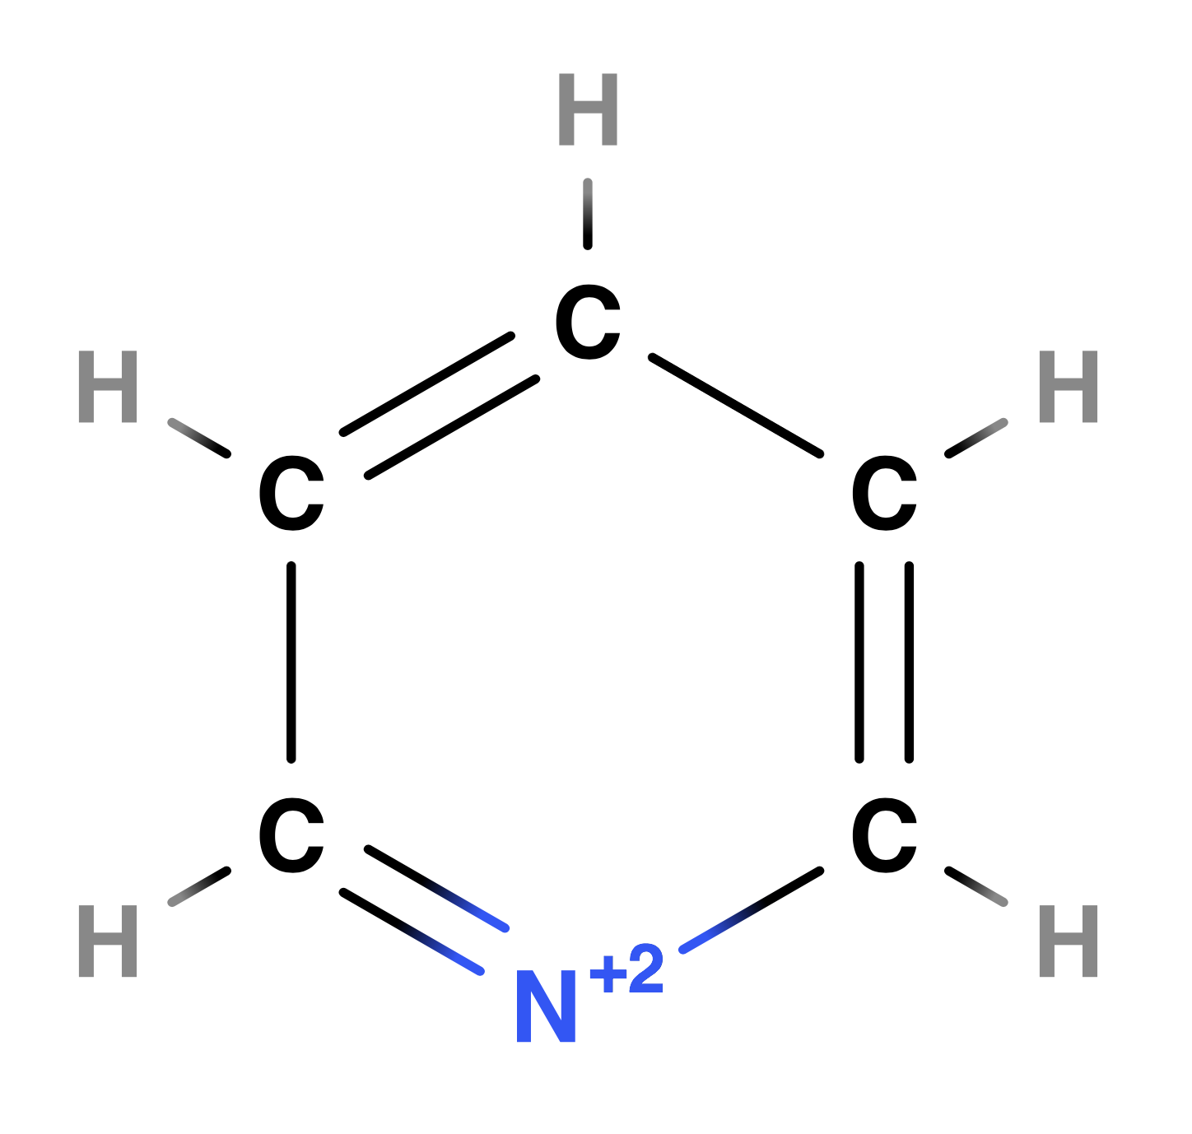
hv = 399.1 eV
Loss: None.
Loss: C, 4H.
X
Y
Z
Loss: 4H.

Slide 3
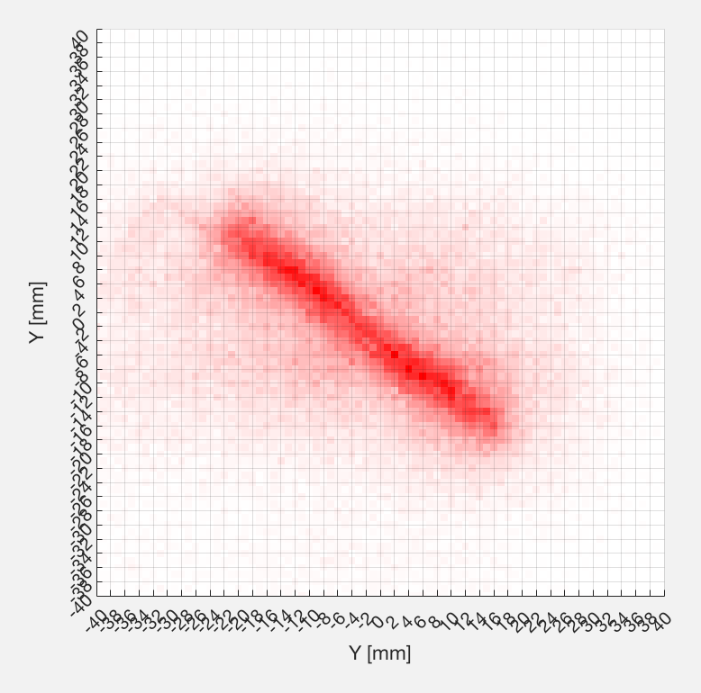
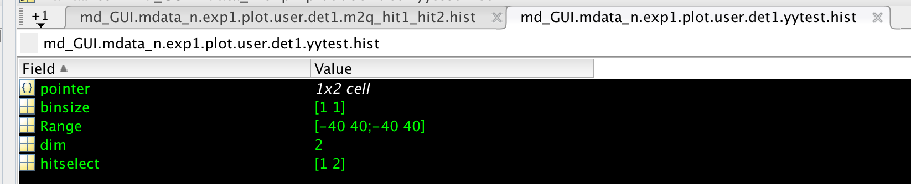
Coulombic repulsion.

