Slide 1
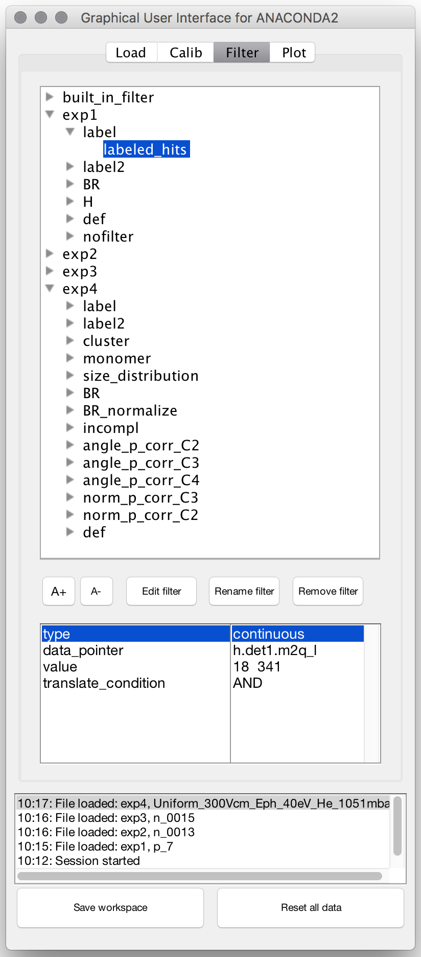
condition
condition parameters

