Slide 1


Egypt’s Digital Sun
Presented By | DataCatalyst Team
Amr Magdy
Heba Shaaban
Sara Mostafa
Samar Maher
Mennatallah Sherif
Mohamed Abdelwahab
May, 2026

Slide 2

Project Idea
Problem Statement
Egypt has high solar energy potential, but analyzing environmental and weather data to identify the best locations for solar energy projects remains a challenge.
Proposed Solution
Egypt’s Digital Sun uses data analytics and interactive dashboards to transform solar and weather data into clear insights that support renewable energy planning and efficiency evaluation.
Unique Value Proposition
- Combines solar radiation and weather analysis in one platform.
- Provides data-driven insights for smarter energy decisions.
- Helps identify the most efficient regions for solar energy projects through interactive visual analytics.

Slide 3

Project Wireframe
Dashboard & User Interface
Interactive dashboard featuring solar radiation KPIs, seasonal charts, city comparisons, weather trend analysis, and dynamic filters by city, season, and year.
User Journey
Users explore the dashboard, apply filters, analyze solar and weather insights, compare efficiency trends, and support data-driven energy decisions.
Usability & User Experience
Simple and user-friendly design with clear visualizations, interactive filtering, and easy-to-read charts for fast and effective analysis.

Slide 4




End Users + Features
End Users | Key Features | Value per User
Government and energy policymakers. Renewable energy companies. Researchers and data analysts. | Solar radiation analysis across Egyptian cities. Seasonal and weather trend visualization. City-based comparison tools. Interactive filtering (city, season, year) | Government: supports strategic planning for solar projects. Companies: identifies most efficient investment locations. Researchers: enables data-driven environmental analysis

Slide 5
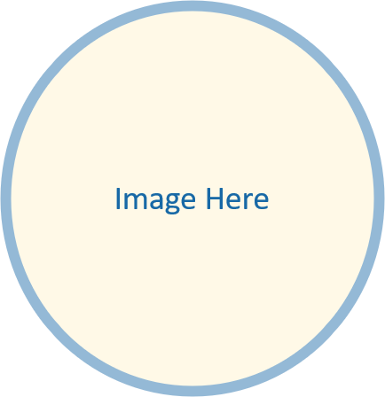

Database Structure | Key Data Entities | Data Flow
A structured dataset stored in tabular format (CSV/Excel-based), organized for analytical processing. | City Date / Time Solar radiation Temperature, humidity, wind speed Seasonal classification | Data is collected from environmental sources → cleaned and processed → stored in structured dataset → analyzed using Python → visualized through dashboards for insights.

Slide 6
Programming Languages + Frameworks
Technologies Used
Python
SQL
Power BI
Excel
Supporting Tools
Data visualization libraries
Statistical analysis techniques
Data cleaning and preprocessing workflows

Slide 7
Live Application + Testing
Application Status
A working prototype dashboard is developed and used for data visualization and insights generation.
Testing Phases
Unit testing for data accuracy
Integration testing for analysis workflow
User testing for dashboard usability
Feedback Summary
Users highlighted:
Clear visual insights
Easy navigation
Strong potential for decision-making support

Slide 8
Deliverables
Project Deliverables
Interactive dashboard
Final analytical report
Cleaned and processed dataset
Presentation slides
Documentation (technical + user guide)
Timeline
Data collection & cleaning → Completed
Analysis & modeling → Completed
Dashboard development → Completed
Final review & submission → Final stage
Final Output
A complete data analytics solution for solar energy insights in Egypt.

Slide 9
Project Team + Roles
Team Members & Roles
Collaboration Approach
Team communication via structured updates
Task distribution based on skills
Collaborative data analysis and dashboard development
Iterative feedback and improvements
Name | Role
Sara Mostafa | Project Manager
Heba Shaaban | Data Sourcing + Data Scientist
Amr Magdy | Data Analyst + Data Engineer
Mohamed Abdelwahab | Data Engineer
Menatallah Sherif | Data Scientist
Samar Maher | Data Engineer

Slide 10
Thank You for Your Time
We appreciate your attention and interest in our project.
Contact Information (Team Members)
Questions & Feedback
We welcome your questions, suggestions, and feedback.
Name | Email | Contact
Sara Mostafa Hafez Ahmed | saramostafahafez95@gmail.com | 01123232833
Amr Magdy Aboud Abd Elmaged | amr_ma@outlook.com | 01093420165
Heba Shaban Shaban | hebaelesawy33@gmail.com | 01099234147
Samar Maher Aldemerdash | Semsemasky@gmail.com | 01067881482
Mennah Allah Shreif Galal | mennahshreif@gmail.com | 01278805266
Mohamed Abdel Wahab Attia Abdel Gayed | abdelwahab528@gmail.com | 01066632663

