Slide 1
Fun with Python

Slide 2
Outline
Lambda
Map, Filter and Reduce
Generator
Decorator

Slide 3
Lambda
A lambda function is a small anonymous function.
A lambda function can take any number of arguments, but can only have one expression.

Slide 4
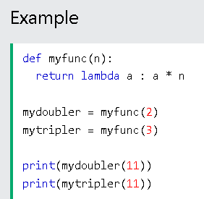
Why use Lambda?
The power of lambda is better shown when you use them as an anonymous function inside another function.
Example: Say you have a function definition that takes one argument, and that argument will be multiplied with an unknown number:

Slide 5
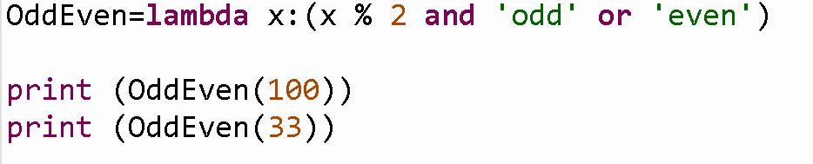
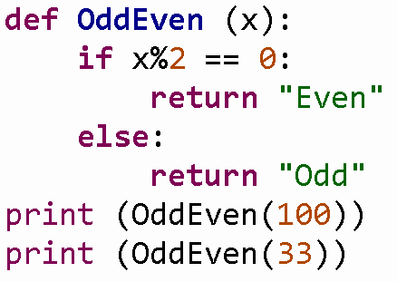
Lambda, Example
Using Lambda
Not using Lambda

Slide 6
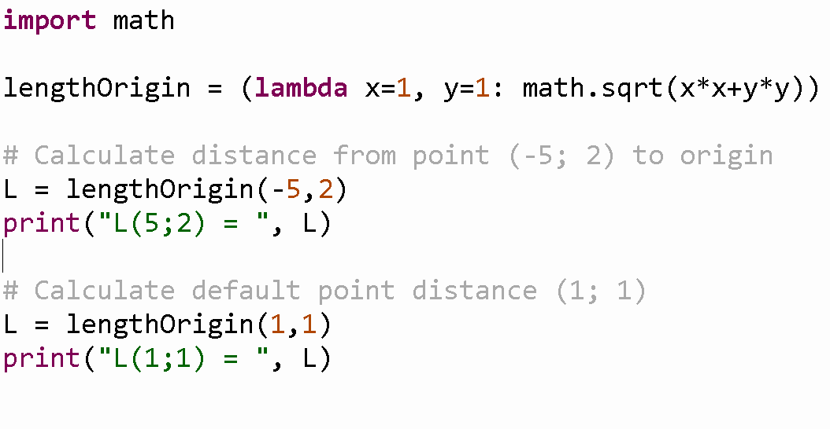
Lambda, with default values

Slide 7
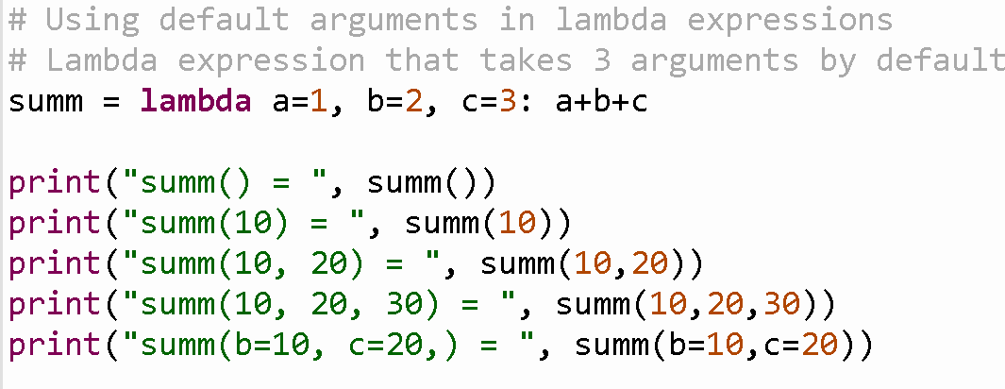
Lambda, with default parameters

Slide 8
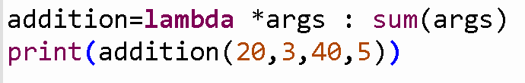
Lambda, with any number of parameters

Slide 9
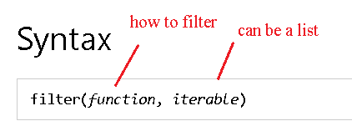
Filter() built in function
The filter() function returns an iterator where the items are filtered through a function to test if the item is accepted or not.
Takes two arguments

Slide 10
Filter() Example
Classic finding even numbers in alist
Using filter with lambda
def evenElem(L):
l1=[]
for i in L:
if (i % 2 == 0):
l1.append(i)
return l1
data = [1, 3, 5, 2, 7, 4, 10]
l=evenElem(data)
print(data)
print(l)
def is_even(i):
return i % 2 == 0
data = [1, 3, 5, 2, 7, 4, 10]
# Filter for even numbers using a lambda function
d1 = list(filter(lambda i: i % 2 == 0, data))
d2 = list(filter(is_even(), data))
print(data)
print(d1)
Print(d2)

Slide 11
Filter() Exercise
Use Filter/lambda to find a list of words including substring ‘cat’
Example a = ["dog", "cat", "wildcat", "thundercat", "cow", "hooo"]
Result = ['cat', 'wildcat', 'thundercat']
Hint use: re.compile(pattern, flags=0) , you need to import re

Slide 12
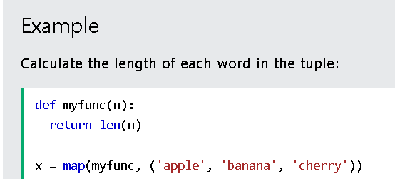
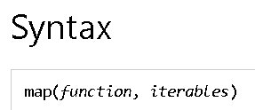
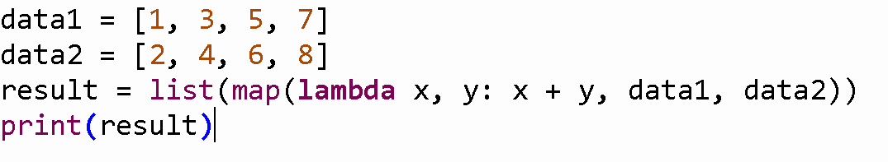
MAP() function
Map each value to a corresponding value using some operation
Example:
https://www.youtube.com/watch?v=kj850Y8y8FI&t=428s

Slide 13
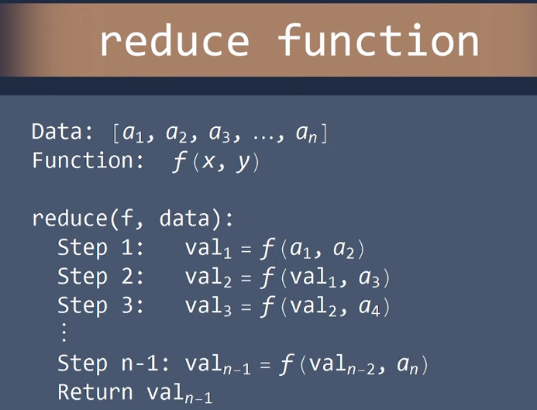
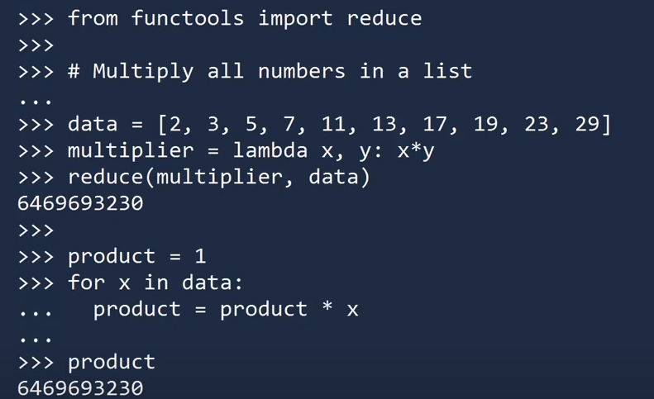
Reduce

Slide 14
MAP, Filter, Reduce
Map, Filter, and Reduce are paradigms of functional programming. They allow the programmer (you) to write simpler, shorter code, without necessarily needing to bother about intricacies like loops and branching.
https://www.youtube.com/watch?v=hUes6y2b--0

Slide 15

Generators
In Python, a generator is a function that returns an iterator that produces a sequence of values when iterated over.
Generators are useful when we want to produce a large sequence of values, but we don't want to store all of them in memory at once.
Syntax:

Slide 16
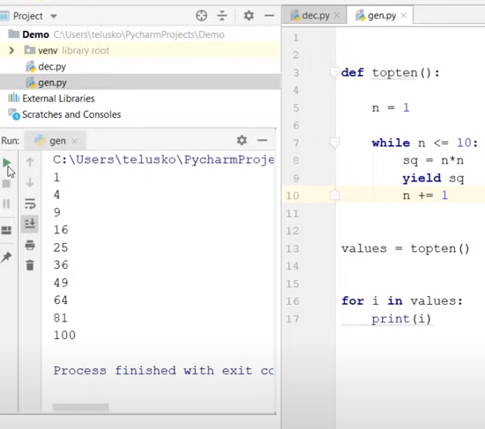
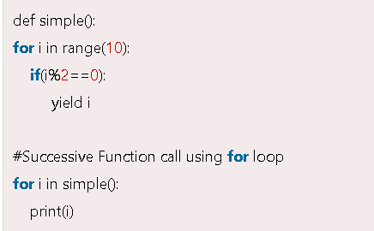
Generators
Example

Slide 17
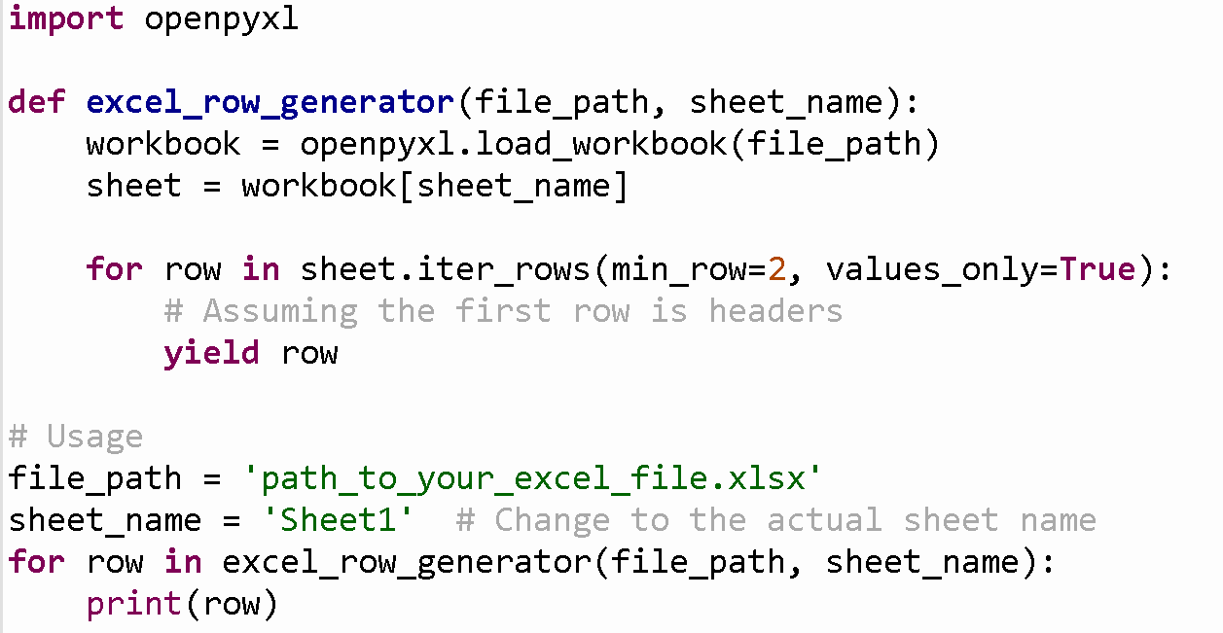
Exercise
Use Generator to fetch one record/ row at a time from Excel file into Object of type Product.
Sort products
according to price
Filter to store
Electronics products into
a separate list/stack

Slide 18
Decorators
In Python, a decorator is a design pattern that allows you to modify the functionality of a function by wrapping it in another function.
i.e. it allows programmers to modify the behavior of a function or class.
is a particular form of a function that takes functions as input and returns a new function as output.

Slide 19
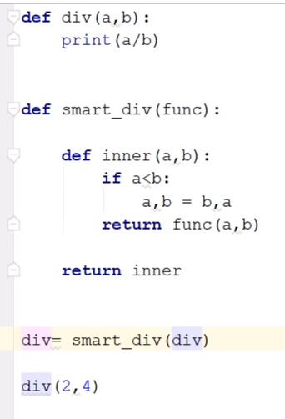
Decorators: Example
Self learning
See https://www.youtube.com/watch?v=yNzxXZfkLUA

