Slide 1

EEG-based Emotion Recognition using Deep Reinforcement Learning
Superviser:
Dr. Hesam Omranpour
Presentor:
Sara Rostami
August 2021

Slide 2
TABLE OF CONTENTS
01
02
03
04
05
06
07
What is
Emotion?
Intro. to Dataset
Preproc.
Problem formulation
Impl.
details
Exp.
results
conclusion

Slide 3
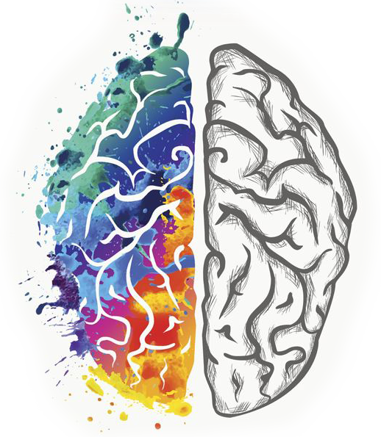
What is emotion?
A complex psychological state that involves:
A subjective experience
A physiological response
A behavioral/expressive response
VAD Dimensions
EEG
Valence
Arousal
Dominance
1

Slide 4
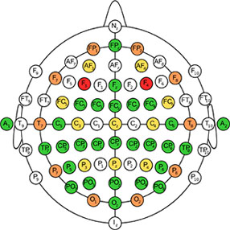
DEap Dataset Introduction
15 female, 17 male participants
For each participant 40 trials (1-minute video)
For each trial 8064 timestamps
For each timestamp 40 channel (electrodes)
2

Slide 5
DEAP Dataset Introduction(cont.)
Participant i
Each trial of a participant has Valence, Arousal, Dominance, Liking values
Trial j
Timestamp k
Channel m
3

Slide 6
Data Preprocessing
File format: participant_i_trial_j_Valence_x_Arousal_y_Dominance_z_Liking_t
EXG8 | EXG7 | … | F7 | AF3 | Fp1
V1,40 | V1,39 | … | V1,3 | V1,2 | V1,1
V2,40 | V2,39 | … | V2,3 | V2,2 | V2,1
… | … | … | … | … | …
… | … | … | … | … | …
V8064,40 | V8064,39 | … | V8064,3 | V8064,2 | V8064,1
Channel name
Each File MinMax Scaler
4

Slide 7
Problem Formulation
Env.
EXG8 | EXG7 | … | F7 | AF3 | Fp1
V1,40 | V1,39 | … | V1,3 | V1,2 | V1,1
V2,40 | V2,39 | … | V2,3 | V2,2 | V2,1
… | … | … | … | … | …
… | … | … | … | … | …
V8064,40 | V8064,39 | … | V8064,3 | V8064,2 | V8064,1
EXG8 | EXG7 | … | F7 | AF3 | Fp1
V1,40 | V1,39 | … | V1,3 | V1,2 | V1,1
V2,40 | V2,39 | … | V2,3 | V2,2 | V2,1
… | … | … | … | … | …
… | … | … | … | … | …
V8064,40 | V8064,39 | … | V8064,3 | V8064,2 | V8064,1
EXG8 | EXG7 | … | F7 | AF3 | Fp1
V1,40 | V1,39 | … | V1,3 | V1,2 | V1,1
V2,40 | V2,39 | … | V2,3 | V2,2 | V2,1
… | … | … | … | … | …
… | … | … | … | … | …
V8064,40 | V8064,39 | … | V8064,3 | V8064,2 | V8064,1
Select trial
Teacher
Next observation
Agent’s last action
Agent
Action
observation
One observation
5

Slide 8
Problem Formulation- Reward Function
Done | Reward | All obs. Seen? | Action | Expected result
True | 1 | x | 1 | 1
True | -1 | x | 0 | 1
True | -1 | x | 1 | 0
True | 1 | x | 0 | 0
True | -5 | yes | nop | x
False | 0 | no | nop | x
6

Slide 9

Problem Formulation – Select trial
Practice this trial again
Select the next trial
Select a trial Randomly
Has the agent learned this trial well?
No
yes
Is there any more trial left?
yes
No
7

Slide 10
implementation
Details
Class_lbl (e.g. arousal / valence ) == 0 or 1
Two agents (for arousal & valence)
10-fold cross val. : |train set| = 36 , |test set| = 4
Evaluation metric : Accuracy
8

Slide 11
Experiment without parameter tuning
Mean | stdev | Valence/ Arousal | Participant id
0.7 | 0.349 | A | 13
0.75 | 0.235 | V
0.45 | 0.197 | A | 32
0.45 | 0.329 | V
0.625 | 0.212 | A | 9
0.225 | 0.342 | V
0.6 | 0.293 | A | 2
0.425 | 0.391 | V
0.725 | 0.275 | A | 24
0.4 | 0.210 | V
Arousal acc:
51%
Valence acc:
37%
.
.
.
9

Slide 12
Small experiment with parameter tuning
prediction | Likes? | Liking value | Participant id
Yes | Yes | 8.08 | 2
No | No | 4.05 | 4
Yes | Yes | 6.32 | 8
Yes | Yes | 7.03 | 9
Yes | Yes | 5.12 | 10
Yes | Yes | 5.63 | 11
Yes | Yes | 5.01 | 14
Yes | Yes | 7.12 | 22
Yes | Yes | 6.01 | 24
Yes | Yes | 6.03 | 25
No | No | 4.03 | 31
Accuracy:
100%
10

Slide 13
conclusion
Easy formulation
Sample efficient
Variable length data
Support online and offline learning easily
Promising results
11

Slide 14

Thank you for your time!

Slide 15
References
Alarcao, S. M., & Fonseca, M. J. (2017). Emotions recognition using EEG signals: A survey. IEEE Transactions on Affective Computing, 10(3), 374-393.
Jenke, R., Peer, A., & Buss, M. (2014). Feature extraction and selection for emotion recognition from EEG. IEEE Transactions on Affective computing, 5(3), 327-339.
Kee, C. Y., Ponnambalam, S. G., & Loo, C. K. (2017). Binary and multi-class motor imagery using Renyi entropy for feature extraction. Neural Computing and Applications, 28(8),2051-2062.
Vaid, S., Singh, P., & Kaur, C. (2015). Classification of human emotions using multiwavelet transform based features and random forest technique. Indian Journal of Science and Technology, 8(28), 1-7.
Dorigo, M., Birattari, M., & Stutzle, T. (2006). Ant colony optimization. IEEE computational intelligence magazine, 1(4), 28-39.
Price, K., Storn, R. M., & Lampinen, J. A. (2006). Differential evolution: a practical approach to global optimization. Springer Science & Business Media.
Sharma, R., Pachori, R. B., & Sircar, P. (2020). Automated emotion recognition based on higher order statistics and deep learning algorithm. Biomedical Signal Processing and Control, 58, 101867.
Ding, Y., Robinson, N., Zeng, Q., Chen, D., Wai, A. A. P., Lee, T. S., & Guan, C. (2020, July). Tsception: a deep learning framework for emotion detection using EEG. In 2020 International Joint Conference on Neural Networks (IJCNN) (pp. 1-7). IEEE.

Slide 16
References (cont.)
Yin, Y., Zheng, X., Hu, B., Zhang, Y., & Cui, X. (2021). EEG emotion recognition using fusion model of graph convolutional neural networks and LSTM. Applied Soft Computing, 100, 106954.
Liu, W., Zhang, L., Tao, D., & Cheng, J. (2018). Reinforcement online learning for emotion prediction by using physiological signals. Pattern Recognition Letters, 107, 123-130.
R.S. Sutton, A.G. Barto, Reinforcement Learning: An Introduction, 2nd edition, MIT Press, Cambridge, MA, 2012.

