Slide 1



Information and Communication Technologies (ICT) and Related Tools
Powerpoint project by
MENZOU SAMIA
RACHA LASLOUNI
SARA khelil
IMANE benmeridja
Meriem chebab
GROUPE 18 SECTION A

Slide 2

Table of Contents
Introduction to ICT
Google Services
Microsoft Tool
Git and GitHub
ICT in Business
Future Trends in ICT
Conclusion

Slide 3

Introduction to ICT
And its importance
Definition of ICT:
ICT stands for Information and Communication Technologies. It refers to the broad range of technologies that facilitate communication, information management, and the manipulation and distribution of information. ICT encompasses both the hardware and software used to manage, process, and transmit information.
Daily life
In daily life, ICT has become integral. It's embedded in various devices and applications that people use for communication (smartphones, social media), work (computers, software tools), entertainment (streaming services, gaming), education (e-learning platforms), and even healthcare (telemedicine, health monitoring devices).
BUSNISES
ICT plays a pivotal role in modern business operations. It enables efficient communication, facilitates data management, streamlines processes, enhances productivity, and allows for global connectivity. Businesses rely on ICT for tasks ranging from customer relationship management (CRM) to supply chain logistics and beyond.

Slide 4






f
logos
Applications in Collaboration and Communication:
application.:Allowing multiple users to work on the same document simultaneously, enabling real-time edits and comments.
Communication: Facilitating seamless communication through emails, chats, and video calls within the same ecosystem.
Collaboration: Allowing multiple users to work on the same document simultaneously, enabling real-time edits and comments.
Google Services
Gmail: Email service allowing communication and collaboration.
Drive: Cloud storage for file management and sharing.
Docs: Word processing for creating documents collaboratively.
Sheets: Spreadsheet software for data organization and analysis.
meet: Presentation software for creating meeting online.
Slides: Presentation software for creating slide decks.

Slide 5





Excel: Spreadsheet software for data analysis and calculations.
PowerPoint: Presentation software for creating slideshows.
Word: Word processing software for creating documents.
Microsoft tools
MICROSOFT OFFICE
Integration Capabilities and Cross-Platform:
Functionality:
Integration: Seamless integration among Microsoft Office applications allows easy data sharing and editing across different software.
Cross-Platform: Availability of Microsoft Office Suite on various devices and operating systems ensures accessibility and consistency in user experience.

Slide 6

What is Git?
Git is a version control system used for tracking changes in code.
It enables multiple developers to work on a project simultaneously.
What is GitHub?
GitHub is a web-based platform that hosts Git repositories.
It enhances collaboration through tools like issues and pull requests
GIT AND GITHUB
Git & GitHub: Benefits and Applications“
Benefits:
Simplified collaboration among developers, enabling teamwork.
Efficient version control, reducing errors and conflicts in code.
Showcases projects, encourages community engagement, and fosters contributions.
Real-world applications:
In software development, Git and GitHub streamline project management and code sharing.
Open-source contributions are made accessible, allowing developers to contribute to global projects.
For individuals, GitHub serves as a portfolio platform, showcasing projects and managing personal repositories.

Slide 7
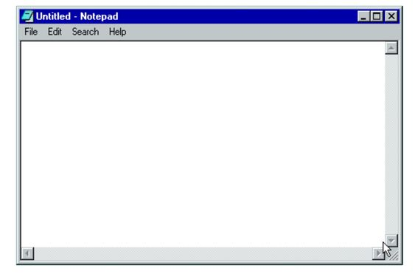
ICT in Business
Enhancing Business Operations and Communication:
Streamlining Operations:
Leveraging ICT tools for automation of tasks, optimizing workflows, and improving overall operational efficiency.
Efficient data management systems ensuring accuracy and accessibility of information.
Facilitating Communication:
Utilizing ICT tools for seamless internal communication (emails, instant messaging) and external interactions.
Integration of collaboration platforms enhancing teamwork and knowledge sharing
2. Case Studies of Successful ICT Implementation:
Examples across Industries:
Showcasing successful ICT integration in diverse sectors (manufacturing, finance, healthcare, etc.).
Highlighting specific instances where ICT solutions brought tangible improvements in processes or outcomes.
Benefits of ICT Adoption for Businesses:
Efficiency Gains:
Demonstrating how ICT adoption leads to streamlined processes, reducing redundancy and enhancing productivity.
Automation reducing manual efforts and optimizing resource utilization.
Cost Reduction:
Illustrating cost-saving aspects, such as reduced operational expenses and infrastructure costs through ICT implementation.
Innovation Through ICT:
Showcasing instances where ICT-driven solutions sparked innovation, fostering a culture of continuous improvement and technological advancement within businesses.

Slide 8

Emerging Technologies Impacting ICT:
New Technologies Overview:
Quick explanation of new technologies like AI, IoT, Blockchain, etc.
How they change how businesses use technology.
How They Affect ICT and Businesses:
Showing how these new technologies change how businesses work with data, automate tasks, and create new things.
Predictions for the Future of ICT:
Advancements in Technology:
Talking about how technology will get better, like AI becoming smarter and Iot growing.
How this will change how businesses do things and how people work.
Changes in How Businesses Work:
Guessing how businesses will change, like how they talk with customers or how people work together.
Challenges and Opportunities in New ICT Trends:
Problems with New Technology:
Explaining the difficulties in using new tech, like making it work with old systems or keeping it safe.
How to solve these problems.
Good Things About New Tech:
Talking about the good things new tech brings, like making new things, finding new customers, and growing businesses.

Slide 9

Recap of ICT Importance:
ICT and related tools, including Google services, Microsoft tools, Git, and GitHub, serve as the backbone of modern connectivity and efficiency.
They enable seamless communication, enhance productivity, and drive innovation across various industries.
Final Thoughts on Technology's Role:
Technology continues to shape our future profoundly, influencing how we live, work, and interact.
Advancements in technology pave the way for further innovations and transformative changes in society.
Conclusion

