Slide 1





ICEALEX
Trainer Profile Project
Created by:
Sara Samy
Shaimaa Elromh

Slide 2

ICEALEX
Objectives:
Analyzing and enhancing trainer satisfaction rate.
Creating a detailed portfolios for each trainer.
01

Slide 3

ICEALEX
Table of Content :
Business Questions.
DataBase Design.
Database Creation.
Data Exploration.
PivotTables.
Analysis and Graphs.
Conclusion.

Slide 4
ICEALEX
Business Questions
02

Slide 5
ICEALEX
Business Questions
Build database structure for ICEALEX trainers to manage their data and optimize trainers’ allocation across ICEALEX programs.
This database should encompass trainer expertise, qualifications, performance metrics, and program history.

Slide 6
ICEALEX
Database Design
03

Slide 7
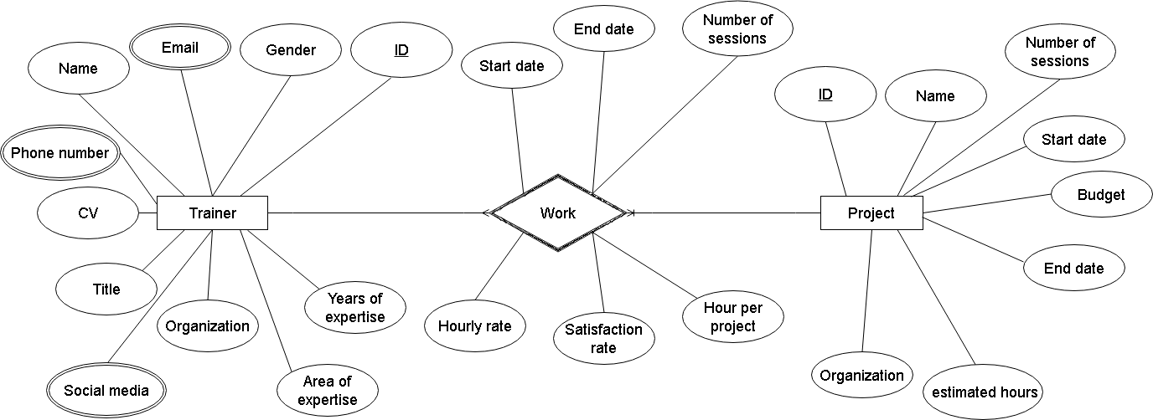
ICEALEX
ERD: Entity Relationship Diagram

Slide 8
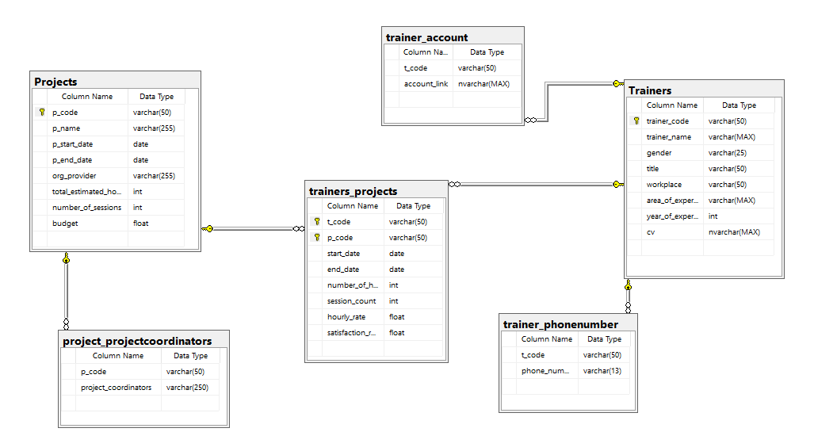
ICEALEX
SCHEMA

Slide 9
ICEALEX
Database Creation
04

Slide 10
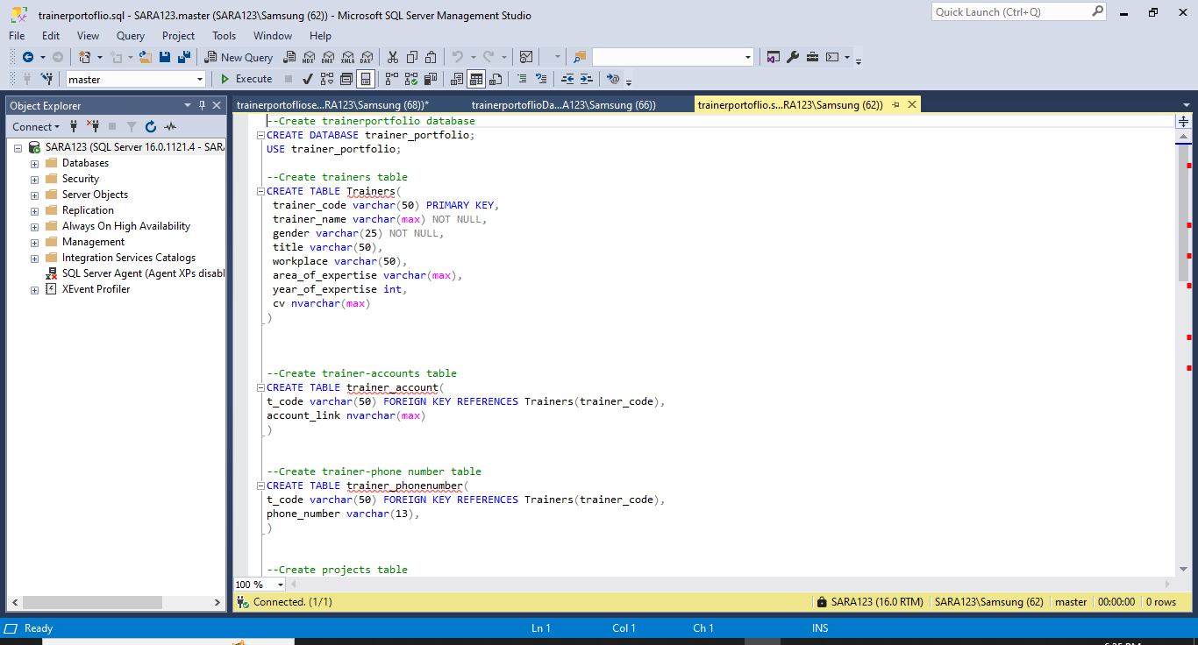
ICEALEX
SQL SERVER

Slide 11
ICEALEX
Data Exploration
05

Slide 12
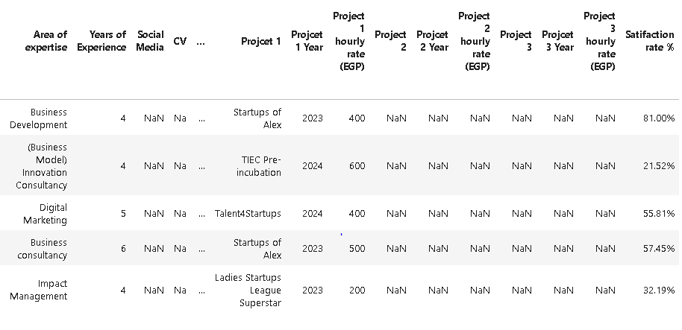
ICEALEX

Slide 13
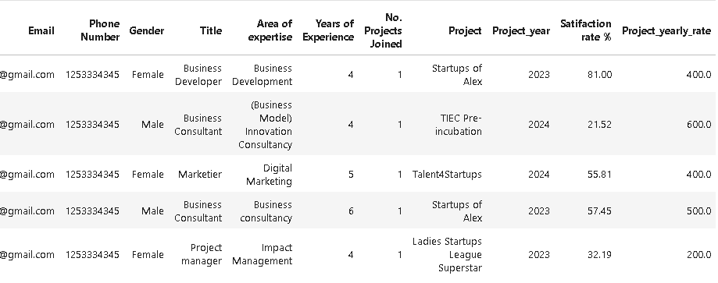
ICEALEX
Notebook

Slide 14
ICEALEX
Pivot Tables
06

Slide 15
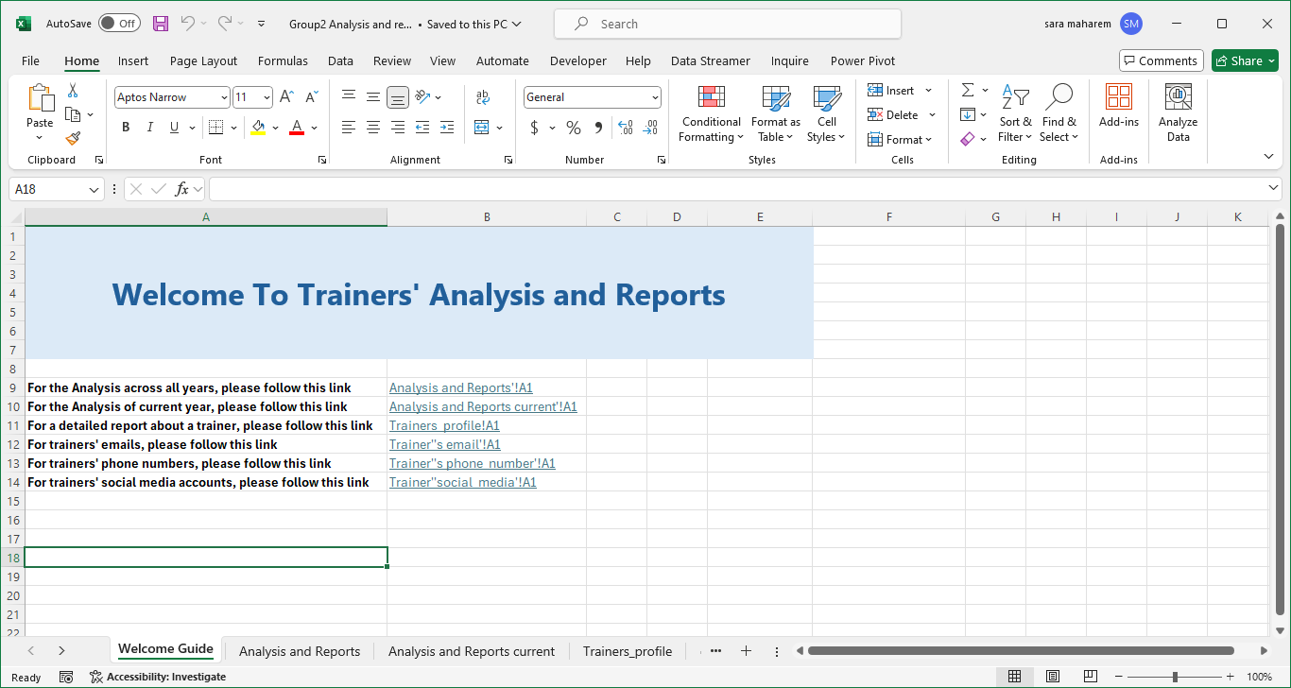
ICEALEX
Pivot Tables

Slide 16
ICEALEX
Analysis and Graphs
07

Slide 17
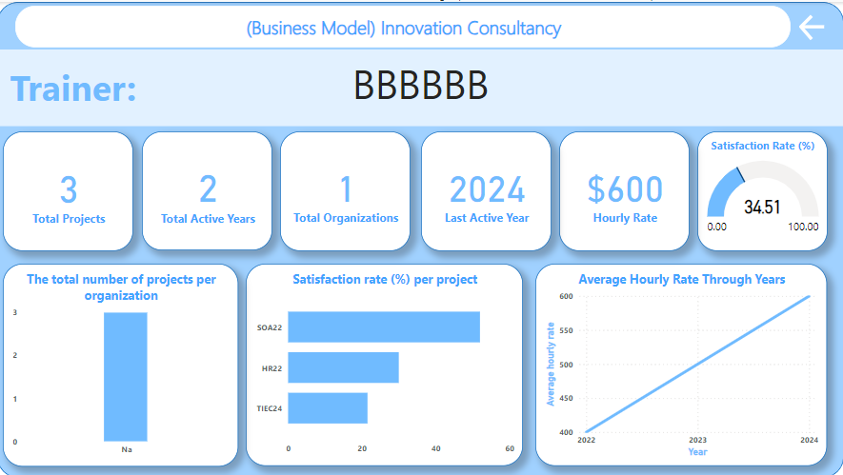
ICEALEX
Dashboard

Slide 18


ICEALEX
Suggestions
Fill All Fields when using the dashboard.
Categorize the area of expertise to subjects.
For project code, use the first letter of each word in the project name and the last two digits in the year.
Adding an instant comment section if the rank applied doesn’t meet the target value.
Convert the years of expertise to experience levels.

Slide 19

ICEALEX
thank
you

