Slide 1
Birth Year: 2011
RF: 90% Assignment Validation dataset 96.8% when running training model on full dataset
LDA: 81.5% (did not get two spring samples)

Slide 2
Birth Year: 2012
RF: 66.7% Assignment for Validation Dataset 88% when running training model on full dataset
LDA: 66.7% (did not get two spring samples)

Slide 3
Birth Year: 2013
RF: 50% Assignment for Validation Dataset 75% when running training model on full dataset
LDA: 71% (did not get two spring samples)

Slide 4
Birth Year: 2014
RF: 80% Assignment for Validation Dataset 94.1% when running training model on full dataset
LDA: 87.5% (did not get two spring samples)

Slide 5
Birth Year: 2015
RF: 66.7% Assignment for Validation Dataset 50% when running training model on full dataset
LDA: 100%

Slide 6
Clustering Analysis Based on Random Forest Models for Morph and A1 Diameter

Slide 7
Dendrogram Based on HClust method = ’Average’
Dendrogram for visualizing clustering Hclust analysis based on both Random Forest and LDA models for Morph and A1 diameter

Slide 8
PCA for visualizing clustering analysis based on both Random Forest and LDA models for Morph and A1 diameter
Colored Based on Grouping Outputs of 4 models
(RFOto, LDAOto, RFMorph, LDAMorph)
Colored Based on HClust method = ’Average’

Slide 9
PCA for visualizing clustering analysis based on both Random Forest and LDA models for Morph and A1 diameter
Colored Based on Grouping Outputs of 4 models
(RFOto, LDAOto, RFMorph, LDAMorph)
Colored Based on HClust method = ’Average’

Slide 10
Dendrogram Based on HClust method = ’ward.D’
Dendrogram for visualizing clustering Hclust analysis based on both Random Forest and LDA models for Morph and A1 diameter

Slide 13
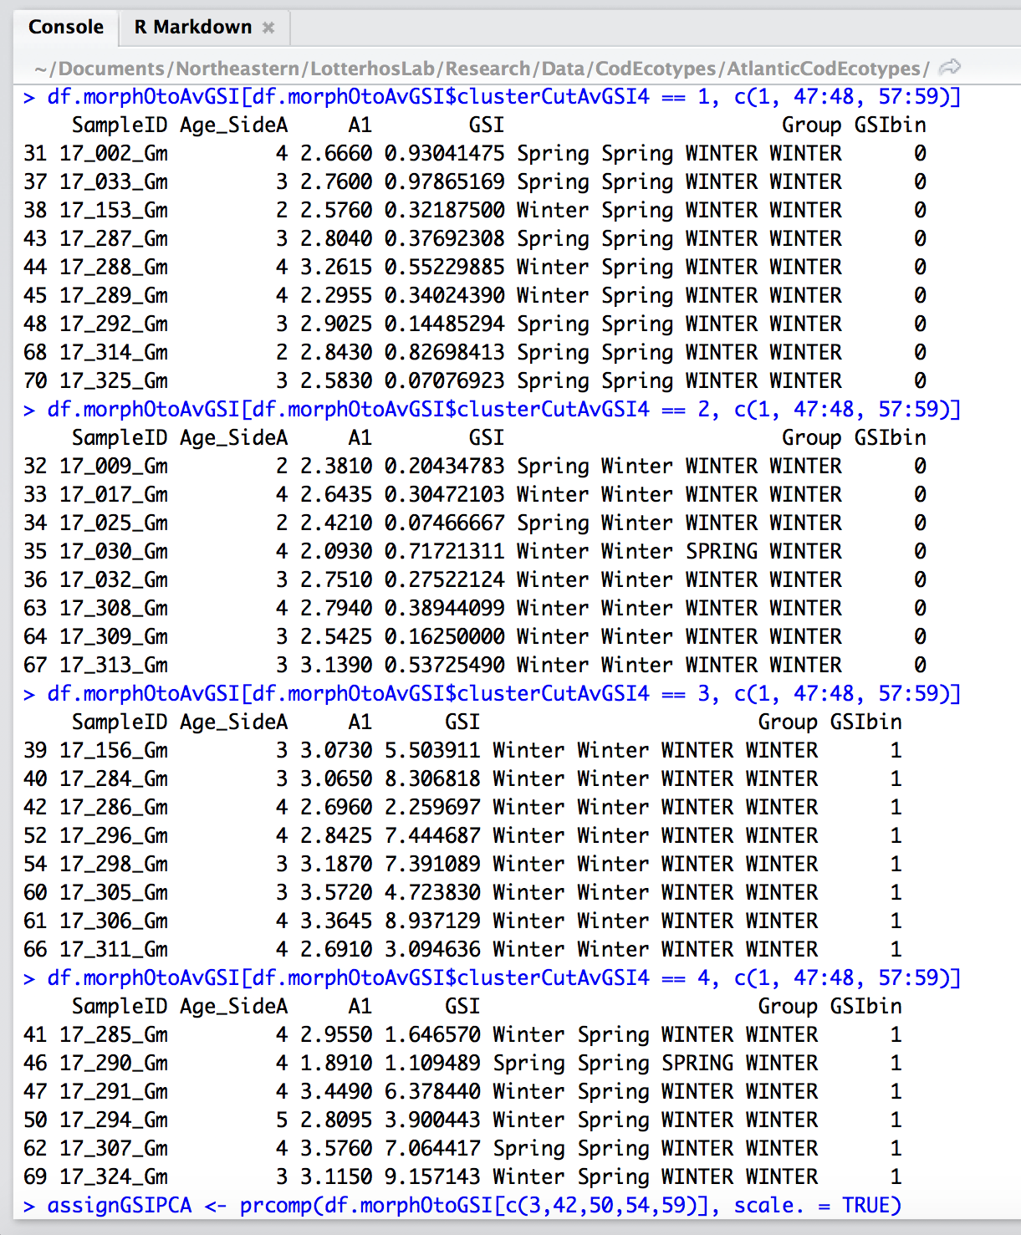

Slide 14
Modeling Chapter – Under what combined levels of migration and selection do ecotypes evolve?
21 chromosomes
A Single Nucleotide Polymorphism

