Slide 1
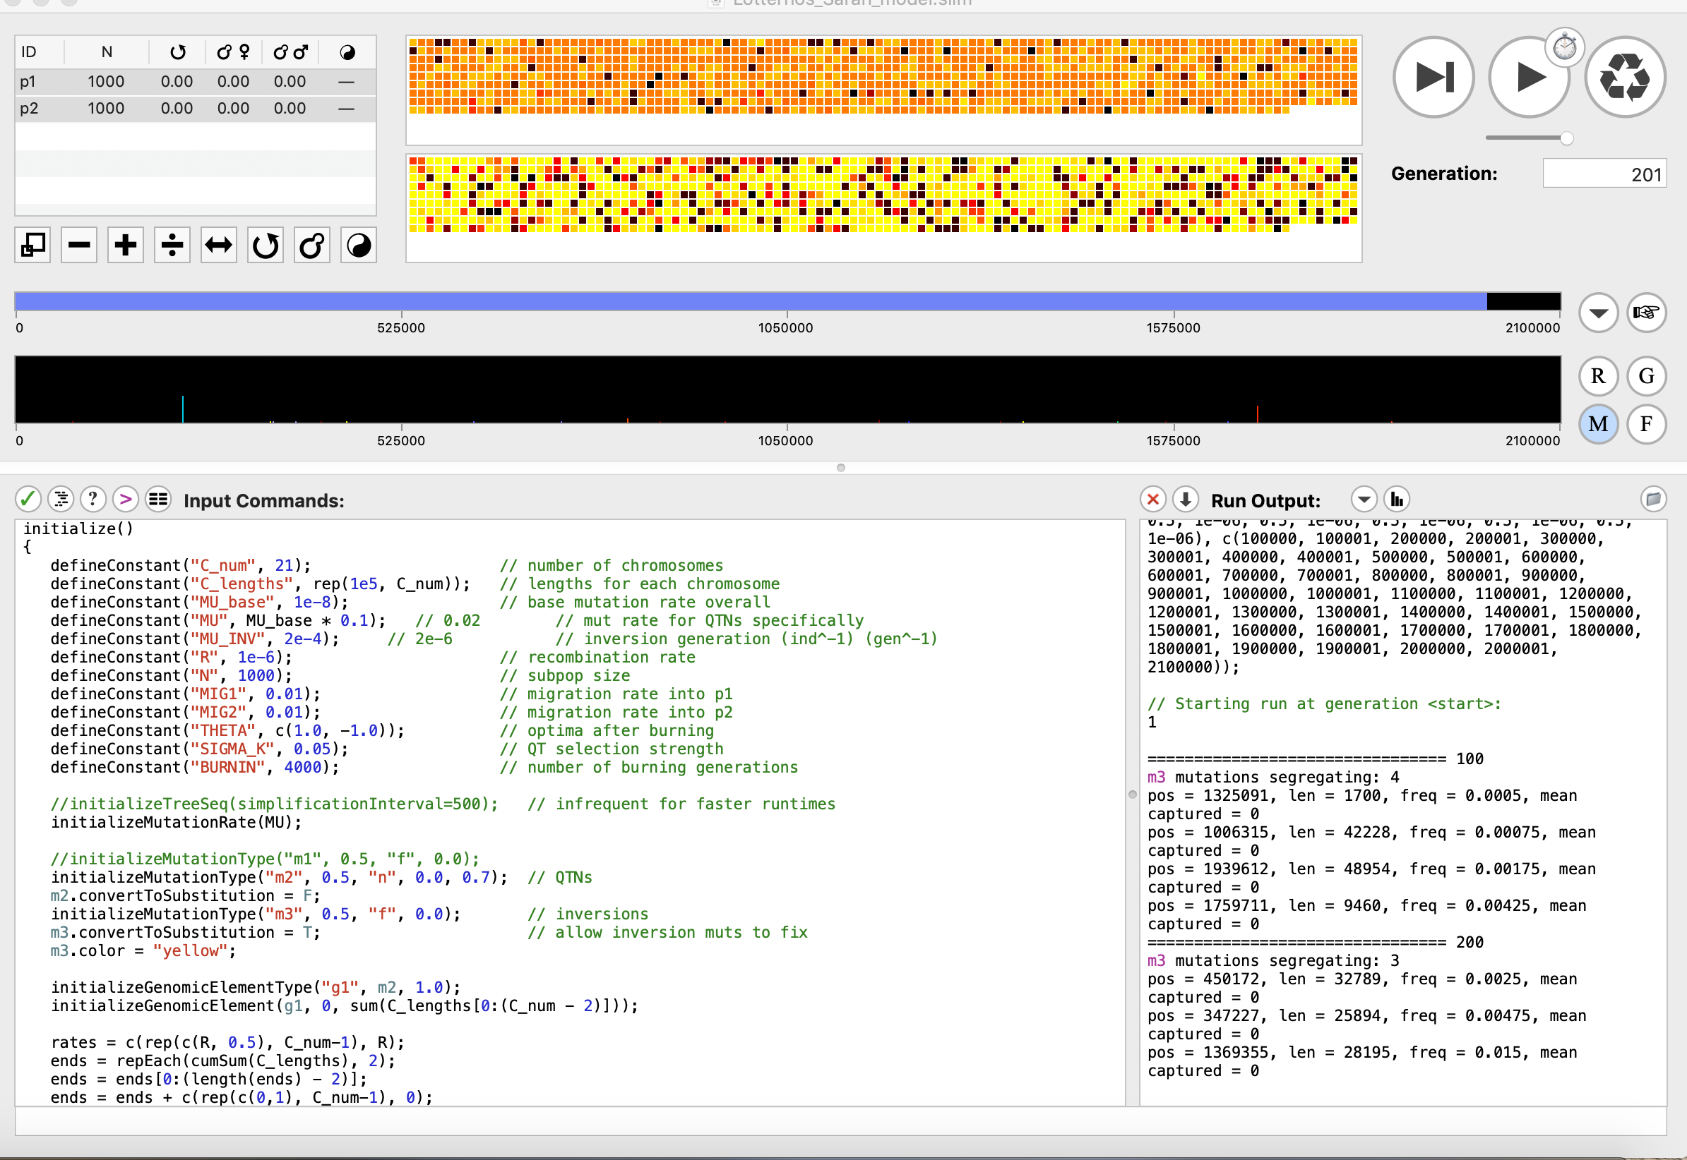
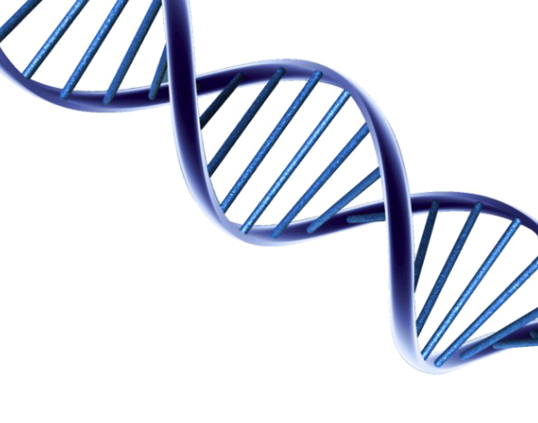
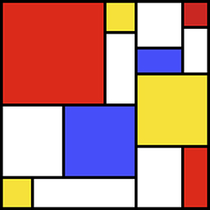
Inversion invasions!
Understanding the conditions in which inversion polymorphisms arise and persist in populations undergoing environmental adaptation
Sara M. Schaal, Ben Haller & Katie E. Lotterhos
SLiM

Slide 2
Kirkpatrick & Barton 2006 – (1-n)m

Slide 3
Inversion invasions!
Under what levels of selection and migration does an inversion invade and persist in a population?
2. Does the genetic architecture underlying the trait, inversion length or specific effect sizes influence the establishment and persistence of an inversion?
3. Is an inversion more likely to establish if it arose with QTNs within it or if it arose neutral and acquired QTNs through mutation?

Slide 4
Inversion invasions!
Under what levels of selection and migration does an inversion invade and persist in a population?
2. Does the inversion length influence the establishment and persistence of an inversion?
3. Is an inversion more likely to establish if it arose with QTNs within it or if it arose neutral and acquired QTNs through mutation?

Slide 5
Model Overview
Model Parameters
N = subpopulation size
m_{1,2} = migration from 1 to 2
m_{2,1} = migration from 1 to 2
Population 1
Population 2
m_{2,1}
N = 1000
N = 1000
m_{1,2}

Slide 6
Model Overview
Model Parameters
N = subpopulation size
m_{1,2} = migration from 1 to 2
m_{2,1} = migration from 1 to 2
Θ₁ = trait optimum in population 1
Θ₂ = trait optimum in population 2
σ = strength of selection (SD of the Gaussian fitness curve)
Population 1
Population 2
m_{2,1}
N = 1000
N = 1000
m_{1,2}
Fitness
-1
+1
Phenotype

Slide 7
Model Overview
Model Parameters
N = subpopulation size
m_{1,2} = migration from 1 to 2
m_{2,1} = migration from 1 to 2
Θ₁ = trait optimum in population 1
Θ₂ = trait optimum in population 2
σ = strength of selection (SD of the Gaussian fitness curve)
C = number of chromosomes
C_len = length of chromosomes
r = recombination rate
mu_base = neutral mutation rate
Population 1
Population 2
m_{2,1}
N = 1000
N = 1000
m_{1,2}
Fitness
-1
+1
Phenotype

Slide 8
Model Overview
Model Parameters
N = subpopulation size
m_{1,2} = migration from 1 to 2
m_{2,1} = migration from 1 to 2
Θ₁ = trait optimum in population 1
Θ₂ = trait optimum in population 2
σ = strength of selection (SD of the Gaussian fitness curve)
C = number of chromosomes
C_len = length of chromosomes
r = recombination rate
mu_base = neutral mutation rate
mu = QTN mutation rate
Population 1
Population 2
m_{2,1}
N = 1000
N = 1000
m_{1,2}
Fitness
-1
+1
Phenotype

Slide 9
Model Overview
Model Parameters
N = subpopulation size
m_{1,2} = migration from 1 to 2
m_{2,1} = migration from 1 to 2
Θ₁ = trait optimum in population 1
Θ₂ = trait optimum in population 2
σ = strength of selection (SD of the Gaussian fitness curve)
C = number of chromosomes
C_len = length of chromosomes
r = recombination rate
mu_base = neutral mutation rate
mu = QTN mutation rate
mu_inv = Inversion mutation rate
Inv_length = length of inversion (variable 100 bp - length half the chromosome size)
Dominance = variable dominance values at a loci (on or off)
envVar = environmental variance on the phenotype
Population 1
Population 2
m_{2,1}
N = 1000
N = 1000
m_{1,2}
Fitness
-1
+1
Phenotype

Slide 10
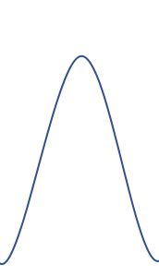
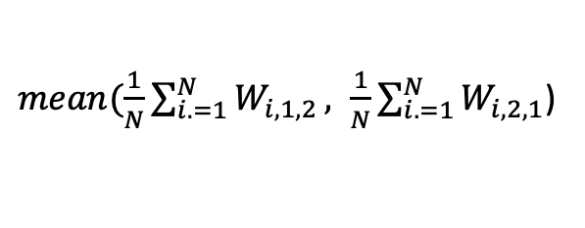
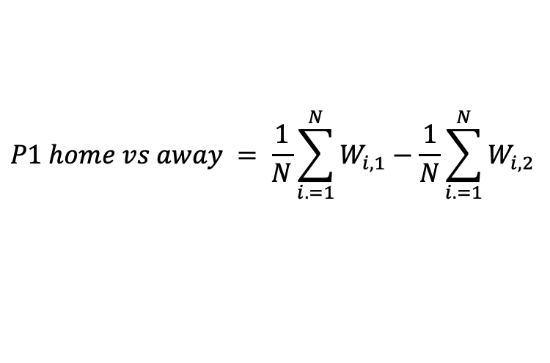
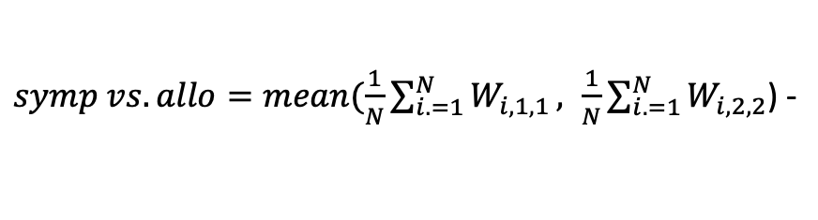
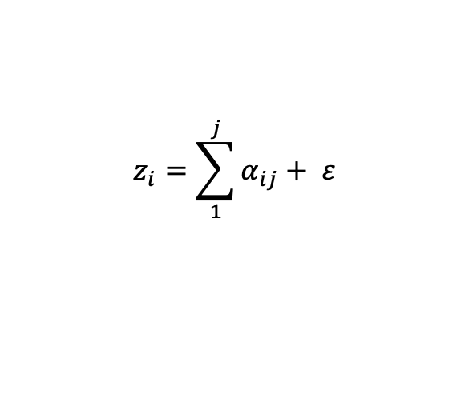
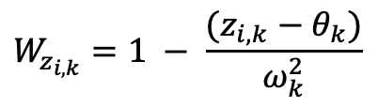
Model Overview
Stabilizing Selection
Population Level
Phenotype
Fitness
θ
Gen 1
Gen 2
$$z_{i}=\sum_{1}^{j}{α_{ij}}+ ε$$
Fitness
$$W_{z_{i,k}}=1 − \frac{(z_{i,k}−θ_{k})}{ω_{k}^{2}}$$
Frequency
Local Adaptation
Trait Value
$symp vs. allo=mean(\frac{1}{N}\sum_{i. =1}^{N}{W_{i,1,1}}, \frac{1}{N}\sum_{i. =1}^{N}{W_{i,2,2}}$) -
$mean(\frac{1}{N}\sum_{i. =1}^{N}{W_{i,1,2}}, \frac{1}{N}\sum_{i. =1}^{N}{W_{i,2,1}}$)
Individual Level
θ
Fitness
$$P1 home vs away = \frac{1}{N}\sum_{i. =1}^{N}{W_{i,1}}−\frac{1}{N}\sum_{i. =1}^{N}{W_{i,2}}$$
Fitness
z
Trait Value

Slide 11
Initial Results – Local Adaptation

Slide 12
Initial Results - Fitness

Slide 13
Initial Results – High Sigma_mu (0.2) Summary

Slide 14
Initial Results – High Sigma_mu (0.2) SD pheno

Slide 15
Initial Results – Low Sigma_mu (0.002) Summary

Slide 16
Initial Results – Average Length of Inversions

Slide 17
Initial Results – Average Length of Inversions

Slide 18
Initial Results – Average Number of QTNs

Slide 19
Output Files
Every 200 generations
Inversion output
Gen | start_position | end_position | lengthINV | freq | freq_p1 | freq_p2 | mean_SelCoef | sd_SelCoef | mean_Dom | sd_Dom
Inversion QTN output
Generation | Inv_Pos | QTN_Pos | QTN_SelCoef | QTN_Dom | QTN_Freq_P1 | QTN_Freq_P2 | QTN_Freq
Population Summary
Gen | uniqueInvMuts | localAdapt | meanFitP1 | sdFitP1 | meanPhenoP1 | sdPhenoP1 | meanFitP2 | sdFitP2 | meanPhenoP2 | sdPhenoP2
End of Sim
Mutation Summary
position | selCoef | originGen | type | freq_p1 | freq_p2 | freq | AdaptPhenoDiv
Simulation Summary
Seed | Mig | Ne | Mu | Mu_Inv | Recom | Alpha | SelStrength
VCF & Individual Phenotype File

Slide 20
Questions
No inversions are fixing with QTNs.
Increase Mutation Rate
Human genetics find 1.78 to 1.88 mutations per 10,000 gametes per generation
0.712 to 0.752 mutation rate
More generations currently at 20,000 (< 10 min per sim) can bump to 200,000 (~73 min per sim)
Inversions are generally old in the literature – millions of years old
Time Series
Do you think it is a problem that I am only writing out every 200 generations?
cons: lose resolution could have inversion arise or be lost and not recorded
pros: saves time
Suggestions for other ways to analyze the time series data

