Slide 1
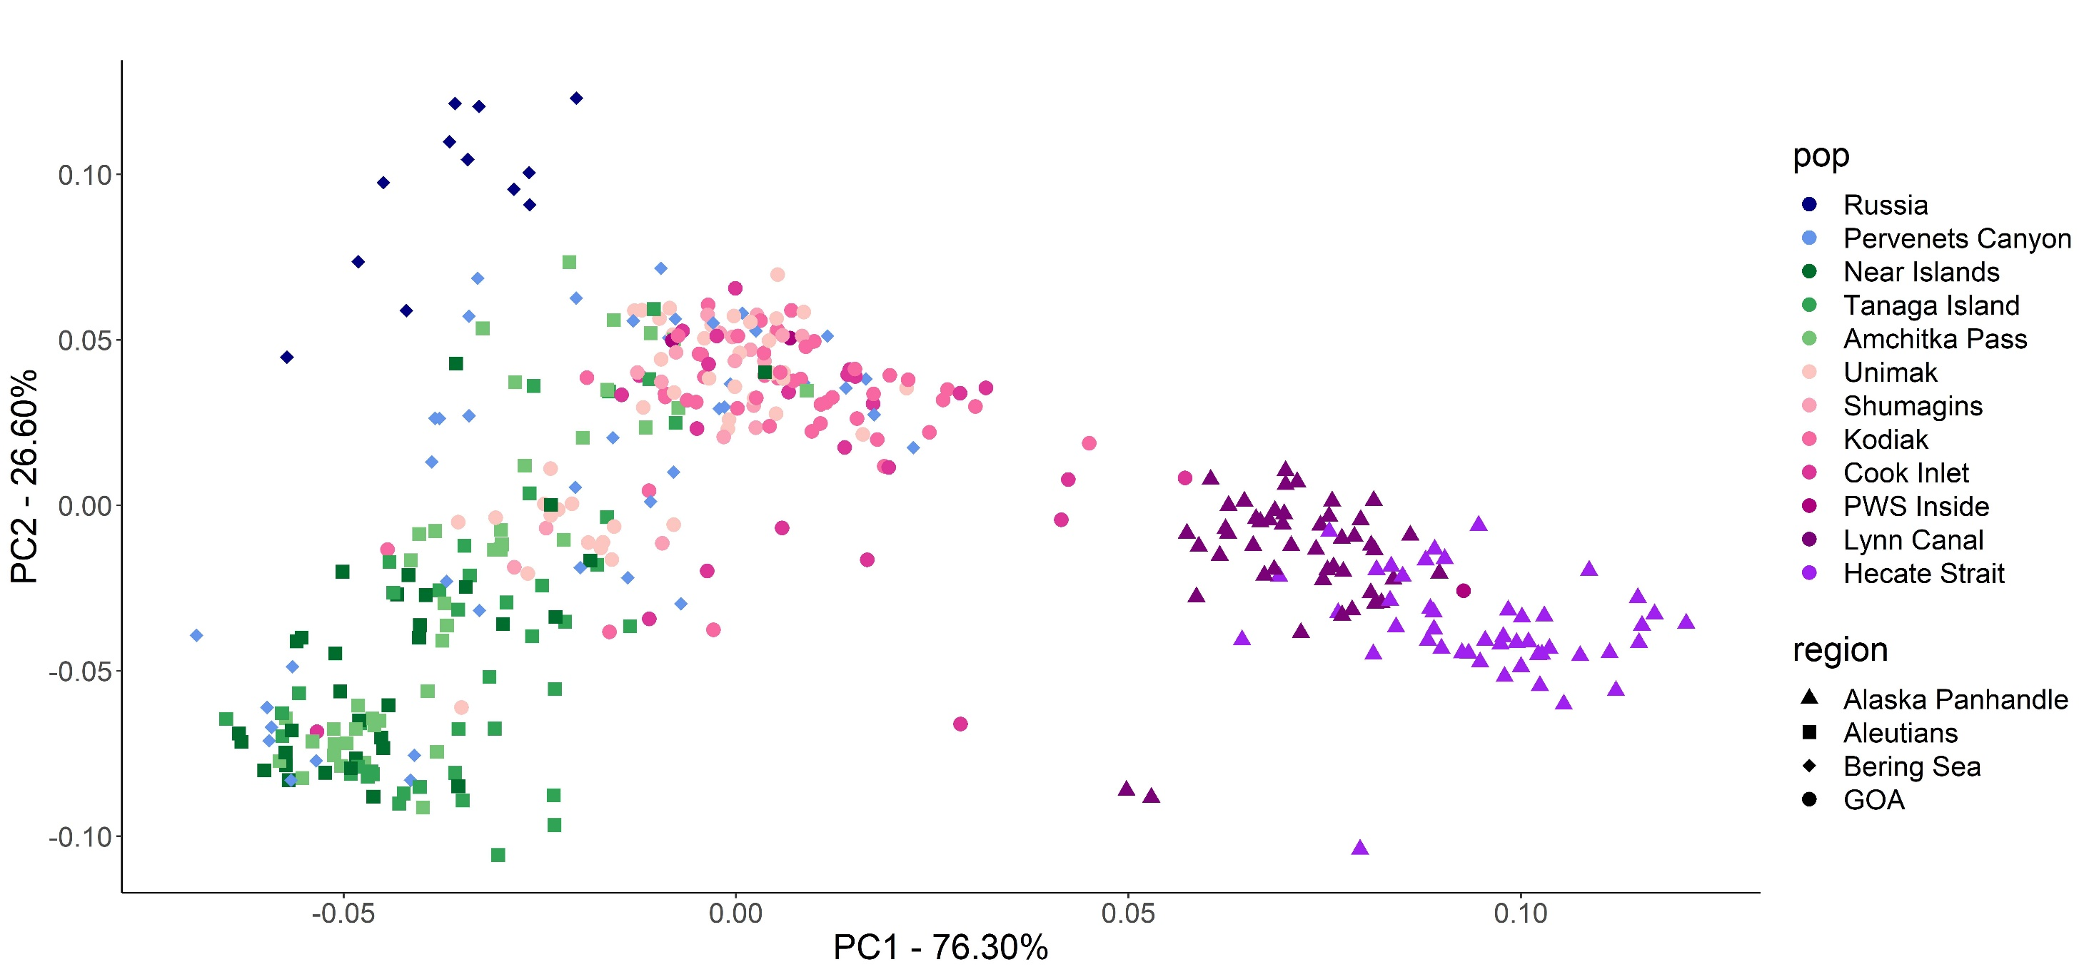
Bering Sea
Western Gulf of Alaska
Eastern Gulf of Alaska
Aleutian Islands

