Slide 1
Exercise1
Pattern Recognition
Calculate the belonging of a pattern to a class

Slide 2
Calculate the belonging of a pattern to a class
In this section, with a simple example, how to use Bayesian formula to classify students admitted to the university based on the score obtained in the entrance exam (a one-dimensional feature is considered) is used. Statistics at this university show that the probability of a student graduating in the first 5 years of study is 0.8. Students' scores follow a normal distribution with an average of 26 and a standard deviation of 2. The entrance exam score of students whose graduation period is more than 5 years also follows a normal distribution with an average of 22 and a standard deviation of 3. We denote these two classes of students by G and G ̅. If a student is accepted with a grade of 22, how likely is he / she to graduate in the first 5 years of study?

Slide 3











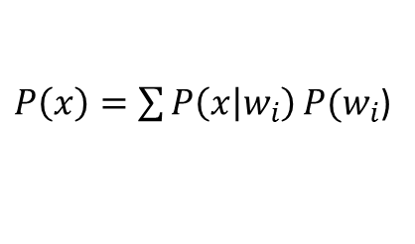

$$P\left(w1\right)=0.8$$
$$P\left(x | w1\right)=N\left(26,2\right)$$
$$P(w2)=0.2$$
$$P\left(x | w2\right)=N\left(22,3\right)$$
$$x=22$$
$$P\left(w1 | x=22\right)=?$$
$$P\left(w1 | x\right)=\frac{P\left(x | w1\right)P(w1)}{p(x)}$$
$P\left(x\right)=\sum{P\left(x | w_{i}\right)}P(w_{i}$)
$P\left(x\right)=$ $P\left(x | w_{1}\right)P(w_{1})$+ $P\left(x | w_{2}\right)P(w_{2})$
$P\left(x\right)=$ $0.027∗0.8+0.133∗0.2=0.0482$
$$P\left(22 | w_{1}\right)=\frac{1}{\sqrt{2π}∗2}exp\left[−0.5∗{(\frac{22−26}{2})}^{2}\right]=0.027$$
$$P\left(w1 | x=22\right)=\frac{0.027∗0.8}{0.0482}=0.4481$$
$$P\left(22 | w_{1}\right)=\frac{1}{\sqrt{2π}∗3}exp\left[−0.5∗{(\frac{22−26}{2})}^{2}\right]=0.133$$

