Slide 1
NoSQL
Mongo DB
by Taras Boichuk

Slide 2
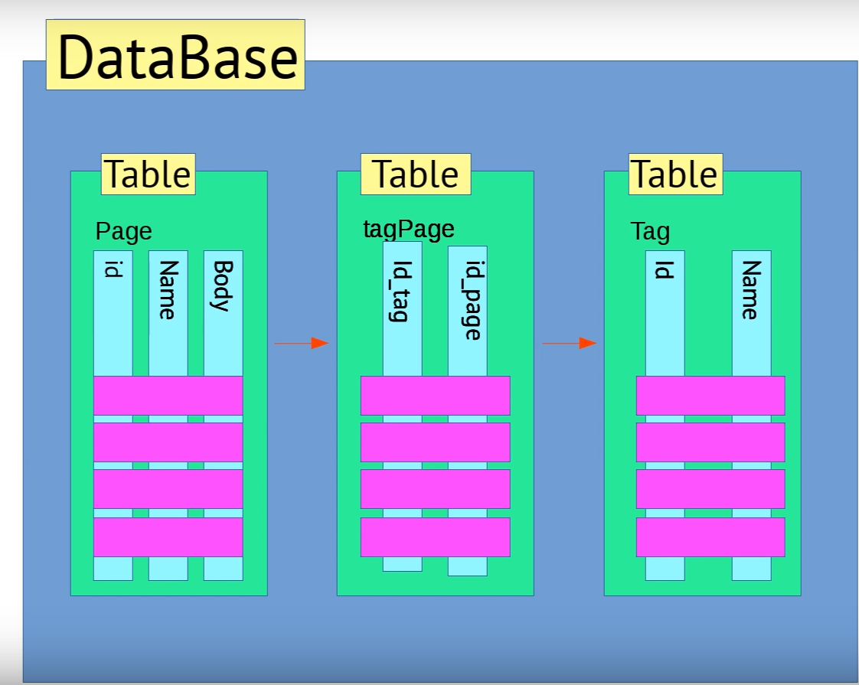
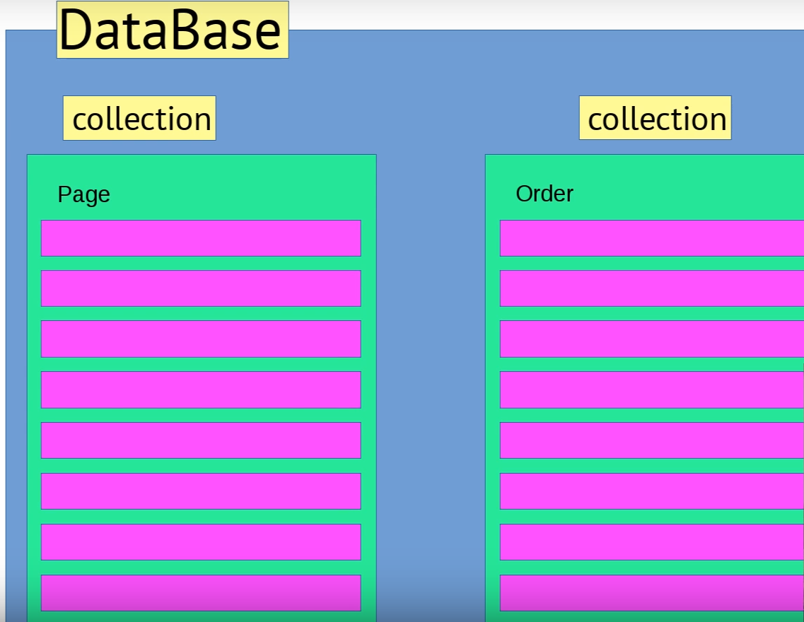
SQL
NoSQL

Slide 3
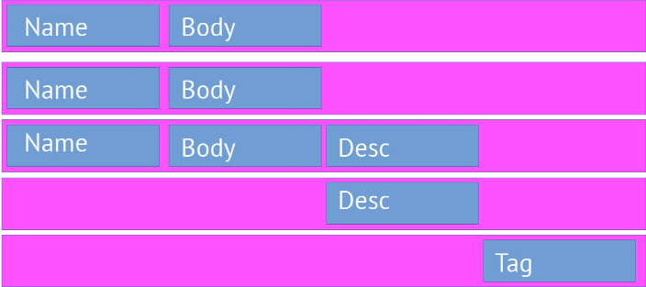
What is NoSQL?
Stands for Not Only SQL.
Term was redefined by Eric Evans after Carlo Strozzi.
Class of non-relational data storage systems.
Do not require a fixed table schema nor do they use the concept of joins.

Slide 4
Need of NoSQL
Explosion of social media sites (Facebook, Twitter, Google etc.) with large data needs. (Sharding is a problem)
Rise of cloud-based solutions such as Amazon S3 (simple storage solution).
Just as moving to dynamically-typed languages (Ruby/Groovy), a shift to dynamically-typed data with frequent schema changes.
Expansion of Open-source community.
NoSQL solution is more acceptable to a client now than a year ago.

Slide 5
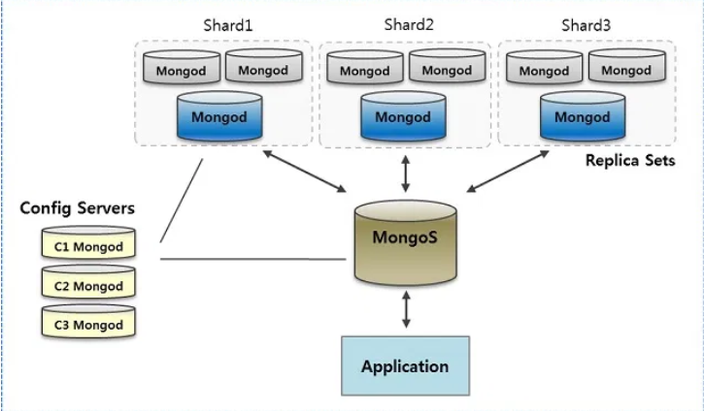
Sharding

Slide 6
What is not provided by NoSQL
Joins
Group by
ACID transactions
SQL
Integration with applications that are based on SQL

Slide 7
NoSQL Types
NoSQL database are classified into four types:
• Key Value pair based
• Column based
• Document based
• Graph based

Slide 8
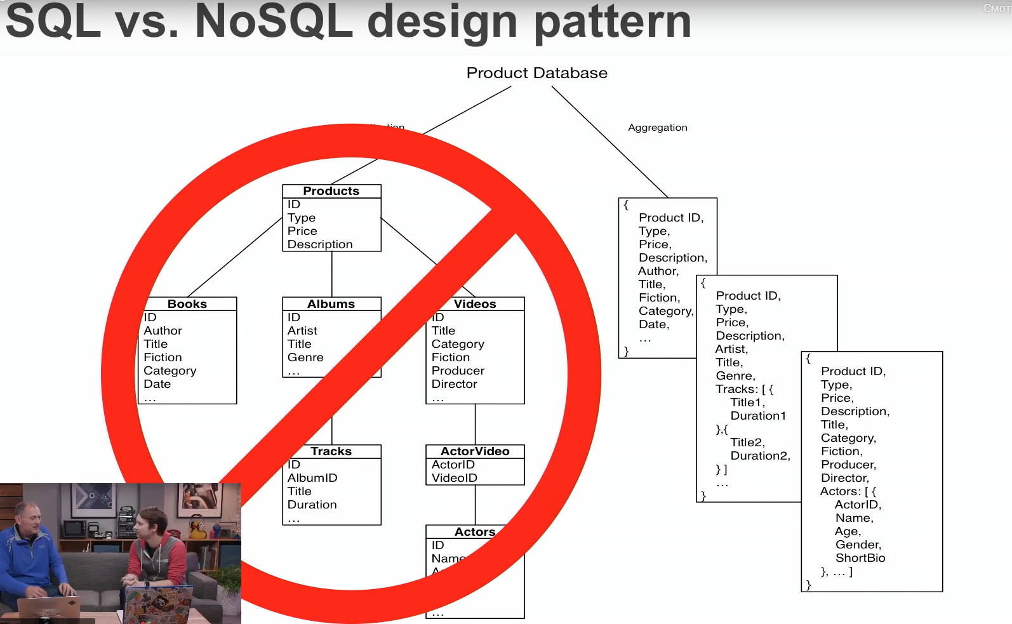
MongoDB

Slide 9
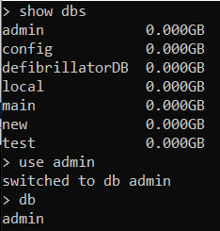
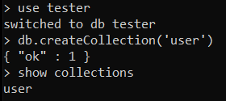
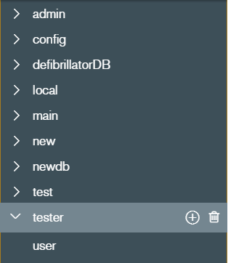
Let start work with MongoDB!

Slide 10
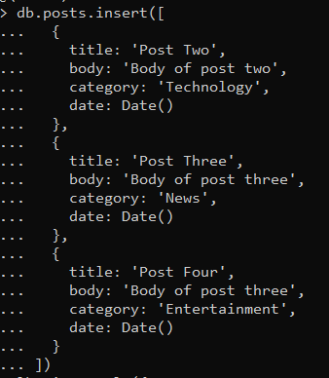
CREATE orerations

Slide 11
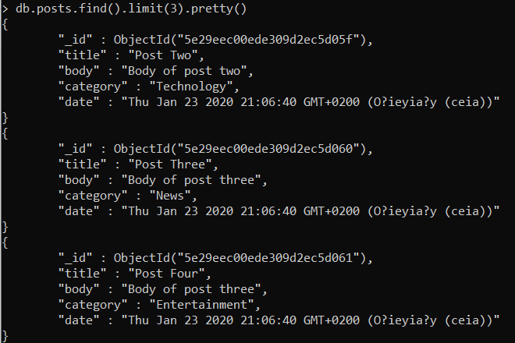
READ orerations

Slide 12
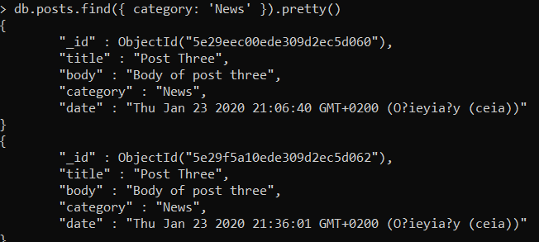
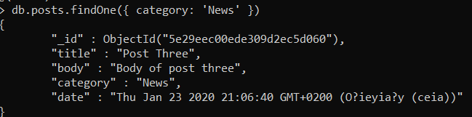
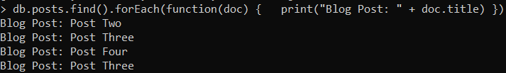
READ orerations

Slide 13
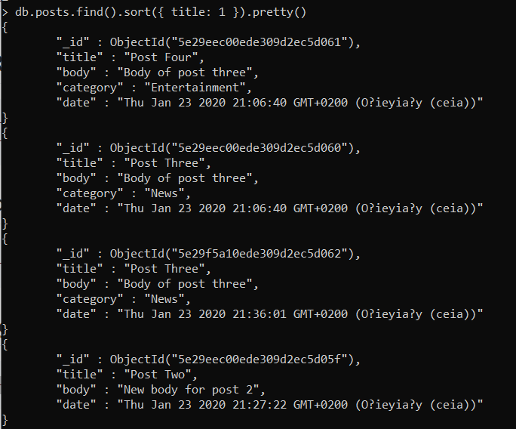

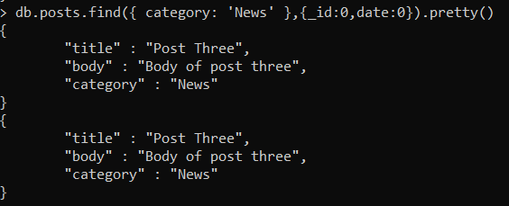
READ orerations

Slide 14
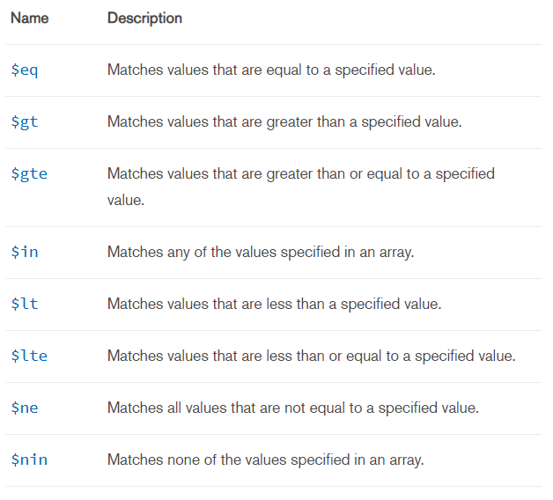
Comparison Query Operators
db.posts.find({ views: { $gt: 2 } })
db.posts.find({ views: { $gte: 7 } })
db.posts.find({ views: { $lt: 7 } })
db.posts.find({ views: { $lte: 7 } })

Slide 15
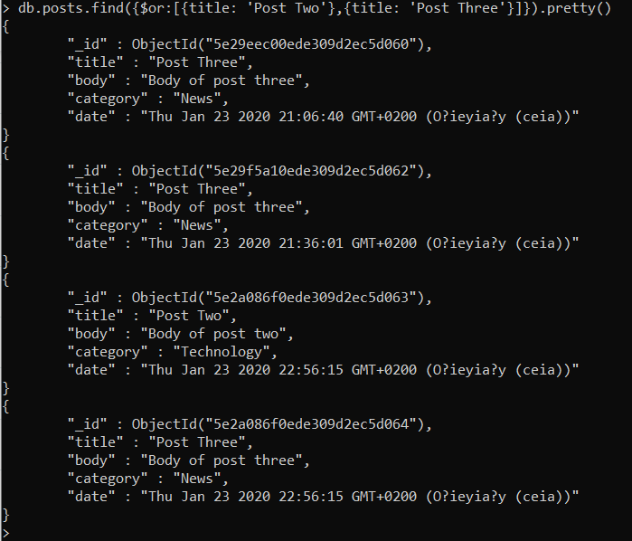
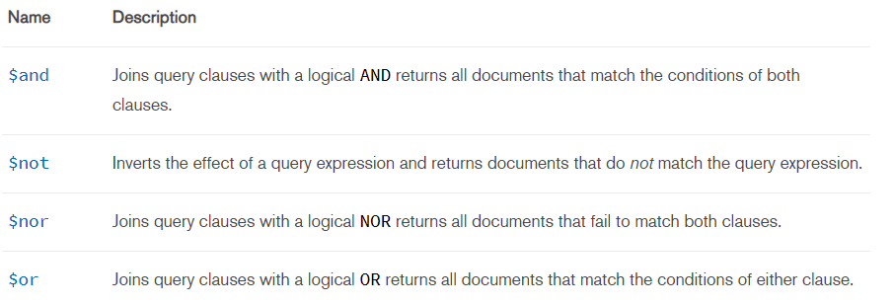
Logical Query Operators

Slide 16
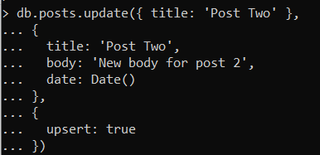
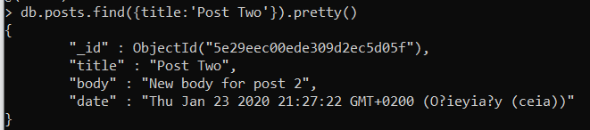
UPDATE operations

Slide 17
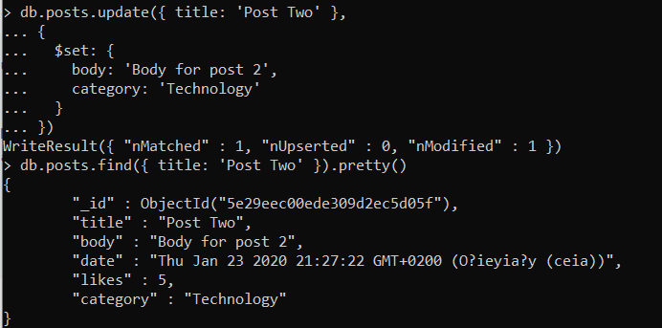
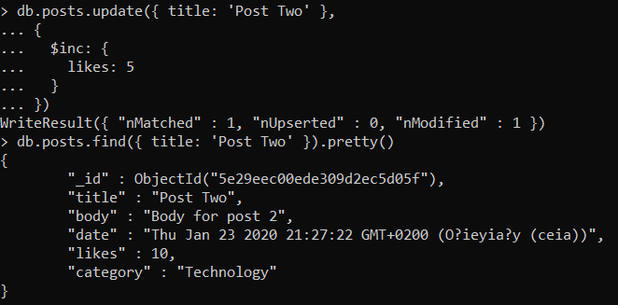
UPDATE operations (using operators)

Slide 18
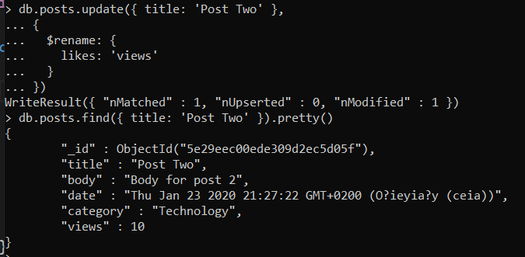
UPDATE operations (using operators)

Slide 19
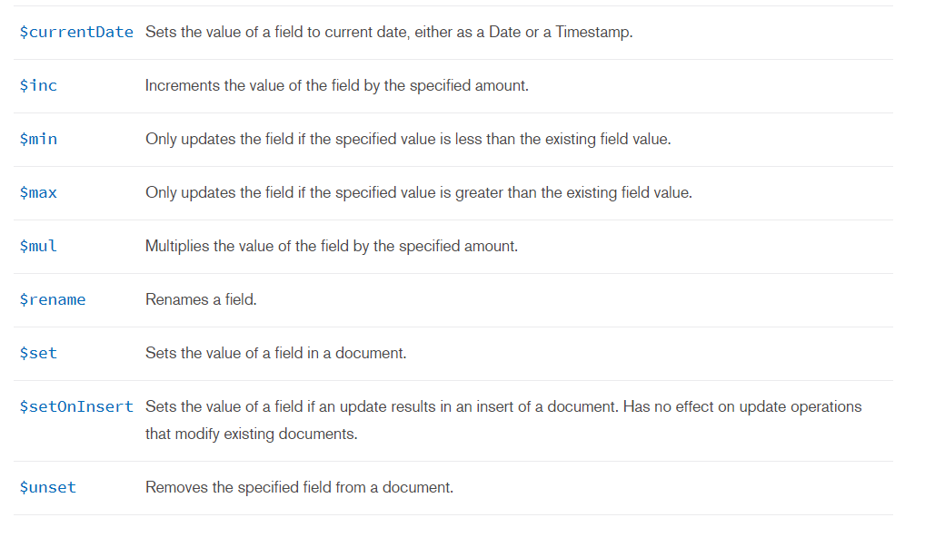
Field Update Operators

Slide 20

DELETE operations

Slide 21
USED LINKS
https://proselyte.net/tutorials/mongodb/sharding/
https://habr.com/ru/post/152477/
https://www.youtube.com/watch?v=pWbMrx5rVBE
https://habr.com/ru/company/oleg-bunin/blog/309330/
https://www.mongodb.com/nosql-inline
https://www.youtube.com/watch?v=-56x56UppqQ

