Slide 1
Syntax. Part1
Keywords, Operators, Expressions, Statements, Control Flow
by Taras Boichuk

Slide 2
Keywords
Keywords are reserved words in JavaScript which you cannot use to name the variables labels or function names. Here are a total of 63 keywords which JavaScript provides the programmers. All of them are shown in the next slide

Slide 3
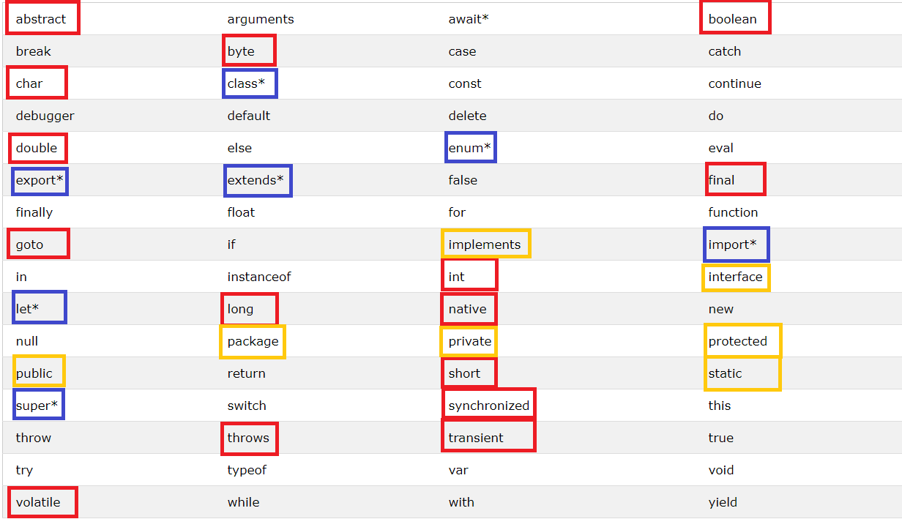

Slide 4
yield*
function* generateSequence() {
yield 1;
yield 2;
return 3;
}
let generator = generateSequence()
let two = generator.next();
console.log(two)//{value: 1, done: false}
two = generator.next();
console.log(two)//{value: 2, done: false}
two = generator.next();
console.log(two)//{value: 3, done: false}
two = generator.next();
console.log(two)//{value: undefined, done: true}
two = generator.next();
console.log(two)//{value: undefined, done: true}

Slide 5
Keywords as IdentifierName
a.import
a["import"]
a = { import: "test" }
FunctionDeclaration
FunctionExpression
VariableDeclaration
function import() {} // неправильно
let import // неправильно

Slide 6
JavaScript Operators
JavaScript includes operators as in other languages. An operator performs some operation on single or multiple operands (data value) and produces a result.
<Left operand> operator <right operand>
<Left operand> operator
Arithmetic Operators
Comparison Operators
Logical Operators
Assignment Operators
Conditional Operators

Slide 7
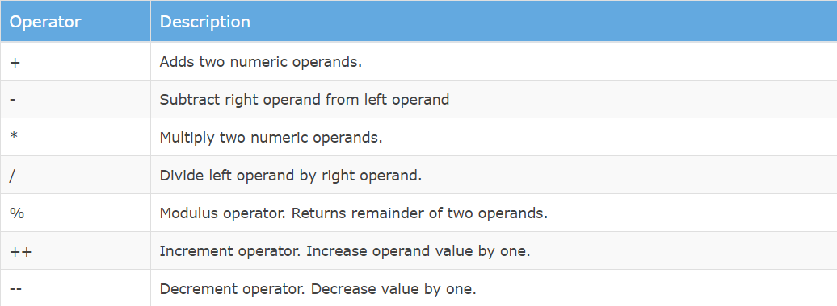
Arithmetic Operators

Slide 8
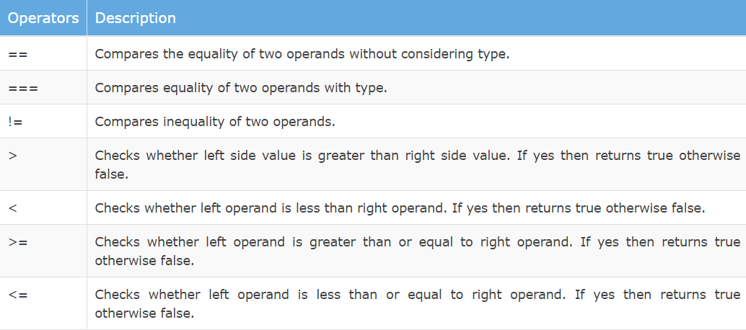
Comparison Operators

Slide 9
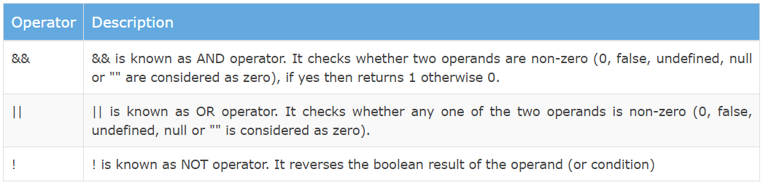
Logical Operators

Slide 10
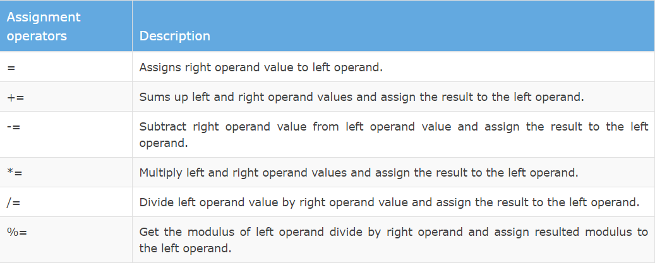
Assignment Operators

Slide 11

Ternary Operator
JavaScript includes special operator called ternary operator :? that assigns a value to a variable based on some condition. This is like short form of if-else condition.

Slide 12
Expression
Any unit of code that can be evaluated to a value is an expression. Since expressions produce values, they can appear anywhere in a program where JavaScript expects a value such as the arguments of a function invocation. As per the MDN documentation, JavaScript has the following expression categories.

Slide 13
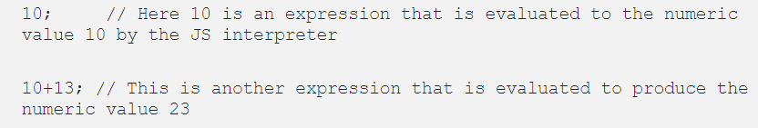
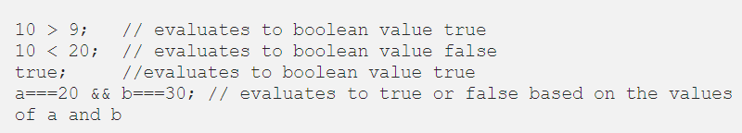
Expression categories
Arithmetic Expressions
String Expressions
Logical Expressions

Slide 14
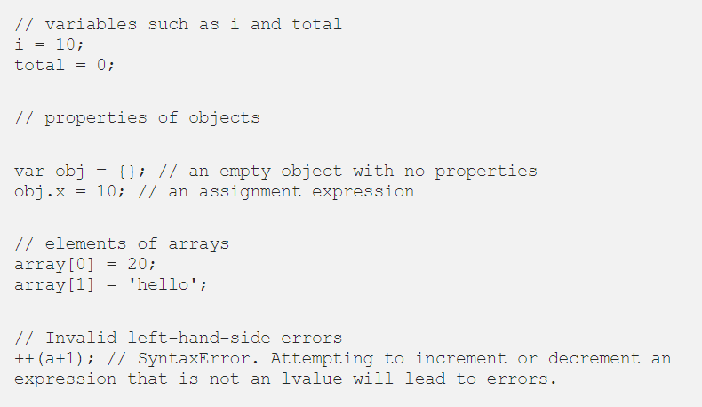
Left-hand-side Expressions/Assignment Expressions
Also known as lvalues, left-hand-side expressions are those that can appear on the left side of an assignment expression. Examples of left-hand-side expressions include the following

Slide 15
Statements
A computer program is a list of "instructions" to be "executed" by a computer.
In a programming language, these programming instructions are called statements.
A JavaScript program is a list of programming statements.
JavaScript statements are composed of:
Values, Operators, Expressions, Keywords, and Comments.
var x, y, z; // Statement 1
x = 5; // Statement 2
y = 6; // Statement 3
z = x + y; // Statement 4
The statements are executed, one by one, in the same order as they are written.

Slide 16
Statements category
Declaration Statements
Expression Statements
Conditional Statements(Conditional statements execute statements based on the value of an expression. Examples of conditional statements includes the if..else and switch statements.)
Loops and Jumps (Looping statements includes the following statements: while, do/while, for and for/in. Jump statements are used to make the JavaScript interpreter jump to a specific location within the program. Examples of jump statements includes break, continue, return and throw.)

Slide 17
Сontrol flow
The control flow is the order in which the computer executes statements in a script.
Code is run in order from the first line in the file to the last line, unless the computer runs across the (extremely frequent) structures that change the control flow, such as conditionals, exeptions and loops.

Slide 18
USED LINKS
https://developer.mozilla.org/en-US/docs/Glossary/Control_flow
https://developer.mozilla.org/uk/docs/Web/JavaScript/Guide/Control_flow_and_error_handling
https://developer.mozilla.org/uk/docs/Web/JavaScript/Guide/%D0%92%D0%B8%D1%80%D0%B0%D0%B7%D0%B8_%D1%82%D0%B0_%D0%BE%D0%BF%D0%B5%D1%80%D0%B0%D1%82%D0%BE%D1%80%D0%B8
https://medium.com/launch-school/javascript-expressions-and-statements-4d32ac9c0e74
https://www.w3schools.com/js/js_statements.asp

