Slide 1
CSS Grid
by Taras Boichuk

Slide 2
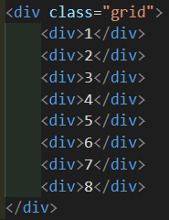
WHAT IS CSS GRID?
CSS Grid Layout is the most powerful layout system available in CSS. It is a 2-dimensional system, meaning it can handle both columns and rows, unlike flexbox which is largely a 1-dimensional system. You work with Grid Layout by applying CSS rules both to a parent element (which becomes the Grid Container) and to that element's children (which become Grid Items

Slide 3
OR
display: grid;
display: inline -grid;

Slide 4
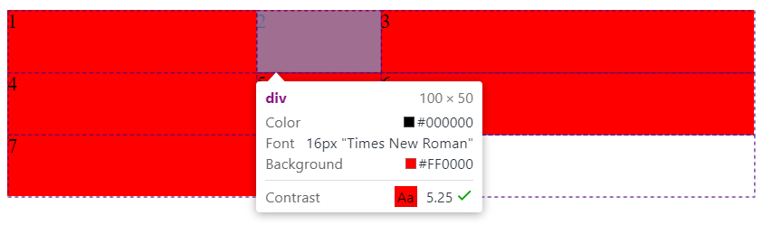
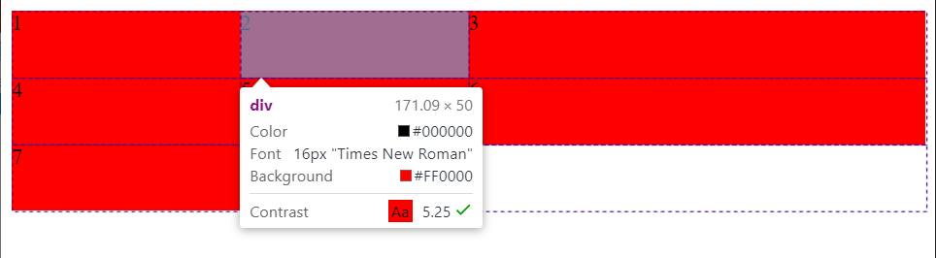
grid-template-columns:
.grid{
display: grid;
grid-template-columns: 200px 100px 300px;
grid-auto-rows: 50px;
}
.grid{
display: grid;
grid-template-columns: 1fr 1fr 2fr;
grid-auto-rows: 50px;
}

Slide 5
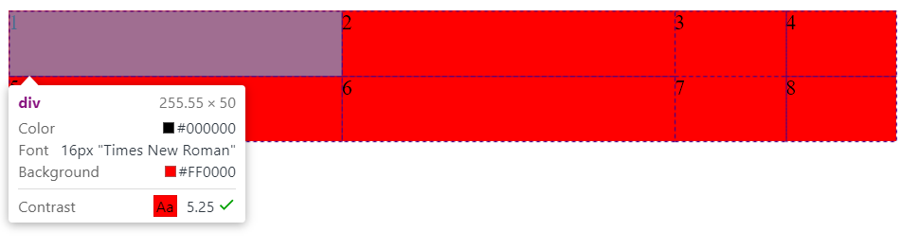
repeat()
==
grid-template-columns: repeat(2, 3fr) repeat(2, 1fr);
grid-template-columns: 3fr 3fr 1fr 1fr;

Slide 6
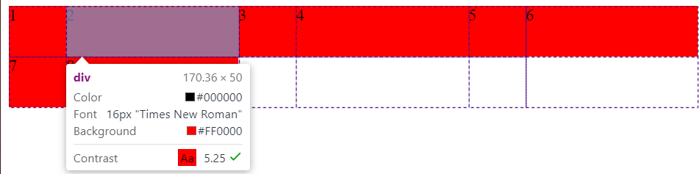
repeat()
grid-template-columns: repeat(3,1fr 3fr);

Slide 7
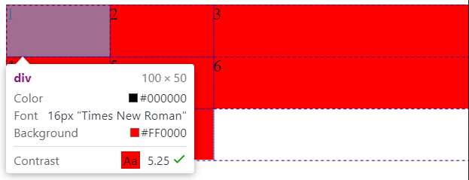
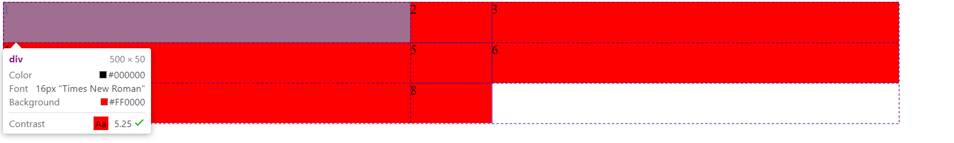
minmax()
grid-template-columns: minmax(100px,500px) 100px 500px ;

Slide 8
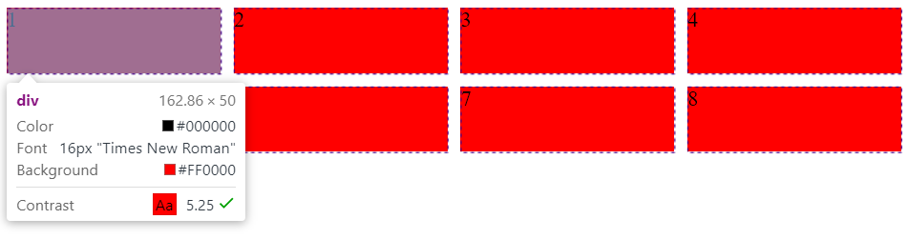
GRID GAP
==
==
==
grid-column-gap: 10px;
grid-row-gap: 10px;
grid-gap: 10px;
column-gap: 10px;
row-gap: 10px;
gap: 10px;

Slide 9
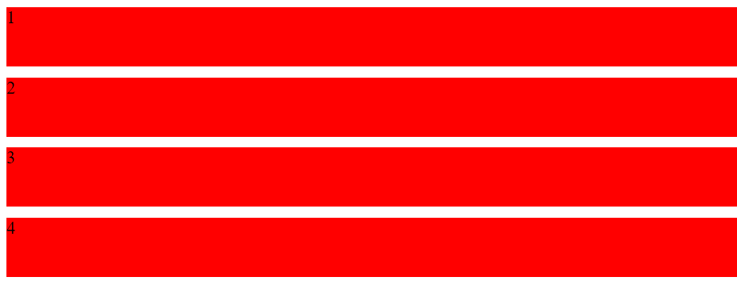
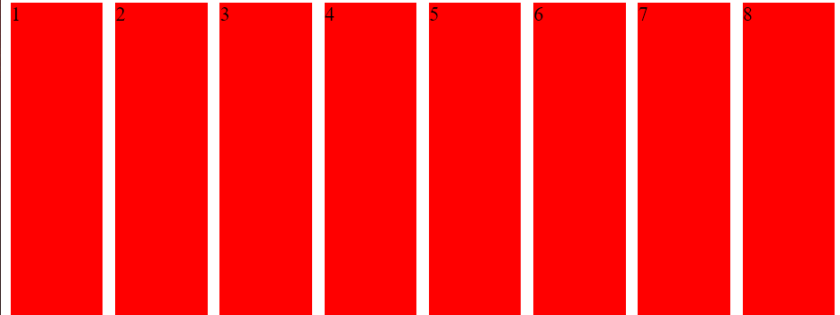
grid-auto-flow
row (default)
column

Slide 10
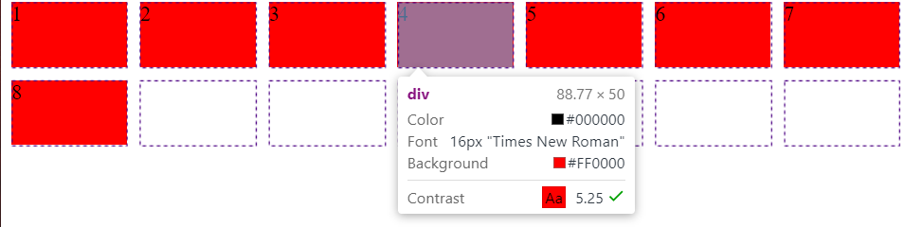
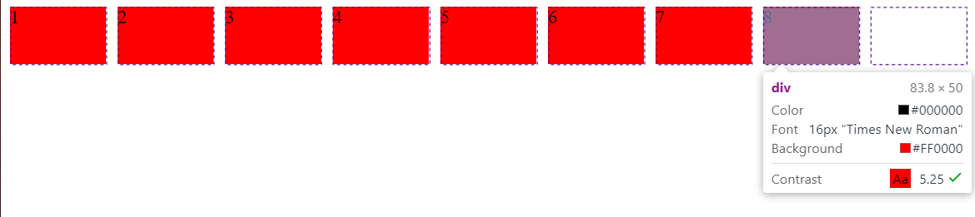
Keywords: auto-fill
grid-template-columns: repeat(auto-fill,minmax(80px,auto));

Slide 11
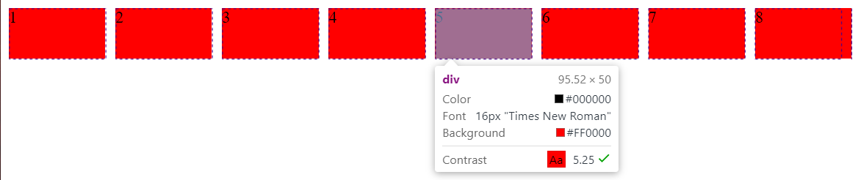
Keywords: auto-fit
grid-template-columns: repeat(auto-fit,minmax(80px,auto));

Slide 12
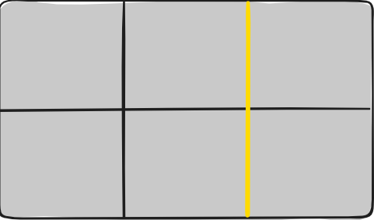
GRID LINE
The dividing lines that make up the structure of the grid. They can be either vertical ("column grid lines") or horizontal ("row grid lines") and reside on either side of a row or column. Here the yellow line is an example of a column grid line.
grid-template-rows: [line1] 50px [line2] 50px [line3];
grid-template-columns: [line1] 50px [line2] 50px [line3] 50px;

Slide 13
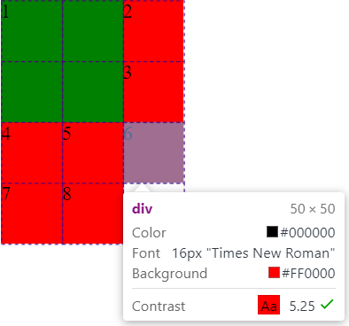
grid-column/grid-row
.grid div:nth-child(1){
background-color: green;
grid-column: line1 / line3;
grid-row: line1 / line3;
}
==
grid-column-start: line1; grid-column-end: line3;
==
grid-column: 1 / 3;

Slide 14
grid-template-areas
grid-template-areas Defines a grid template by referencing the names of the grid areas which are specified with the grid-area property. Repeating the name of a grid area causes the content to span those cells. A period signifies an empty cell. The syntax itself provides a visualization of the structure of the grid.

Slide 15
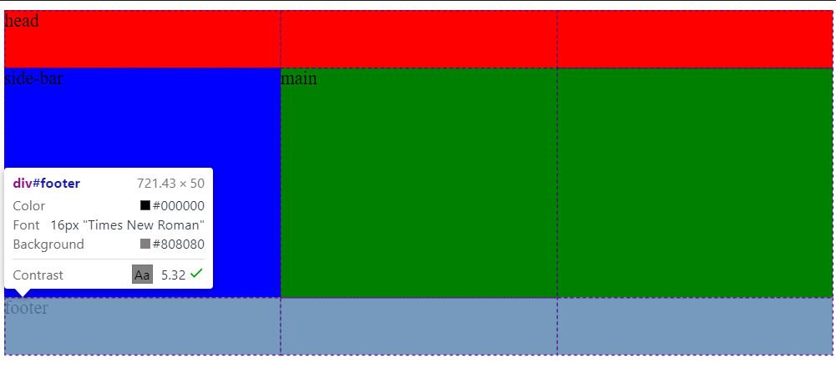
grid-template-areas
.grid {
display: grid;
grid-template-columns: 1fr 1fr 1fr;
grid-template-rows: 50px 200px 50px;
grid-template-areas:
"head head head"
"side-bar main main"
"footer footer footer";
}
#head{
grid-area: head;
background-color: red;
}
#main{
grid-area: main;
background-color: green;
}
#footer{
grid-area: footer;
background-color: gray;
}
#side-bar{
grid-area: side-bar;
background-color: blue;
}
<div class="grid">
<div id="head">head</div>
<div id="main">main</div>
<div id="footer">footer</div>
<div id="side-bar">side-bar</div>
</div>

Slide 16
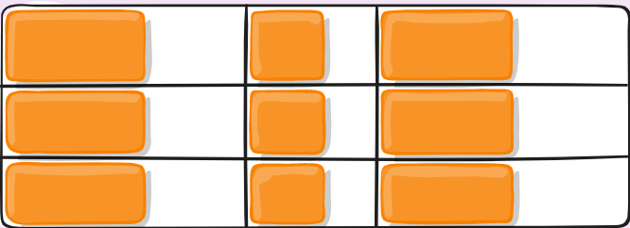
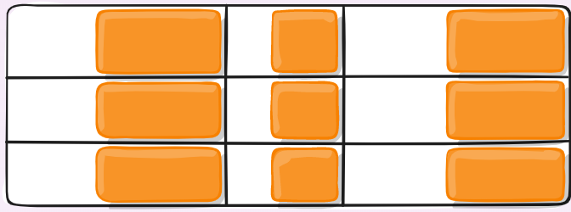
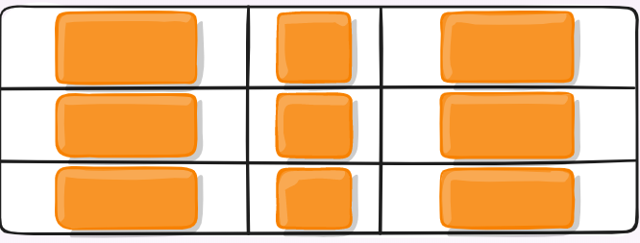
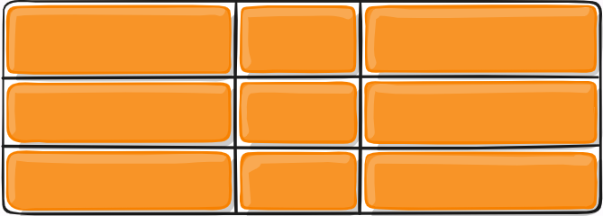
justify-items/align-items
start - aligns items to be flush with the start edge of their cell
end - aligns items to be flush with the end edge of their cell
center - aligns items in the center of their cell
stretch - fills the whole width of the cell (this is the default)
*place-items

Slide 17
justify-content/align-content
start - aligns the grid to be flush with the start edge of the grid container
end - aligns the grid to be flush with the end edge of the grid container
center - aligns the grid in the center of the grid container
stretch - resizes the grid items to allow the grid to fill the full width of the grid container
space-around - places an even amount of space between each grid item, with half-sized spaces on the far ends
space-between - places an even amount of space between each grid item, with no space at the far ends
space-evenly - places an even amount of space between each grid item, including the far ends
*place-content

Slide 18
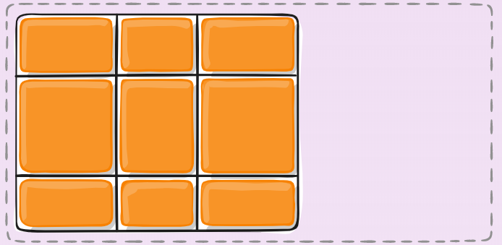
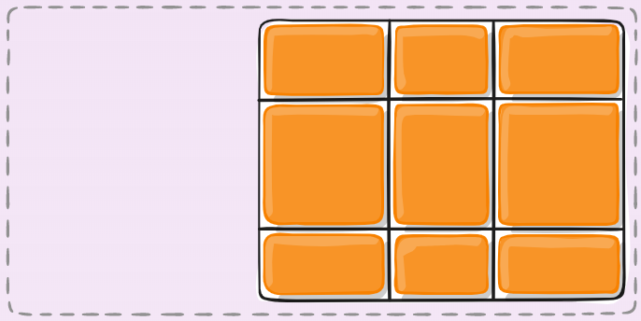
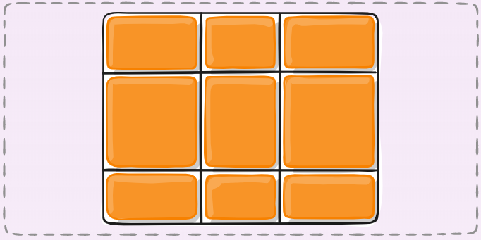
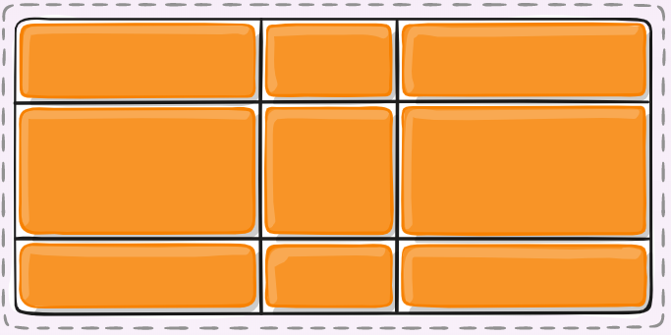
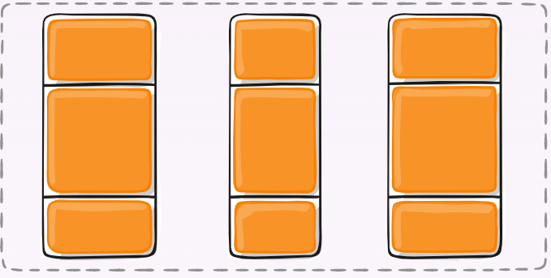
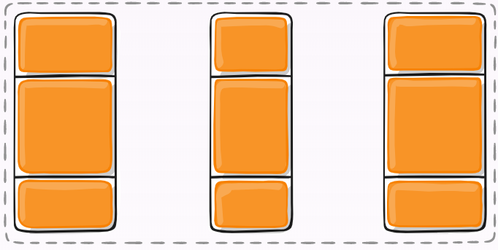
justify-content:start
justify-content:end
justify-content:center
justify-content:stretch
justify-content:space-around
justify-content:space-between

Slide 19
USED LINKS
https://css-tricks.com/snippets/css/complete-guide-grid/
https://www.w3schools.com/css/css_grid.asp
https://www.youtube.com/watch?v=-fDqBEjfzGo
https://www.youtube.com/watch?v=jV8B24rSN5o

