Slide 2

iamsaravieira.com
@NikkitaFTW
hey@iamsaravieira.com

Slide 3
Building Layouts in CSS
Tables
Floats
Inline Block

Slide 4
FLEXBOX

Slide 5
Browser Support
ALL the browsers !
(Yes , even mobile and IE)

Slide 6
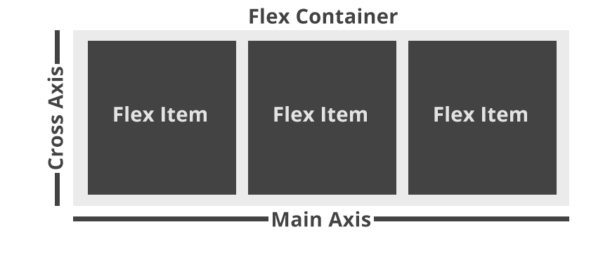
Flexbox Structure

Slide 7
Flexbox Recap
CSS Module Built Specifically for Layouts
Centre Alignment
Order Control
Control by Flex Parents
RTL Compatible

Slide 8
CSS GRID

Slide 9
Browser Support
IE 11 & Edge
Chrome , Opera and Firefox through Flags
(http://caniuse.com/#feat=css-grid)

Slide 10
CSS Grid Recap
CSS Module Built Specifically for Grid Design
Order Control
No need for margins
Responsible

