Slide 1





GiNet: Integrating Sequential and Context-Aware Learning for Battery Capacity Prediction IEEE VTC Spring 2025
${Sara Sameer}^{1}$(Presenter), ${Wei Zhang}^{1}$, ${Xin Lou}^{1}$, ${Qingyu Yan}^{2}$, ${Terence Goh }^{3}$, ${Yulin Gao }^{3}$
Singapore Institute of Technology
Nanyang Technological University
ST Engineering
Paper
Code
Notes:
- f

Slide 2
Table of Content
Why Batteries Matter More Than Ever?
Why State of Charge is Crucial?
Research motivation for Transformers Model
GINet
Informers – Embedding
Informers – Architecture
Experimental Setup
Results
Sensitivity Analysis – Encoder Decoder Layers
Why Prob Sparse Attention?
Directions for Future Research

Slide 3

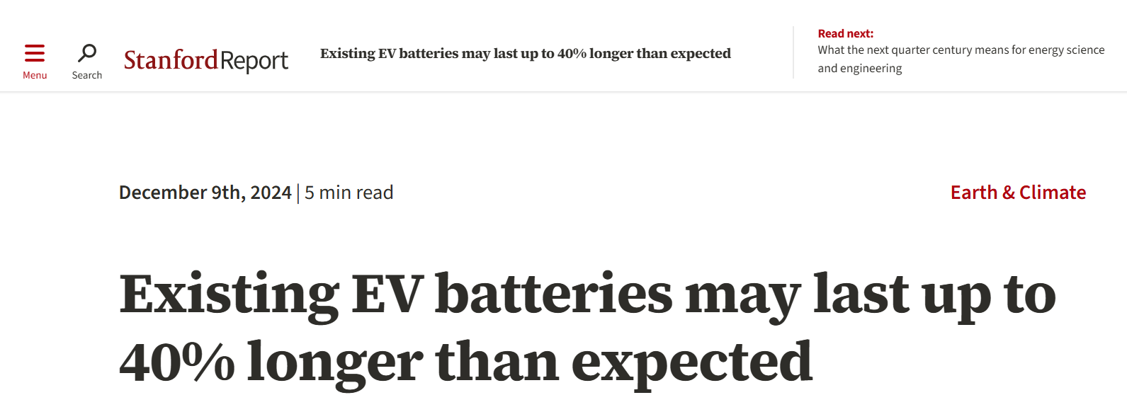
Why Batteries Matter More Than Ever?
Headline Highlight: Existing EV Batteries may last upto 40% longer than expected - Standford News, 2024
Electric Vehicles, Smartphones, Solar energy – all depend on battery reliability.
Lower battery replacement = lower total cost of ownership.
Battery estimation models must adapt to real-world variations.
Need models that understands the real-time driving and battery degradation.
Notes:
- Let's start with something we all interact with which is batteries. from smartphones, to electric vehicles, everything has batteries and as we are moving forward towards a cleaner and safer version of energy, the dependence on battery is only going to increase.
But here’s the catch: batteries don’t last forever and its health does not always degrade as we expect.
In the recent study from Standford, found that EV batteries may last up to 40% longer than expected when used in real-world conditions. That’s huge.
It tells us that our existing models are not able to keep up with real wordl scenarios and we need more robust models that think in terms of real-driving sceanorios.

Slide 4
Why State of Charge is Crucial?
State of Charge (SoC) estimation is crucial for:
Optimizing battery performance
Preventing overcharge or deep discharge,
Maximizing the battery’s life.
Conventional approaches like Support Vector Regressors (SVR), Kalman filters and LSTM suffer from inability to capture temporal patterns and dependencies in high dimensional time-series data.
Panasonic 18650PF Li-ion Battery Data for SoC estimation
Attribute | Description
Battery Type | 2.9Ah Panasonic 18650PF cell
Charging Profile | Cycled at 1C rate at 25degC
Discharging Temperatures | 25degC, 10degC, 0degC, -10degC, and -20degC
Drive Cycles Profiles | Cycle 1, Cycle 2, Cycle 3, Cycle 4, US06, HWFET, UDDS, LA92, NN
Features | Current(I), Voltage(V), Temperature(T)
Notes:
The critivcal part f any battery health management system is State of Charge which basically tells us how much charge is left in the battery before it runs out. It is important to measure soc accurately to optimize battery performance, prevent over charge/discharge. Now, methods like Kalman filters and Support Vector Regression have been used before. But they rely on strong assumptions about battery dynamic and struggle to perform well on real-world dataets.
For our experiment, we have used the publicly available dataset which is Panasonic. It has realistic driving profiles and ambient temperatures across which we can train and test our model. We have primarlity used three features for our experiment which are current, voltage ans termpatyre, These features are readily available and measurable in real-time

Slide 5
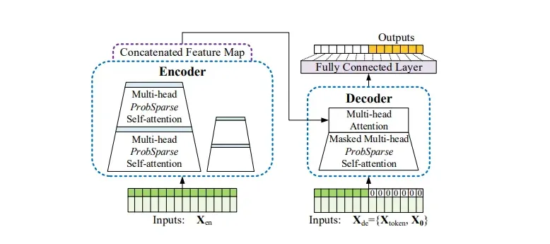
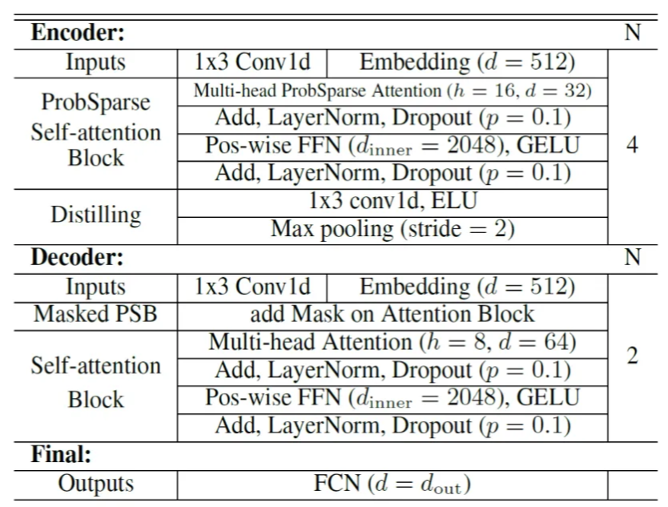
Research motivation for Transformers Model
Transformers:
Capture long-range dependencies
No need for recurrent layers
Suited for complex temporal patterns
Informer: Efficient Transformer Variant
Handles long sequences
Uses ProbSparse attention
Optimized for high-dimensional time series
Notes:
So our motivato is to build a model that can capture the compelx dependices in the dataset and this is where trasnformers comes in. Tramformer has the ability to capture logn term sequnces in the datatset, without the need of recurrent layers which makes it faster. But still as the data grows, the key query compuataion becomes expensive. So to address this limiataion, we have used Informers (a variant of tarsnformers) for this application. Informer is just an efficient version of tarsnformer with two key benefits which we will discuss in the susbesuqnty slides.

Slide 6



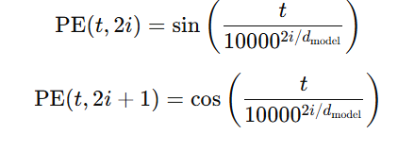
Informers – Embedding
(1)
Embeddings:
Value Embedding (Token Embedding): Converts I, V and T into higher dimensional data.
Positional Embedding: It encodes the position of each time step in the sequence.
Temporal Embedding: It encodes the time stamp into time aware encoding.
(2)
Notes:
Like tarsnformers, Informers also need positional embedding to retain the sequenc estructrue. But in addition to just positomal embedding which creates unique positional encoding for each timestep, we have added two more emebddings to enchnace tge eaftrue reprensetaion. The first one is value embedding that takes the raw data and convert it into high dimenstional vectors using 1d convolutional layers to add conext information in addition to the positional information. Lastly , tenoroal embedding adds cyclical information that what time ( in untis of seconds or hours) was the data captured. This helops to retains the cyclical pattern of the datatset.

Slide 7




Informers - Architecture
(3)
OR
(4)
(5)
🔑 Input embeddings are transformed into queries (Q) and keys (K) using learned weights - These define how much attention each input should give to others
🧠 Instead of computing attention for all key-value pairs, ProbSparse Attention samples only the most relevant ones, based on probability
- Making attention faster and lighter for long sequences
🔁 Instead of using a large model during inference, distillation trains a student model to mimic the behavior of a powerful teacher model
- Preserving accuracy while reducing computational cost
Notes:
Here is whats happening under the hood:
After getting the concatenated input from the embedding layers. We project the input into the attention layer and the attention s te crux of the Informers. Unlike tardtional fulla tetntion mechanism where all input points attends to all input points forming a dense n^2 matrix. Probsparse attention brings a unique concept of fosuing on only ifnormative timesteps in the input based on its learned probability. So it only computes attention score of top K important time steps which significantlyyu reduced the time compuataion of the model.
Another benefit that Informers offers is the use of knwoeldege distallition in which knowledge is tarnsfered from a large model to a smaller model to make it deployable in our case, distilalaiton is an internal architeture feature in Informers. We used ditailaltion operation bwtreen the encoding layers to reduce the input size intohalf as it moves froards while retaining teb important information. This reduced the overall memory usage and make it deployable. This is critical for running on embedded systems inside EVs

Slide 8
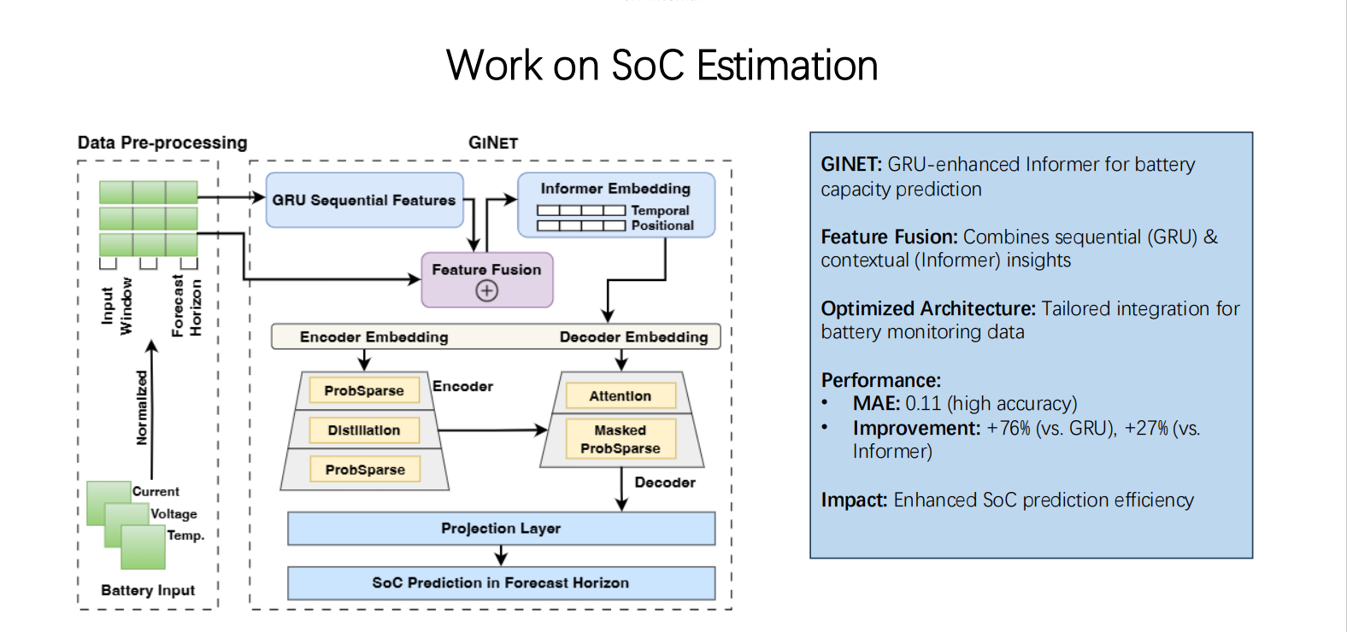
GINet
Notes:
So based on all of our insights, we developed Ginet which basically comroises of GRU and informer network. Ginet takes three battery features and then project it to GRU for feature enchancment. The reason for using GRU prior to informer is that it can capture short term dependencies in the dataset and make it more temporal aware. GRU layer is a ligthwiueght choice which helps in smothting the short term termproal nosie acting like a soft filter preparing our model for a deep temporal mdoeling. This archietcure is designed for robust and effective rpeiccton of SOC.

Slide 9
Experimental Setup
d_model | n_heads | e_layers | d_layers | Drop out | Learning Rate | Epoch | Batch Size
512 | 8 | 2 | 1 | 0.1 | 0.0001 | 20 | 32
Training Data: 130547
Validation: 32637
Test: 81680
Training Data
-10C to 25C
Profiles: Mix 1-4,US06
Informers Network
Compare Performance
RMSE, MAE
Testing Data
-10C to 25C
Profiles: LA92, NN
Test Network
Notes:
Testing and evaluation -> profiles, unseen profiles in testing data to micmic rela world scenario where every test case is not knowne. The table in red shows the hyerparapmetrrs that we have used to generate the result and to evelaute the results we have used RMSE and MAE as the eprofmmance mreteric. The lower the better.

Slide 10
Results
Forecast Horizon |  | 25 |  |  | 10
Input Length |  | 200 | 100 | 10 | 200 | 100 | 10
LSTM | RMSE ↓ | 0.30 | 0.31 | 0.43 | 0.29 | 0.30 | 0.42
 | MAE ↓ | 0.26 | 0.27 | 0.36 | 0.26 | 0.27 | 0.33
GRU | RMSE ↓ | 0.27 | 0.29 | 0.30 | 0.26 | 0.28 | 0.29
 | MAE ↓ | 0.24 | 0.25 | 0.27 | 0.24 | 0.25 | 0.25
Informers | RMSE ↓ | 0.20 | 0.21 | 0.22 | 0.19 | 0.21 | 0.21
 | MAE ↓ | 0.18 | 0.18 | 0.20 | 0.17 | 0.17 | 0.18
GINET | RMSE ↓ | 0.15 | 0.18 | 0.22 | 0.14 | 0.16 | 0.17
 | MAE ↓ | 0.13 | 0.15 | 0.19 | 0.11 | 0.14 | 0.15
Notes:
Finally, so what do we get from our GINET?
We compare our model with the baseline LSTM and the standalone GRU and Informers. GiNet consistently achieves lower errors — and more importantly, it maintains performance under temperature variation and unseen driving patterns. We can see that when we increase the input size, and the forecast window, the conventional mdoels struggles however our GINET continues to achieve good results.

Slide 11
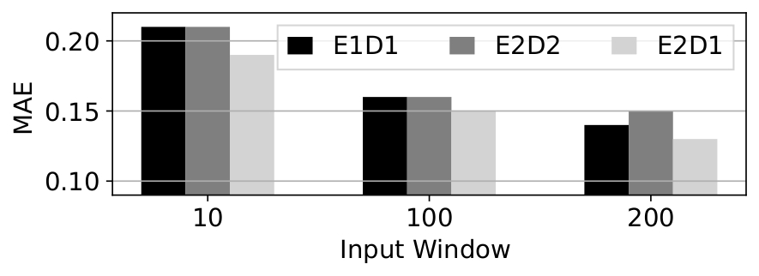
Sensitivity Analysis – Encoder Decoder Layers
Notes:
To better understand how architectural depth affects performance, we conducted a sensitivity analysis on different encoder-decoder configurations.
Specifically, we tested three setups:
E1D1 – 1 encoder and 1 decoder layer (black),
E2D2 – 2 encoders and 2 decoders (dark grey),
And E2D1 – 2 encoders and 1 decoder (light grey).

Slide 12
Why Prob Sparse Attention?
Attention | Distillation | MAE | RMSE | Time
ProbSparse | True | 0.15 | 0.18 | Pros Sparse takes 1/3th of training time than Full attention -
ProbSparse | False | 0.16 | 0.19
Full Attention | True | 0.16 | 0.19
Full Attention | False | 0.18 | 0.21
Notes:
Expiemented with both attention mdoels, and the distillation method -> model optimize

Slide 13
Directions for Future Research
Integrate physical models to fuse domain knowledge
Quantify prediction confidence with uncertainty aware forecasting.
Optimize the model for on device SoC estimation.
Notes:
So where are we heading next? There are two dimensions that we are interested to explore, one is to use physical models like ECM and battery physics to understand the internal mechanics of battery, and our second aspiration is to develop lightweight models that can be deployed in real-time for that we can currently building minimal parameter models. That was the quick walkthrough of my work, if you have any questions or comments, then please do share.

Slide 14
Conclusion and Upshots
GiNet — Transformer for battery health
Learns temporal + contextual patterns
Uses ProbSparse attention & distillation
Achieves accuracy, efficiency, robustness
Validated across diverse profiles & temperatures
Enables real-world SOC/SOH estimation
Notes:
So where are we heading next? There are two dimensions that we are interested to explore, one is to use physical models like ECM and battery physics to understand the internal mechanics of battery, and our second aspiration is to develop lightweight models that can be deployed in real-time for that we can currently building minimal parameter models. That was the quick walkthrough of my work, if you have any questions or comments, then please do share.

Slide 15
Any Questions? Thank You!

