Slide 1

Github Actions
Agile Methodology - SCE

Slide 2
Collabrator’s
Aishwarya Shukla
Anish Kekane
324002
324014
Sakshi Aherkar
Bhushan Thombare
324004
324021

Slide 3

Agenda
Understanding Github Actions
Customising Actions
Essential Customising Features
Usuage, Limits, Billing and Administration

Slide 4
Understanding Github Actions
1

Slide 5

Overview
GitHub Actions is a continuous integration and continuous delivery (CI/CD) platform that allows you to automate your build, test, and deployment pipeline. You can create workflows that build and test every pull request to your repository, or deploy merged pull requests to production.
GitHub Actions goes beyond just DevOps and lets you run workflows when other events happen in your repository. For example, you can run a workflow to automatically add the appropriate labels whenever someone creates a new issue in your repository.
GitHub provides Linux, Windows, and macOS virtual machines to run your workflows, or you can host your own self-hosted runners in your own data center or cloud infrastructure.

Slide 6
Components of Github Actions
Workflows
A workflow is a set of automated tasks that are executed in response to an event in a repository, such as a push or pull request. Workflows are defined using YAML syntax and can be customized to suit the needs of the project.
Workflows are defined in the .github/workflows directory in a repository, and a repository can have multiple workflows, each of which can perform a different set of tasks.
For example, you can have one workflow to build and test pull requests, another workflow to deploy your application every time a release is created, and still another workflow that adds a label every time someone opens a new issue.
Runner
A runner is a server that runs your workflows when they're triggered. Each runner can run a single job at a time. GitHub provides Ubuntu Linux, Microsoft Windows, and macOS runners to run your workflows; each workflow run executes in a fresh, newly-provisioned virtual machine. GitHub also offers larger runners, which are available in larger configurations

Slide 7
Components of Github Actions
Events
An event is a specific activity in a repository that triggers a workflow run. For example, activity can originate from GitHub when someone creates a pull request, opens an issue, or pushes a commit to a repository. You can also trigger a workflow to run on a schedule, by posting to a REST API, or manually.
Actions
An action is a custom application for the GitHub Actions platform that performs a complex but frequently repeated task. Use an action to help reduce the amount of repetitive code that you write in your workflow files. An action can pull your git repository from GitHub, set up the correct toolchain for your build environment, or set up the authentication to your cloud provider.
You can write your own actions, or you can find actions to use in your workflows in the GitHub Marketplace.

Slide 8
Components of Github Actions
Jobs
A job is a set of steps in a workflow that is executed on the same runner. Each step is either a shell script that will be executed, or an action that will be run. Steps are executed in order and are dependent on each other. Since each step is executed on the same runner, you can share data from one step to another. For example, you can have a step that builds your application followed by a step that tests the application that was built.
You can configure a job's dependencies with other jobs; by default, jobs have no dependencies and run in parallel with each other. When a job takes a dependency on another job, it will wait for the dependent job to complete before it can run. For example, you may have multiple build jobs for different architectures that have no dependencies, and a packaging job that is dependent on those jobs. The build jobs will run in parallel, and when they have all completed successfully, the packaging job will run.

Slide 9
Customising Github Actions
2

Slide 10
Creating custom actions: If you need to perform a specific task that is not covered by the pre-built actions provided by GitHub, you can create your own custom actions. Custom actions are defined using YAML syntax and can be stored in your repository or in a separate public or private repository.
Modifying pre-built actions: GitHub provides a large library of pre-built actions that cover a wide range of tasks. These actions can be modified to suit your needs by changing the input variables or modifying the underlying code.
Using environment variables: Environment variables can be used to customize the behavior of actions. They can be used to store sensitive information, such as API keys or passwords, or to modify the behavior of an action based on the environment it is running in.

Slide 11
4. Using conditional expressions: Conditional expressions can be used to modify the behavior of a workflow or action based on the outcome of a previous step or job. For example, you can use a conditional expression to run an action only if a specific condition is met.
5. Using matrix configurations: Matrix configurations can be used to run the same job or step with multiple configurations. This is useful for testing code across multiple environments or for running parallel builds.
6. Using caching: Caching can be used to speed up the build process by storing dependencies or other files that are used frequently. Caching can be configured at the job or step level and can be customized to suit the needs of your project.

Slide 12
Essential Customising Features
3

Slide 13
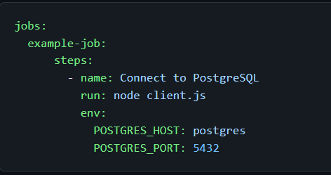
Using variables in your workflows
GitHub Actions include default environment variables for each workflow run. If you need to use custom environment variables, you can set these in your YAML workflow file. This example demonstrates how to create custom variables named POSTGRES_HOST and POSTGRES_PORT. These variables are then available to the node client.js script.

Slide 14
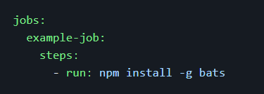
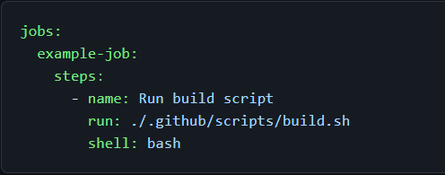
Adding scripts to your workflow
You can use actions to run scripts and shell commands, which are then executed on the assigned runner. This example demonstrates how an action can use the run keyword to execute npm install -g bats on the runner.
For example, to run a script as an action, you can store the script in your repository and supply the path and shell type.

Slide 15
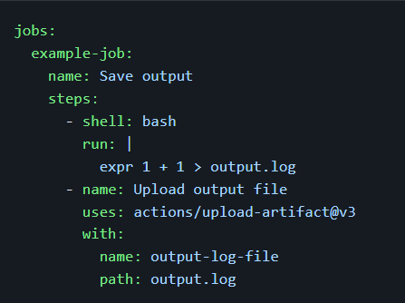
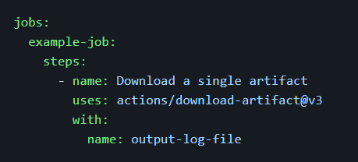
Sharing data between jobs
If your job generates files that you want to share with another job in the same workflow, or if you want to save the files for later reference, you can store them in GitHub as artifacts. Artifacts are the files created when you build and test your code. For example, artifacts might include binary or package files, test results, screenshots, or log files. Artifacts are associated with the workflow run where they were created and can be used by another job. All actions and workflows called within a run have write access to that run's artifacts.
To download an artifact from a separate workflow run, you can use the actions/download-artifact action. For example, you can download the artifact named output-log-file.
For example, you can create a file and then upload it as an artifact.

Slide 16
Usage limits, billing, and administration
4

Slide 17
About billing for GitHub Actions
GitHub Actions help you automate your software development workflows in the same place you store code and collaborate on pull requests and issues. You can write individual tasks, called actions, and combine them to create a custom workflow.
GitHub Actions usage is free for standard GitHub-hosted runners in public repositories, and for self-hosted runners. For private repositories, each GitHub account receives a certain amount of free minutes and storage for use with GitHub-hosted runners, depending on the product used with the account. Any usage beyond the included amounts is controlled by spending limits.

Slide 18



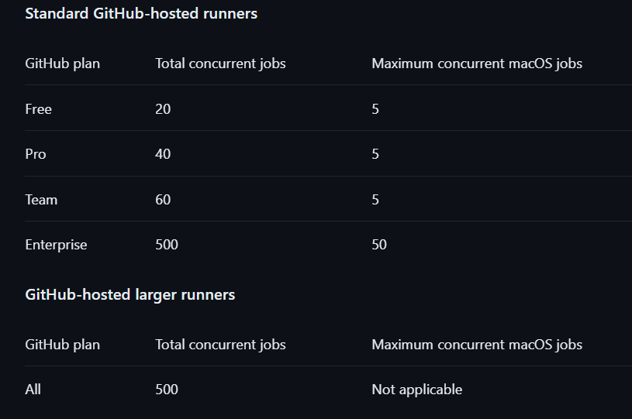


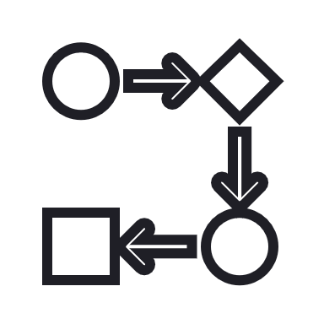
Usage Limits
Job execution time - Each job in a workflow can run for up to 6 hours of execution time. If a job reaches this limit, the job is terminated and fails to complete.
Workflow run time - Each workflow run is limited to 35 days. If a workflow run reaches this limit, the workflow run is cancelled. This period includes execution duration, and time spent on waiting and approval.
There are some limits on GitHub Actions usage when using GitHub-hosted runners. These limits are subject to change.
API requests - You can execute up to 1000 requests to the GitHub API in an hour across all actions within a repository. If requests are exceeded, additional API calls will fail which might cause jobs to fail.
Concurrent jobs - The number of concurrent jobs you can run in your account depends on your GitHub plan, as well as the type of runner used. If exceeded, any additional jobs are queued.
Job matrix - A job matrix can generate a maximum of 256 jobs per workflow run. This limit applies to both GitHub-hosted and self-hosted runners.
Workflow run queue - No more than 500 workflow runs can be queued in a 10 second interval per repository. If a workflow run reaches this limit, the workflow run is terminated and fails to complete.

Slide 19
THANK YOU!

