Slide 1


CLOUD COMPUTING
Docker & Kubernetes
Modern Container Orchestration

Slide 2
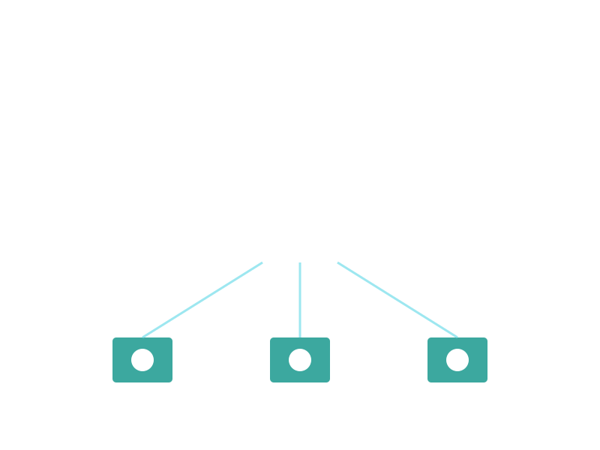
UNDERSTANDING CLOUD COMPUTING
Cloud computing delivers on-demand computing resources and services over the internet with pay-as-you-go pricing.
Key Benefits:
Access anywhere, anytime
No upfront hardware investment
Automatic scaling and updates
Enterprise-grade security

Slide 3

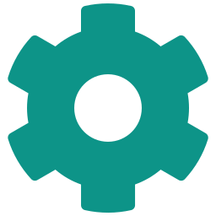

TYPES OF CLOUD SERVICES
Infrastructure as a Service
Platform as a Service
Software as a Service
Virtualized computing resources
Complete infrastructure control
Examples:
Amazon EC2, Azure VMs, Google Compute
Development and deployment platform
Built-in development tools
Examples:
Heroku, Firebase, App Engine
Ready-to-use applications
Accessible via web browser
Examples:
Office 365, Salesforce, Dropbox

Slide 4



DEPLOYMENT STRATEGIES
Public Cloud
Private Cloud
Shared infrastructure managed by third-party providers. Most cost-effective option for standard workloads.
Dedicated infrastructure for single organization. Maximum control and security for sensitive data.
Hybrid Cloud
Multi-Cloud
Combines public and private clouds. Balance between cost, security, and flexibility for diverse needs.
Uses multiple cloud providers. Avoid vendor lock-in and optimize for best features from each platform.

Slide 5




CONTAINERIZATION REVOLUTION
Containers package applications with all dependencies into lightweight, portable units that run consistently across environments.
Lightweight & Fast - Containers share the host OS kernel, making them faster to start and use less resources than traditional VMs.
Consistent Environments - 'Works on my machine' problem solved. Same container runs identically in development, testing, and production.
Microservices Architecture - Break applications into smaller, independent services that can be developed, deployed, and scaled separately.
Rapid Deployment - Deploy applications in seconds instead of minutes. Perfect for CI/CD pipelines and agile development workflows.

Slide 6

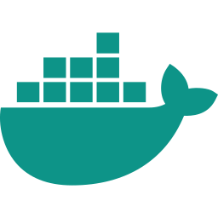
WHAT IS DOCKER?
Docker is the leading containerization platform that enables developers to package, distribute, and run applications in isolated containers.
Docker Image
Docker Container
Docker Engine
Template containing app code, libraries, and dependencies. Like a snapshot or blueprint for containers.
Running instance of an image. Isolated process with its own filesystem, networking, and resources.
Runtime that creates and manages containers. The core technology that makes containerization possible.

Slide 7
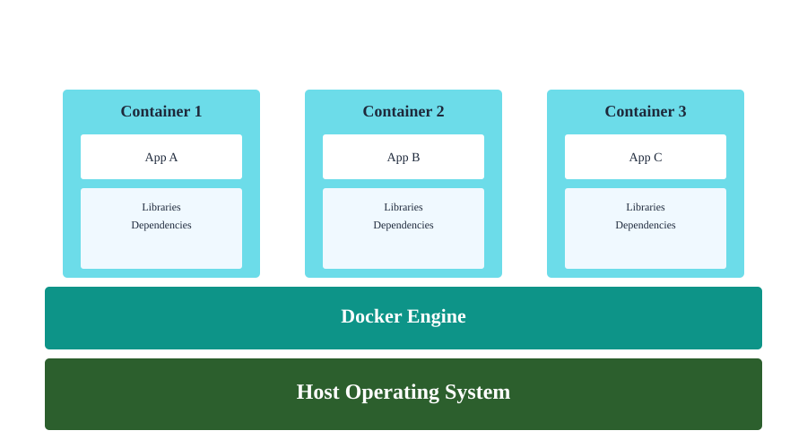
DOCKER ARCHITECTURE

Slide 8
WHY USE DOCKER?
Portability Across Platforms
Docker containers run on any system - Windows, Mac, Linux, cloud platforms. Build once, run anywhere.
Resource Efficiency
Containers share the host OS kernel, using far less memory and CPU than virtual machines. Run 10x more containers than VMs on same hardware.
Version Control for Infrastructure
Docker images are versioned and stored in registries like Docker Hub. Roll back to previous versions easily.
Simplified CI/CD
Integrate seamlessly with Jenkins, GitLab CI, GitHub Actions. Automated testing and deployment in consistent environments.

Slide 9


WHAT IS KUBERNETES?
Kubernetes (K8s) is an open-source container orchestration platform that automates deployment, scaling, and management of containerized applications across clusters.
Originally developed by Google, now maintained by the Cloud Native Computing Foundation (CNCF).
Automated Orchestration - Automatically manages container placement, load balancing, and health monitoring across multiple servers.
Self-Healing - Automatically restarts failed containers, replaces containers, and kills containers that don't respond to health checks.
Horizontal Scaling - Scale applications up or down with a simple command or automatically based on CPU usage and custom metrics.

Slide 10
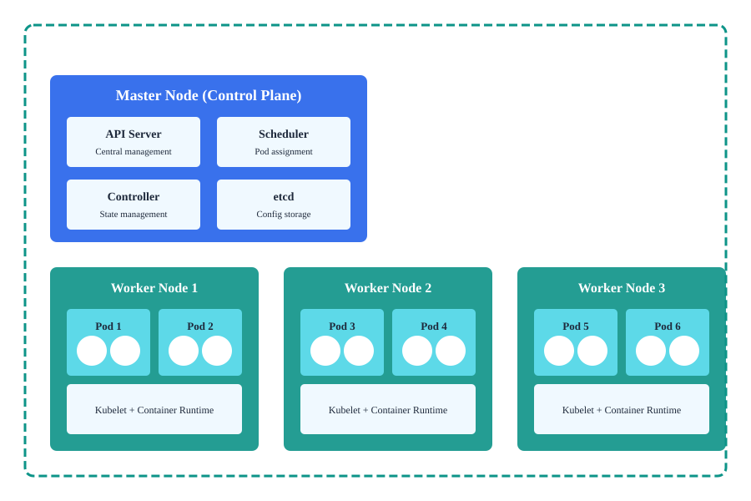
KUBERNETES ARCHITECTURE

Slide 11
KUBERNETES KEY COMPONENTS
Pods
Smallest deployable unit in K8s. One or more containers that share storage and network resources.
Services
Expose applications running on pods. Provide stable IP addresses and DNS names for pod groups.
Deployments
Declarative updates for pods. Define desired state and K8s manages the transition automatically.
ConfigMaps & Secrets
Store configuration data and sensitive information separately from application code.
Namespaces
Virtual clusters within a physical cluster. Organize and isolate resources for different teams or projects.
Volumes
Persistent storage for containers. Data survives container restarts and can be shared between pods.
Ingress
Manages external access to services. Provides load balancing, SSL termination, and name-based virtual hosting.
StatefulSets
Manages stateful applications. Provides stable network identities and persistent storage for databases.

Slide 12
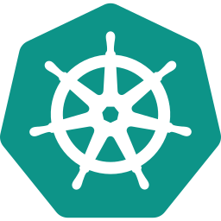
DOCKER vs KUBERNETES
They're complementary, not competitors!
Docker
Kubernetes
Containerization platform
Packages apps with dependencies
Runs on single host
Great for development & testing
Simple to learn and use
Container orchestration platform
Manages containerized apps
Runs across multiple hosts/clusters
Production-scale deployments
Steeper learning curve

Slide 13
REAL-WORLD USE CASES
Microservices Architecture
Companies like Netflix, Uber, and Airbnb use K8s to manage thousands of microservices. Each service runs in containers, scaled independently based on demand.
CI/CD Pipelines
Automated testing and deployment workflows. Docker builds images, K8s deploys them. Companies achieve multiple deployments per day.
Multi-Cloud Deployments
Run the same application across AWS, Azure, and Google Cloud. K8s provides consistent management regardless of cloud provider.
Edge Computing & IoT
Deploy containerized applications to edge locations and IoT devices. Lightweight K8s distributions like K3s enable this use case.

Slide 14
BEST PRACTICES
Docker Best Practices:
Use official base images
Keep images small and focused
Use .dockerignore files
Don't run as root user
Scan images for vulnerabilities
Use multi-stage builds
Tag images properly
Kubernetes Best Practices:
Use namespaces for organization
Set resource limits and requests
Implement health checks (liveness/readiness)
Use ConfigMaps for configuration
Enable RBAC for security
Monitor and log everything
Use Helm for package management

