Slide 1
IBM University Engagement Project Submission
“Exploring the Power of Agentic AI with IBM Granite and IBM Bob”

Slide 2

Project Tile – LearnMate Personalized Course Pathway Agent
Domain of Project – Education
Student Name | Recent Passport Photo | Email ID | Mobile number [WhatsApp]
Sara Sayyed Zahir |  | sarasayy07@gmail.com | 9420492611

Slide 3
Problem Statement -
Problem Statement : Agentic AI for Personalized Course Pathways
The Challenge
Students often struggle to identify the right learning path that aligns with their interests and long-term goals due to the overwhelming number of online courses and a lack of personalized guidance. LearnMate aims to solve this by acting as an Agentic AI coach that interacts with students, understands their interests (like Frontend Development, Cybersecurity, UI/UX Design, etc.), assesses their current skill level, and dynamically builds a personalized course roadmap that adapts over time based on progress and preferences.
The Objective
Build an AI-powered Course Pathway Agent (LearnMate) that delivers personalized learning paths, targeted assessments, and seamless progress tracking for students and self-learners.
The solution should:
Personalized Course Pathways – Generate tailored step-by-step learning roadmaps based on user onboarding goals and skill gaps.
Adaptive Remediation Quizzes – Create dynamic 10-question quizzes to test module comprehension and reinforce weak areas.
Progress Tracking & Profile Drawer – Track completed modules dynamically in a centralized user profile checklist using SQLite persistence.
Exportable Learning Plans – Allow single-click PDF export of customized learning roadmaps for offline study and documentation.
Resilient Multi-Layer Agent – Leverage IBM Granite 3.0 API with automated local mock fallbacks to guarantee uninterrupted user experience and zero API demo errors.

Slide 4
Proposed Solution -
Proposed Solution: Course Pathway Agent (LearnMate)
The Innovation
LearnMate is an AI-driven educational platform powered by IBM Granite 3.0 that transforms static learning into an adaptive, personalized experience. By combining real-time roadmap generation with dynamic remediation quizzes and local mock fail-safes, LearnMate delivers an end-to-end agentic workflow that ensures 100% demo stability and tailored student progression.
Key Components & Features
User Authentication & Persistence – Secure JWT-based Login and Registration system backed by SQLite database for seamless progress retention across sessions.
Granite-Powered Roadmap Generation – Leverages IBM Granite 3.0 via IBM watsonx.ai to generate structured, step-by-step learning pathways tailored to individual student goals.
Adaptive 10-Question Remediation Quizzes – Automatically generates targeted quizzes for each module to evaluate comprehension, identify knowledge gaps, and reinforce learning.
Centralized Profile & Progress Tracking – Top-right Profile Drawer providing an interactive checklist of completed modules to visualize learner advancement in real time.
Exportable PDF Roadmaps – Direct single-click PDF export functionality that packages customized study paths for offline access and documentation.
Resilient API Fail-Safe Layer – Defensive backend implementation with try...catch error handling that automatically serves mock fallback data during rate limits (HTTP 429) or network errors.

Slide 5
Technology Used
IBM Bob platform – For agentic workflow orchestration, rapid prototyping, and automated code generation.
IBM Granite model (granite-4-h-small) – For natural language understanding, personalized roadmap reasoning, and 10-question quiz generation.
IBM watsonx.ai – For foundation model inference, deployment management, and monitoring token usage efficiency.
SQLite Database – Lightweight, persistent storage for user authentication (JWT) and interactive module completion tracking.

Slide 6
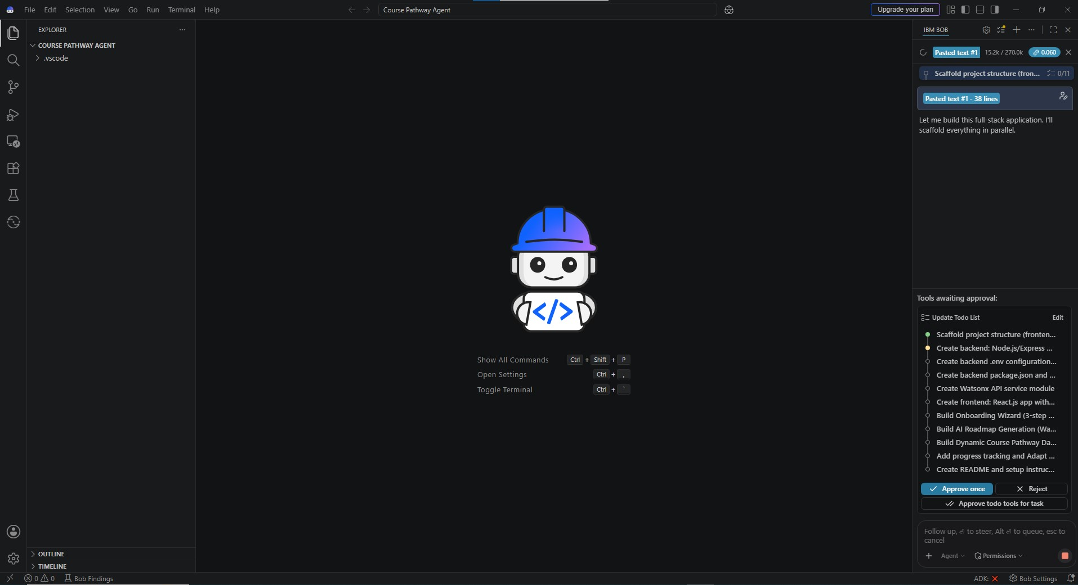
Required Files created using IBM bob -

Slide 7
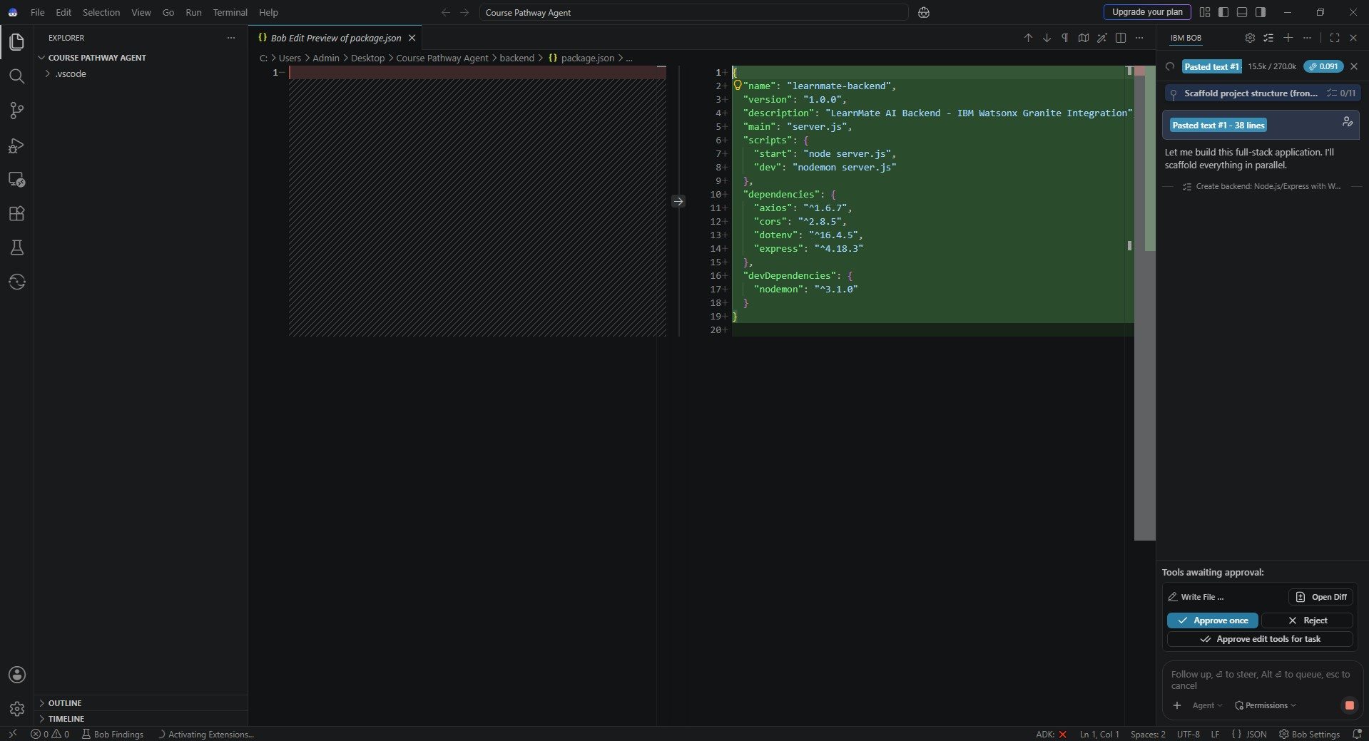

Slide 8
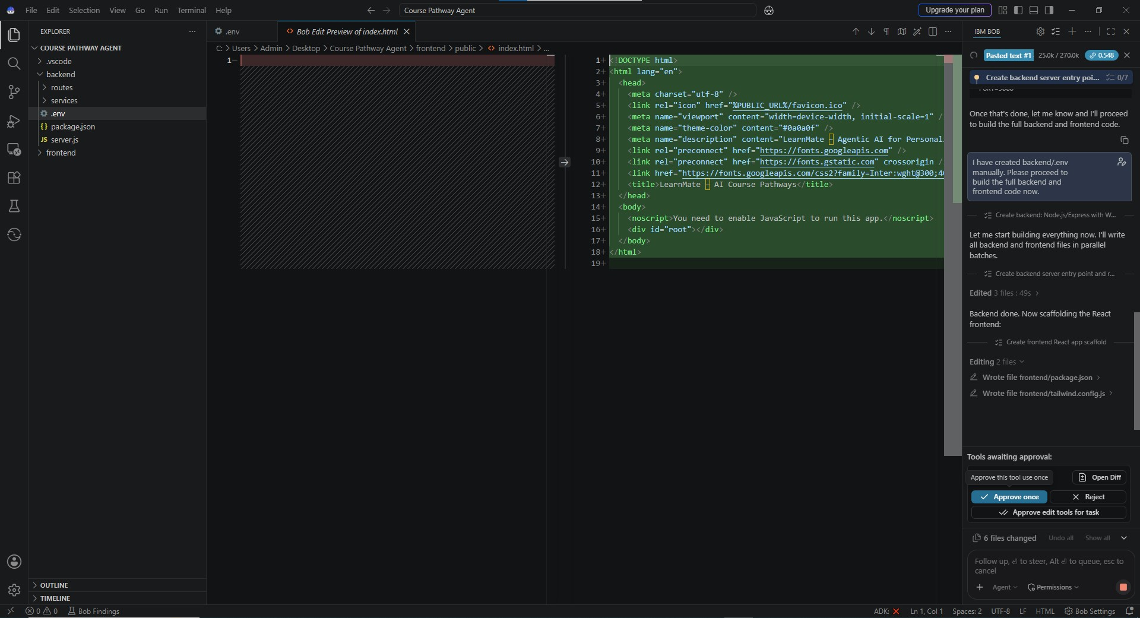

Slide 9
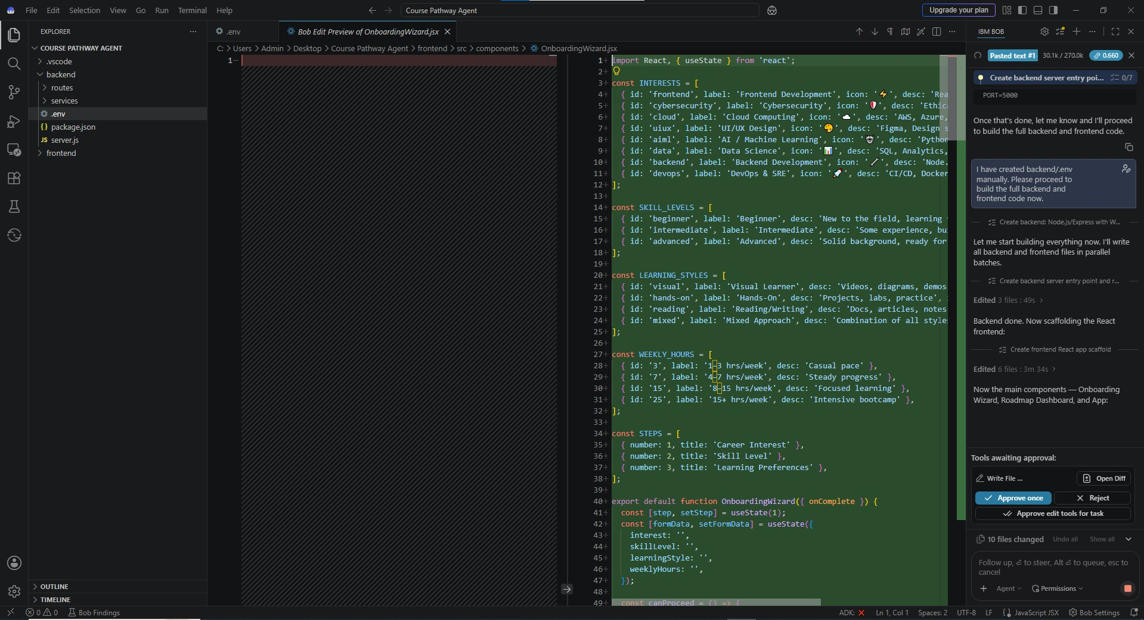

Slide 10
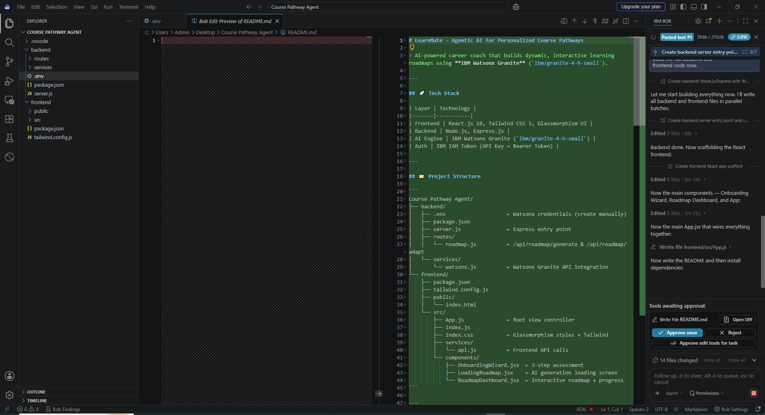

Slide 11
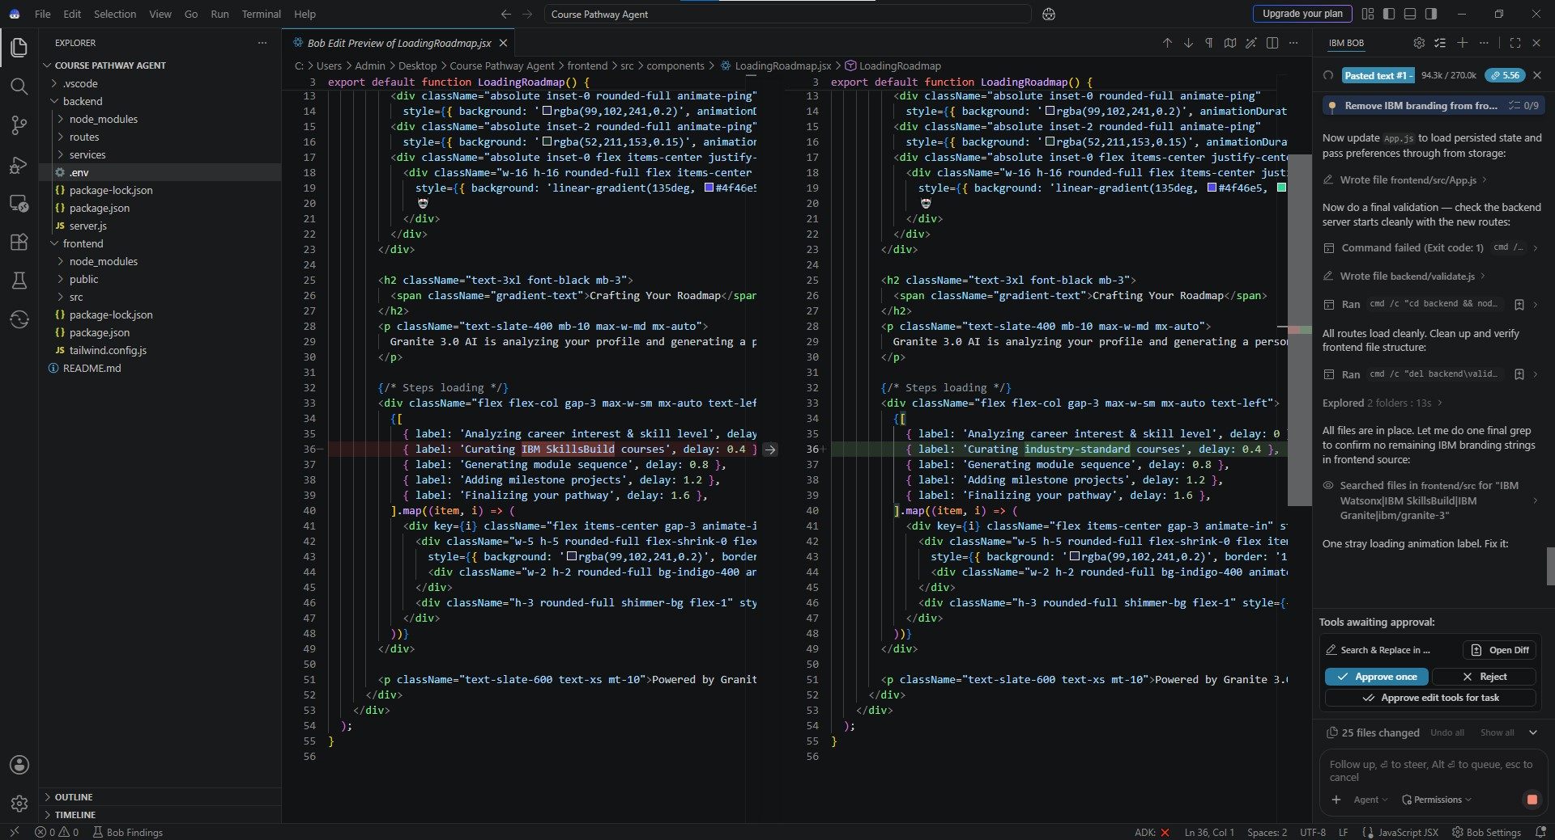

Slide 12
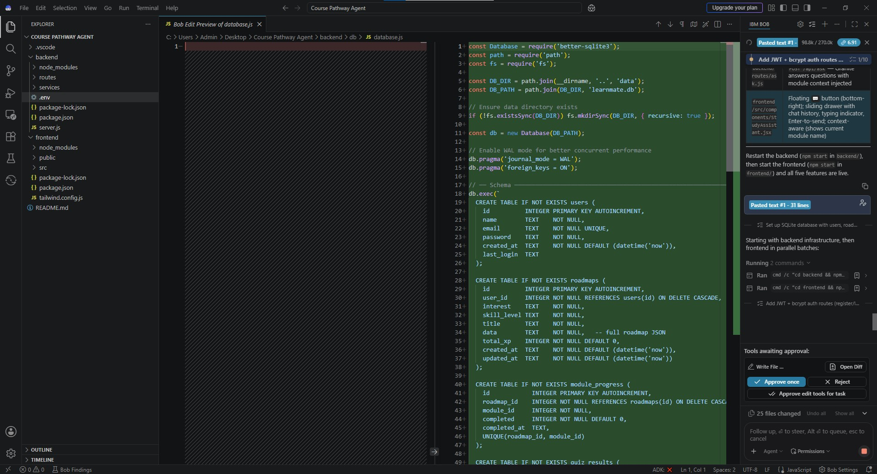

Slide 13
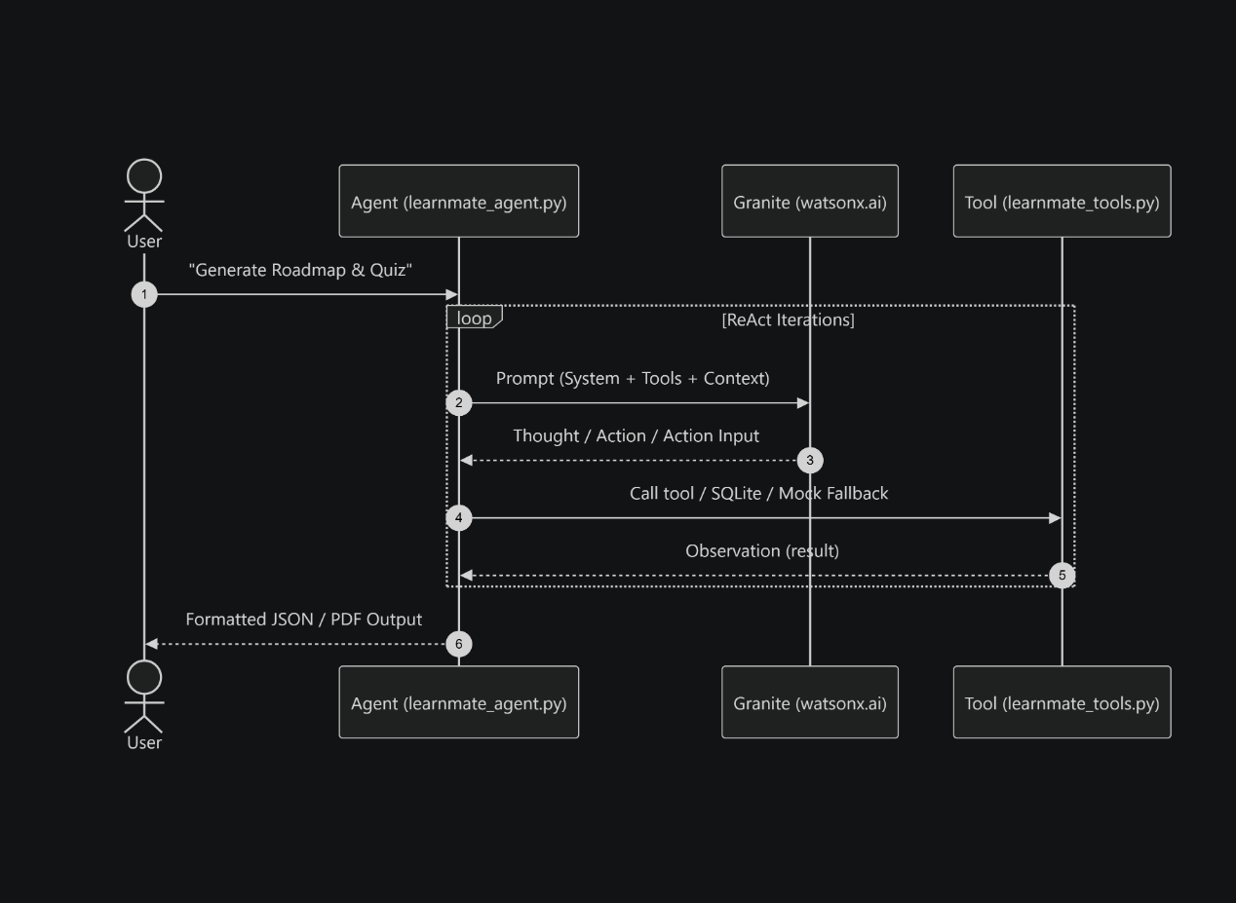
Architecture blueprint for IBM bob:

Slide 14

Role of Agentic AI in the solution
Agentic AI enables LearnMate to function as an intelligent, autonomous learning coach rather than a static curriculum aggregator. Powered by IBM watsonx.ai and IBM Granite 4-h-small models, it coordinates specialized reasoning workflows to construct highly customized course pathways.
Each component performs a dedicated role, analyzing target domains, evaluating skill levels, structuring prerequisite sequences, generating interactive quizzes, and managing backend fallback mechanisms, while working collaboratively to ensure seamless delivery.
Agentic AI also brings context awareness, understanding user inputs such as domain preferences, experience levels, and weekly time commitments to generate tailored study timelines. It supports dynamic adaptation, structuring knowledge checkpoints and module evaluations based on learner interaction.
Overall, Agentic AI makes the system proactive, adaptive, and goal-driven, acting like a smart digital mentor that guides students toward structured career outcomes.

Slide 15
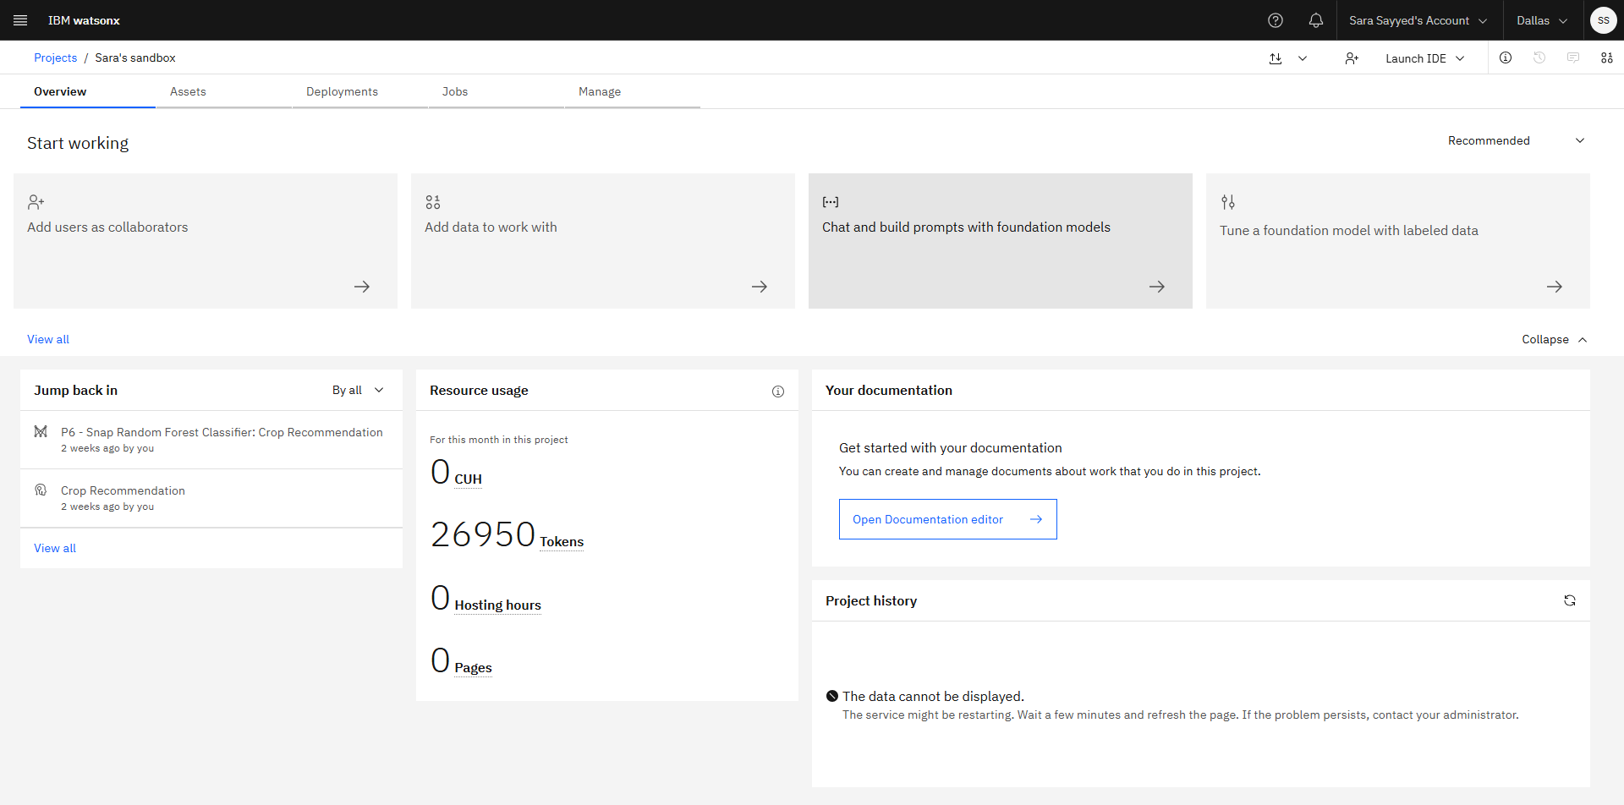
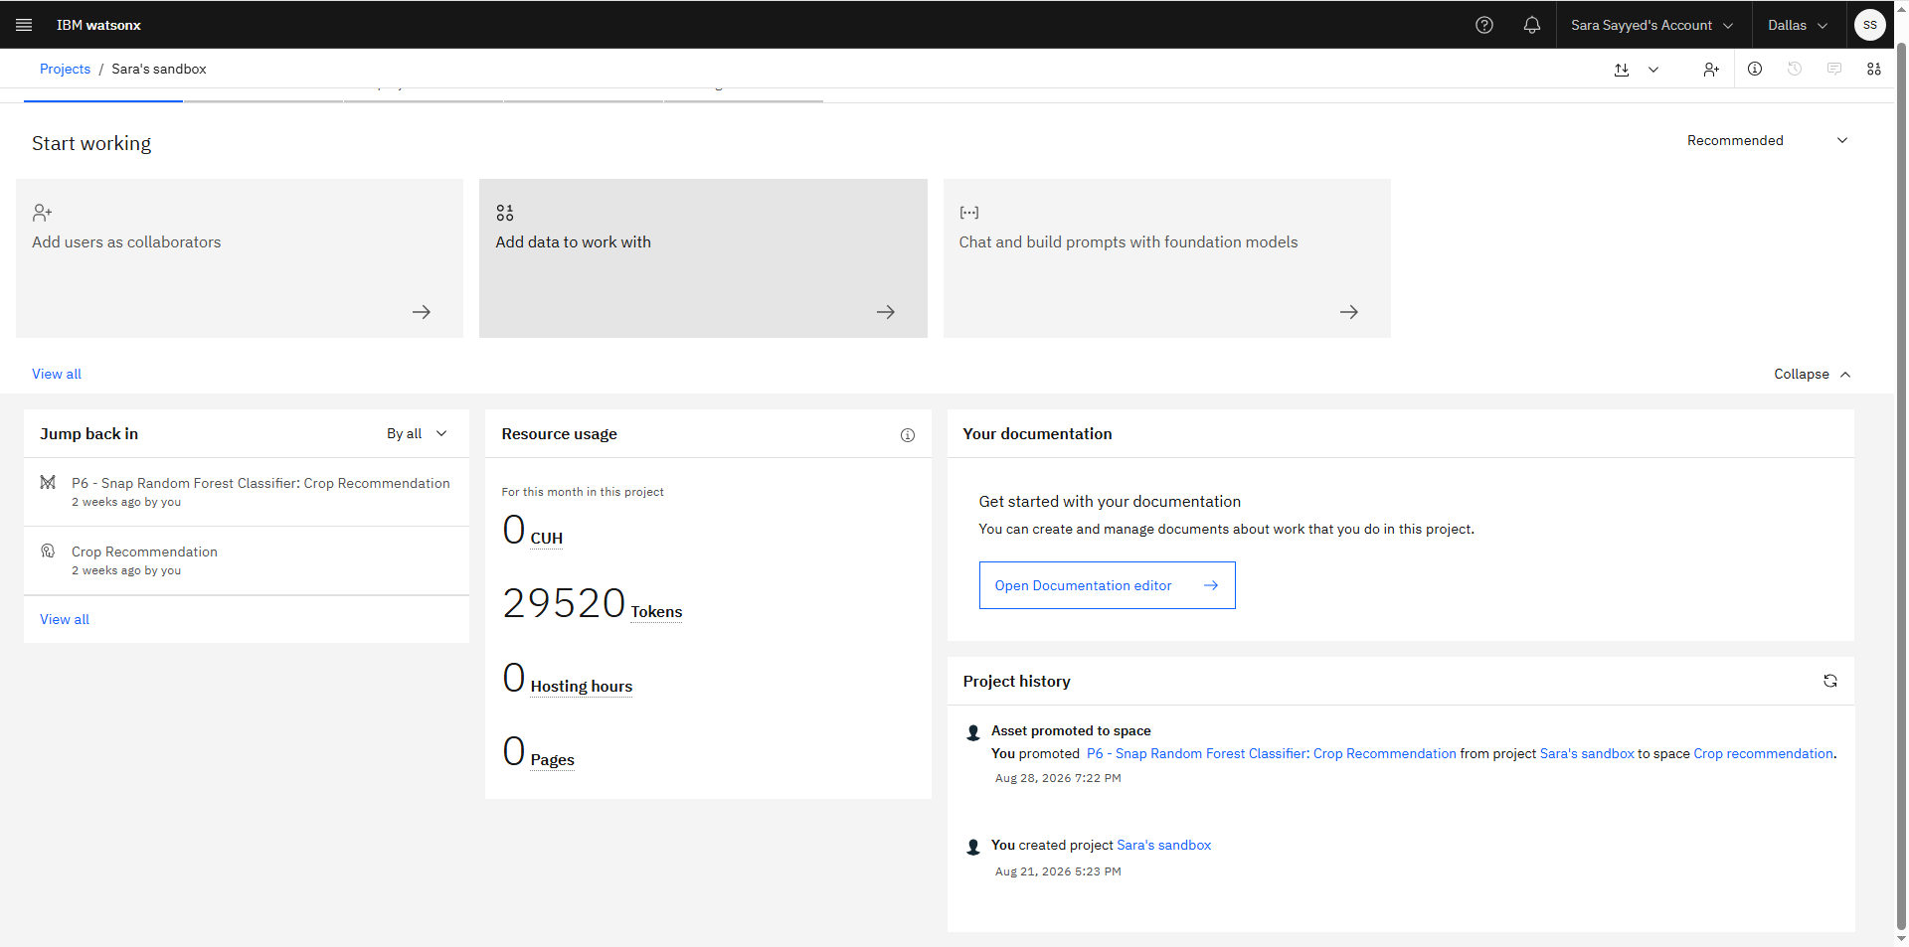
Token Usage
Tokens Used: 2,570
Before Prompt
After Prompt

Slide 16
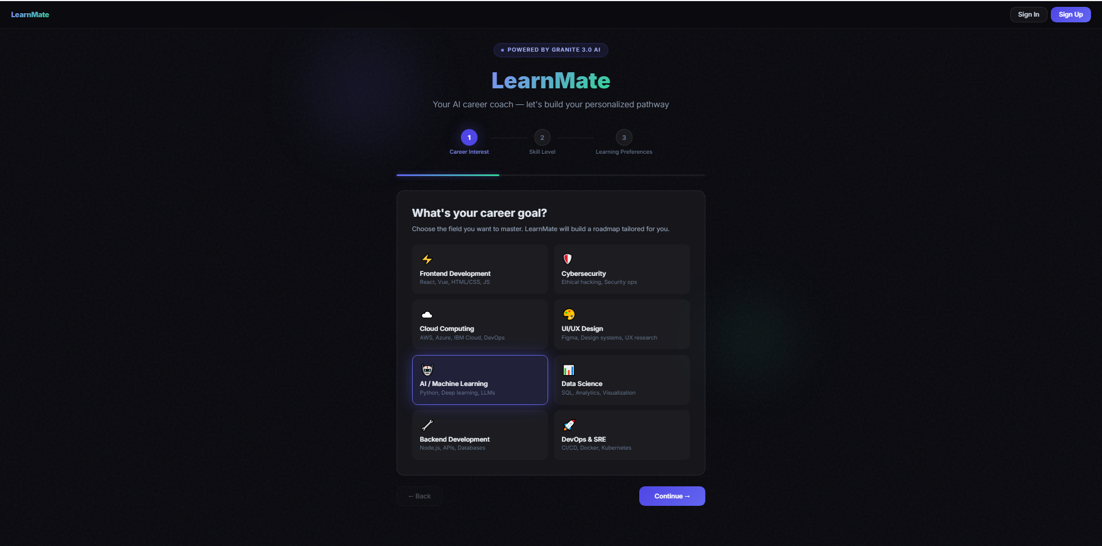
Project Output Screenshot

Slide 17
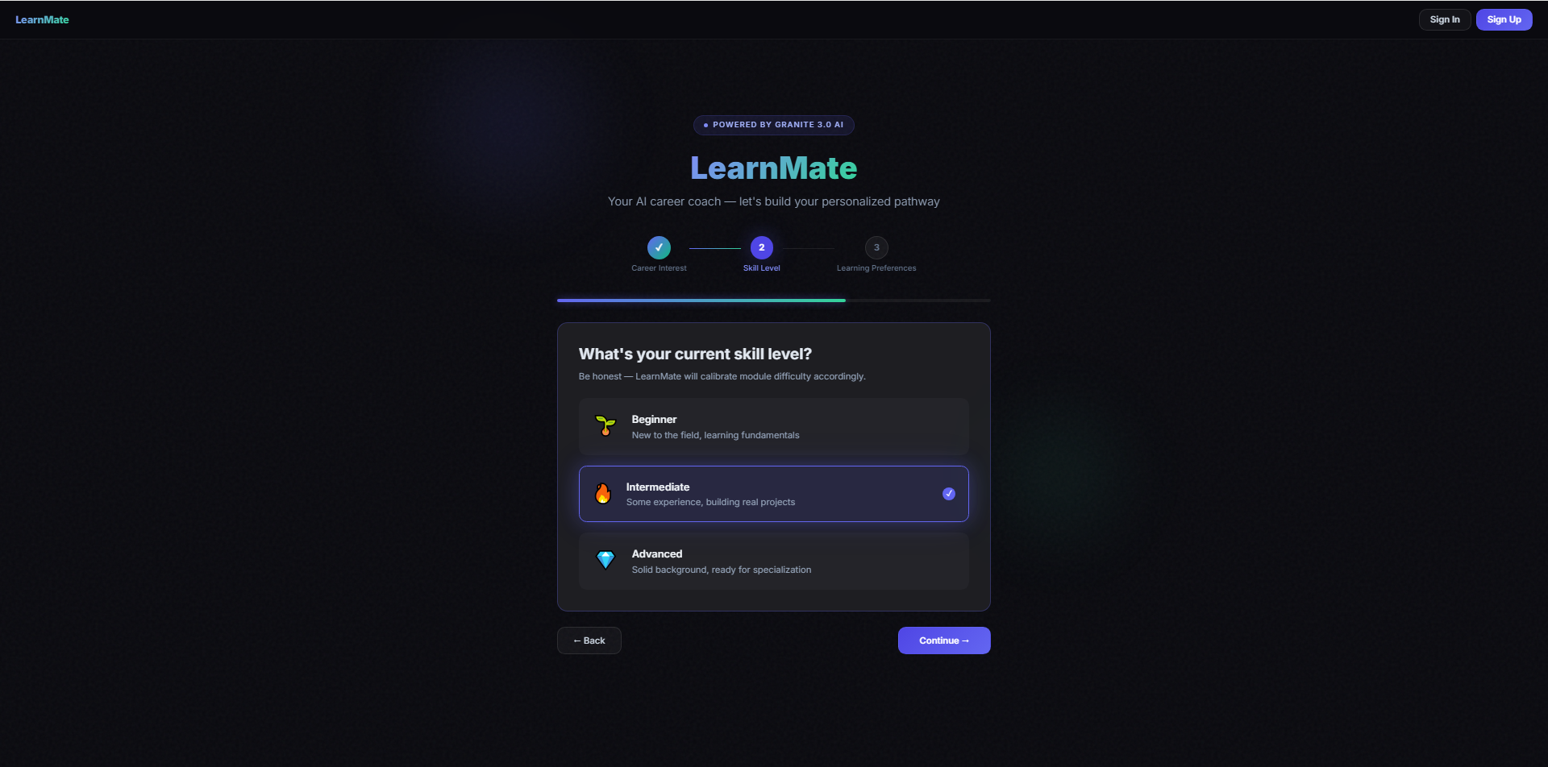

Slide 18
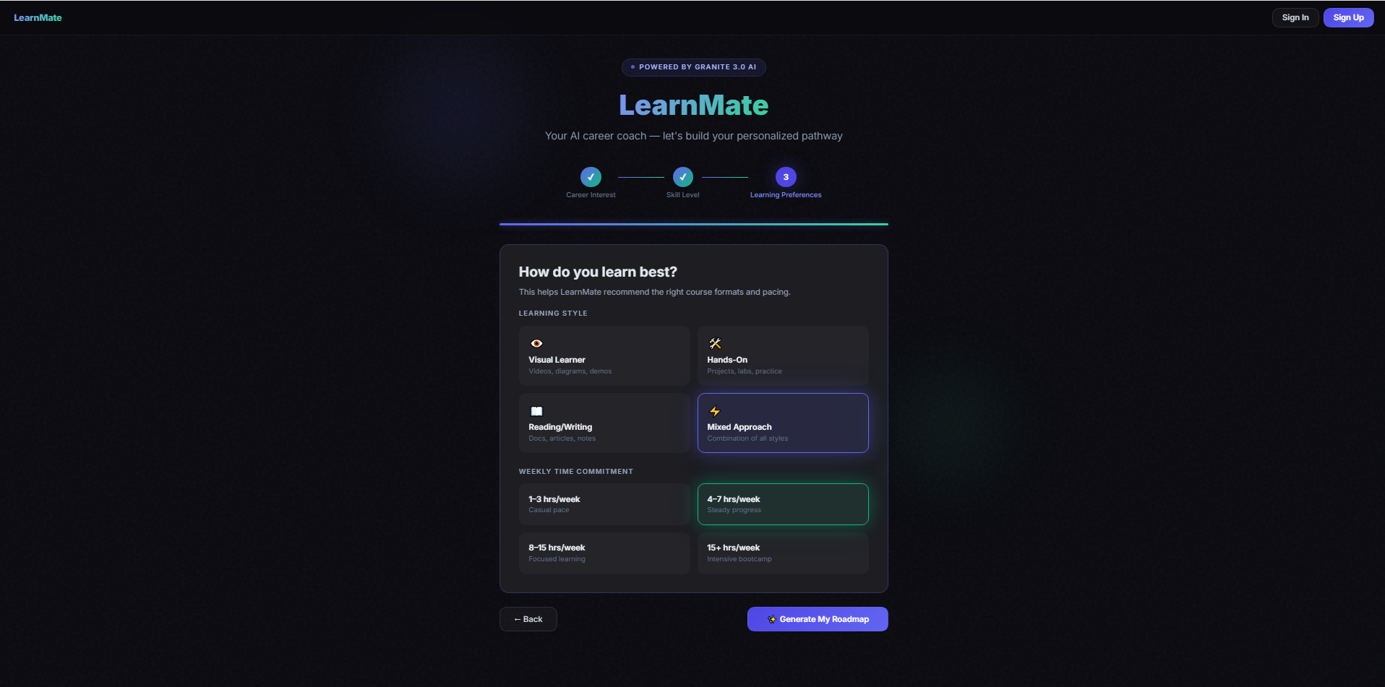

Slide 19
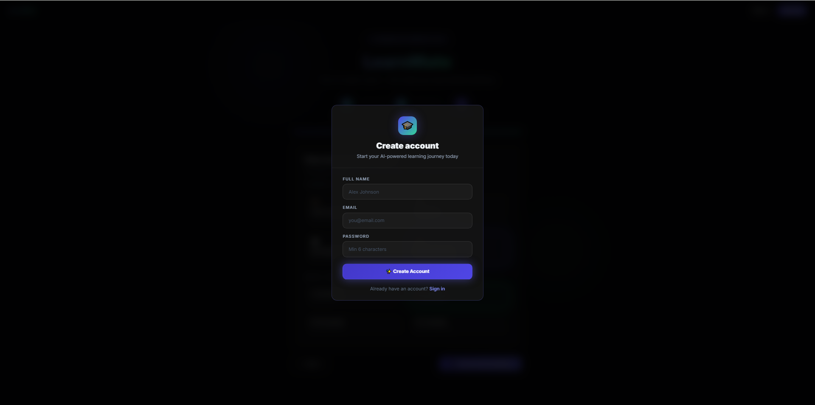

Slide 20
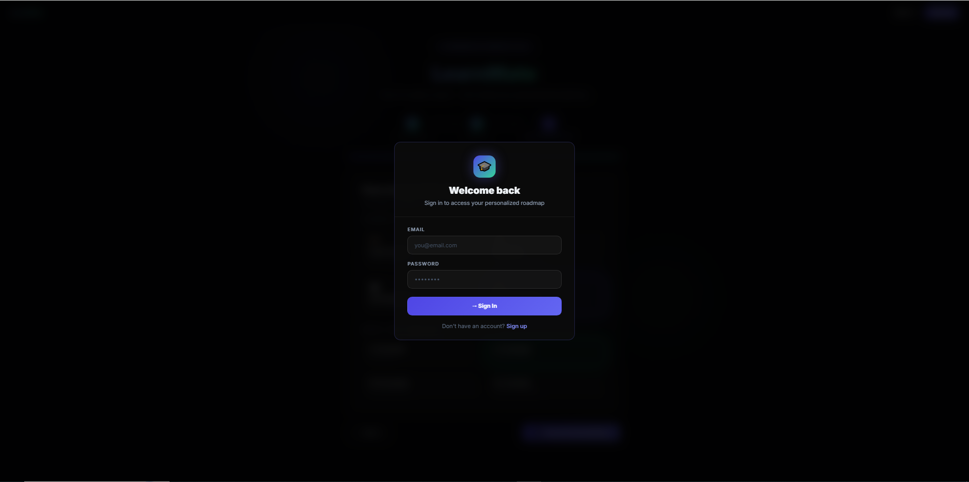

Slide 21


Slide 22
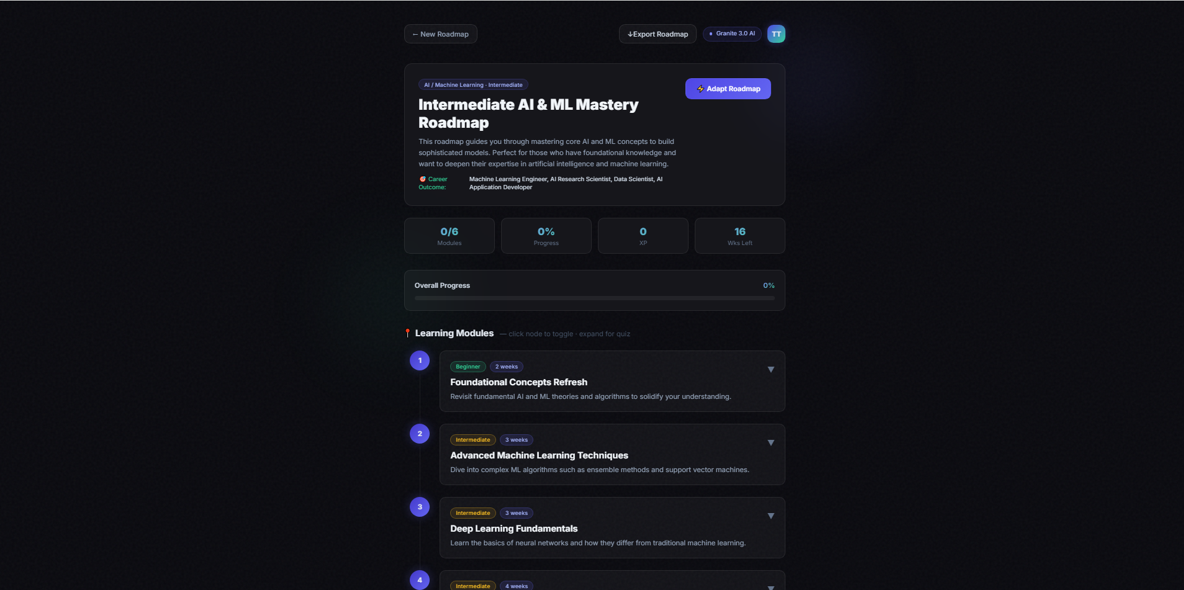

Slide 23
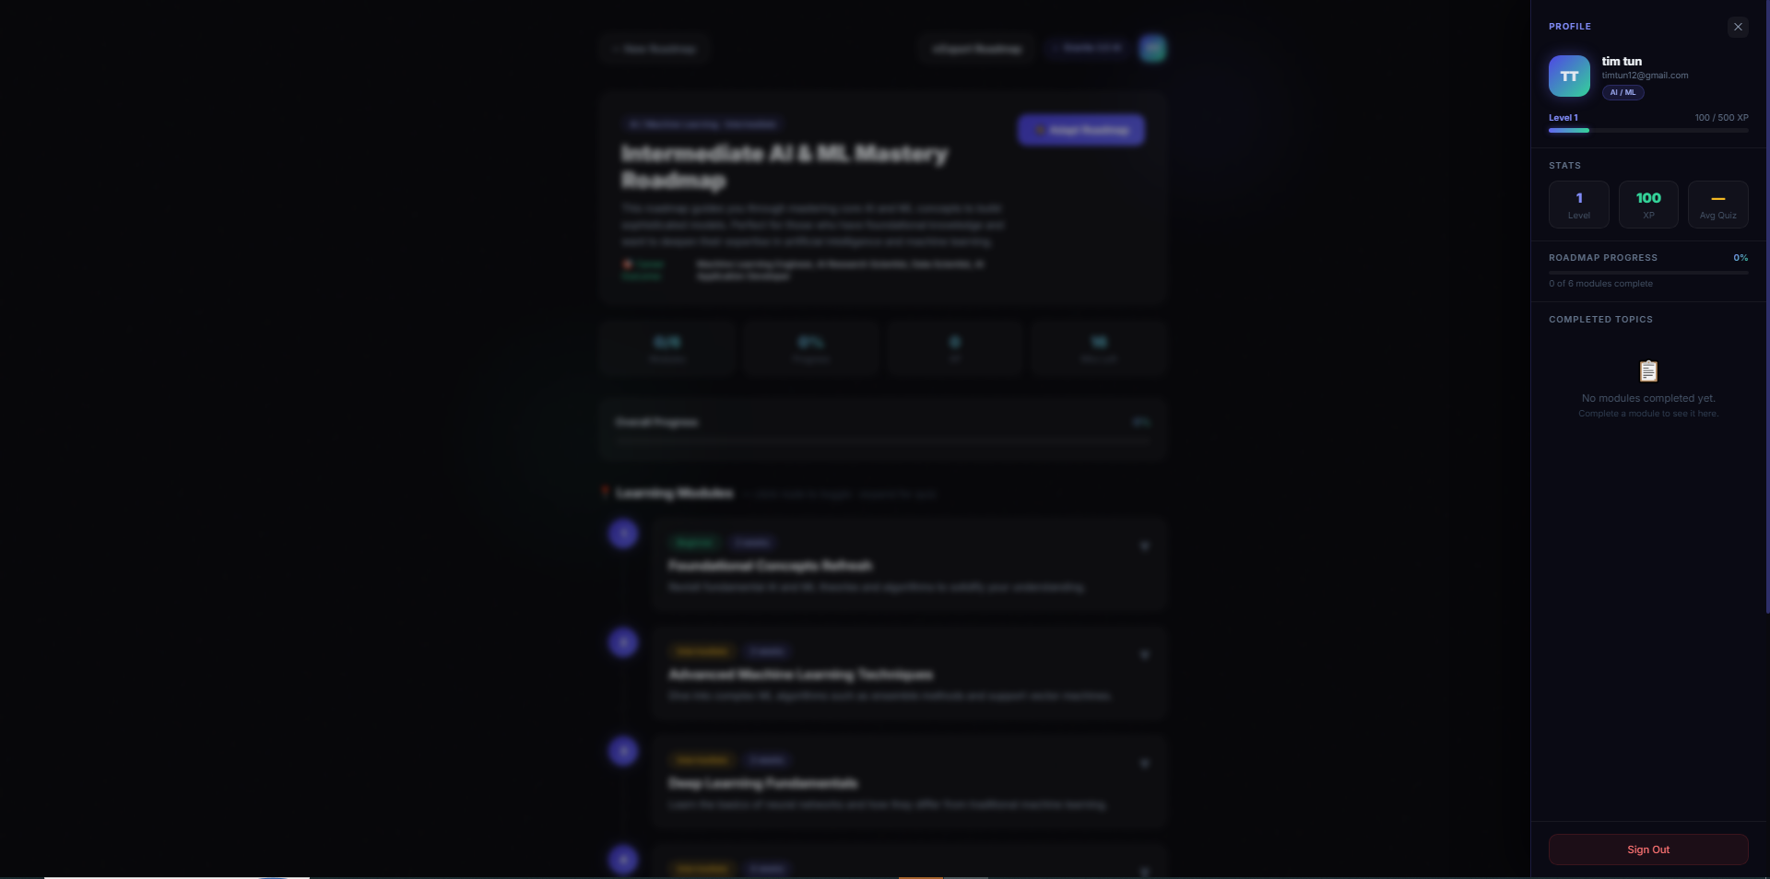

Slide 24
Novelty and Uniqueness
The proposed LearnMate stands out by combining Agentic AI, dynamic assessment, and deep personalization into a single intelligent system.
Agentic Pathway Synthesis – Specialized AI reasoning powered by IBM Granite 4-h-small dynamically structures custom learning pathways based on domain, skill level, and study hours.
Hyper-Personalized Pacing – Adapts course depth and step durations to individual user availability, delivering realistic and actionable learning schedules.
Dynamic Knowledge Validation – Generates auto-evaluated interactive quizzes per module to test comprehension before advancing through the pathway.
Persistent Learner State – Integrates JWT authentication and SQLite database management to securely store user progress, quiz scores, and saved roadmaps across sessions.
This makes the solution a smart, adaptive, and proactive digital AI coach, not just a static learning content aggregator.

Slide 25
Git Hub Link
·
https://github.com/Saracode06/LearnMate-Personalized-Course-Pathway.git
·
·
·

Slide 26
Future Scope
1. Integration with Developer Platforms & Coding Environments –
The system can be integrated with GitHub, LeetCode, and IDE extensions (like VS Code) to track real-time coding activity, repository commits, and project completion. This will enable LearnMate to dynamically adjust roadmap milestones based on practical execution and actual coding performance.
2. Multi-Modal AI Tutor & Interactive Voice Mentorship –
Enhancing the system with voice-enabled AI coaching and automated code-review capabilities will improve learning engagement. Students can interact naturally via voice, ask clarifying questions on complex concepts, and receive real-time feedback in their preferred language.
·
·
·

Slide 27
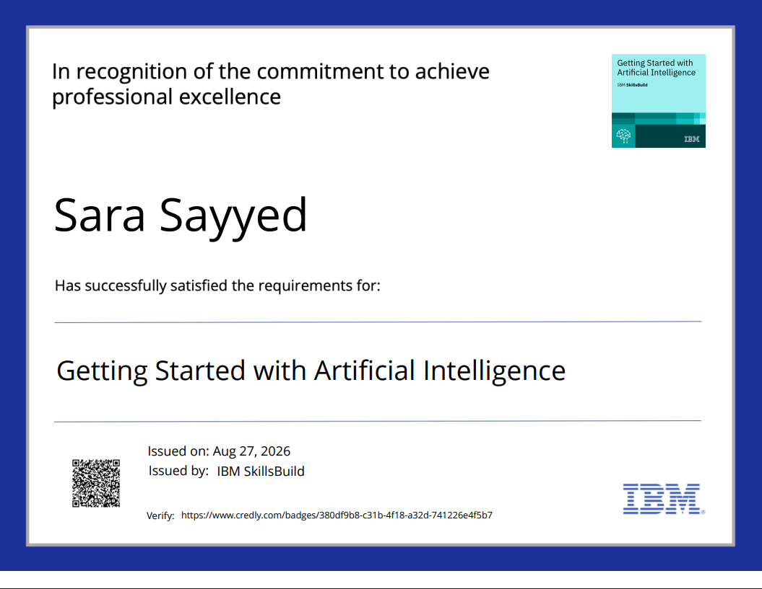
Certificates Earned:
Please add your credly certificate(Getting Started with Artificial Intelligence)

Slide 28
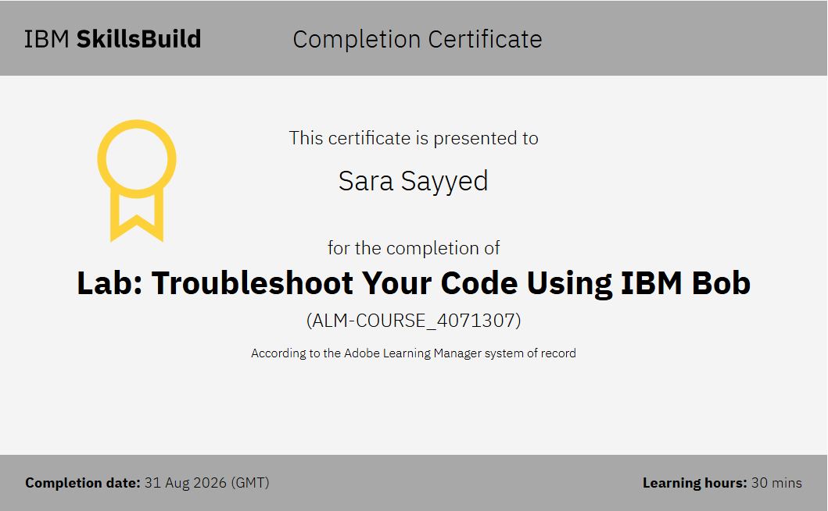
Certificates Earned:​
Add your IBM BOB Certificate

Slide 29


