Slide 1
COMMUNITY LIBRARY
MANAGEMENT SYSTEM
Java-based mini project
Students
Behera Sai Sanatana Sarada — 2620030660
Shaik Shaheena Amreen — 2620030469
Project Details
Faculty Guide: Gopi Krishna
Batch No.: 10

Slide 2
1. Introduction
A simple Java application for managing day-to-day library activities.
Maintains book and member information in an organized way.
Supports issue and return of books with late-fine calculation.
Allows users to search books by title, author, or category.
Uses Java control statements to implement menu-driven operations.
Community Library Management System • Batch 10 1

Slide 3
2. Problem Statement
Manual library management can be slow and error-prone.
Tracking available and issued books manually is difficult.
Member and issue/return records may become disorganized.
Calculating fines for late returns can take extra time.
Searching for a book manually is inconvenient.
A simple computerized system can make these tasks faster and more consistent.
Community Library Management System • Batch 10 2

Slide 4
3. Objectives
The project aims to make basic library operations easier.
Add, update, and delete book records.
Register and manage library members.
Issue and return books while checking availability.
Calculate fines for late returns.
Search books using title, author, or category.
Practice Java concepts such as if-else, switch, for, and while.
Community Library Management System • Batch 10 3

Slide 5
4. Existing System
Traditional / manual library management.
Book details are often maintained in registers or separate records.
Availability checking requires manual verification.
Issue and return entries are recorded manually.
Fine calculation may require separate calculations.
Searching for a particular book can take more time.
These limitations motivate a simple computerized solution.
Community Library Management System • Batch 10 4

Slide 6
5. Proposed System
A menu-driven Java application for basic library management.
Centralized handling of books, members, and issue/return records.
Availability is checked before issuing a book.
Return processing can calculate late fines.
Search supports title, author, and category.
Switch-case provides clear menu navigation.
While loop keeps the application running until the user chooses Exit.
Community Library Management System • Batch 10 5

Slide 7
6. System Architecture
Input → Processing → Data Management → Output
1
User / Librarian
2
Main Menu
(switch-case)
3
Library Operations
4
Processing
& Validation
5
Output / Records
Core processing includes availability checking, fine calculation, and search.
The loop returns the user to the main menu until Exit is selected.
Community Library Management System • Batch 10 6

Slide 8
7. Functionalities
Core functions provided by the system.
Functionality
📚 Book Management — Add, update, delete, and display books.
Functionality
👤 Member Management — Register and maintain member details.
Functionality
🔄 Issue / Return — Issue available books and process returns.
Functionality
💰 Fine Calculation — Calculate a fine for late returns.
Functionality
🔎 Search — Find books by title, author, or category.
Functionality
🚪 Exit — End the program safely from the main menu.
Community Library Management System • Batch 10 7

Slide 9
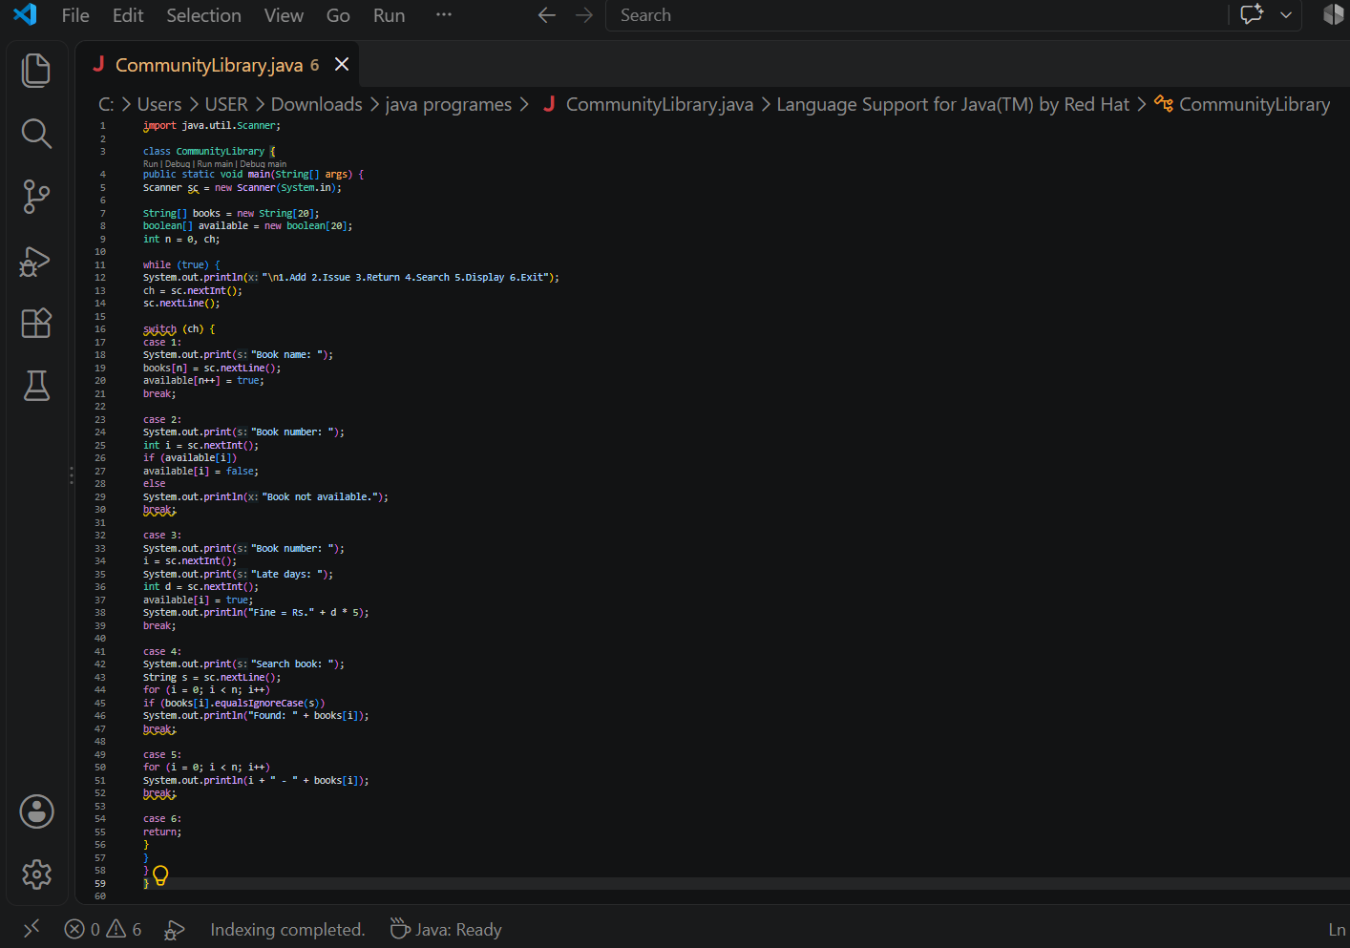
8. Implementation – Java Code Screenshot
Community Library Management System • Batch 10 8

Slide 10
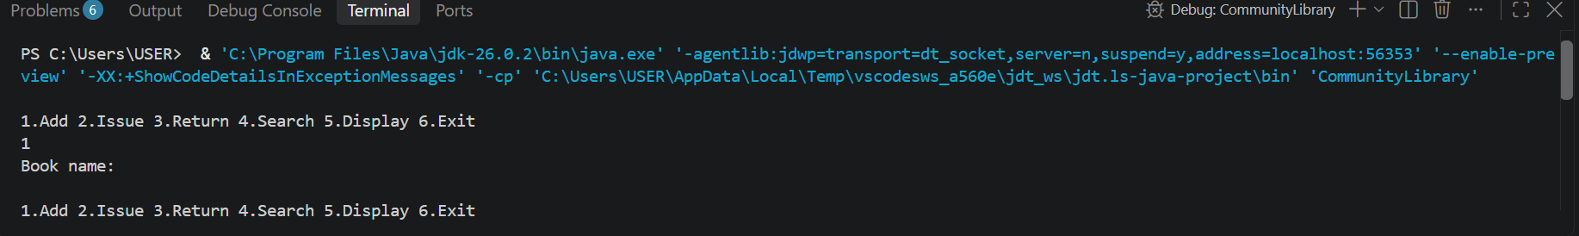
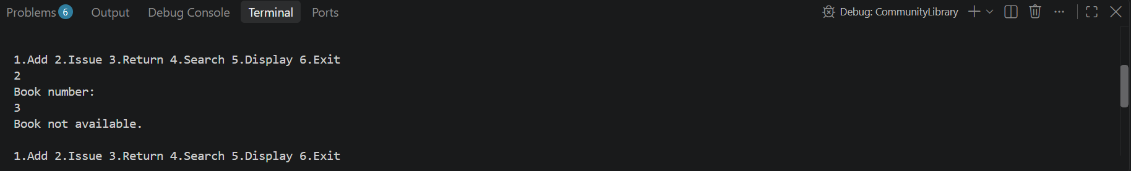
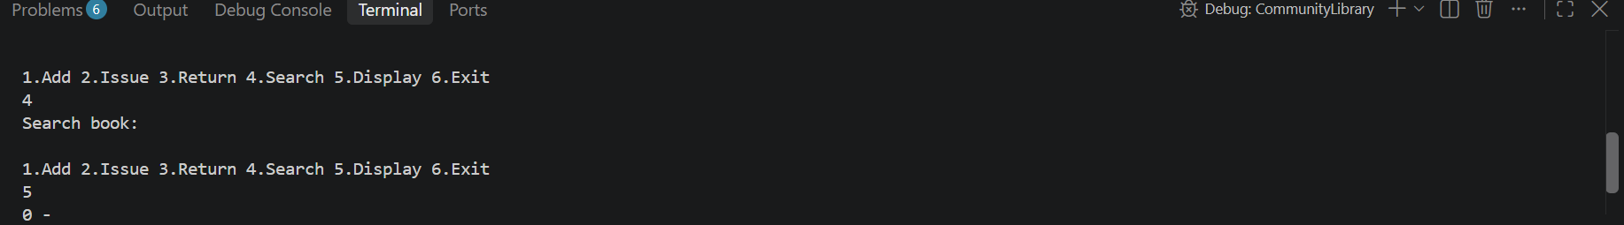
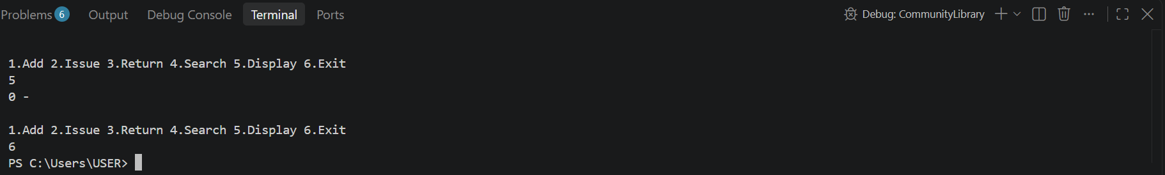

Slide 11
10. Future Scope
Possible improvements for a larger library system.
Connect the application to a database such as MySQL.
Add login and role-based access for librarian and members.
Add due-date reminders and notifications.
Generate reports for issued, returned, and overdue books.
Add a graphical user interface (GUI).
Support barcode/QR-based book identification.
Community Library Management System • Batch 10 10

Slide 12
11. Conclusion
The Community Library Management System demonstrates how Java can automate basic library tasks.
It organizes books and member information.
It simplifies issue and return operations.
It supports search and fine calculation.
It demonstrates practical use of if-else, switch, for, and while loops.
The project provides a foundation for developing a more advanced library application.
Community Library Management System • Batch 10 11

Slide 13
THANK YOU
Community Library Management System
Behera Sai Sanatana Sarada • Shaik Shaheena Amreen

