Slide 1


IMDb Movie Rating Prediction
Using ML
BY: Osarum Khurshid

Slide 2

Introduction
The aim of this project is to predict rating of any movie based on its
features. To achieve accurate prediction we use different regression
models

Slide 3
Data Collection and Preprocessing
Data Cleaning
Data Sources
Here we deal with any missing values or junk values that are not useful
data.isnull().sum()
data = data.dropna(subset=['Metascore','age_limit' ])
data.duplicated().sum()
data['rating'].value_counts()
data.drop(columns=['rank', 'description', 'name'])
Get IMDb's movie metadata from Keggel which includes
year, rating
Duration , name
Metascore , description
age_limit , numberof_ratings.

Slide 4
Data Collection and Preprocessing
Preprocessing
Encoding age limit.
le = LabelEncoder()
data['age_limit'] = le.fit_transform(data['age_limit’])
Converting duration as integer and apply new values to dataset.
data['duration'] = data['duration'].apply(FUNCTION NAME THE CONVERTS)
Converting number of ratings to numerical and apply new values to dataset.
data['numberof_ratings'] = data['numberof_ratings'].apply(FUNCTION NAME THE CONVERTS)

Slide 5

Model Selection
Linear Regression
Decision Tree
Random Forest
Gradient Boosting
SVR
K-Nearest Neighbors
Evaluation Metrics
Mean Absolute Error (MAE)
Mean Squared Error (MSE)
Root Mean Square Error (RMSE)
R-squared (R²)

Slide 6
Model Selection
Gradient Boosting
MSE: 0.044944844508599376
R2: 0.4724355975628365
SVR
MSE: 0.04173708641744858 R2: 0.5100883917603367
K-Nearest Neighbors
MSE: 0.05275502958579884 R2: 0.38075932927831646
Linear Regression
MSE: 0.04433760681942772 R2: 0.47956337811537286
Decision Tree
MSE: 0.08106508875739644 R2: 0.04845470984711531
Random Forest
MSE: 0.04244702366863917 R2: 0.501755119595593

Slide 7
Model Selection
Random Forest
MSE: 0.04244702366863917
R2: 0.501755119595593
SVR
MSE: 0.04173708641744858
R2: 0.5100883917603367
We select these models for predictions as there score are bester then rest of all

Slide 8

Predicting The Ratings
1
2
3
4
5
Create Function
New data
Featuring
Predict
Rating
Created a function in which it does the following steps.
It take input from a user for a new data to predict .
And applies scaling and conversion functions to new data.
Then predict using the features provided by user.
Display the rating based on input.

Slide 9
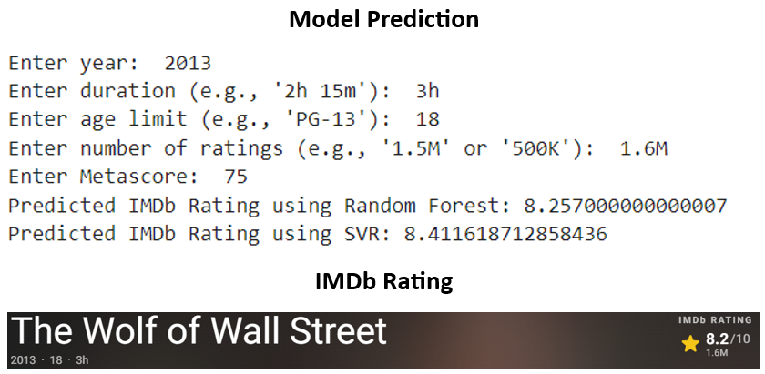
Result
In our best two models Random Forest shows better performance then SVR

Slide 10
Thank You

