Slide 1

EXECUTIVE STAKEHOLDER BRIEFING
GreenTech Downtime
Analysis Project
Evaluating Production Bottlenecks Through Data-Driven Insight
Presented by Sarah Abhulimhen
Data Analyst Intern | GreenTech Manufacturing
Notes:
Good morning/afternoon, everyone, and thank you for making time for this briefing. My name is Sarah Abhulimhen, and I'm the Data Analyst Intern who led this project. Today I'll walk you through an analysis of production downtime here at GreenTech, built using PostgreSQL and Power BI, aimed at identifying operational inefficiencies and giving you data-driven recommendations you can act on. Over the next 10 to 15 minutes I'll cover the business context, our methodology, the key findings from the data, and a set of practical recommendations for improving production reliability.

Slide 2





ROADMAP
Agenda
01
Company & Business Context
Overview, challenges, and project objectives
02
Methodology & Architecture
Tools, data workflow, and dashboard design
03
Key Findings
Downtime factors, duration trends, and operator analysis
04
Business Impact & Recommendations
Cost implications and an improvement roadmap
05
Skills, Reflection & Close
What was learned, and next steps
GreenTech Downtime Analysis Project
2
Notes:
Here's how I've structured today's briefing. We'll start with some quick context on GreenTech and the business challenges that motivated this project. Then I'll walk through the methodology and data architecture behind the analysis. From there, we'll spend most of our time on the key findings — downtime factors, duration trends, and operator scheduling. I'll close with the business impact, my recommendations, and a few reflections from the project before opening the floor to questions.

Slide 3
AT A GLANCE
Executive Summary
Across six months of production data, downtime touched over half of all batches — but the root causes are concentrated, visible, and fixable.
363 / 645
21.74 days
69%
batches delayed (56%)
lost to downtime
of downtime is non-operator (process/system)
TOP FINDINGS
PRIORITY RECOMMENDATION
• Cleaning/sanitation, scheduling, and raw-material shortages drive most delays
Introduce preventive maintenance and real-time inventory alerts, paired with data-driven operator scheduling.
• GreenFoam Hand Soap is the most disrupted product line
These three levers directly target the causes behind 21.74 lost production days.
• 51 days show operators double-booked across concurrent batches
GreenTech Downtime Analysis Project
3
Notes:
Before we go deep into the data, here's the headline picture. Of 645 production batches analyzed, 363 — just over half — experienced delays, and together those delays cost GreenTech roughly 21.74 production days. Importantly, 69% of that downtime was not caused by operator error; it's rooted in process and system issues like cleaning cycles, scheduling, and material shortages. That's actually encouraging, because process issues are more predictable and fixable than people issues. My top recommendation is a combination of preventive maintenance, real-time inventory monitoring, and smarter operator scheduling — three levers that directly target the biggest drivers of lost time. I'll unpack all of this in detail over the next few slides.

Slide 4

BUSINESS CONTEXT
Company Overview
CORE PRODUCT LINES
GreenTech Manufacturing
GreenFoam Hand Soap
GreenTech is a sustainable manufacturing company producing environmentally friendly household products, including cleaning supplies and recyclable packaging.
BioWipe Cleaning Sheets
EcoWash Liquid Detergent
Operations depend on efficient production scheduling and minimal downtime to protect profitability and customer satisfaction.
RePack Recycled Packaging Film
The organization aims to balance ambitious sustainability goals with operational excellence — making downtime analysis a critical business function, not just a technical exercise.
GreenTech Downtime Analysis Project
4
Notes:
A quick word on GreenTech itself. GreenTech is a sustainable manufacturing company producing environmentally friendly household products — things like eco-cleaning supplies and recyclable packaging. Because these are physical production lines, GreenTech's profitability and customer satisfaction depend heavily on efficient scheduling and minimal downtime. The company is also trying to balance its sustainability mission with operational excellence, which is exactly why understanding and reducing downtime matters — it's not just a technical exercise, it's core to the business model.

Slide 5



THE PROBLEM
Business Challenges
56% of Batches Delayed
Recurring Operational Issues
No Centralized Visibility
Over half of all production batches experienced disruption during the reporting period — a scale too large to ignore.
Machine breakdowns, cleaning requirements, raw-material shortages, and scheduling conflicts repeatedly reduced production efficiency.
Management lacked a single, unified view of downtime patterns — making it difficult to target interventions where they would matter most.
GreenTech Downtime Analysis Project
5
Notes:
So what prompted this project? GreenTech was experiencing significant operational disruption — over half of all production batches were delayed. Digging deeper, we saw recurring issues: machine breakdowns, cleaning and sanitation requirements, raw material shortages, and scheduling conflicts, all repeatedly cutting into production efficiency. But perhaps the biggest challenge was structural: management didn't have a centralized view of downtime patterns. Without that visibility, it was very difficult to know where to intervene, or whether a fix in one area was actually moving the needle.

Slide 6



PURPOSE
Project Objectives
SECONDARY OBJECTIVES
PRIMARY OBJECTIVE
Assess operator performance and workload distribution
Identify the root causes of production delays and evaluate their impact on productivity.
Identify downtime trends and seasonal patterns over time
This forms the foundation for every recommendation later in this deck.
Recommend strategies to improve efficiency and reduce cost
GreenTech Downtime Analysis Project
6
Notes:
With that context, the project had one primary objective: identify the root causes of production delays and evaluate their impact on productivity. Everything downstream — the dashboards, the analysis, the recommendations — supports that goal. Alongside that, we pursued three secondary objectives: assessing operator performance and workload distribution, identifying trends over time, and ultimately recommending concrete strategies to improve efficiency and reduce costs.

Slide 7




HOW WE GOT HERE
Methodology
PostgreSQL
Power BI
Data Modeling
DAX Measures
Production and downtime records were extracted and queried from a PostgreSQL database, ensuring a single reliable source of truth.
Interactive dashboards were built in Power BI to give stakeholders real-time, self-serve visibility into production performance.
Tables were structured and related through a clean data model, linking batches, operators, products, and downtime factors.
Custom DAX measures calculated the KPIs behind every dashboard — from delayed-batch rates to downtime duration trends.
GreenTech Downtime Analysis Project
7
Notes:
On the technical side, the approach was straightforward but rigorous. Production and downtime data lived in PostgreSQL, which we queried directly to build a reliable, single source of truth. From there, the data was imported into Power BI, where we built a clean data model — relating batches, operators, products, and downtime factors to one another. On top of that model, we wrote custom DAX measures to calculate the KPIs you'll see throughout this deck: delayed-batch rates, downtime duration, and frequency by factor. Finally, we packaged all of this into interactive Power BI dashboards so stakeholders can explore the data themselves, not just read a static report.

Slide 8


PROCESS FLOW
Data Architecture & Workflow
From raw transactional records to boardroom-ready recommendations — a six-stage pipeline that turns operational exhaust into a decision-making tool leadership can trust.
1
2
3
4
5
6
Data Extraction
Transformation
Data Modeling
DAX Measures
Power BI Dashboards
Insights & Recommendations
PostgreSQL production & downtime records
Cleaning, structuring & relating tables
Relationships across batches & operators
KPIs: delays, duration, frequency
Interactive stakeholder reporting
Actionable strategy for leadership
GreenTech Downtime Analysis Project
8
Notes:
This slide shows the end-to-end workflow — from raw data to recommendations. We start by extracting production and downtime records from PostgreSQL, then clean and transform that data. Next, we build a data model connecting batches, operators, and products, and layer DAX measures on top to calculate our core KPIs. That model feeds the interactive Power BI dashboards you'll see shortly, and ultimately, all of it distills down into the insights and recommendations I'll share today. Each stage builds on the one before it, so the recommendations at the end are traceable all the way back to the raw data.

Slide 9
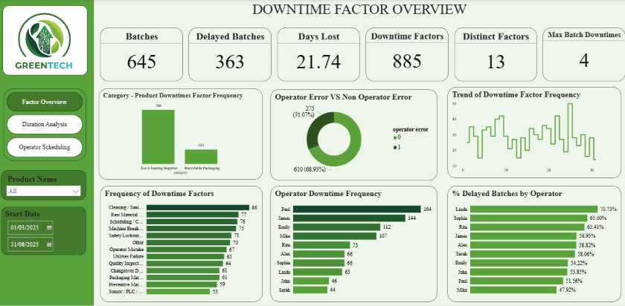
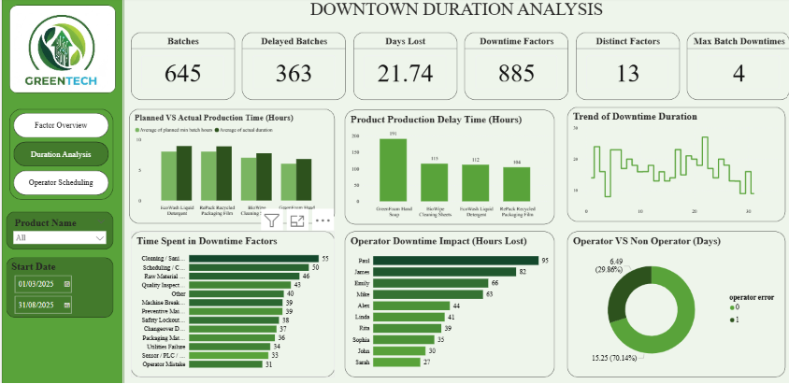
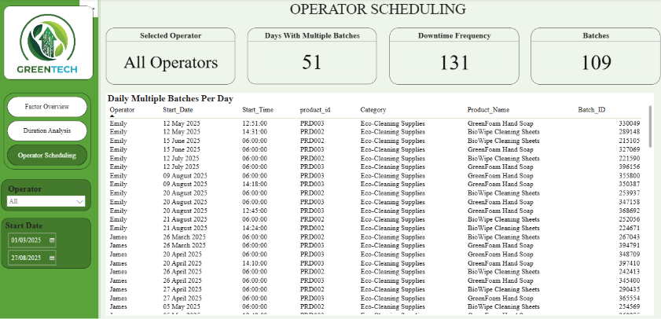
THE TOOLSET
Dashboard Overview
Downtime Factor Overview
Duration Analysis
Operator Scheduling
Highlights the biggest downtime drivers by category and product.
Tracks production delays and downtime duration trends over time.
Evaluates operator workload distribution and scheduling effectiveness.
GreenTech Downtime Analysis Project
9
Notes:
Three dashboards were developed to give a holistic view of operations. The Downtime Factor Overview highlights the major drivers of downtime by category and product. The Duration Analysis dashboard focuses specifically on production delays and how downtime duration trends over time. And the Operator Scheduling dashboard evaluates workload distribution and scheduling effectiveness across the team. All three are fully interactive and filterable by product and date range, which is what stakeholders will use going forward to self-serve their own questions.

Slide 10
THE NUMBERS
Key Findings
645
363
21.74
BATCHES PRODUCED
DELAYED BATCHES
DAYS LOST
885
13
4
DOWNTIME FACTORS
DISTINCT FACTORS
MAX DOWNTIMES / BATCH
GreenTech Downtime Analysis Project
10
Notes:
Let's ground this in the numbers. Across the reporting period, GreenTech produced 645 batches, of which 363 experienced delays — that's the 56% figure I mentioned earlier. Those delays translated into 21.74 lost production days. In total, we recorded 885 downtime incidents across 13 distinct downtime categories, with a maximum of four separate downtime events affecting any single batch. These six figures are the backbone of everything else in this presentation.

Slide 11
ROOT CAUSE
Downtime Factor Analysis
69%
KEY INSIGHTS
• Cleaning/sanitation is the single most frequent downtime factor.
of downtime is
non-operator (process/system)
• GreenFoam Hand Soap saw the most production disruption overall.
• Non-operator (process) causes dominate — a systems fix, not a people fix.
GreenTech Downtime Analysis Project
11
Notes:
Diving into root causes: cleaning and sanitation activities were the single most frequent downtime factor, closely followed by raw material shortages, scheduling and coordination delays, and machine breakdowns. Looking at products specifically, GreenFoam Hand Soap experienced the highest level of disruption, which points to process inefficiencies within that particular line. Perhaps most importantly, about 69% of downtime incidents were unrelated to operator error. That's a critical distinction for leadership — it tells us the biggest opportunity is in fixing systems and processes, not in disciplining or replacing people.

Slide 12
TRENDS OVER TIME
Duration Analysis
DASHBOARD EXHIBIT
Power BI — Duration Analysis dashboard, filterable by product and date range.
WHAT THE TREND TELLS US
• April experienced a spike, driven by increased downtime in GreenFoam Hand Soap and RePack Recycled Packaging Film production.
• A downward trend was observed from May through July.
• BioWipe Cleaning Sheets saw a consistent increase in downtime from April to July.
• August recorded a renewed high, with GreenFoam Hand Soap again spiking.
GreenTech Downtime Analysis Project
12
Notes:
Looking at how downtime evolved over the six-month period, we see clear fluctuation rather than a flat pattern. April showed a sharp spike, driven mainly by increased downtime in GreenFoam Hand Soap and RePack Recycled Packaging Film production. Things improved through a downward trend from May to July, but BioWipe Cleaning Sheets bucked that trend with a consistent increase across the same window, and August recorded another high point, again led by GreenFoam Hand Soap. Recognizing these seasonal and product-specific patterns lets management proactively allocate resources and schedule preventive measures during the periods we now know carry the most risk.

Slide 13
WORKFORCE PLANNING
Operator Scheduling Analysis
51
Days with operators assigned multiple batches
131
Scheduling-overlap downtime instances
109
Batches affected by overlap
Running two or more different products concurrently is a significant, avoidable cause of downtime.
GreenTech Downtime Analysis Project
13
Notes:
Turning to operator scheduling: Paul, James, and Emily show the highest downtime frequency, while Linda, Sophia, and Rita show the highest percentage of delayed batches — two related but distinct signals. The major factors behind operator-linked downtime are safety lockout and emergency stop events, cleaning and sanitation cycles, scheduling and coordination delays, and machine breakdown. More structurally, we found 51 separate days where operators were assigned to multiple batches simultaneously — 131 instances of scheduling overlap across 109 batches in total. That's a workforce-planning gap, not a performance problem, and it's directly addressable through better shift allocation.

Slide 14




WHY IT MATTERS
Business Impact
Persistent downtime is not a back-office issue — it compounds directly into cost, service, and competitiveness.
Reduced Productivity
Higher Operating Costs
Delayed Order Fulfillment
Weaker Competitive Position
Every downtime event compounds — 21.74 lost days represent capacity that could have gone to fulfillable orders.
Unplanned downtime drives overtime, expedited materials, and inefficient labor allocation.
Delayed batches ripple downstream into delivery schedules and customer commitments.
If unresolved, reliability gaps risk customer satisfaction and market standing over time.
GreenTech Downtime Analysis Project
14
Notes:
Why does all of this matter to leadership? Persistent downtime doesn't stay contained to the shop floor — it compounds into reduced productivity, higher operating costs, delayed order fulfillment, and, over time, a weaker competitive position. Those 21.74 lost days aren't just an internal metric; they represent real capacity that could have gone toward fulfillable customer orders. If these patterns go unaddressed, we risk both rising costs and declining customer satisfaction — which is exactly why the recommendations on the next slide are structured around the root causes we've just walked through.

Slide 15





THE PATH FORWARD
Recommendations
01
02
03
04
05
Preventive Maintenance
Inventory Management
Operator Training
Scheduling Optimization
Real-Time Monitoring
Introduce scheduled preventive maintenance programs to reduce equipment-related disruptions before they occur.
Implement real-time inventory monitoring and automated low-stock alerts to prevent material-shortage delays.
Deliver targeted training and conduct monthly performance reviews to support continuous improvement.
Use historical production data to optimize batch scheduling and eliminate concurrent-assignment overlaps.
Adopt real-time dashboards so leadership can make faster, better-informed operational decisions.
GreenTech Downtime Analysis Project
15
Notes:
Based on everything we've reviewed, here are five concrete recommendations. First, preventive maintenance programs to reduce equipment-related disruptions before they happen. Second, real-time inventory monitoring with automated alerts to prevent material-shortage delays. Third, targeted operator training paired with monthly performance reviews. Fourth, scheduling optimization that uses our historical data to avoid the concurrent-batch overlaps we identified. And fifth, adopting real-time monitoring dashboards more broadly so leadership always has current, accurate visibility rather than waiting for a monthly report. Together, these five actions directly target the root causes identified in this analysis.

Slide 16






PERSONAL GROWTH
Skills Gained
This project was as much a technical development exercise as it was a business deliverable.
PostgreSQL
SQL
Power BI
Querying and managing relational production data
Writing queries to extract and validate operational records
Building interactive, stakeholder-ready dashboards
DAX
Dashboard Design
Data Storytelling
Authoring custom measures to power live KPIs
Structuring layouts for clarity and self-service exploration
Translating raw data into a clear business narrative
GreenTech Downtime Analysis Project
16
Notes:
On a personal note, this project stretched my technical toolkit considerably. I deepened my hands-on experience with PostgreSQL and SQL for extracting and validating production data, built out Power BI dashboards from scratch, and wrote custom DAX measures to power live KPIs. Beyond the technical tools, I also developed my dashboard design sense — thinking about layout and clarity for a non-technical audience — and, maybe most importantly, my data storytelling: turning a dense dataset into a narrative that a leadership team can act on in fifteen minutes.

Slide 17

LOOKING BACK
Reflection & Lessons Learned
This project demonstrated how data analytics can be leveraged to solve real operational business problems — not just describe them.
Skills Reinforced
Core Lesson
SQL, PostgreSQL, Power BI, DAX, dashboard development, data storytelling, and stakeholder communication all came together in one deliverable.
The greatest value came from transforming raw data into actionable business insight — not from the analysis alone.
GreenTech Downtime Analysis Project
17
Notes:
Stepping back, this project demonstrated how data analytics can be leveraged to solve real operational business problems, not just describe them after the fact. On the technical side, I reinforced skills across SQL, PostgreSQL, Power BI, DAX, dashboard development, data storytelling, and — importantly — stakeholder communication, since a dashboard only creates value once someone can act on it. If I take one lesson forward, it's that the real value of a project like this isn't the analysis itself, it's the translation of that analysis into something a leadership team can actually use to make a decision.

Slide 18

WRAPPING UP
Conclusion
GreenTech now has a clear, data-backed picture of where downtime originates — and a practical roadmap to reduce it.
645 batches, 13 downtime factors, and 6 months of data now live in three interactive Power BI dashboards.
69% of downtime is process-driven — meaning the biggest wins are structural, not disciplinary.
Five targeted recommendations offer a realistic path to fewer delays and lower operating cost.
Thank you for your time and engagement throughout this project.
GreenTech Downtime Analysis Project
18
Notes:
To conclude: this project set out to identify why GreenTech was losing production days to downtime, and I believe the data gives us a clear, actionable answer. We now have 645 batches and 13 downtime factors mapped across six months in three interactive dashboards. We know that 69% of downtime is process-driven, meaning the biggest wins available to us are structural, not about individual performance. And we've translated that into five concrete recommendations that can realistically reduce delays and cost. Thank you again for your time and engagement throughout this project.

Slide 19

Questions & Discussion
Thank you — happy to discuss the methodology, findings, or recommendations in more depth.
Sarah Abhulimhen • Data Analyst Intern • GreenTech Manufacturing
GreenTech Downtime Analysis Project
19
Notes:
That brings me to the end of the formal presentation. Thank you again for your attention — I'd now like to open the floor for questions, whether on the methodology behind the analysis, any of the specific findings, or the recommendations I've proposed. I'm also happy to walk through the live Power BI dashboards in more detail if that would be useful.

Slide 20
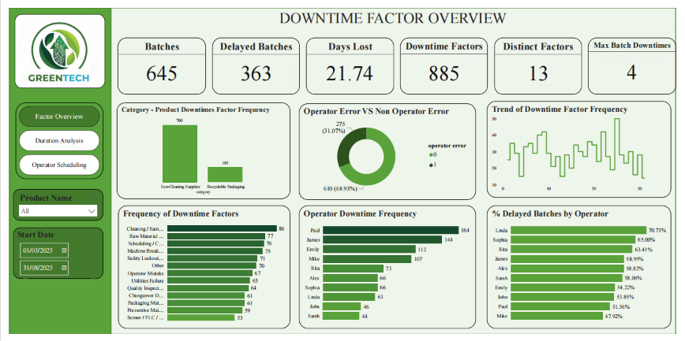
Dashboard
Appendix
GreenTech Downtime Analysis Project
20
Notes:
Stepping back, this project demonstrated how data analytics can be leveraged to solve real operational business problems, not just describe them after the fact. On the technical side, I reinforced skills across SQL, PostgreSQL, Power BI, DAX, dashboard development, data storytelling, and — importantly — stakeholder communication, since a dashboard only creates value once someone can act on it. If I take one lesson forward, it's that the real value of a project like this isn't the analysis itself, it's the translation of that analysis into something a leadership team can actually use to make a decision.

Slide 21
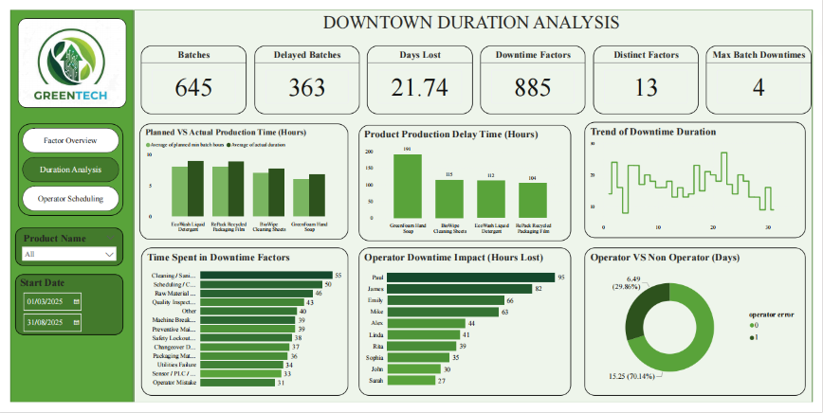
Dashboard
Appendix
GreenTech Downtime Analysis Project
21
Notes:
Stepping back, this project demonstrated how data analytics can be leveraged to solve real operational business problems, not just describe them after the fact. On the technical side, I reinforced skills across SQL, PostgreSQL, Power BI, DAX, dashboard development, data storytelling, and — importantly — stakeholder communication, since a dashboard only creates value once someone can act on it. If I take one lesson forward, it's that the real value of a project like this isn't the analysis itself, it's the translation of that analysis into something a leadership team can actually use to make a decision.

Slide 22
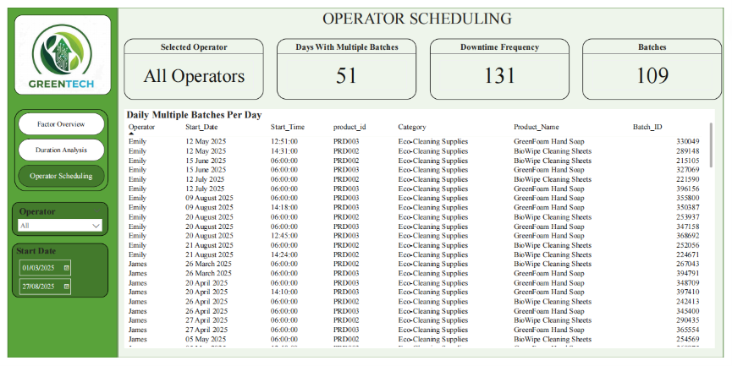
Dashboard
Appendix
GreenTech Downtime Analysis Project
22
Notes:
Stepping back, this project demonstrated how data analytics can be leveraged to solve real operational business problems, not just describe them after the fact. On the technical side, I reinforced skills across SQL, PostgreSQL, Power BI, DAX, dashboard development, data storytelling, and — importantly — stakeholder communication, since a dashboard only creates value once someone can act on it. If I take one lesson forward, it's that the real value of a project like this isn't the analysis itself, it's the translation of that analysis into something a leadership team can actually use to make a decision.

