Slide 1

AMDARI DATA ANALYTICS INTERNSHIP PROGRAM
NorthBridge Health Services Ltd
Customer Service Ticket & SLA
Optimisation System
A data-driven approach to visibility, SLA performance, and proactive service management.
Group 5
Data Analytics | Data Engineering | Data Science
July 2026

Slide 2
WHAT WE'LL COVER
Agenda
Business Understanding
Business Challenges
Project Objectives
1
2
3
Data Engineering Solution
Data Analytics Solution
Data Science & Forecasting
4
5
6
Recommendations
Business Impact
Conclusion
7
8
9
NorthBridge Health Services Ltd | Customer Service Ticket & SLA Optimisation System
2

Slide 3


BUSINESS UNDERSTANDING
About NorthBridge
NorthBridge Health Services Ltd is a UK-based healthcare administration and operational support organization serving more than 680 healthcare clients. Core services span appointments, billing, insurance, complaints, referrals, and medical records administration.
680+
Healthcare clients served
Operating across:
Manchester
Leeds
Birmingham
Edinburgh
11,000+
Customer service tickets processed monthly
NorthBridge Health Services Ltd | Customer Service Ticket & SLA Optimisation System
3

Slide 4
BUSINESS UNDERSTANDING
Business Challenges
Increasing first-response times
Growing ticket backlogs
Frequent SLA breaches
Inconsistent workload distribution
Limited operational visibility
Delayed escalation handling
Manual and fragmented reporting processes
NorthBridge Health Services Ltd | Customer Service Ticket & SLA Optimisation System
4

Slide 5

BUSINESS UNDERSTANDING
Project Objectives
Centralize fragmented operational data
Improve visibility into ticket and SLA performance
Identify tickets at risk of breaching SLAs
Reduce SLA breach volumes
Improve backlog monitoring
Support workload and capacity planning
Deliver interactive Power BI dashboards
Forecast future ticket demand and operational risk
NorthBridge Health Services Ltd | Customer Service Ticket & SLA Optimisation System
5

Slide 6




DATA ENGINEERING SOLUTION
Data Pipeline
1
2
3
4
Automated Ingestion
→
Secure Storage
→
Daily Warehouse Load
→
Reduced Manual Effort
Automated ingestion of ticket, client, and agent data.
Secure storage of raw source files.
Daily loading into a centralized data warehouse.
Eliminates manual data handling and reduces human error.
NorthBridge Health Services Ltd | Customer Service Ticket & SLA Optimisation System
6

Slide 7




DATA ENGINEERING SOLUTION
Organizing the Data the Way the Business Thinks
Who:
Agent & Client
What:
Ticket Category
When:
Calendar Dates
History:
Audit & Escalations
Ticket Events
(what actually happened)
Reference information (“who”, “what”, “when”) stays separate from ticket events — so every report defines a client, agent, or category the exact same way, every time.
NorthBridge Health Services Ltd | Customer Service Ticket & SLA Optimisation System
7

Slide 8


DATA ENGINEERING SOLUTION
Data Cleaning & Standardization
Standardized ticket status values
Removed duplicate ticket records
Consistent labels across all systems for accurate tracking.
Ensures each ticket is counted once for accurate KPIs.
Handled missing values
Standardized date & timestamp formats
Applied predefined business rules to fill data gaps.
Enables reliable time-based calculations and reporting.
NorthBridge Health Services Ltd | Customer Service Ticket & SLA Optimisation System
8

Slide 9

DATA ANALYTICS SOLUTION
Dashboard Architecture
Executive Summary
Ticket Operations
SLA Risk Monitoring
Workload & Capacity
Demand Forecasting
NorthBridge Health Services Ltd | Customer Service Ticket & SLA Optimisation System
9

Slide 10
DATA ANALYTICS SOLUTION
Business Value
Improved SLA visibility
Reduced manual reporting
Better workload allocation
Faster decision-making
Improved customer experience
Support for proactive service management
NorthBridge Health Services Ltd | Customer Service Ticket & SLA Optimisation System
10

Slide 11
DATA ANALYTICS SOLUTION
Power BI Analytics Solution
5
25+
Dynamic Slicers & Filtering
Interactive
Dashboards
DAX Measures
SLA Monitoring & Risk Tracking
Capacity Planning Metrics
Historical Trend Analysis
Executive-Level Reporting
Forecasting Support
NorthBridge Health Services Ltd | Customer Service Ticket & SLA Optimisation System
11

Slide 12
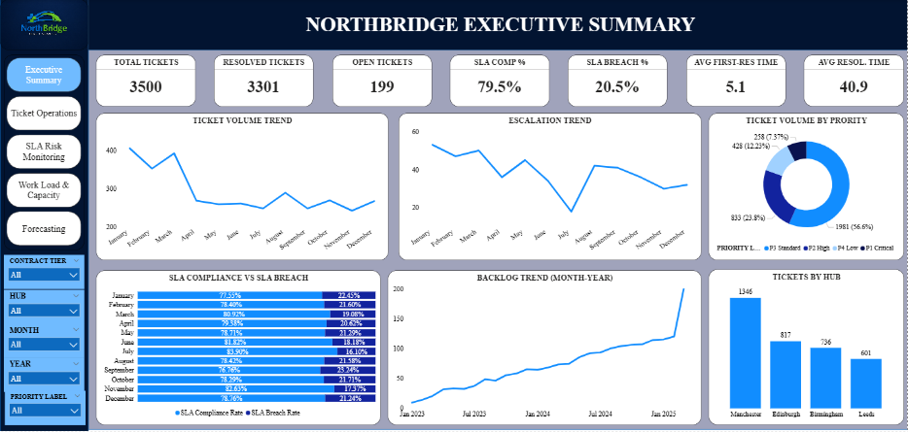
POWER BI ANALYTICS SOLUTION
Executive Summary Dashboard
3,500
3,301
Total Tickets
Resolved Tickets
79.5%
20.5%
SLA Compliance
SLA Breach Rate
5.1 hrs
40.9 hrs
Avg Response Time
Avg Resolution Time
Business Interpretation: NorthBridge demonstrates strong ticket resolution performance (94%); however, SLA compliance of 79.5% indicates opportunities to improve service responsiveness and reduce operational risk.
NorthBridge Health Services Ltd | Customer Service Ticket & SLA Optimisation System
12

Slide 13
POWER BI ANALYTICS SOLUTION
Executive Summary Dashboard
NorthBridge Health Services Ltd | Customer Service Ticket & SLA Optimisation System
13

Slide 14

POWER BI ANALYTICS SOLUTION
Executive Summary – Business Insights
BUSINESS PERFORMANCE
TIME-SERIES ANALYSIS
OPERATIONAL PRIORITY
94.3% of tickets resolved (3,301 of 3,500) — strong operational throughput.
Ticket demand declined after Q1, then stabilised.
Manchester generates the highest ticket volume — the priority hub for process optimisation.
79.5% SLA compliance — roughly 1 in 5 tickets missed contractual targets.
Escalations followed the same downward pattern, easing pressure.
Backlog kept rising despite fewer tickets — unresolved work is outpacing clearance.
NorthBridge Health Services Ltd | Customer Service Ticket & SLA Optimisation System
14

Slide 15
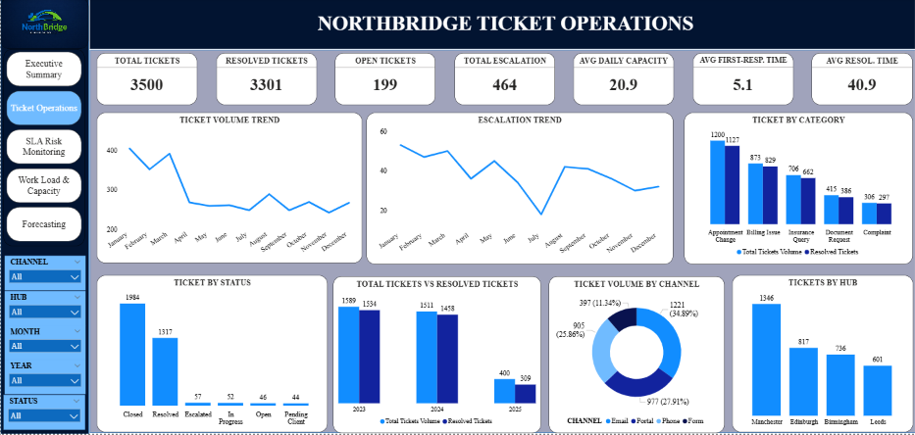
POWER BI ANALYTICS SOLUTION
Ticket Operations Dashboard
Key Insights
Appointment Changes account for the highest ticket volume.
Manchester processes the largest number of support tickets.
Email remains the primary communication channel.
The majority of tickets successfully reach closure.
Business Interpretation: Appointment Change requests and Manchester operations represent the primary drivers of ticket demand. These areas should be prioritized for process improvement and resource allocation.
NorthBridge Health Services Ltd | Customer Service Ticket & SLA Optimisation System
15

Slide 16
POWER BI ANALYTICS SOLUTION
Ticket Operations Dashboard
NorthBridge Health Services Ltd | Customer Service Ticket & SLA Optimisation System
16

Slide 17
POWER BI ANALYTICS SOLUTION
Ticket Operations – Operational Analysis
TIME-SERIES FINDINGS
OPERATIONAL DRIVERS
Ticket demand stabilised after the sharp decline seen in April.
Appointment Change requests remain the largest contributor to ticket demand.
Operational workload has become more predictable.
Email is the dominant channel — an opportunity for self-service automation.
HUB PERFORMANCE
OPERATIONAL OBSERVATION
Manchester consistently records the highest ticket volumes, suggesting elevated demand or operational bottlenecks.
Most tickets ultimately reach closure, demonstrating effective ticket lifecycle management.
NorthBridge Health Services Ltd | Customer Service Ticket & SLA Optimisation System
17

Slide 18
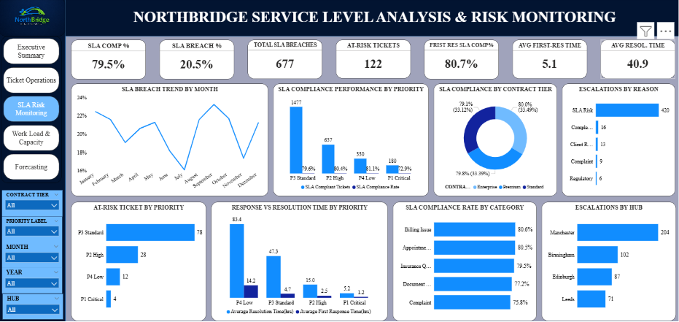
POWER BI ANALYTICS SOLUTION
SLA Risk Monitoring Dashboard
79.5%
677
SLA Compliance
SLA Breaches
122
13.3%
At-Risk Tickets
Escalation Rate
Key Insights
P3 Standard tickets contribute the highest SLA burden.
SLA performance varies significantly by ticket category.
At-risk tickets provide opportunities for proactive intervention.
Business Interpretation: P3 Standard tickets contribute disproportionately to SLA risk, suggesting that targeted interventions and proactive monitoring could significantly improve compliance rates.
NorthBridge Health Services Ltd | Customer Service Ticket & SLA Optimisation System
18

Slide 19
POWER BI ANALYTICS SOLUTION
SLA Risk Monitoring Dashboard
NorthBridge Health Services Ltd | Customer Service Ticket & SLA Optimisation System
19

Slide 20

DATA ANALYTICS SOLUTION
SLA Monitoring – Operational Risk Analysis
122
AT-RISK TICKETS — WHAT THEY ARE & WHY THEY MATTER
TICKETS AT RISK
122 tickets are classified At-Risk: approaching their SLA deadline but not yet in breach.
They flag an opportunity for proactive intervention before a contractual failure occurs.
KEY FINDING
PRIORITY ANALYSIS
TIME-SERIES ANALYSIS
First-response compliance exceeds 80%, but overall SLA compliance is lower — delays occur later in the ticket lifecycle.
Most at-risk tickets sit in the P3 Standard category — the highest-impact area for improvement.
Monthly SLA performance fluctuates rather than improving consistently, pointing to recurring constraints.
NorthBridge Health Services Ltd | Customer Service Ticket & SLA Optimisation System
20

Slide 21
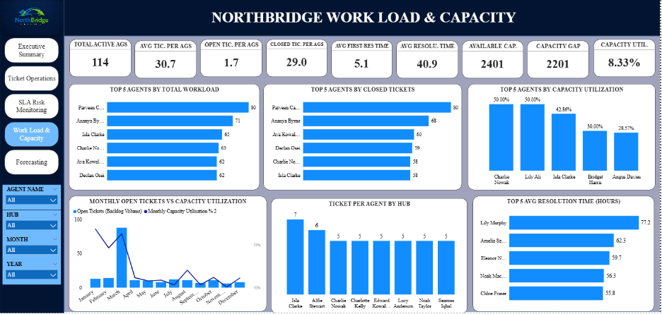
POWER BI ANALYTICS SOLUTION
Workload & Capacity Dashboard
114
2,401
Active Agents
Available Capacity
2,201
8.33%
Capacity Gap
Capacity Utilization
Key Insights
Significant unused capacity exists across the service desk.
Workload distribution remains uneven among agents.
Capacity metrics support future staffing decisions.
Business Interpretation: Capacity utilization of 8.33% suggests that NorthBridge may have excess operational capacity or an imbalance in workload allocation across agents.
NorthBridge Health Services Ltd | Customer Service Ticket & SLA Optimisation System
21

Slide 22
POWER BI ANALYTICS SOLUTION
Workload & Capacity Dashboard
NorthBridge Health Services Ltd | Customer Service Ticket & SLA Optimisation System
22

Slide 23

DATA SCIENCE & FORECASTING
Data Science & Predictive Analytics
The Data Science team is developing predictive models to support proactive operational management.
SLA Breach Prediction –
Predict tickets likely to breach SLA
– Complete
Demand Forecasting – Forecast future ticket demand
– Complete
Backlog Forecasting – Forecast future backlog growth
– Complete
Ticket Triage – Predict ticket category & priority
– Partial
The Data Science workstream enables NorthBridge to transition from reactive operational reporting to proactive decision-making by introducing predictive analytics capabilities across ticket management, SLA monitoring, and workload planning.
NorthBridge Health Services Ltd | Customer Service Ticket & SLA Optimisation System
23

Slide 24
DATA SCIENCE & FORECASTING
SLA Breach Prediction
Key Insights
48 tickets predicted to breach SLA.
Key Insights
Logistic Regression selected as the production model after comparison with Logistic Regression, XGBoost, and LightGBM.
50 High-Risk tickets identified.
Process Flow: New Ticket → Risk Score Generated → Low / Medium / High → Operational Intervention
Average breach probability: 33.4%.
SLA Risk is the largest driver of escalations.
Business Interpretation:
The model provides an early warning mechanism, allowing operational teams to intervene before contractual service breaches occur.
NorthBridge Health Services Ltd | Customer Service Ticket & SLA Optimisation System
24

Slide 25
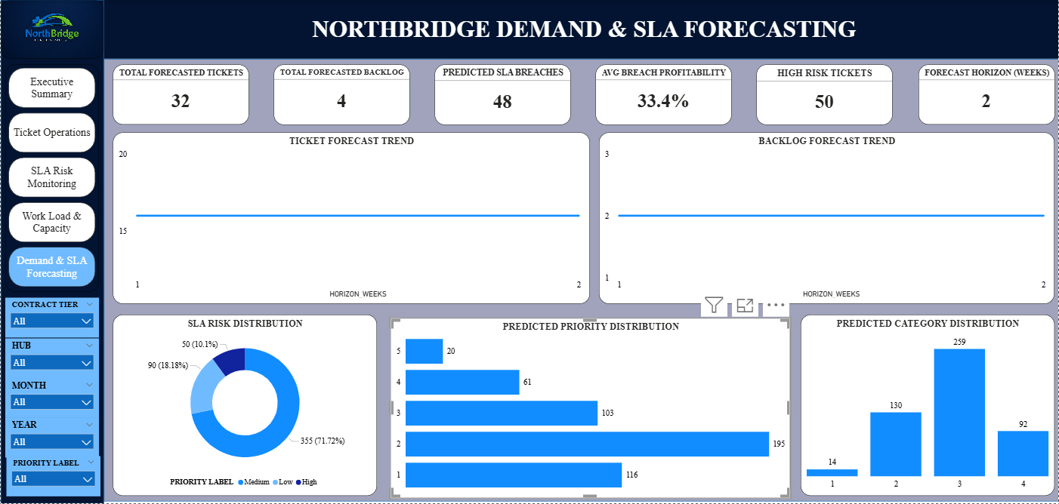
DATA SCIENCE & FORECASTING
Demand & Backlog Forecasting
2 weeks
32
Forecast Horizon
Forecasted Ticket Volume
4
Forecasted Backlog
Key Insights
Historical demand patterns indicate stable short-term ticket volumes.
Short-term forecasts provide support for resource planning.
Forecasting reliability is currently validated only for a 1–2 week horizon.
Business Interpretation: Forecasting enables operational managers to anticipate upcoming workload and allocate resources proactively rather than responding after demand peaks occur.
NorthBridge Health Services Ltd | Customer Service Ticket & SLA Optimisation System
25

Slide 26
DATA SCIENCE & FORECASTING
Demand & Backlog Forecasting
NorthBridge Health Services Ltd | Customer Service Ticket & SLA Optimisation System
26

Slide 27
DATA SCIENCE & FORECASTING
Forecast Interpretation – Business Actions
DEMAND FORECAST
MODEL LIMITATIONS
Short-term forecasts point to relatively stable demand over the next two weeks.
Forecasting is currently reliable only to a two-week horizon, limited by available history.
Forecasts support proactive workforce planning.
Planned upgrades: confidence intervals, longer horizons, accuracy validation.
48
RECOMMENDED ACTIONS — 48 PREDICTED SLA BREACH TICKETS
TICKETS PREDICTED TO BREACH SLA
Review all predicted breach tickets and validate before acting.
Prioritise High-Risk tickets for immediate attention.
Confirm predicted ticket categories before rerouting work.
Escalate tickets approaching their SLA deadline ahead of breach.
These actions enable NorthBridge to intervene before SLA breaches occur, reducing contractual risk, improving customer service performance, and supporting proactive operational decision-making.
NorthBridge Health Services Ltd | Customer Service Ticket & SLA Optimisation System
27

Slide 28
DATA SCIENCE & FORECASTING
Ticket Triage & Model Limitations
Future Enhancements:
Confidence Intervals
MAPE Validation
Hindcasting
Fairness Review
Ticket Text Integration
Extended Forecast Horizons
Ticket Triage Results:
Category prediction achieved meaningful performance improvements.
Priority prediction remains unreliable.
Category predictions are suitable as operational recommendations.
Reliable:
Predicted Category
Not Recommended: Predicted Priority
Bottom Statement:
The inclusion of ticket text data is expected to significantly improve prediction accuracy and represents the highest-value enhancement opportunity identified by the Data Science team.
NorthBridge Health Services Ltd | Customer Service Ticket & SLA Optimisation System
28

Slide 29
STRATEGIC RECOMMENDATION
Recommendations
Implement automated SLA alerts for at-risk tickets
Introduce proactive escalation monitoring processes
1
2
Review staffing allocations across operational hubs
Continue investing in forecasting capabilities
3
4
Implement backlog reduction initiatives
Standardize monthly operational reporting
5
6
NorthBridge Health Services Ltd | Customer Service Ticket & SLA Optimisation System
29

Slide 30


EXPECTED BUSINESS BENEFITS
Business Impact
Operational Benefits
Financial Benefits
Customer Benefits
Improved SLA visibility
Reduced SLA-related penalties
Faster response times
Faster decision-making
Improved resource utilization
Improved customer satisfaction
Reduced manual reporting
Lower operational inefficiencies
Increased service reliability
Better workload management
NorthBridge Health Services Ltd | Customer Service Ticket & SLA Optimisation System
30

Slide 31
WRAPPING UP
Conclusion
By combining Data Engineering, Power BI analytics, and predictive modelling, the NorthBridge Customer Service Ticket & SLA Optimisation System creates a single, data-driven environment that shifts operations from reactive reporting to proactive decision-making.
NorthBridge’s operational challenges are driven less by a lack of resources and more by visibility, prioritisation, and process inefficiencies — the exact issues this solution is built to solve.
Together, these capabilities give NorthBridge a strong foundation for improving SLA performance, workforce planning, and long-term operational efficiency.
NorthBridge Health Services Ltd | Customer Service Ticket & SLA Optimisation System
31

Slide 32
Thank You
Group 5
Customer Service Ticket & SLA Optimisation System

