Slide 1

InsurTech
InsurTech: Using AI, ML to predict Insurance Health Care Charges
Group Future Fintech
•Amjad Alqarni
•Sarah Almaghthawi
•Nada AlGhamdi
•Somaya Abodabeel
•Malak Alsuroor

Slide 2
Content
01
02
03
04
Introduction
PPT
IPython Notebook walkthrough
GUI Interface
Business proposal
PPT

Slide 3
InsurTech
A combination of the words insurance and technology, Insurtech refers to new insurance technology that improves the customer experience, simplifies policy management, and increases competition.
What is Health Insurance?
Health Insurance covers your medical expenses due the diseases and accident.
Health Insurance is a contract between an individual/group and the insurer.
- The policy providers specific health cover for a particular premium.

Slide 4
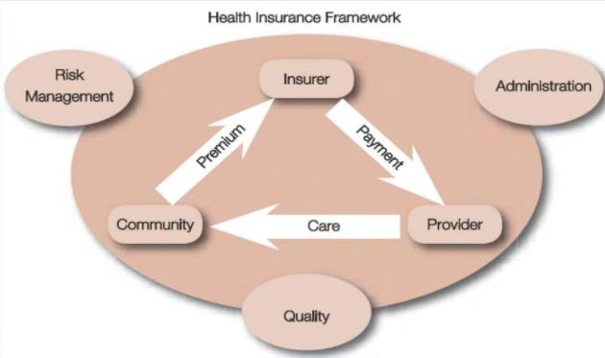
Elements:

Slide 5
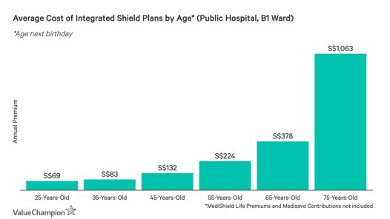
Statistics
Some studies say that age is the most influential factor on the cost of insurance. However, according to our analyzes on the database, we find other factors that increase the cost of insurance, such as smoking and BMI. We will show that later in our research.

Slide 6
This dataset contains 1338 rows of insured data, where the Insurance charges are given against the following attributes of the insured: Age, Sex, BMI, Number of Children, Smoker and Region. The attributes are a mix of numeric and categorical variables.
Dataset

Slide 7
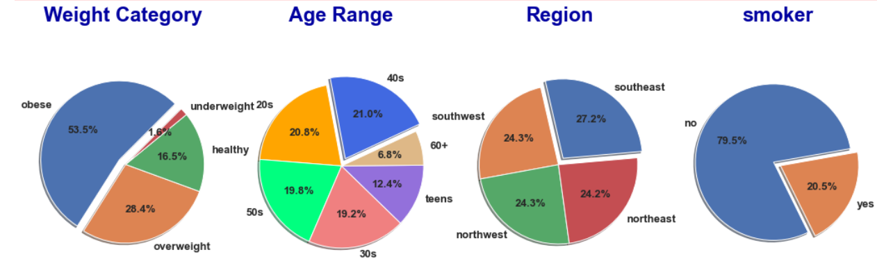
Data Exploration
Using a Pie chart, we were able to classify the distribution ratios of the dataset

Slide 8
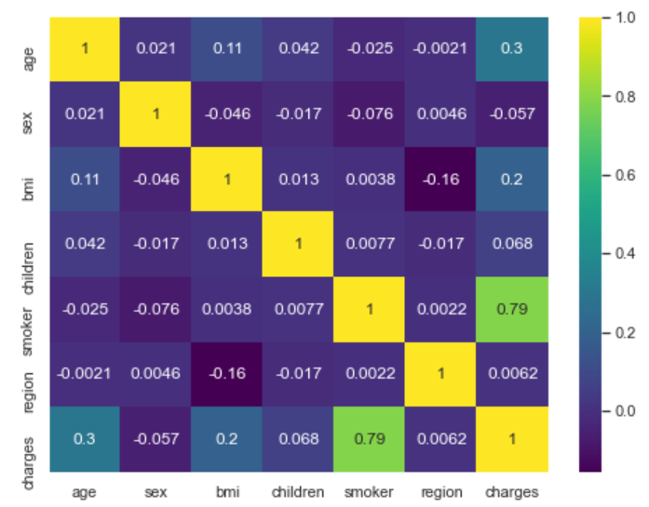
Correlation
Sex, children, and Region have the lowest correlation to charges.
Smoking has the biggest correlation to charges.

Slide 9

01
LinearRegression
Model
02
SVR
03
RandomForestRegressor
04
GradientBoostingRegressor

Slide 10
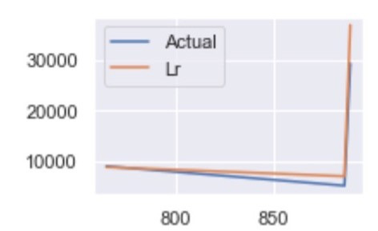
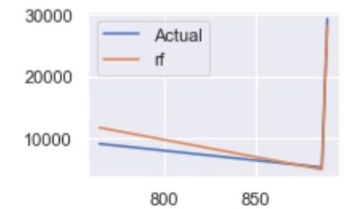
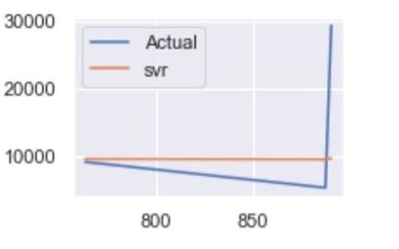



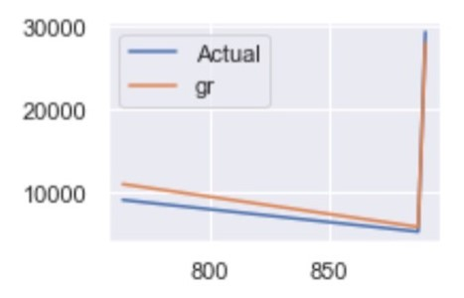


Models
LinearRegression
SVM
Random Forest Regression
used to explain the relationship between one dependent variable and one or more independent variables.
SVM is classification algorithm but applies it to predict real values rather than a class. SVR acknowledges the presence of non-linearity in the data and provides a proficient prediction model.
Random Forest Regression is a supervised learning algorithm that uses ensemble learning method for regression.
0.7833463107364539
-0.07229793131123086
0.8652550150413151
GBR
Gradient Boosting Regressors (GBR) are ensemble decision tree regressor models.
0.8779726251291786

Slide 11
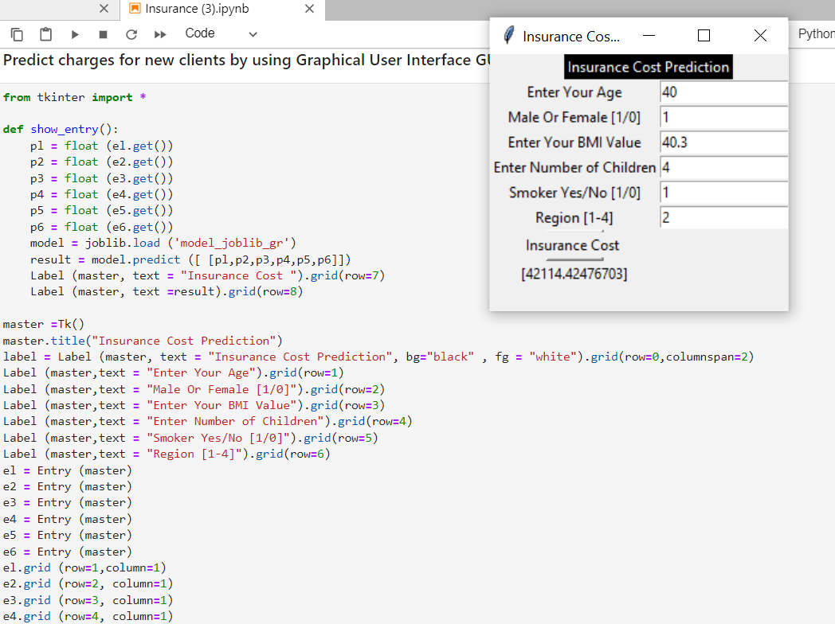
GUI
Tkinter is the standard GUI library for Python. Python when combined with Tkinter provides a fast and easy way to create GUI applications. Tkinter provides a powerful object-oriented interface to the Tk GUI toolkit.
Creating a GUI application using Tkinter is an easy task.

Slide 12
Thank you for listening

Slide 13
https://www.ehealthinsurance.com/resources/individual-and-family/how-much-does-individual-health-insurance-cost
https://www.valuechampion.sg/average-cost-and-benefits-health-insurance
https://www.kaggle.com/jsonlim/insurancedataset/notebook
https://www.google.com/amp/s/slideplayer.com/amp/8080918/
Resource Page

