Slide 1
Sleep Disorder
Sarah Alshumayri, Reema Abdallah, Yehya Aseeri

Slide 2
Problem Statement
“Sleep Disorder Analysis: Unveiling the Interplay Between Lifestyle, Health, and Sleep Quality”
This project aims to delve into an extensive dataset comprising individual sleep patterns, health indicators, and lifestyle choices. Our objective is to uncover the complex relationships between these factors and their collective impact on sleep quality and disorders. The insights gained through this analysis could be pivotal in enhancing our understanding of sleep health and informing better lifestyle and health choices.

Slide 3
Background
Sleep is a critical component of overall health and well-being, yet it is often influenced by a myriad of factors ranging from lifestyle choices to health conditions. Understanding the dynamics of sleep and its relationship with different health and lifestyle factors can provide crucial insights for improving sleep quality and, by extension, overall health and life satisfaction.
This project leverages data-driven analysis to explore these relationships. With datasets detailing sleep efficiency, stages of sleep, and other relevant sleep metrics, combined with data on physical activity, stress levels, BMI categories, and more, we can draw a comprehensive picture of the multifaceted nature of sleep in the context of contemporary lifestyles. This analysis can potentially lead to actionable recommendations for individuals seeking to improve their sleep and overall health.

Slide 4
Methods Explored
In the initial stages of our sleep data analysis project, we considered several methodologies to ensure a comprehensive approach.
Data Preprocessing and Feature Selection:
The first step involved data preprocessing, which included cleaning, handling missing values, and normalizing data. Feature selection was critical to identifying relevant variables impacting sleep quality.
Exploratory Data Analysis (EDA):
EDA was conducted to explore trends and relationships, focusing on factors like ‘Sleep Duration’, ‘Lifestyle Habits’, ‘Health Indicators’, and ‘Sleep Efficiency’.
Methodological Choices:
We considered statistical models for sleep quality prediction and correlation analysis to understand the interplay between lifestyle choices and sleep health. R, along with libraries like tidyverse, dplyr, and ggplot2, was identified as suitable for these analyses. These considerations laid the groundwork for our analytical approach, tailored to uncover meaningful insights into sleep patterns and health.

Slide 5
The Methods/Tools Used
After evaluating our options, we finalized our methodologies and tools for analyzing the Sleep_health_and_lifestyle_dataset.csv effectively.
Data Preprocessing and Analysis Tools:
R: Chosen for its robust data manipulation and statistical analysis capabilities. We utilized R, particularly with dplyr and ggplot2, for data preprocessing, analysis, and visualization.
Rationale: The selection was based on the efficiency and the comprehensive data analysis capabilities offered by R.

Slide 6
Results
Presenting Initial Findings or Data Our preliminary analysis, based on the cleaned and prepared data, has revealed significant insights into the correlation between sleep disorders and various lifestyle and health factors.
Further Results:
Additional Results or Visualizations Building upon our initial findings, the following visualization provides an insight into the relationship between lifestyle choices and sleep quality.

Slide 7
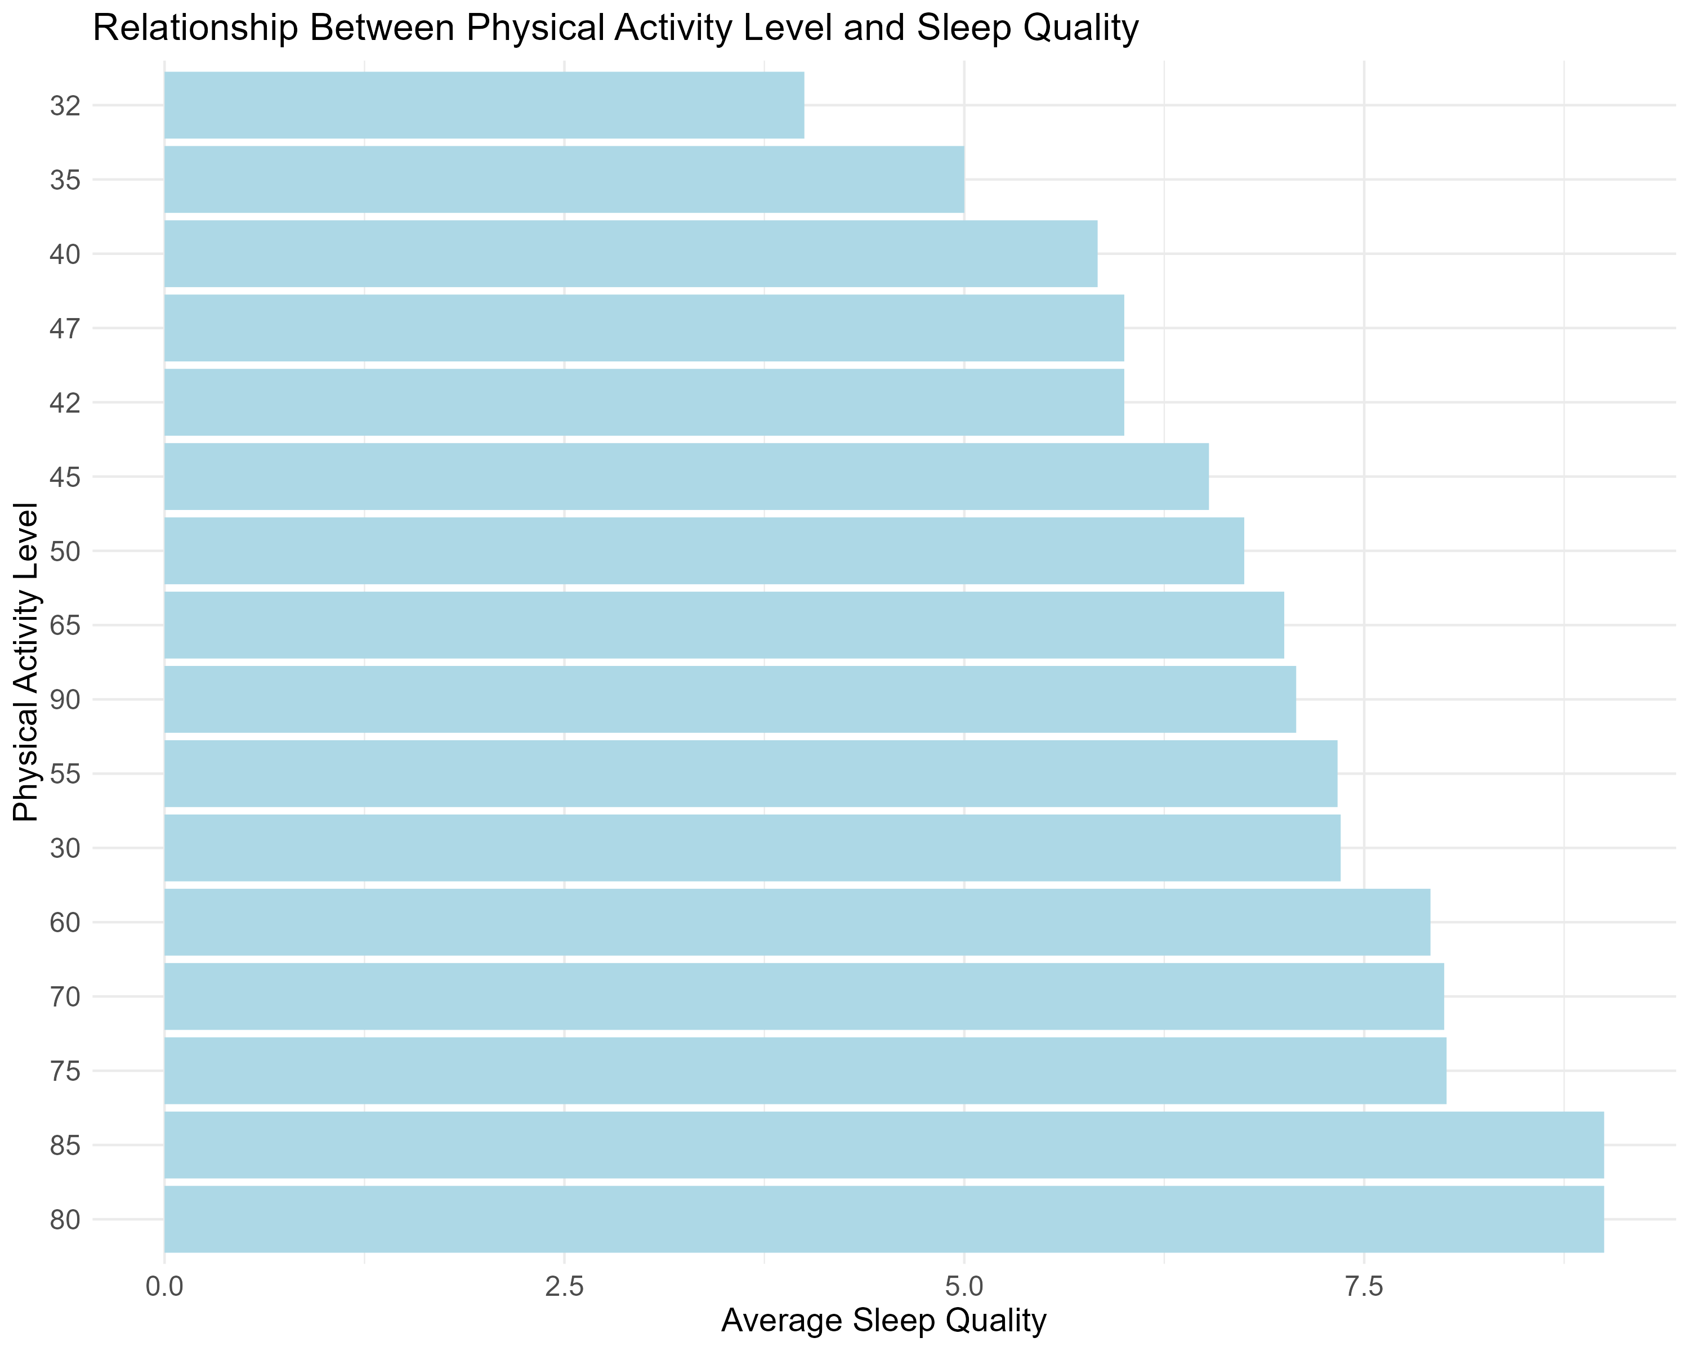

Slide 8
Lessons Learned
-Identified key factors influencing sleep quality and disorders.
-Explored the impact of lifestyle choices on sleep efficiency.
-Analyzed health indicators correlating with sleep patterns.
-Encountered challenges in data normalization due to diverse health indicators.
-Recognized the importance of multidisciplinary insights in sleep research.

Slide 9
Future Plans
-Deepen the analysis to include psychological factors.
-Explore machine learning models for predictive analysis.
-Collaborate with healthcare professionals for practical application.
-Utilize advanced statistical methods for more nuanced insights.
-Assess the implications of findings on public health and wellness.

