Slide 1
Sleep Disorder
Sarah Alshumayri, Reema Abdallah, Yehya Aseeri

Slide 2
Problem Statement
“Sleep Disorder Analysis: Unveiling the Interplay Between Lifestyle, Health, and Sleep Quality”
This project aims to delve into an extensive dataset comprising individual sleep patterns, health indicators, and lifestyle choices. Our objective is to uncover the complex relationships between these factors and their collective impact on sleep quality and disorders. The insights gained through this analysis could be pivotal in enhancing our understanding of sleep health and informing better lifestyle and health choices.

Slide 3
Background
Sleep is a critical component of overall health and well-being, yet it is often influenced by a myriad of factors ranging from lifestyle choices to health conditions. Understanding the dynamics of sleep and its relationship with different health and lifestyle factors can provide crucial insights for improving sleep quality and, by extension, overall health and life satisfaction.
This project leverages data-driven analysis to explore these relationships. With datasets detailing sleep efficiency, stages of sleep, and other relevant sleep metrics, combined with data on physical activity, stress levels, BMI categories, and more, we can draw a comprehensive picture of the multifaceted nature of sleep in the context of contemporary lifestyles. This analysis can potentially lead to actionable recommendations for individuals seeking to improve their sleep and overall health.

Slide 4
Methods Explored
Reema’s part

Slide 5
The Methods/Tools Used
Yahya’s part

Slide 6
Results
Presenting Initial Findings or Data Our preliminary analysis, based on the cleaned and prepared data, has revealed significant insights into the correlation between sleep disorders and various lifestyle and health factors.
Additional Results or Visualizations Building upon our initial findings, the following visualization provides an insight into the relationship between lifestyle choices and sleep quality.

Slide 7
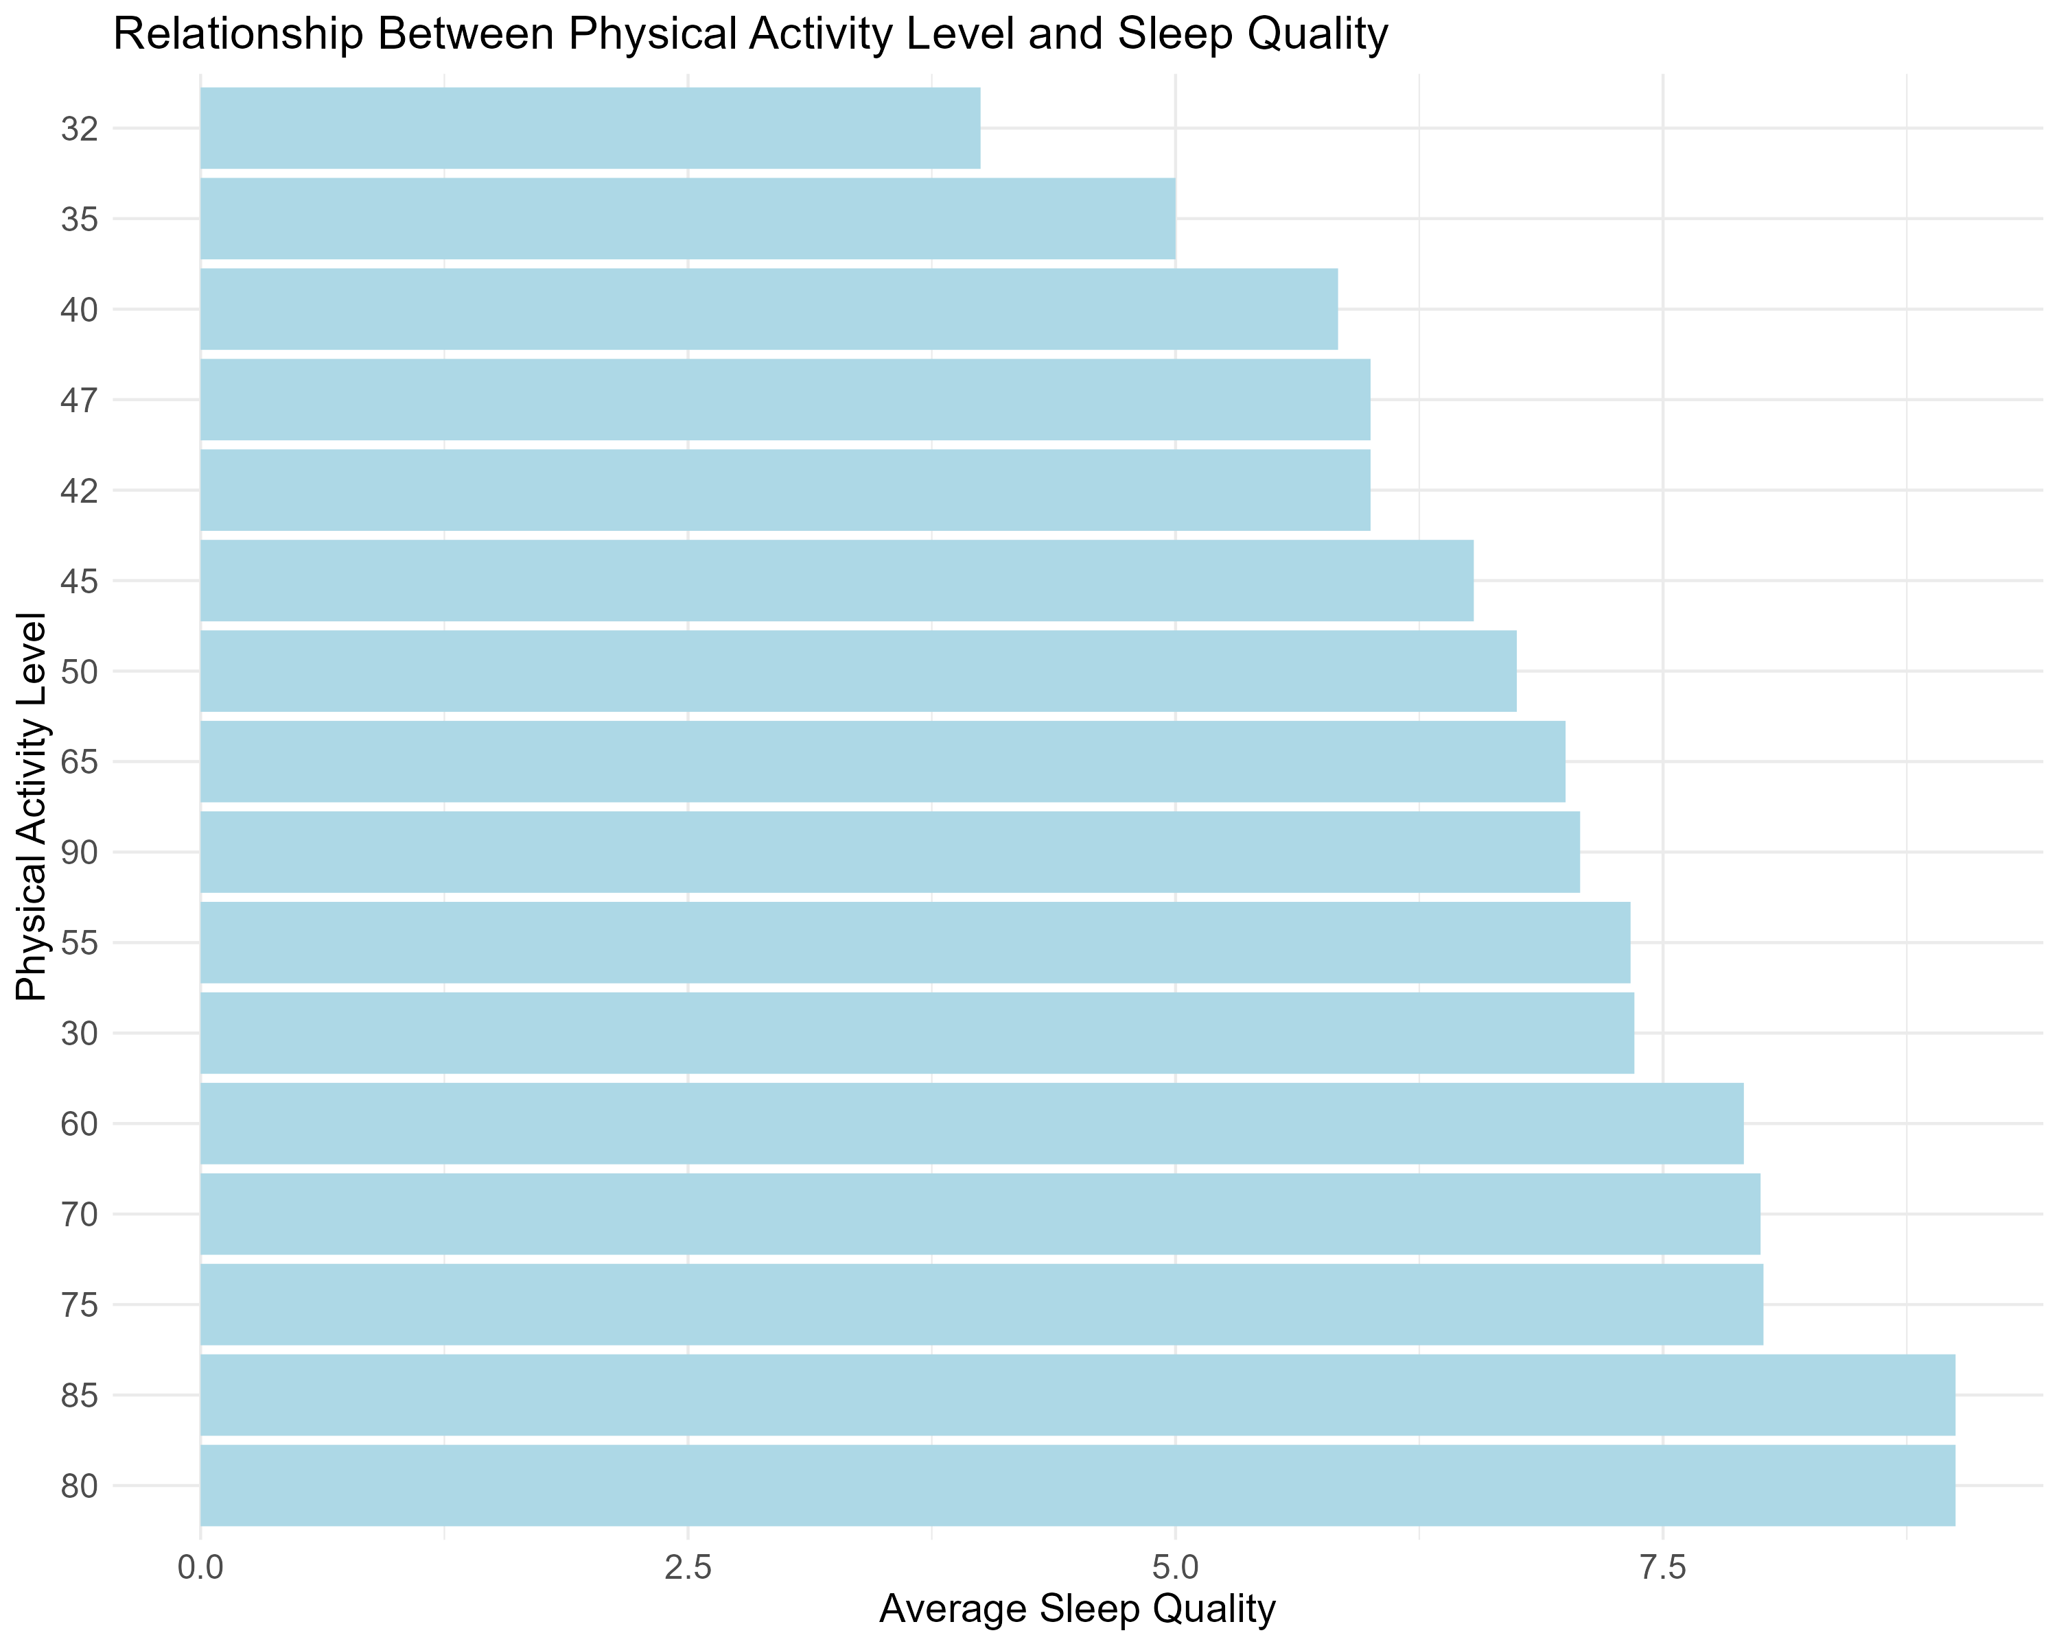

Slide 8
Lessons Learned
Reema’s part

Slide 9
Future Plans
Reema’s part

