Slide 1
Syeda Sarah Mashhood
Data Analyst
Bridging Data Insights with Business Strategy

Slide 2
Power BI Project Details

Slide 3
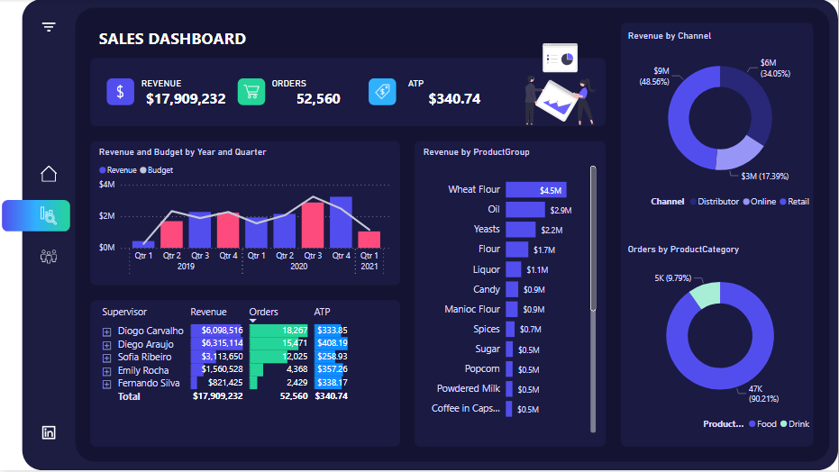
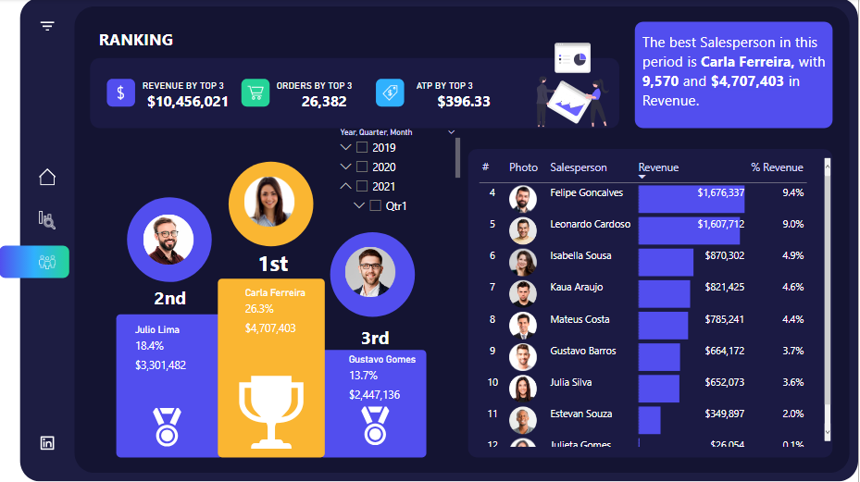
Project 1: Multi-page Sales Dashboard
Developed a comprehensive Sales Dashboard featuring multiple pages:
  The first page presents revenue and budget by year, revenue by channel by product group, orders by product, and additional insights on revenue, orders, and ATP.
  The second page showcases top performers, their revenue, orders, ATP, revenue percentage by different salespersons.
Leveraged DAX expressions to create columns, measures, and tables, optimizing memory usage and ensuring dynamic calculations for real-time insights.
Implemented data modeling techniques to structure and optimize the dataset for efficient analysis and visualization.

Slide 4
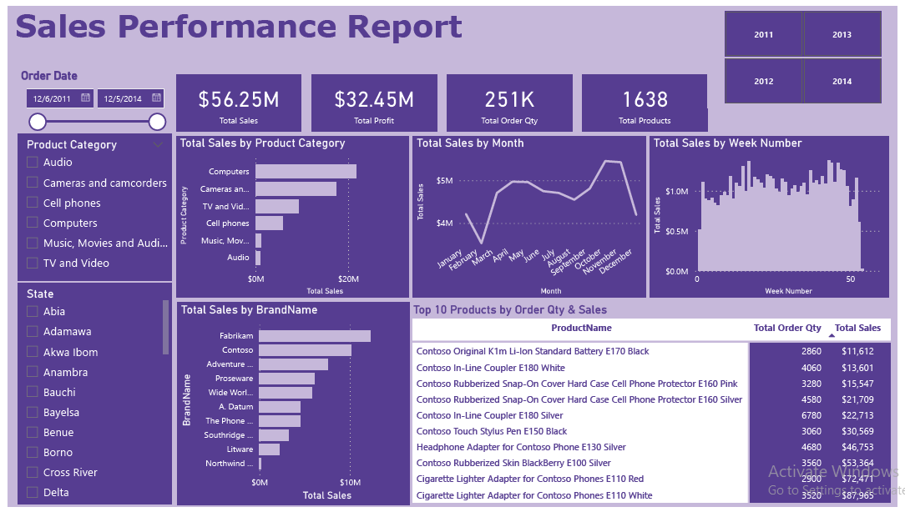
Project 2: Sales Performance Report
Engineered a Sales Performance Report, meticulously transforming tables and optimizing data modeling for accuracy.
Presented key metrics such as Total Sales, Total Profit, Order Quantity, and Total Products, alongside dynamic visualizations including monthly and weekly sales trends, top 10 products analysis, sales by brand, and product category. Incorporated date, product category, and state filters for enhanced user interactivity, with a dedicated page for regional sales analysis showcasing state-level insights.

Slide 5
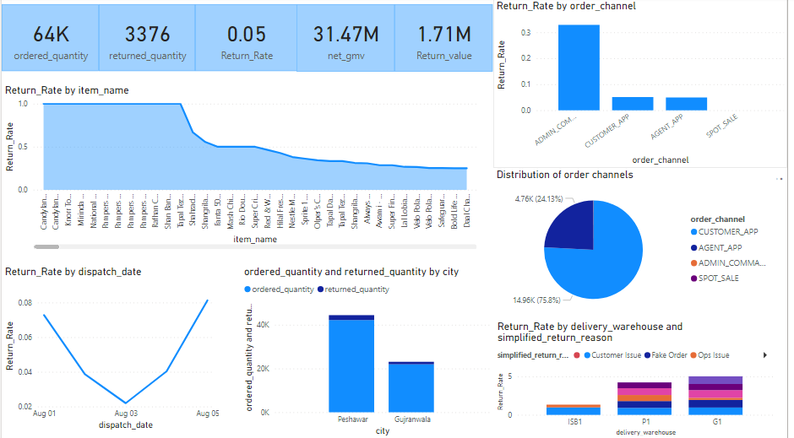
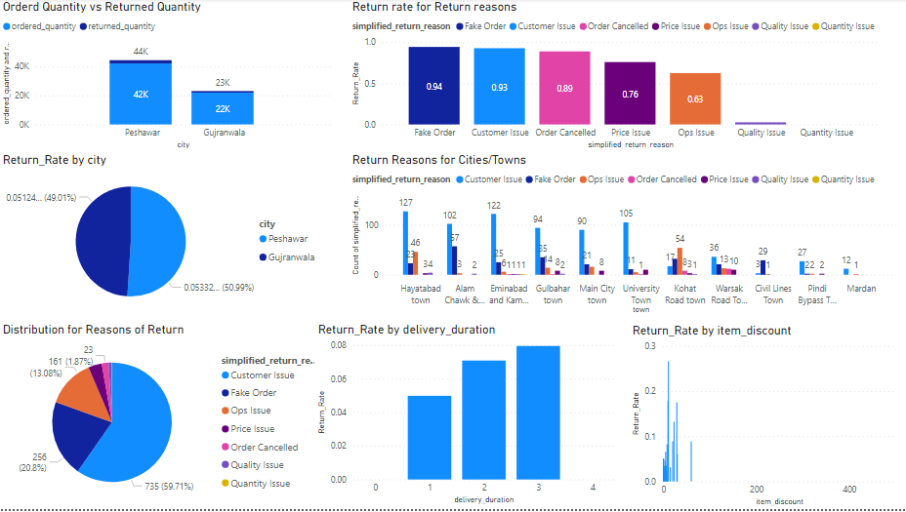
Project 3: Customer Experience Analysis
Utilized a dataset encompassing deliveries in different region to address stakeholders' key concerns: what happened, why it matters, and recommended actions.
Extracted and presented meaningful insights to highlight trends, patterns, and potential areas to reduce market returns.

Slide 6
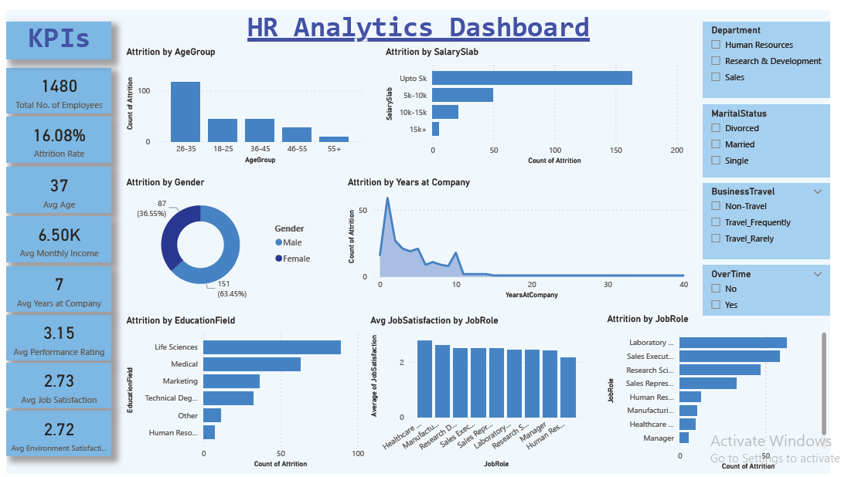
Project 4: HR Analytics Dashboard
Created an extensive HR Analytics dashboard, showcasing essential metrics like attrition rates, average age, and salary data.
Developed dynamic visualizations to illustrate attrition trends by education, salary, age, tenure, job role, and gender, alongside departmental filters for nuanced analysis.

