Slide 1
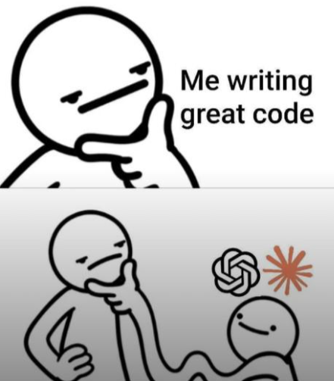
Whisper through Google Colab: A Beginner’s Guide
Automatic Speech Recognition for Linguistic Research
Sarah Syamken
Georgetown University

Slide 2
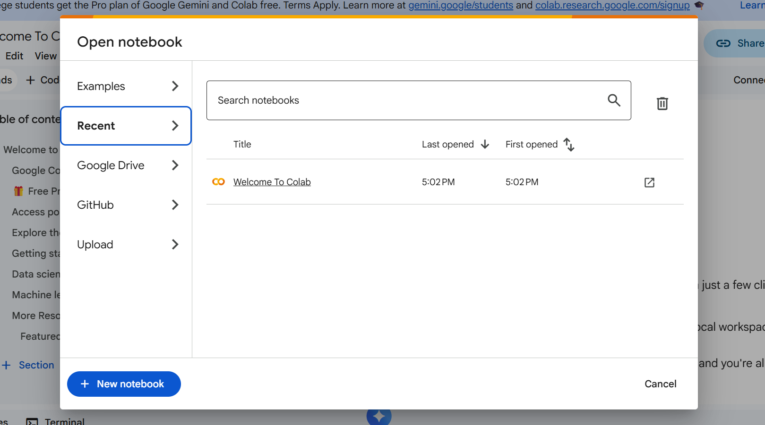
Step 1
Go to: https://colab.research.google.com/ (it should look like this; you want to click the blue +New Notebook button)
You’ll need a Google account to access Colab — a personal Gmail account works fine.

Slide 3
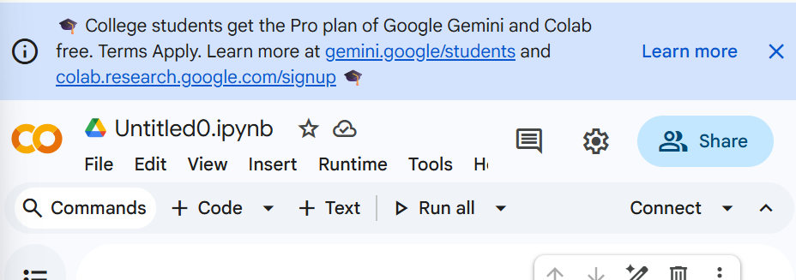
Step 2
Take advantage of the Pro plan for college students and click the second hyperlink
This is not necessary, but it is HIGHLY recommended, especially if you have a lot of audios to transcribe.

Slide 4
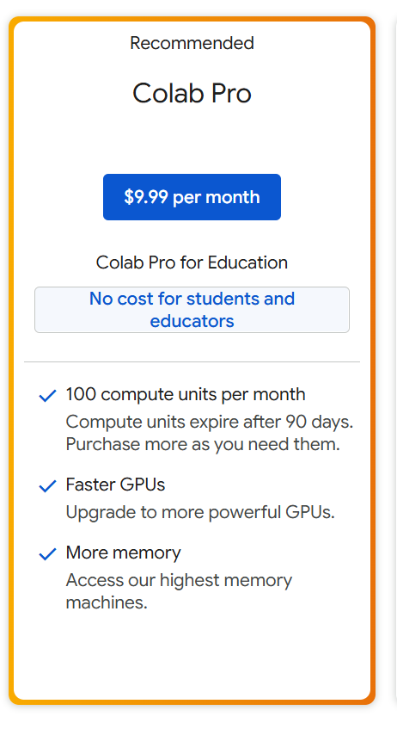
Step 3
Select the “Colab Pro” option.
We are doing this because the Pro plan allows us to use GPU processors, which are very important for large data sets (lots of audios)
If you only want to see how Whisper works, or only have a few short audios, you can stay on the CPU and don’t need to go through the rest of the steps.

Slide 5
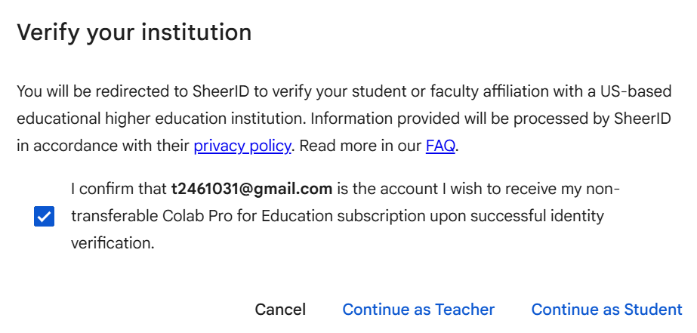
Step 4
Verify your institution; if you have already used SheerID (a third-party service) before, it should be easy
If not, you will have to upload an ID
If you have trouble with this, don’t worry! You can still use Whisper without the faster processor — transcripts just take a bit longer.

Slide 6
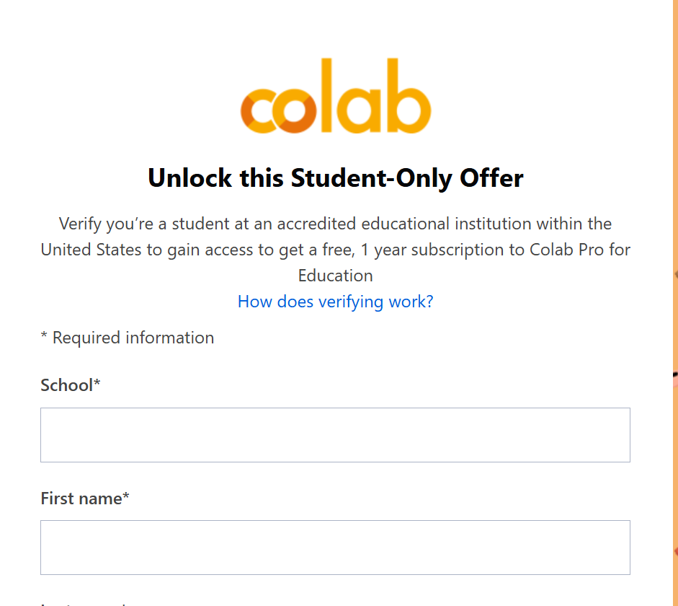
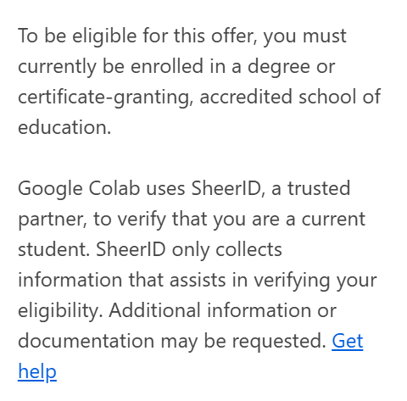
Step 5
This is what the student-registration site should look like.

Slide 7
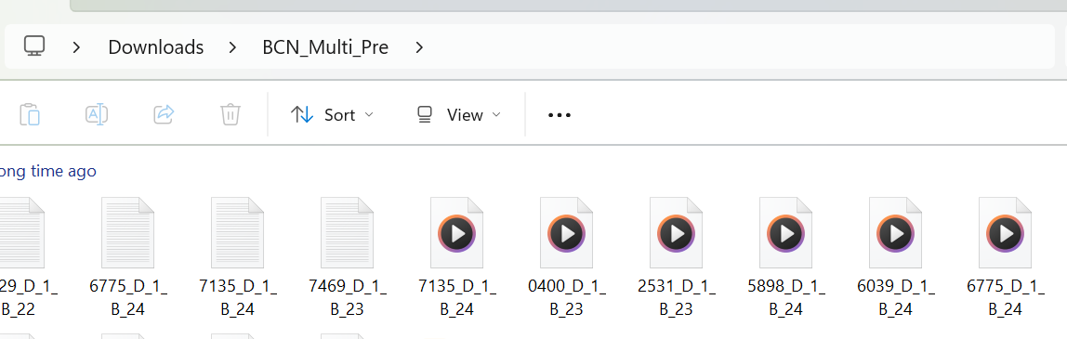
Step 6
Organize a folder on your laptop with your audio files so you’re ready to hit the ground running with Whisper.
This folder is just for convenience; what matters is that the audio files you want to transcribe are easily accessible and saved in WAV format.

Slide 8
Step 7
Please take a moment to double-check what you’ve completed so far. Before getting started, you should have:
Accessed Google Colab and feel comfortable with what a notebook is
Verified your student status through SheerID in order to access Google Colab Pro
Organized several audio files on your laptop (not in Google Drive), saved in WAV format, so you’re ready to transcribe
If SheerID isn’t working for you, that’s okay! Just be prepared to practice with a short sample audio, or trim one of your own files to about 1–2 minutes.

Slide 9

Let’s jump into it!

Slide 10
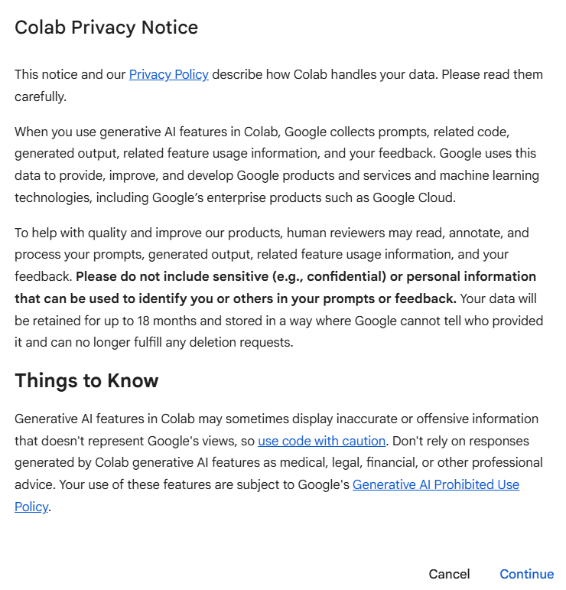
Info about the Privacy Notice…
From what I understand, the special data collection is only related to using the new AI features in Colab, which we will not be using.
Our use is restricted to Google’s regular privacy policy, which all Google platforms use.
I am not an expert in all of this, so if you have concerns, please do your own research:)

Slide 11
Open up your Notebook

Slide 12

Getting your Audio Ready
If you are working on a GPU processor, feel free to use any audio that you would like.
If working on a CPU processor, any audio that you have that you have shortened to 30 - 90 seconds or you can use this short example to practice (I have attached it here, but you will need to download a short sample audio to practice with).
You will want to have the audio downloaded in a folder.

Slide 13
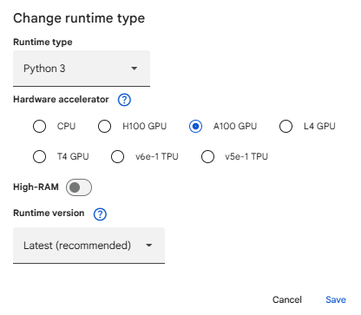
Getting Started with the Processing (under the hood)
Runtime → Change runtime type → Hardware accelerator: None (CPU).
Run: A100 GPU, T4 GPU, or CPU
(this is the calculator behind the operations)

Slide 14
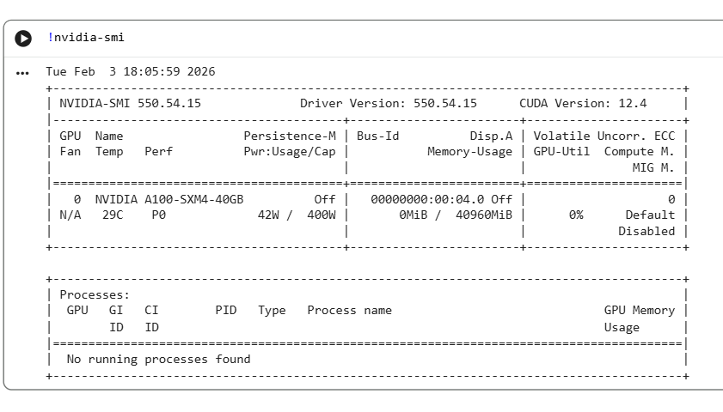

For GPU/ CPU Processing…
Type the following code in the first: !nvidia-smi
Notes:
What does !nvidia-smi do?
nvidia-smi is a command-line tool from NVIDIA that reports the status of NVIDIA GPUs. When it does run, it shows things like:
What GPU you have
How much GPU memory is being used
Whether a process (like Whisper) is using the GPU
Why the ! at the beginning?
In Google Colab:
Python code runs normally ! tells Colab: “Run this as a shell (terminal) command, not Python.” So:
!nvidia-smi
means: “Ask the underlying Linux machine to run the nvidia-smi program.
Why does it say command not found on CPU… but the notebook still works?
!nvidia-smi is just a diagnostic check, if it doesn't exist, Whisper / Python code simply falls back to CPU execution

Slide 15
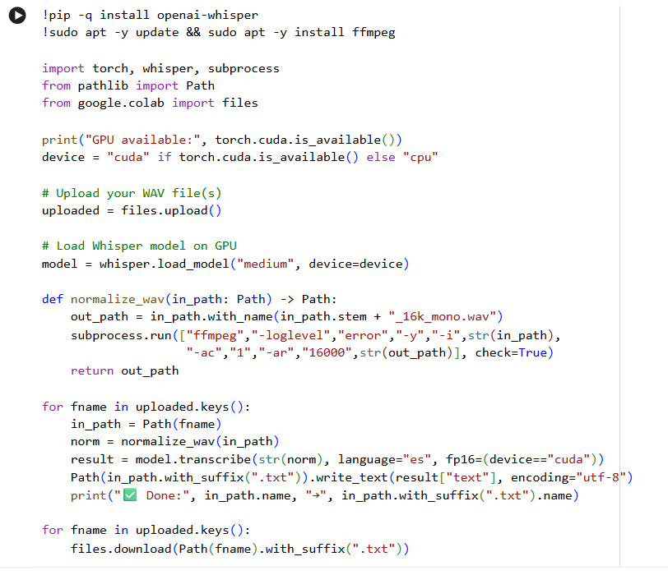
The Whole Enchilada (in a new cell)

Slide 16
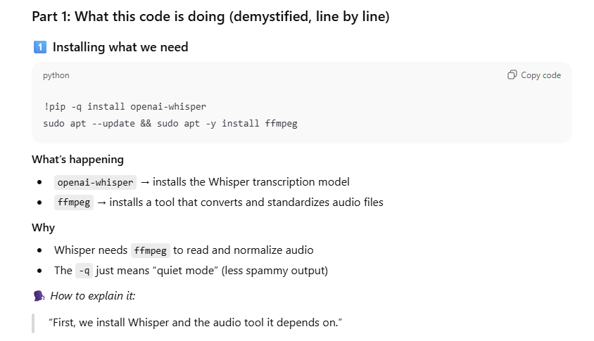

Slide 17
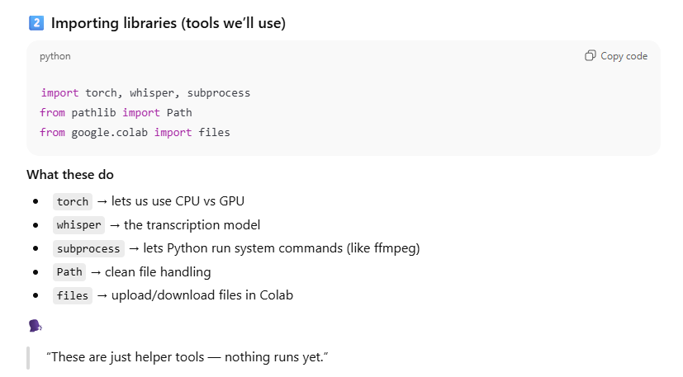

Slide 18
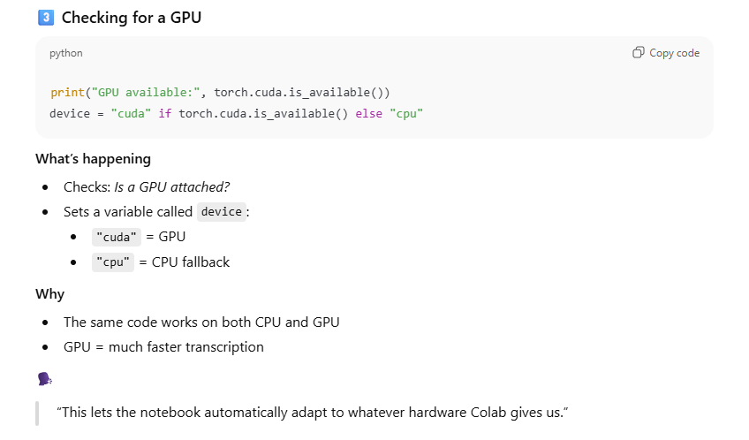

Slide 19
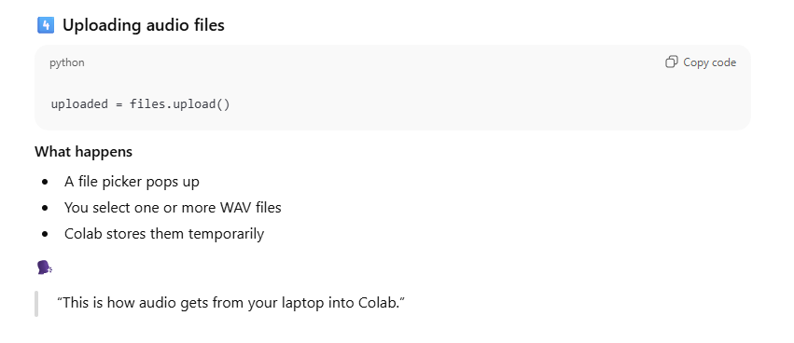

Slide 20
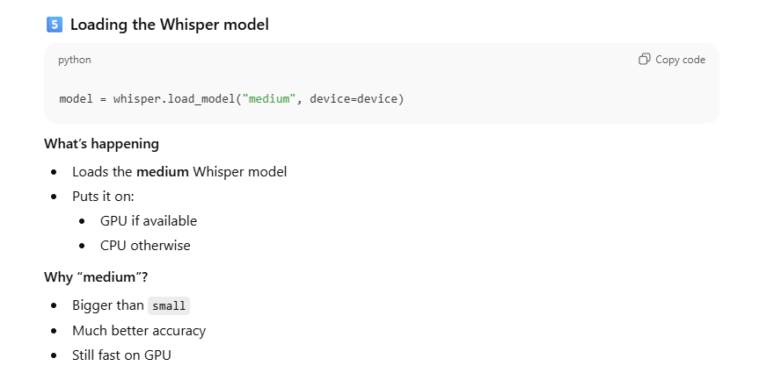
***There is also a large model, which may be better than the medium one depending on your needs.

Slide 21
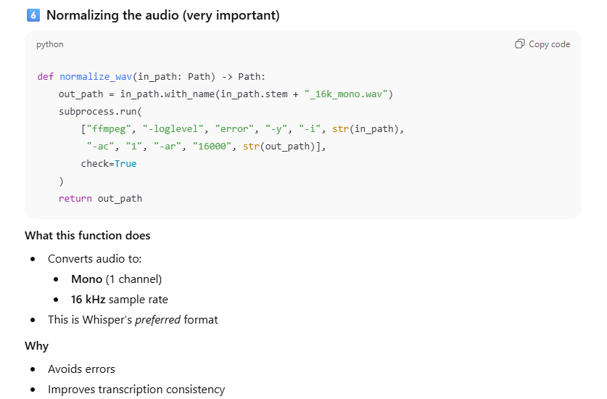

Slide 22
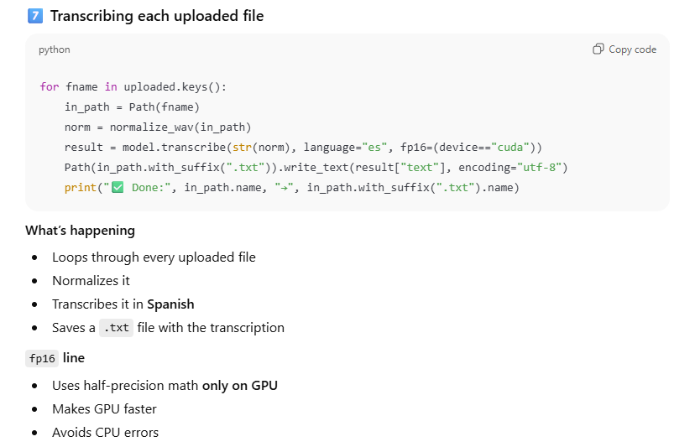
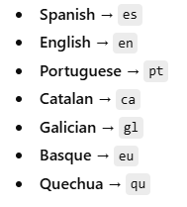

Slide 23
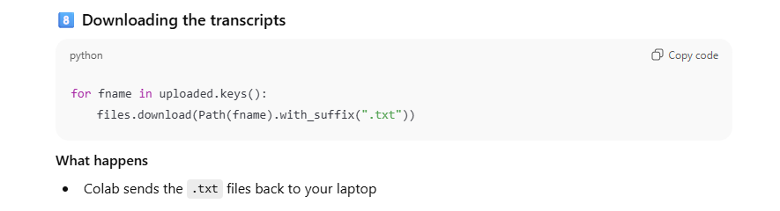

Slide 24
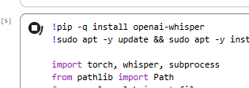

Let’s do this thing!
Copy and paste the entire code in a cell in Google Colab in PLAIN TEXT directly.
Press the button that looks like an arrow/triangle in the top left corner; it should turn into a square, which shows you that the cell is running.
Once you see the “Choose Files” button, select the file you want Whisper to transcribe
You will then see the matching begin to install dependencies, this means things are running!

Slide 25
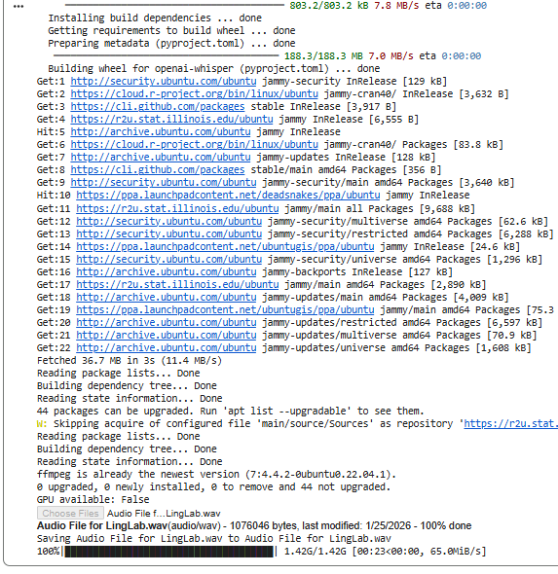

Notes:
This is all basically noise…this all looks good!

Slide 26
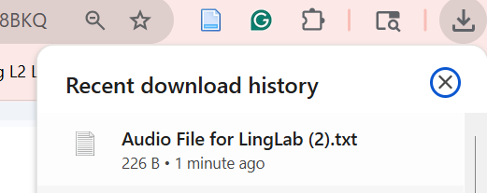
Getting the Transcription
Once Whisper has finished transcribing, you should be able to download and view your file as a plain text document.

Slide 27
Common FAQs
Can I transcribe more than one audio at one time?
Yes, but I have found the max is 8-10 for 10 minute audios on a GPU
This could still take about 45 minutes
Can I do other stuff on my laptop while Whisper runs in the background?
Yes! That’s what I recommend, especially as if you let your laptop screen go dark or shut off your computer, you will lose all of your progress.
Can Whisper handle dialogue between two or more people?
Yes, but it cannot separate the speakers. There may be more adequate tools out there, but I’m unsure.

Slide 28
Thanks for using this guide!
Questions?
Feedback welcome!
sarah-syamken.github.io

