Slide 1
VIKASH PHARMACY
A Multi-Page Responsive Website
Done by
Sarah Philomin V

Slide 2
TABLE OF CONTENTS
DASHBOARD
01
ABOUT US
02
SERVICES
03
04
CONTACT US
Here you can reach with what you need help.
Here you could see our work and experience.
Here you could view the service we offer to the needful.
REGISTER WITH US
Here you can register an account for further use.
05
Here you could try and reach us for any help.

Slide 3
INTRODUCTION
Now-a-days we witness a phase transition of buying pattern of any goods or electronics,etc.
With the advent of technology,buying anything online is in fashion.

Slide 4
MISSION
VISION
Online pharmacy,is going to be the next big evolution that will impact billions of lives and bring a healthy behavioral change to safer and more convenient tomorrow
While many aspects of healthcare service delivery, like finding doctors of hospitals, booking appointments, payment of fees, booking a lab test, viewing lab test reports, have gone online, pharmacy is one area which still lags behind.

Slide 5
01
DASHBOARD
Here you can reach with what you need help.

Slide 6
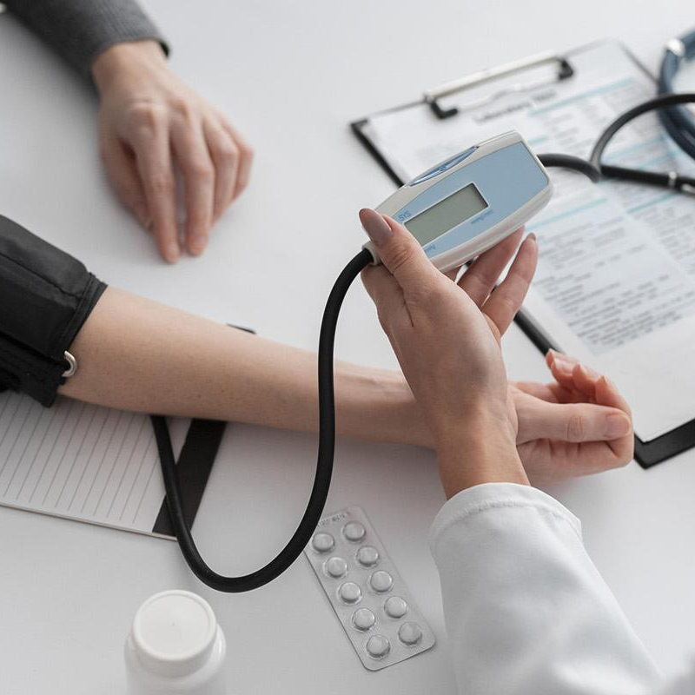
DASHBOARD
The registered pharmacist forwards the verified prescriptions to pharmacy store from where the medicines are dispensed by Vikash Pharmacy.

Slide 7
Web-based or Mobile based application for consumers transmits their prescriptions and place requests for medicines
The web or mobile-based platform to be governed under the IT Act 2000 and rules there under.

Slide 8
02
ABOUT US
Here you could see our work and experience.

Slide 9
ABOUT US
We recommend medicines at affordable prices
Our qualified pharmacy staff are there to give discreet guidance
We investigate new drugs and treat serious diseases

Slide 10
03
SERVICES
Here you could view the service we offer to the needful.

Slide 11
SERVICES
A
B
C
D
No contact delivery
Preserved Safely
Temperature checks
Regular sanitization

Slide 12
04
REGISTER
Here you can register with us for later use.

Slide 13
REGISTERATION
Safe! and Secure!
Enter username/password
Create an account.
If you already have an account click “Sign in”
Login yourself for purchasing medicines

Slide 14
05
CONTACT US
You can try to reach Vikash for any queries.

Slide 15
QUALITY MEASURES
Orders are recieved and verified carefully
Sanitized securely
Despite location crises,we tend to deliver to max places
Medical care of infants, children, and adolescents.
Pediatric medicines are provided with authorized doctor permissions.
Faster Delivery

Slide 16
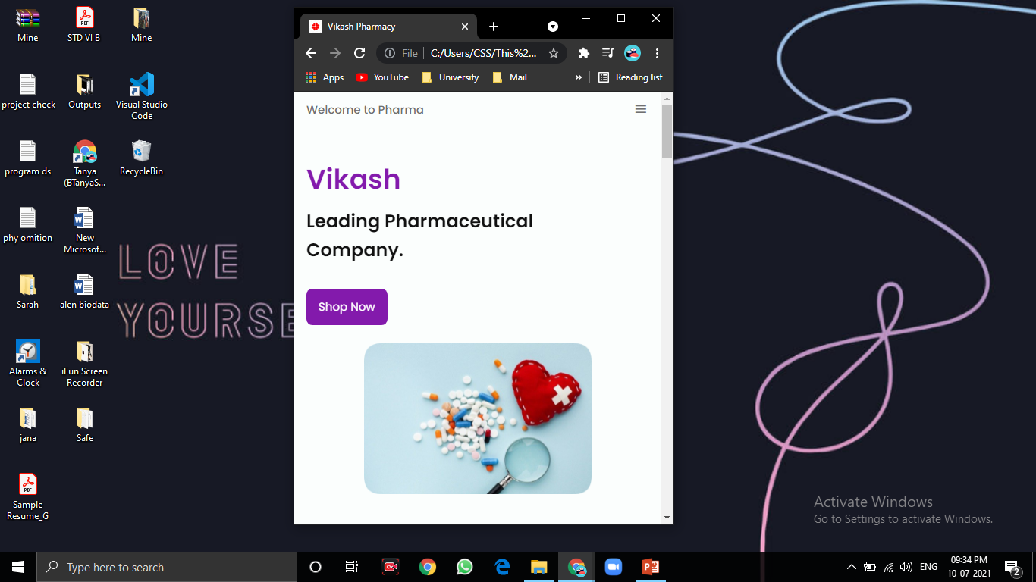
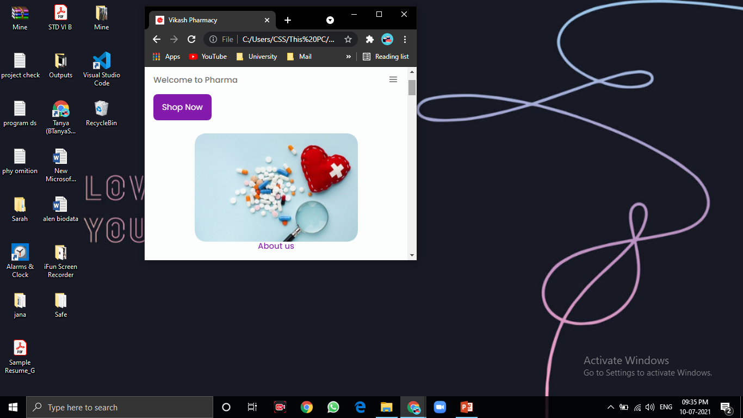
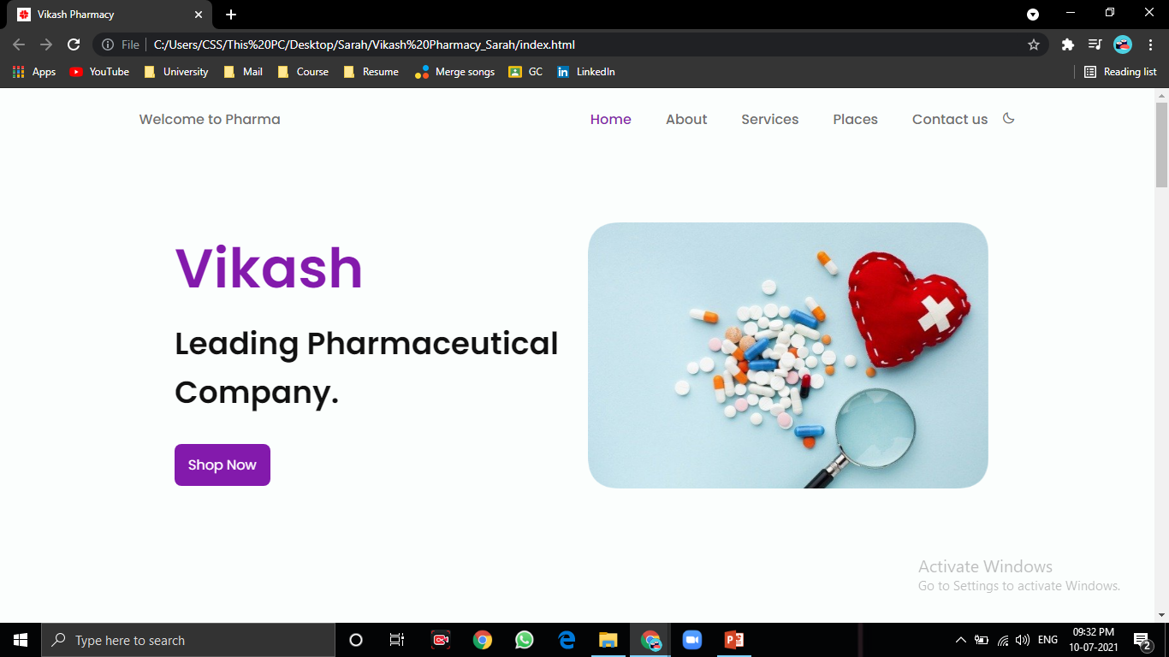
FOLLOW US
Each page is responsive and uses the size of the design content!

Slide 17
THANKS
vikashpharm@yahoo.com
+91 916-785-234

