Slide 1

WEATHER PREDICTION USING ML

Slide 2

HELLO ALL!
WE’RE “TEAM-CHAMP”
PRESENTED BY ,
PAVITHRAPRIYA K
NITHYA M
SARAH PHILOMIN V
AHILA R R

Slide 3
Credits
I am pleased to acknowledge my sincere thanks to Board of Management of SATHYABAMA for their kind encouragement in doing this hackathon project and for completing it successfully.
I would like to express my sincere and deep sense of gratitude to my Project Guide Dr. S.Revathy Associate Professor., for her valuable guidance, suggestions and constant encouragement paved way for the successful completion of my project work.

Slide 4
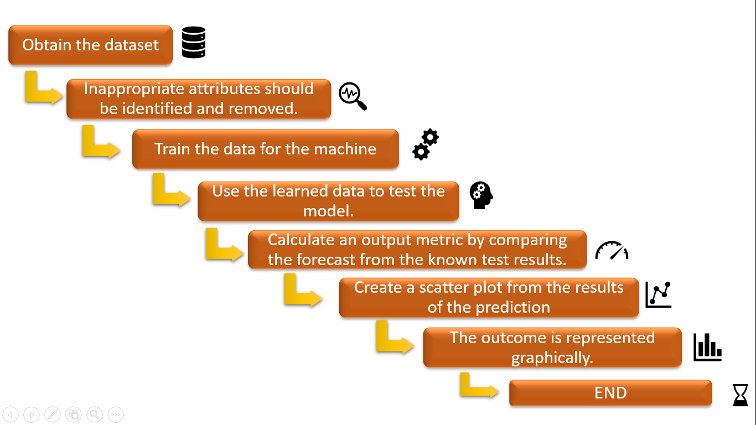
WORKFLOW :

Slide 5
Introduction to Weather Forecasting
Theoritical Applications
Weather forecasting provides forecasts of shifts in the Earth's surface temperature in addition to predictions of atmospheric phenomena. These shifts are influenced by atmospheric conditions such as snow and ice cover.
The application of physics principles, augmented by a range of statistical and analytical methods, to predict the weather is known as weather forecasting.
Practical Applications
Systematic weather records were kept after the invention of the instruments for measuring atmospheric conditions during the 17th century.
Planting and harvesting can be planned better and carried out more efficiently if all the long-term weather patterns are estimated in advance.
Weather warnings are issued by government and military organizations throughout the world for all kinds of threatening weather events like tropical storms which are called as hurricanes, typhoons, or tropical cyclones, depending on location.

Slide 6
1.
Abstract
Let’s start with the Aim / Scope of the Model

Slide 7
IT IS BEST TO READ THE WEATHER FORECAST BEFORE PRAYING FOR RAIN!

Slide 8
AIM/SCOPE
The Goal of Weather Prediction is to provide information people and organizations can use to reduce weather-related losses and enhance societal benefits, including protection of life and property, public health and safety, and support of economic prosperity and quality of life.
In economic terms, the benefit of the investment in public weather forecasts and warnings is substantial :
The estimated annualized benefit is about $31.5 billion, compared to the $5.1 billion cost of generating the information
Meteorologists in Weather Forecasting: Meteorologists may write the governing mathematical equations to express how the atmosphere changes over time in response to various factors if they understand how the atmosphere changes over time in response to various factors.
These equations are turned into numerical models in order to determine how the environment is evolving and will change in the future.

Slide 9
Forecast Data
Between 1980 and 2009 - 96 weather disasters in the United States each caused at least $1 billion in damages, with total losses exceeding $700 billion (NCDC, 2010).
Between 1999 and 2008 - there were an average of 629 direct weather fatalities per year (NWS, 2010).
The annual impacts of adverse weather on the national highway system and roads are staggering:
Weather is also a major factor in the complex set of interactions that determine air quality; more than 60,000 premature deaths each year are attributed to poor air quality (Schwartz and Dockery, 1992).
In addition, $4.2 billion is lost each year as a result of weather-related air traffic delays (NOAA, 2010).
1.5 million weather-related crashes with 7,400 deaths, more than 700,000 injuries, and $42 billion in economic losses (BTS, 2007).

Slide 10
Pre-Processing Steps
Features Selection
The data we have collected has many unwanted attributes which will not be needed in our project.
Hence, we use the attributes which we need only.
Normalization
The data we collected from internet should be first normalized.
Normalization refers to rescaling real valued numeric attributes into the rage or 0 and 1.
After the data are filtered it is then normalized.
Machine Learning
Training a model is the process of iteratively improving your prediction equation by looping through the dataset multiple times
Training is complete when we reach an acceptable error threshold, or when subsequent training iterations fail to reduce our cost.

Slide 11
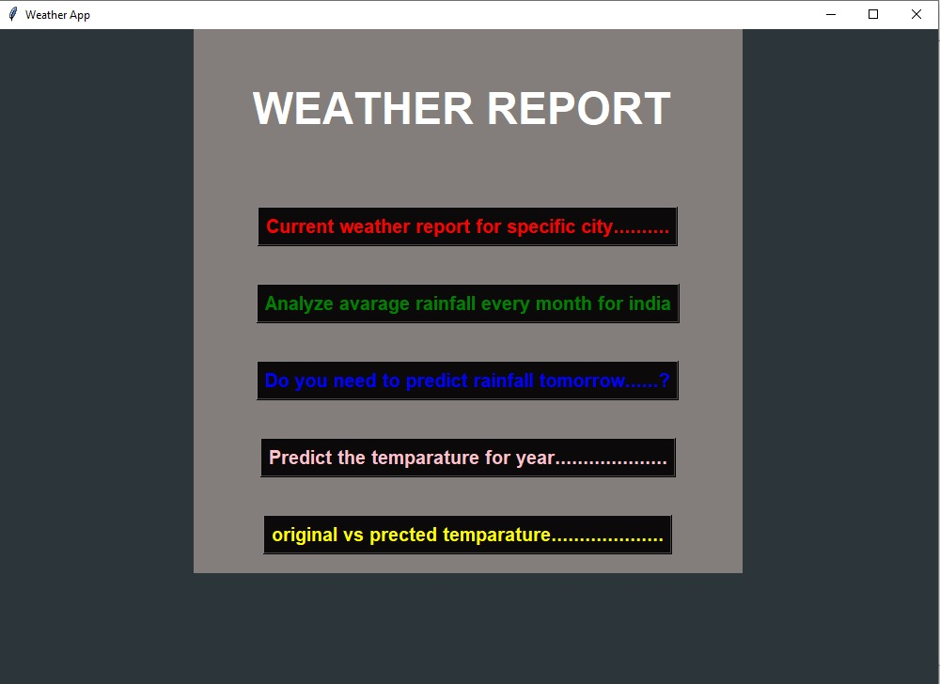
Dashboard

Slide 12
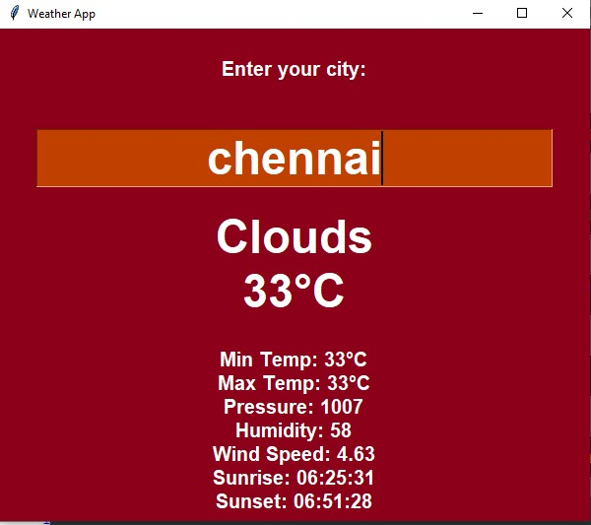
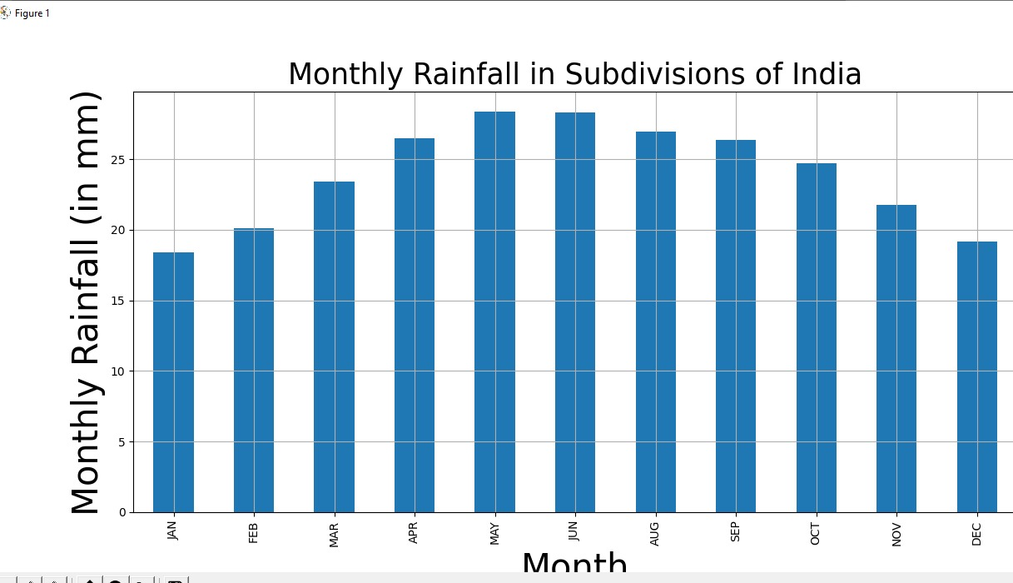
OUTPUT:

Slide 13
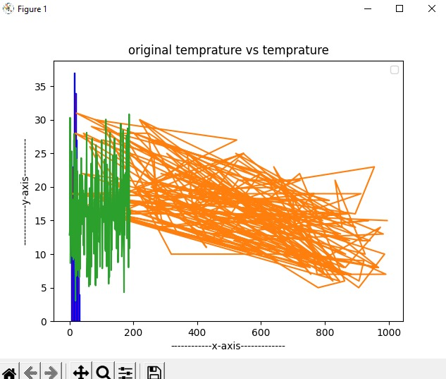
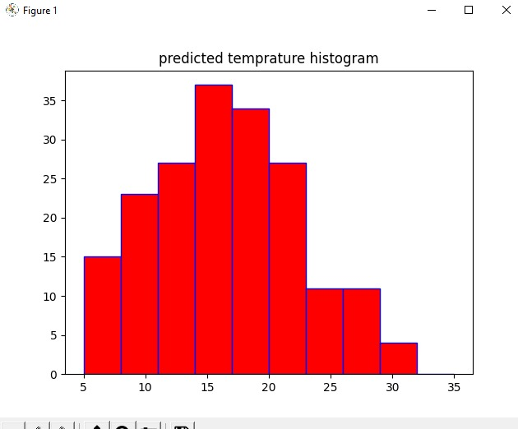
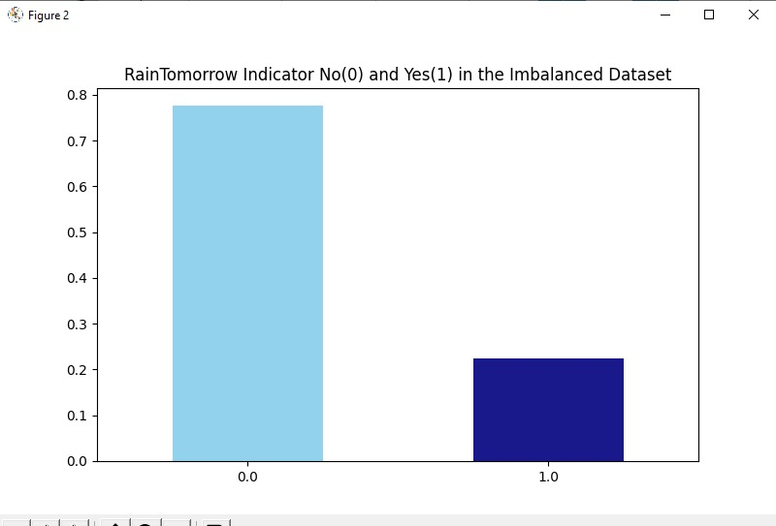

Slide 14

Algorithms Used
Linear Regression
Regression is a method of modeling a target value based on independent predictors.
This method is mostly used for forecasting and finding out cause and effect relationship between variables.
Regression techniques mostly differ based on the number of independent variables and the type of relationship between the independent and dependent variables.
Naïve Bayes Classification
Naïve Bayes Algorithm is a probabilistic machine learning algorithm which can be widely used in various classification tasks which is based on Bayes Theorem.
The term naïve is given because it assumes the data that is given to the model are independent of each other, that is they have independent distribution.
So, if we change the value of one feature than it doesn’t affect the value of other features used in the algorithm.
.

Slide 15
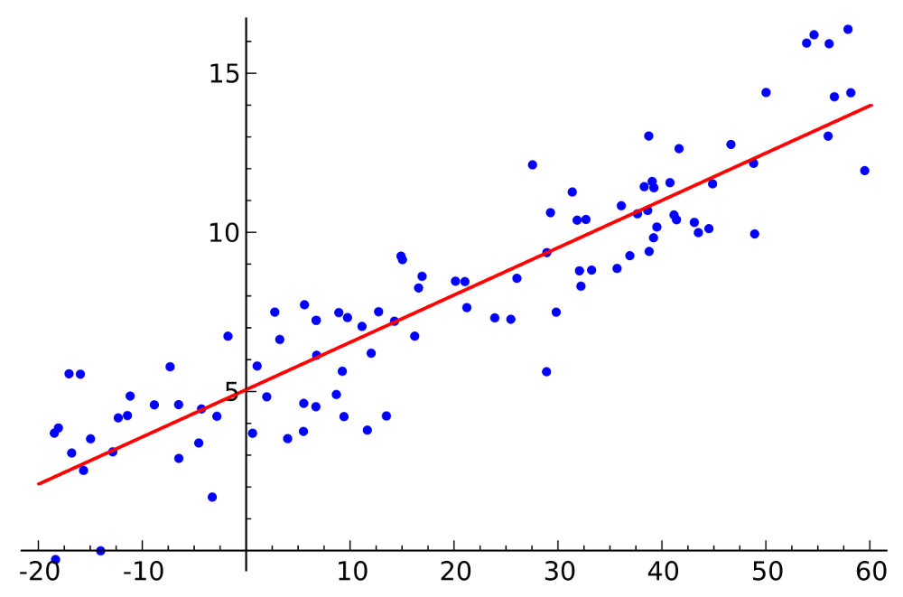
Linear Regression

Slide 16
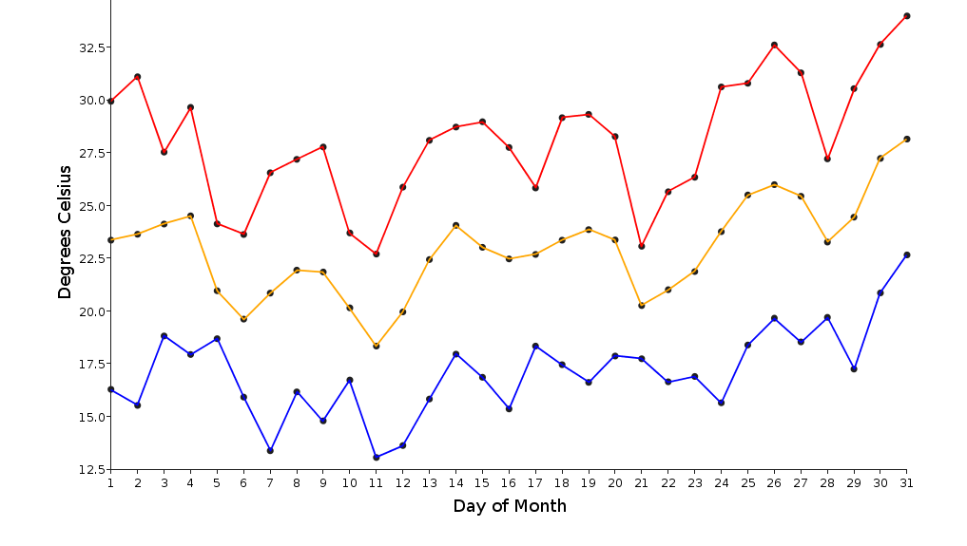
Graphical Representation
Weather variations:
Min, Mean and Max Weather condition until 2020

Slide 17
Temperature Prediction
We'll work on forecasting the average global land and ocean temperature using over 100 years of historical weather data. We'll pretend that we don't have access to any weather forecasts.
Through a comparative study of weather data collected in Central Kerala from 2007 to 2015, we propose a system for temperature prediction using three machine learning models
Multiple Linear Regression (MLR), Artificial Neural Network (ANN), and Support Vector Machine (SVM)
We still have a century's worth of historical global temperature averages, including global maximum and minimum temperatures, as well as global land and ocean temperatures.
Having all of this, we know that this is a supervised, regression machine learning problem.
Mean Error (ME), Mean Absolute Error (MAE), and other metrics are used to assess the experimental outcomes.

Slide 18
Data Acquisition
Identify Anomalies/ Missing Data
First, we need some data. To use a realistic example, I retrieved temperature data from the Berkeley Earth Climate Change: Earth Surface Temperature Dataset found on Kaggle.com.
Being that this dataset was created from one of the most prestigious research universities in the world, we will assume data in the dataset is truthful.
Looking through the data (shown above) from Berkeley Earth, I noticed several missing data points, which is a great reminder that data collected in the real-world will never be perfect.
Missing data can impact analysis immensely, as can incorrect data or outliers.

Slide 19
Applications in various fields
Air Traffic
Accurate weather forecasting is critical in the aviation industry because it is so weather-sensitive.
Many planes are unable to land or take off due to fog or very low ceilings. Turbulence and freezing are two other major in-flight dangers.
Agriculture
Farmers use weather forecasts to determine what work they can do on any given day. Drying hay, for example, is only possible in dry weather.
Drought can destroy corn crops, but their dried remains, known as silage, can be used as a cattle feed substitute.
Forestry
Wind, precipitation, and humidity forecasting are critical for preventing and managing wildfires.
Various indices have been created, such as the Forest fire weather index and the Haines Index, to predict which areas are more likely to experience fire due to natural or human causes.
Royal Navy
The UK Royal Navy has its own specialist branch of weather observers and forecasters who track and forecast operating conditions around the world in collaboration with the UK Met Office.
Marine
The MAFOR code, for example, has been designed to efficiently transmit detailed marine weather forecasts to vessel pilots via radio (marine forecast). (95) RTTY, Navtex, and Radiofax can all be used to receive standard weather forecasts at sea.
US Navy Force
The Air Force and the Army use Air Force Weather to predict weather.
Air Force forecasters provide Army support and cover air operations in both combat and peacetime.

Slide 20
Applied all over the world.
Africa
North America
Seoul
INDIA
Canada UK
South Africa
Antarctica

Slide 21
Result:
The prediction method is in good working order. Many of the attribute values had been correctly preprocessed.
The model was implemented and trained using train data after all of the preprocessing was completed. Tkinter was used to build the system's user interface.
Python IDLE was used for the coding. We linked the DataSet collection after completing all of the steps. Our precision was discovered to be around.
We linked the front-end to the back-end after completing all of the steps. The accuracy of our predictions was found to be about 82 percent.

Slide 22
Conclusion:
Weather forecasting using the linear regression algorithm and the Naive Bayes algorithm is critical for improving people's future results. The linear regression algorithm and the Naive Bayes algorithm were used to forecast the weather using weather datasets. Using some selected input variables obtained from Kaggle,GitHub, we created a model to predict the weather.
The issue with the current weather situation is that we are unable to organize ourselves and complete essential tasks. As a result, this model was developed in order to know the weather scenario with high precision while taking into account all of the factors that influence the weather scenario.

Slide 23
References
Weather: Forecasting from the Beginning". InfoPlease. Retrieved January 14, 2020.
University of California Museum of Paleontology. "Aristotle (384-322 B.C.E.) Archived November 20, 2016, at the Wayback Machine". Retrieved January 12, 2008.
David Pingree (December 14, 2017). "The Indian and Pseudo-indian Passages in Greek and Latin Astronomical and Astrological Texts"(PDF). pp. 141–195 [143–4]. Retrieved March 1, 2010.^{[permanent dead link]}
Bible Gateway passage: Matthew 16:2-3 - English Standard Version". Bible Gateway. Retrieved December 1, 2016.
Further Reading - Ian Roulstone & John Norbury (2013). Invisible in the Storm: the role of mathematics in understanding weather.

Slide 24
THANK YOU ALL!

