Slide 1
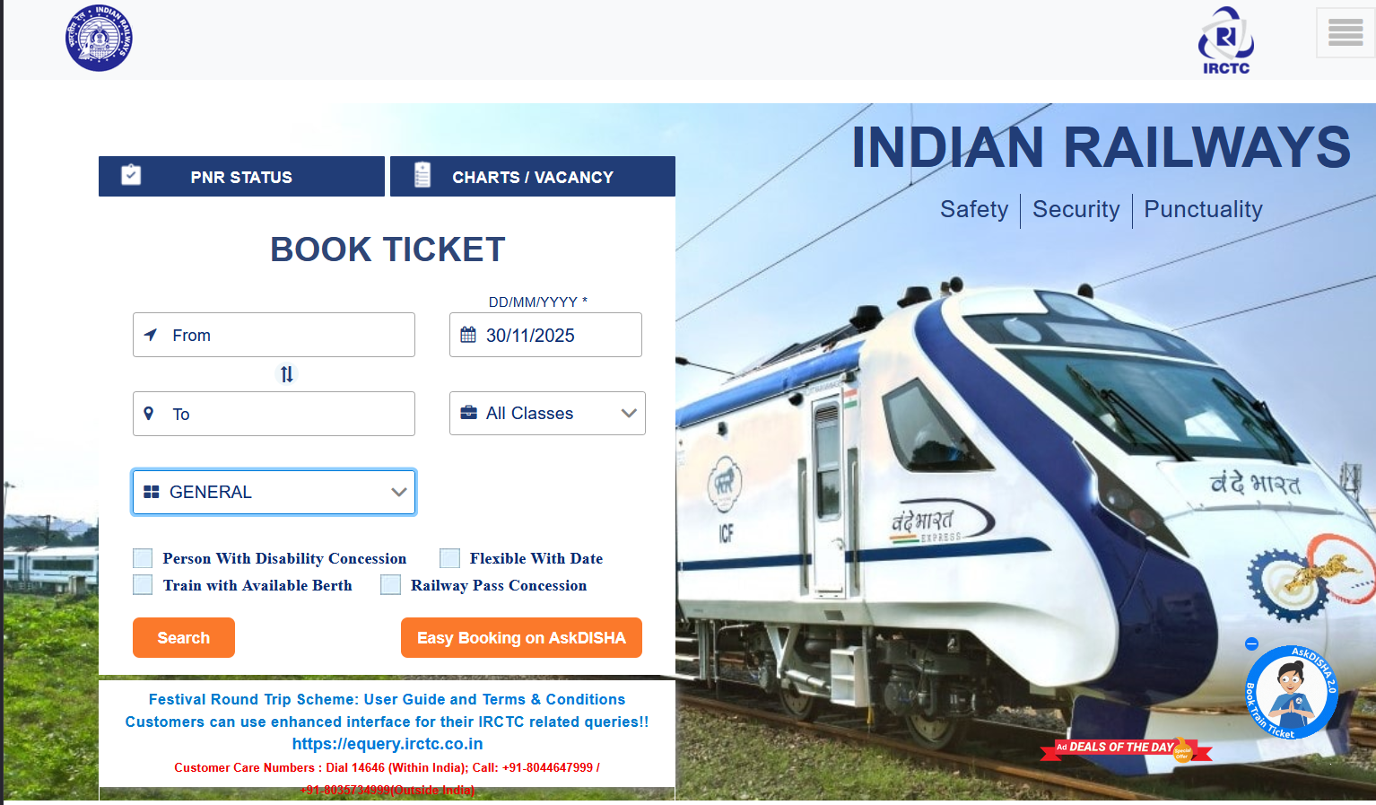
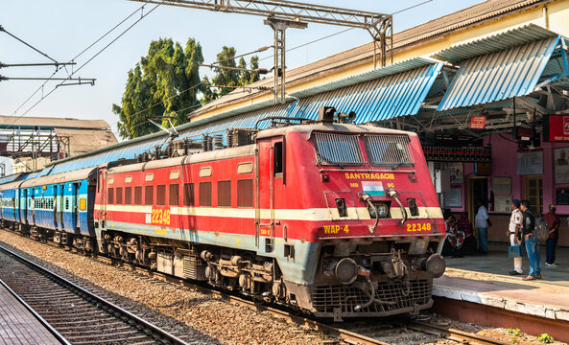
PROJECT
TRAIN TICKET BOOKING SYSTEM
C PROGRAMMING
SUBMITTED BY: SARAH KUNDU
SAP ID: 590023804
BATCH NO. 60

Slide 2
INTRODUCTION
This project stimulates a simple railway booking system.
Implemented using C programming language.
Demonstrates user input handling, conditional statements and structured design.
Generates a basic e- ticket at the end.

Slide 3
PROBLEM DEFINITION
Railway booking systems are complex, but we need a basic version for learning.
This project solves the problem by providing a simplified, console-based reservation flow.
Helps us understand how real ticketing systems handle user data and decision-making.
SCOPE OF WORK:
Single passenger ticket booking.
Route selection (Source → Destination).
Class selection (AC1/AC2/AC3/Sleeper).
Seat availability check.
Passenger details collection.
Payment confirmation.
E-ticket generation.

Slide 4
SOLUTION APPROACH
Main Steps:
Accept the route inputs (To & From).
Require user to specify travel class.
Check seat availability using conditions.
Collect your journey date and passenger information.
Show ticket price and request a confirmation of payment.
Create an e-ticket with travel details.
Modules / Components:
Input Module:
From-to, date, passenger details.
Checker: Available / Waitlist / Not available.
Booking Confirmation Payment Module: Book and pay for your seat now.
Ticket Generator: Generates formatted ticket output.
System / Algorithm Flow:
Sequential flow
Uses if-else decision-making.
Simple data storage using variables.
Terminal-based output

Slide 5
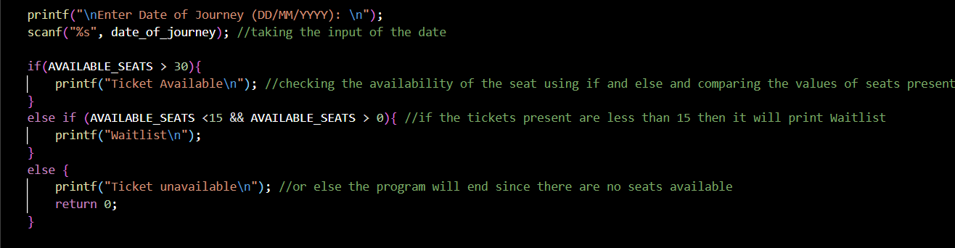
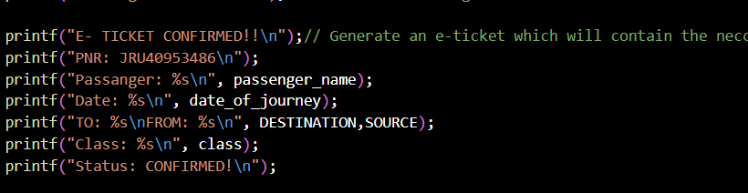
CODE DEMONSTRATION
Seat availability and passenger input:
Ticket Generation:

Slide 6
Demonstration (Input → Output):
INPUT:
To: Mumbai
From: Delhi
Class: AC3
Journey Date: 22/12/2025
Passenger: Sarah
Payment: Yes
OUTPUT:
Ticket Available
Booking Confirmed
Payment Successful
E-Ticket Generated

Slide 7
NOVELITIES
What is Unique or Innovative?
Simpler model of large railway networks written from the scratch in C basics.
No libs or DBs needed—great for learning basic logic.
A console interaction only simulation of that booking you have always dreamed of making.
Design Improvements / Good Choices:
Clear decision-based flow using conditions.
User-friendly prompts and structured outputs.
Modular control system input → check → confirm → foster.
Clean e-ticket formatting for readability.

Slide 8
CONCLUSION
Successfully stimulates a simple train booking system.
Demonstrates practical uses of C fundamentals.
User-friendly and interactive.
REFERNCES:
Let Us C — Yashavant Kanetkar
Railway Reservation System examples and tutorials

Slide 9
THANK YOU!!!
Any Questions?

