Slide 1
Where's Mochi?
An interactive mystery website
CCT360 Interactive Discovery | Group: Sarah Khan and [partner name]

Slide 2
Project overview
Mochi, a curious house cat, has disappeared. The visitor explores the house to find out where she went.
Each clue is found by clicking objects in a scene, and the clues unlock the next part of the story.
The mystery ends in one of two ways, depending on how much the visitor found.
The intended feeling is a small, playful detective game that rewards careful exploration.

Slide 3
Interaction and navigation
Entrance: find the key under the pumpkin, then open the front door.
Living room: check the cat toy, food bowl, and couch for three clues.
Drawer: opens only after all three clues. It points to Mochi's workspace.
Workspace: the laptop, smoothie, and pink spoolie. The spoolie unlocks the lash studio.
Lash studio: the happy ending if the visitor found everything, or a missing-cat ending if not.
Two routes lead to the workspace: from the living room, or from the drawer.

Slide 4
Technical features
Variables track the key, each clue, the spoolie, and which rooms the visitor has already seen.
If / else if / else statements decide what happens: the door opens only with the key, the drawer opens only with all three clues, and the ending depends on the clues and the spoolie.
Event listeners respond to every clickable object.
innerHTML updates the story text and the return message, and style.display shows and hides each scene.
The page keeps its state while open. Reloading the page starts the mystery again.

Slide 5

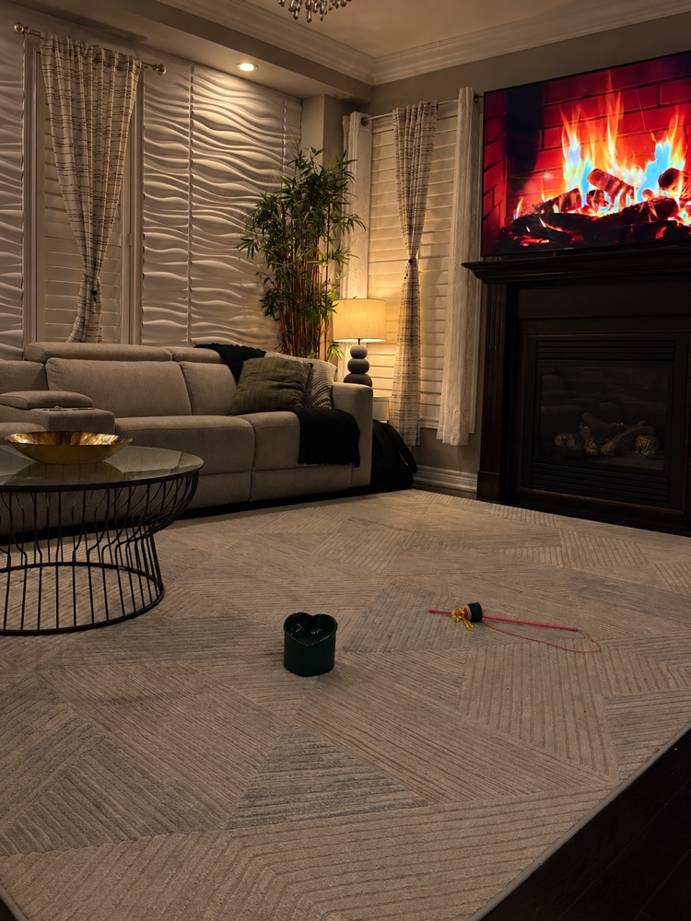
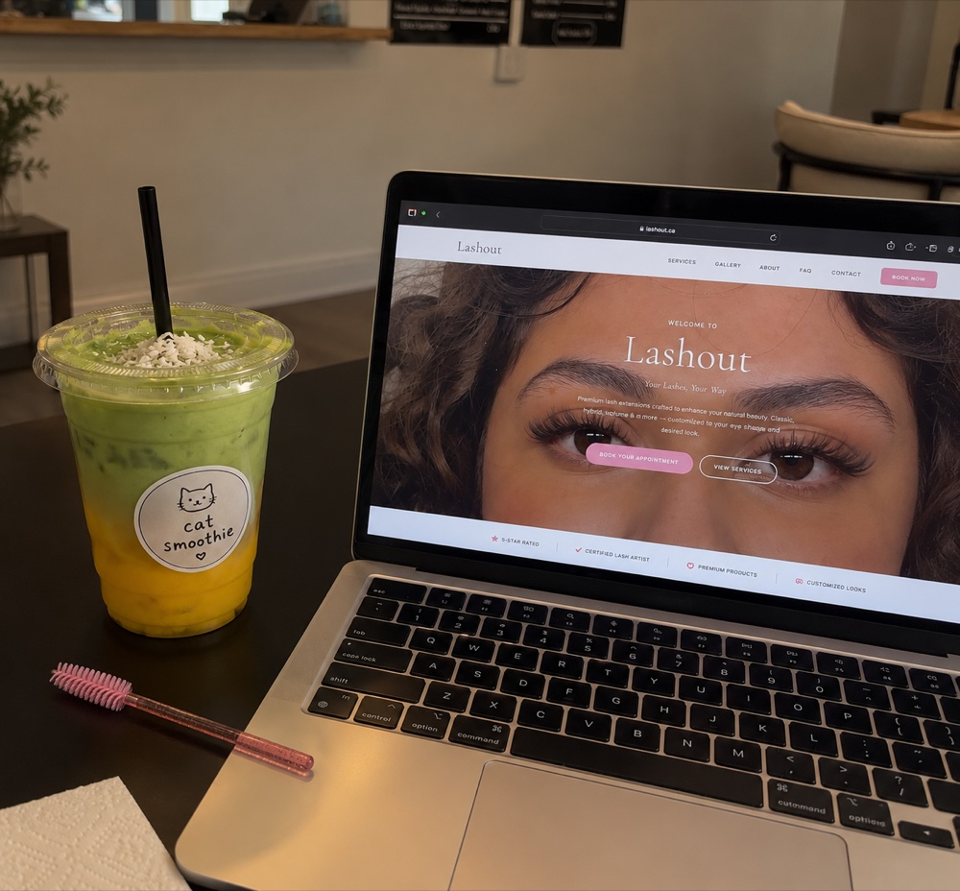
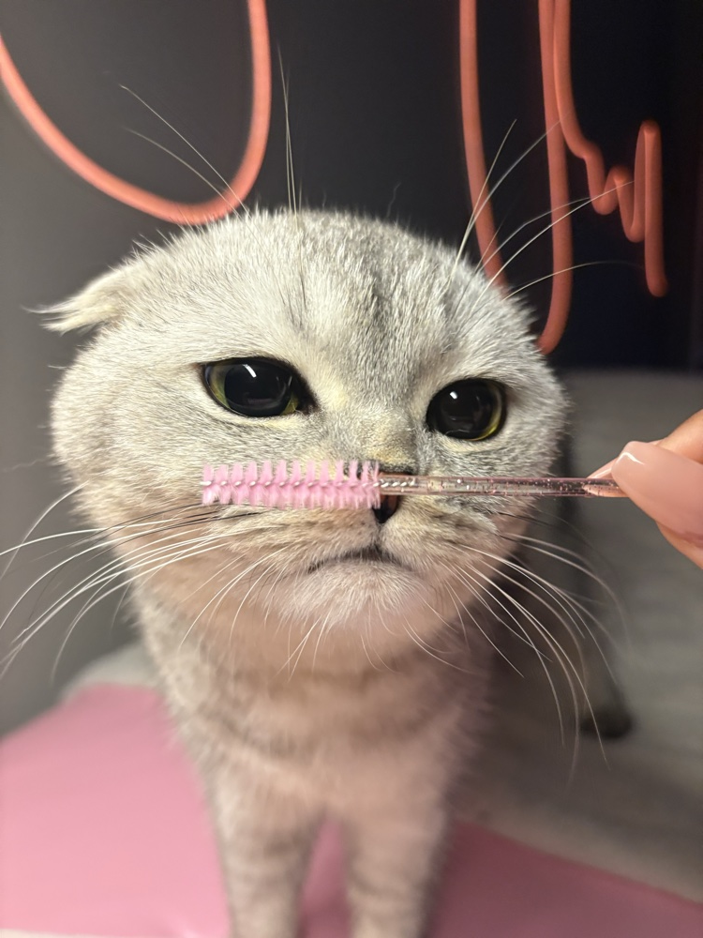
Visual design
Colour: a dark purple-grey base with warm light, matching the night scenes.
Typography: Arial throughout, with bold headings and plain body text.
Imagery: our own photos for the main rooms. The drawer photo is credited on the last slide.

Slide 6
Design rationale and learning
Concept: a cat mystery that is easy to follow, so the focus stays on the clicks and the logic.
Challenge: keeping the state and the endings consistent, so every route through the house makes sense.
Challenge: making the page work at phone width, with the viewport setting and simple layout rules.
Learning: each class technique in the project was checked against the class demos before it was used.
Limitation: the state resets when the page reloads, since it is stored in variables only.

Slide 7
Website, credits, and AI use
Live website: https://sarah1544.github.io/cct360-mochi/
Photo credit: drawer image by Matt Briney on Unsplash (Unsplash License).
Other photos: taken by the group, with the edits listed below.
AI use: the code was built with AI help and then reviewed and tested by the group. Photos were edited with an AI tool: [list the edited photos here].

