Slide 1
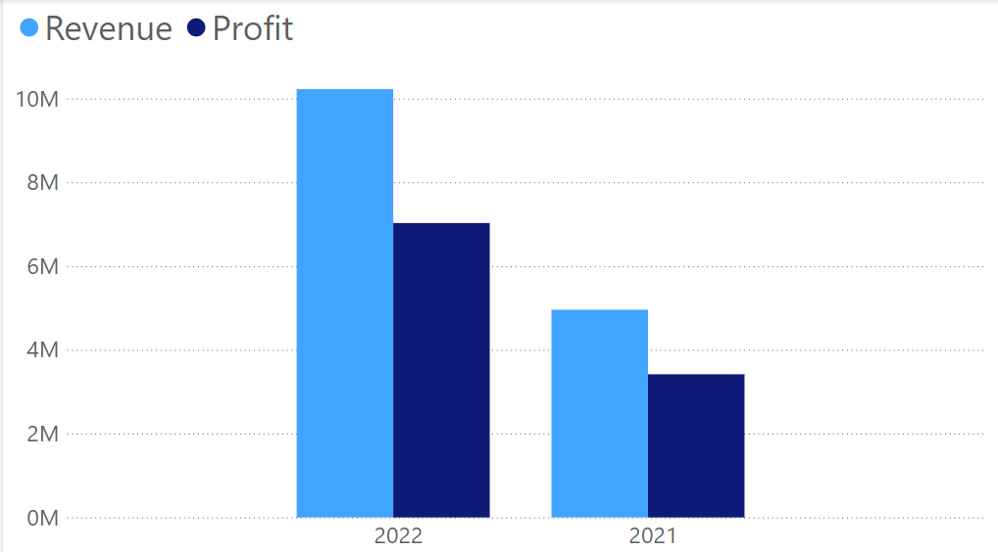
Should WE raise Prices in 2023?
Recommendation:​
The company can pursue a price increase after a careful review of projected costs in 2023 and competitor pricing.
Findings:
From 2021 to 2022, ridership surged by 65% despite a 25% price hike ($1.00). During the same period, profits soared by 105%, all while sustaining a robust profit margin of 69%.
Market Analysis:
Conduct additional research. What is the average trip distance for our riders? What is the pricing structure of other bike share companies in our vicinity? Which pricing structure is best for our company?
NACTO:
According to the National Association of City Transportation Officials (NACTO), bikeshare usage in the United States grew from 2021 to 2022. Many systems are moving away from flat-rate pricing for 30- to 60-minute rides and are now charging by the minute. This change has led to a 70% increase in average per-trip costs. The average trip distance on a shared bike or e-scooter is 1.5 miles. As the cost of using shared bikes and scooters rises in many cities, ridership is expected to keep growing. NACTO has raised concerns about affordability given the increasing prices.
https://nacto.org/publication/shared-micromobility-in-2022/

