Slide 1
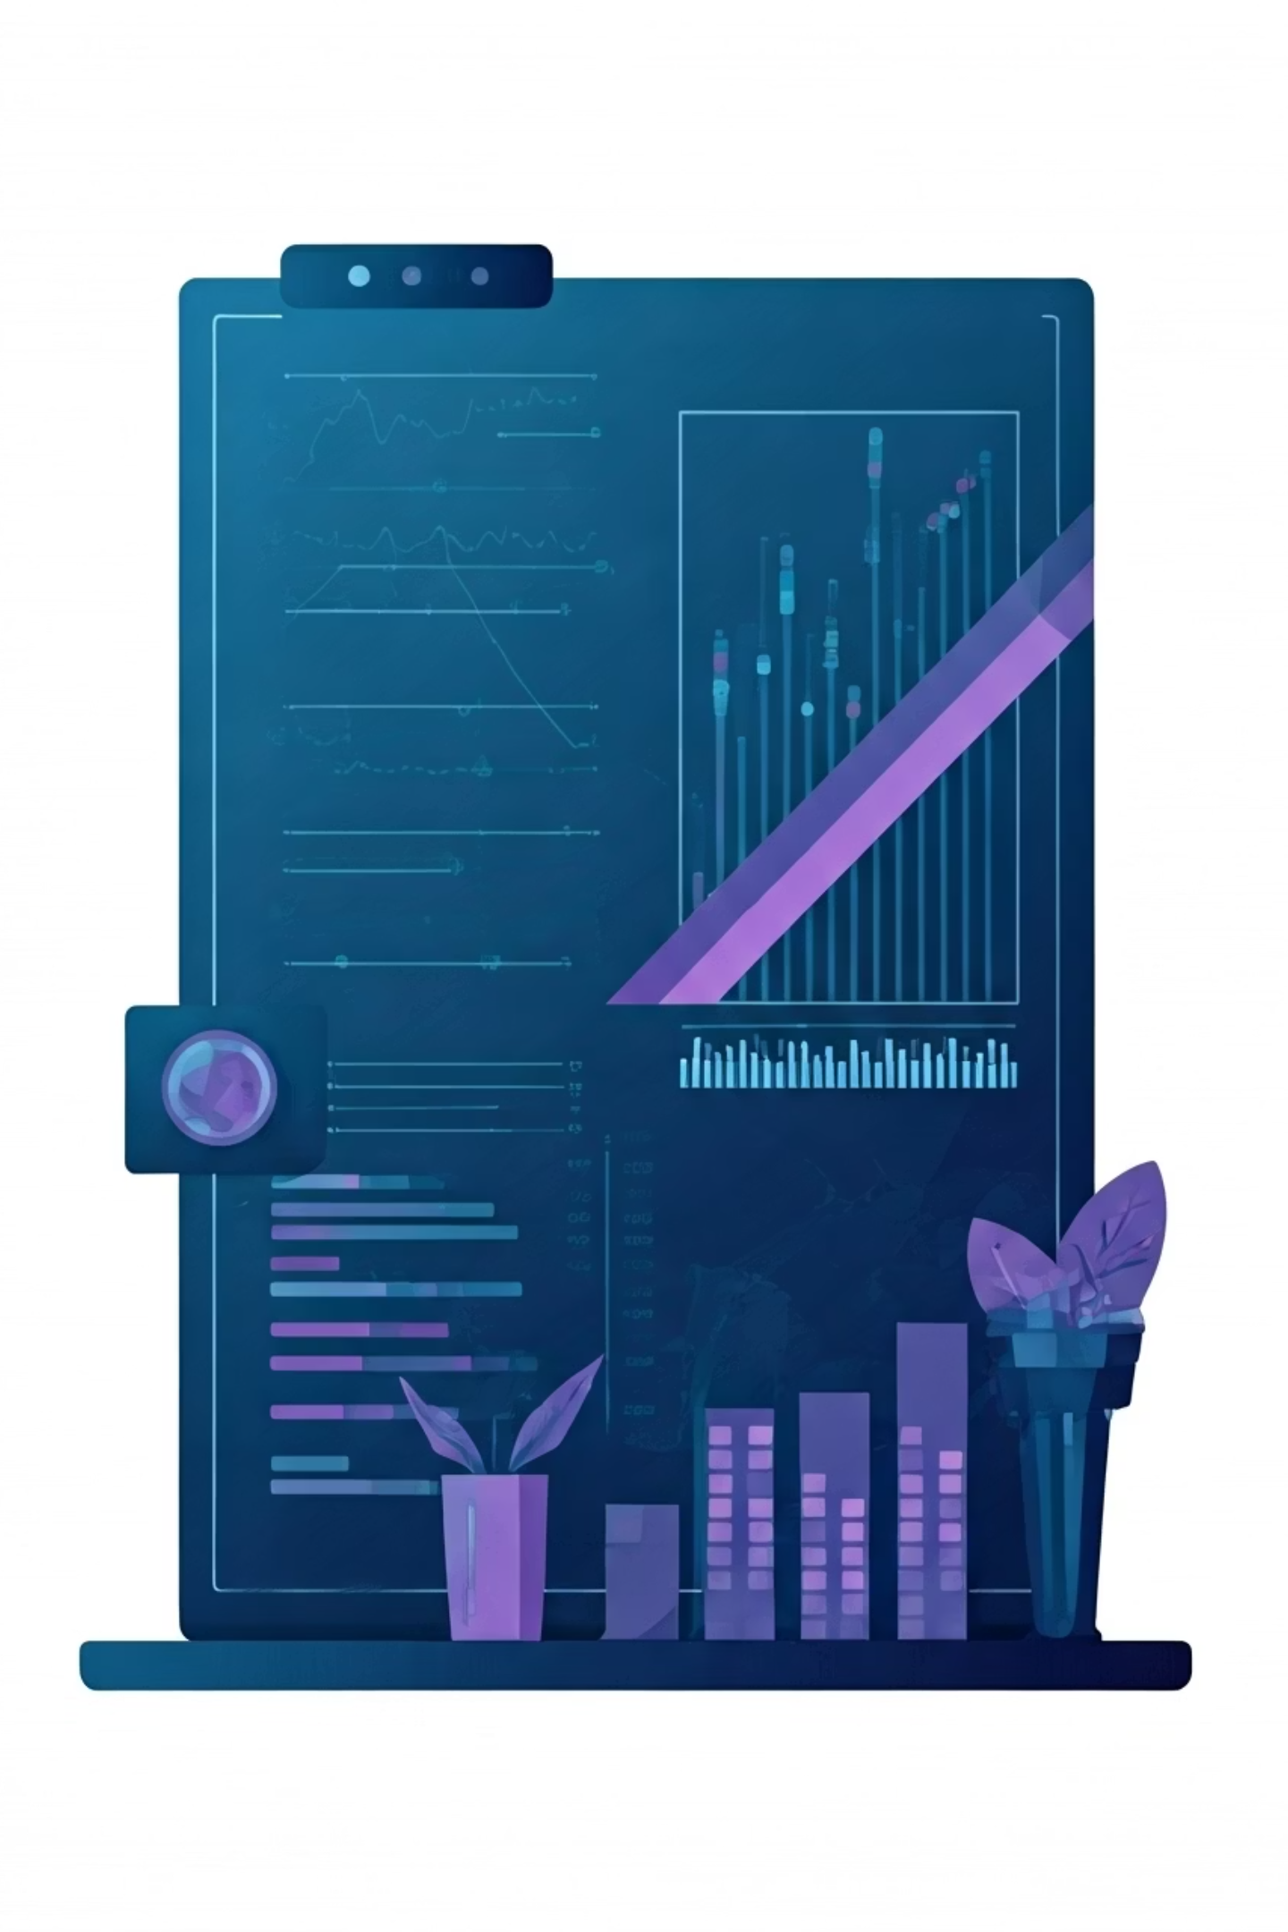
Predicting No-Shows: XGBoost Model Results & Analysis
Our XGBoost classification model achieved 72% accuracy in predicting appointment no-shows, helping identify patients at risk of missing scheduled visits. This presentation summarizes key findings and next steps for implementation.

Slide 2
Key Findings & Action Plan
Model Insights
Top Predictive Factors
Recommended Next Steps
72% accuracy in predicting no-shows
Days between scheduling and appointment date
Develop user-friendly risk prediction interface for staff
20% overall no-show rate across all appointments
Patient gender (65% of no-shows were female patients)
Implement targeted transportation assistance for high-risk neighborhoods
Data cleaning required for scheduling date inconsistencies
Neighborhood (highest in Jardim Camburi, Maria Ortiz, Itarrare)
Consider home visit options for infants and mobility-challenged patients
Create automated reminder system with escalating contact methods

