Slide 1
LONDON RESTAURANTS
BY: Sarah Alharbi

Slide 2
TABLE OF CONTENTS
01
02
INTRODUCTION
DATA COLLECTION & PREPARATION
03
04
CLUSTRING
CONCLUSION
Statement of the goal of the project
Using web scrapping and Foursquare API, to collect our data
Using KNN
Challenges and future work.

Slide 3
THINK!
As an investor.

Slide 4
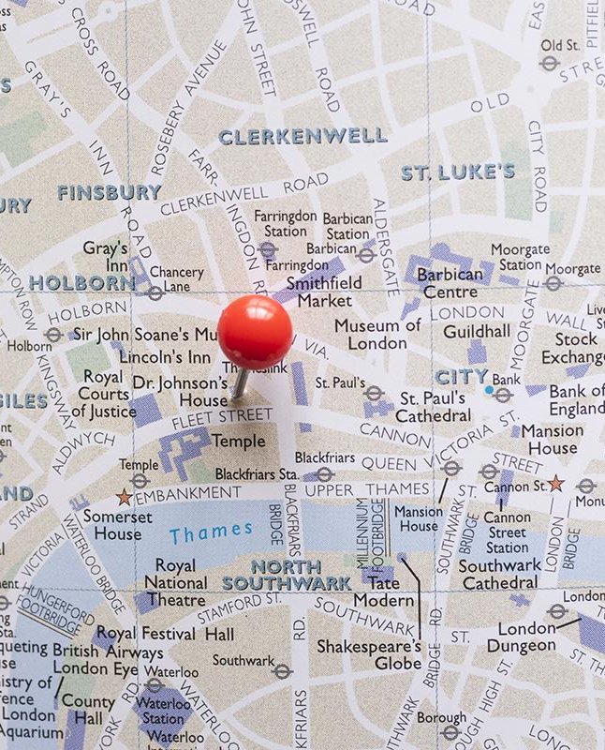
FINDING THE BEST LOCATION
Understanding your target market.

Slide 5
01
INTRODUCTION

Slide 6
+9 Million
London's 2022 population

Slide 7
PROJECT QUESTIONS
Are particular cuisines/restaurant types more popular in specific places than others?
Is it feasible to cluster boroughs or neighbourhoods based on cuisine criteria in London?

Slide 8
DATA COLLECTION
02

Slide 9
DATA SOURCES
Foursquare API
London Boroughs Data
Median Household Income
Number of Employees
Density
Searching for restaurants
Web scraping from Wikipedia
CASI
London geojson
Office for National Statistics (ONS)
Wikipedia
Github

Slide 10
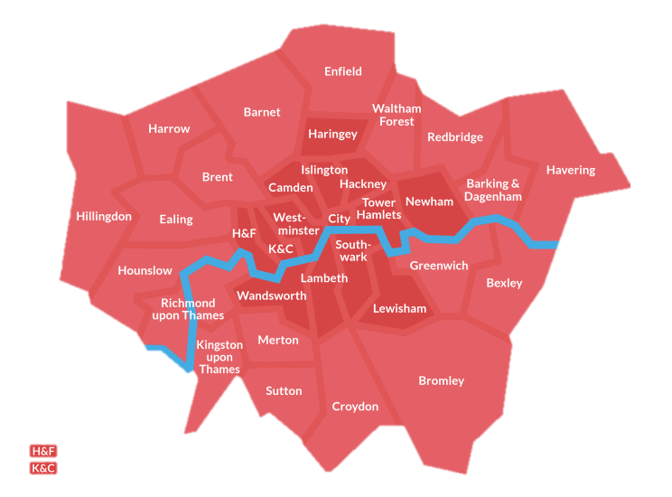
LONDON BOROUGHS
Hammersmith & Fulham
Kensington and Chelsea
[Source]:https://hidden-london.com/miscellany/london-boroughs-map/

Slide 11
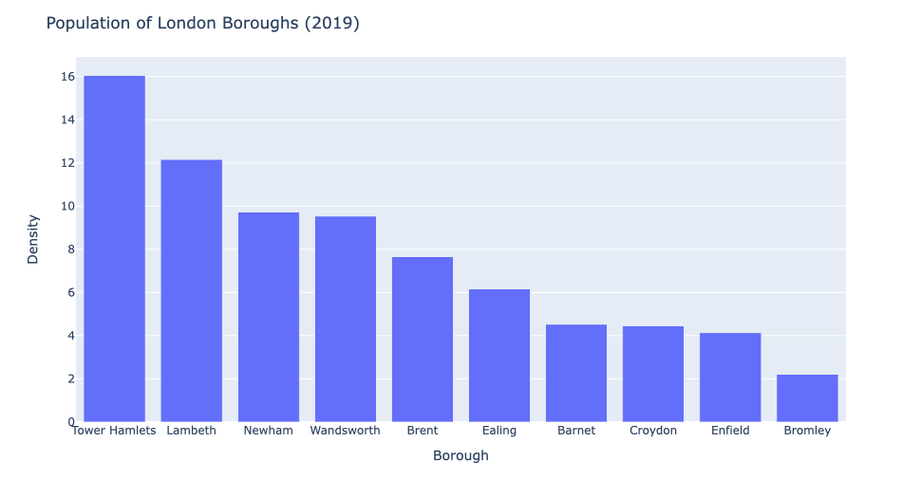

Slide 12
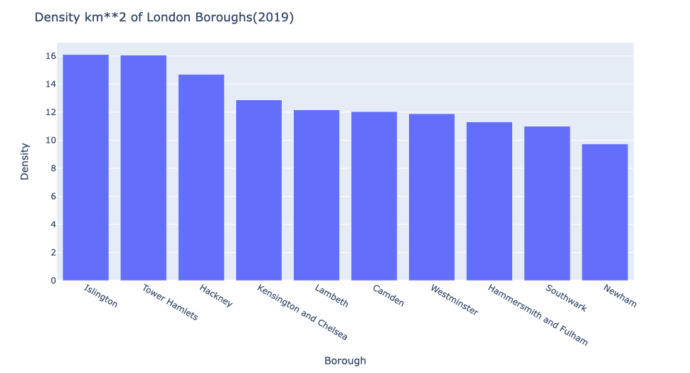

Slide 13
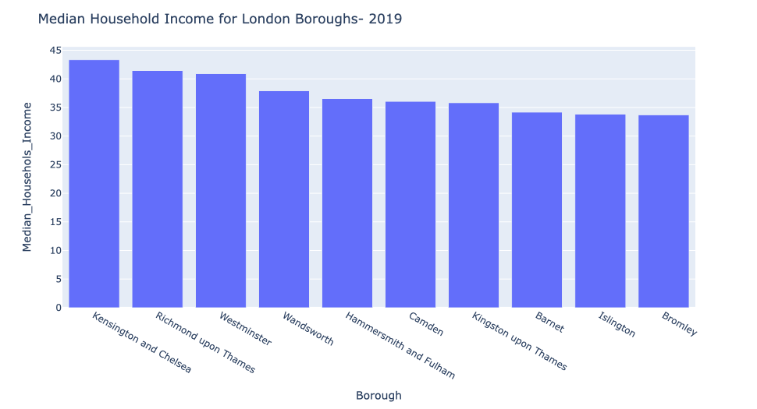

Slide 14
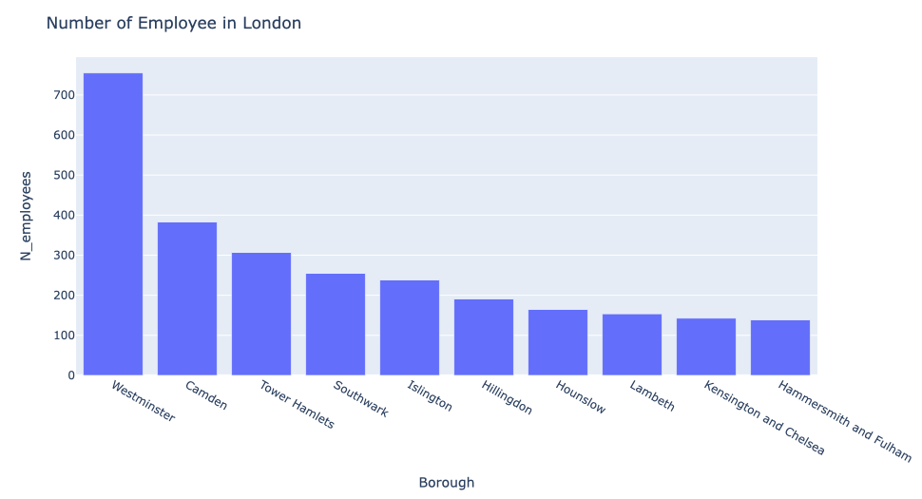

Slide 15
Foursquare API
1692 Restaurants
101 Unique categories
1st Popular Fast-food

Slide 16
ISSUE I’ve Faced
Restaurant
Café
Cafes and restaurants in general should not be included under the restaurants category. However, because we have limited data, these two categories will not be excluded.

Slide 17
How many restaurants for each borough?
Ranging from 3 restaurants to 88 restaurants.
Remove boroughs that have less than 10 restaurants in our data.

Slide 18
METHODOLOGY
03
One-hot encoding
KNN algorithm

Slide 19
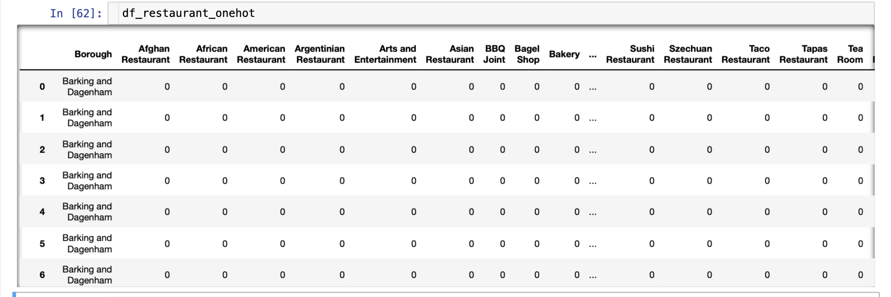
Steps:
One-hot encoding using dummy
Grouping our restaurants by boroughs.
Figuring out the ratio for each category.

Slide 20
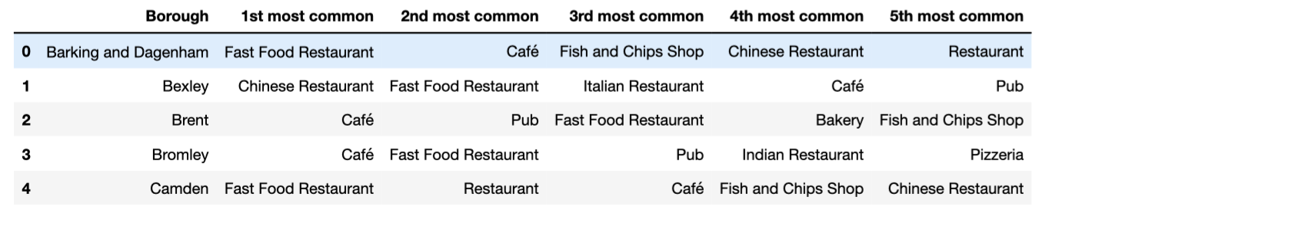
What are the most popular restaurant categories in each borough?

Slide 21
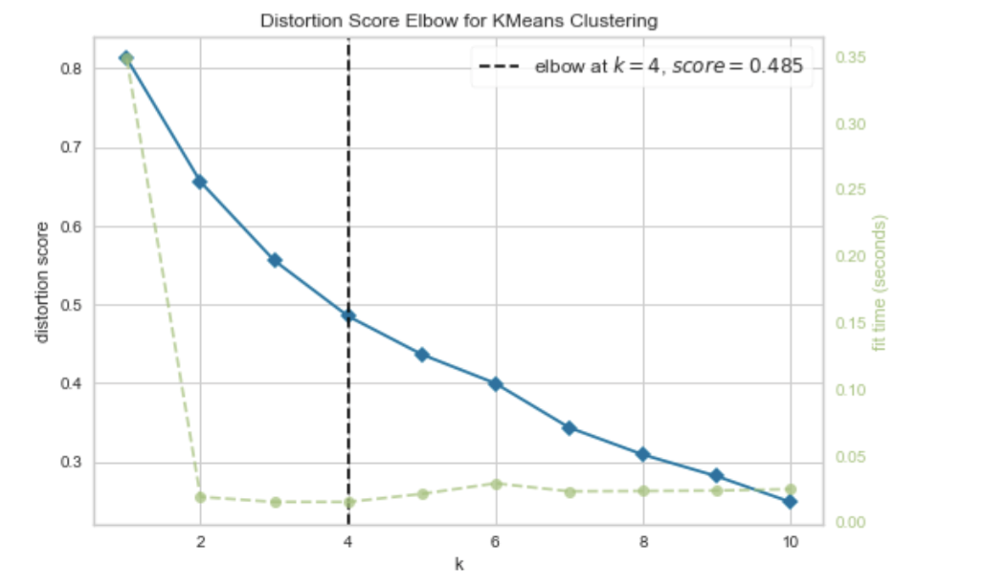
Elbow’ Finding Method

Slide 22
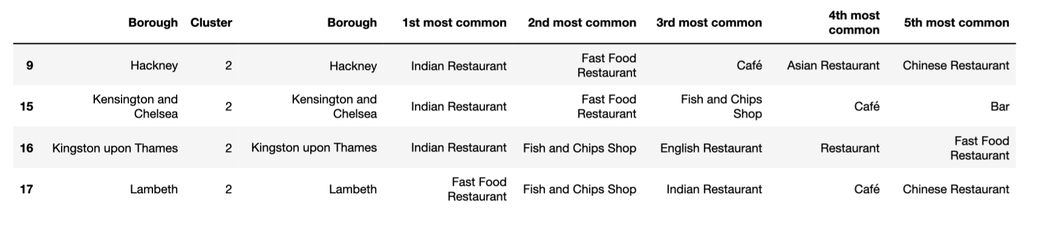
Example

Slide 23
WHAT ABOUT FOUR COLUMNS?
MARS
VENUS
JUPITER
MERCURY
Despite being red, Mars is a very cold place
Venus has a beautiful name, but it’s hot
It’s the biggest planet in the Solar System
Mercury is the closest planet to the Sun

Slide 24
ITINERARY
1
Place the text here
4
2
Place the text here
2
5
1
3
Place the text here
3
6
4
Place the text here
5
Place the text here
6
Place the text here

Slide 25
THIS IS A TABLE
MERCURY | 0.06 | 0.38 | 0.38
MARS | 0.11 | 0.53 | 0.38
SATURN | 95.2 | 9.4 | 1.16

Slide 26
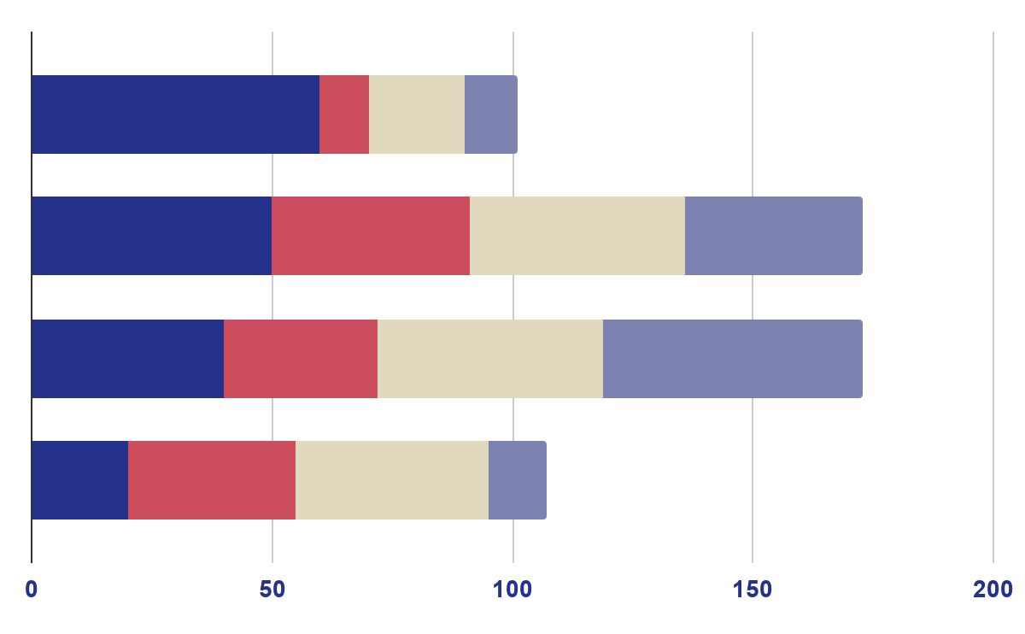
SHOW YOUR INFORMATION WITH A GRAPH
MERCURY
MARS
JUPITER
VENUS
Mercury is the closest to the Sun
Despite being red, Mars is cold
It’s the biggest planet of them all
Venus has a nice name, but it’s hot
To modify this graph, click on it, follow the link, change the data and paste the new graph here

Slide 27
04
CONCLUSION

Slide 28
ISSUES FACED AND CHALLENGES
Not enough data.
Version 3 of the Foursquare API
Creating new features
Dealing with new concepts
1
Due to the limited FREE API
2
There’re not enough resources
3
By looking for other reliable sources.
4
Using Geojson file in order to create Choropleth map, Scraping data from Wikipedia.

Slide 29
FUTURE WORKS
Getting more data
Premium API
Locally!
the prImplementingoject in Jeddah.
Dashboard
Creating an interactive dashboard

Slide 30
THANK YOU!
Do you have any questions?

