Slide 1

AUTOMOBILE ANALYSIS
Sarah Aisagbon

Slide 2
Agenda
We will be comparing 2015 with 2023.
Then, we will looking at trends over the whole period.

Slide 3

2015 vs 2023

Slide 4
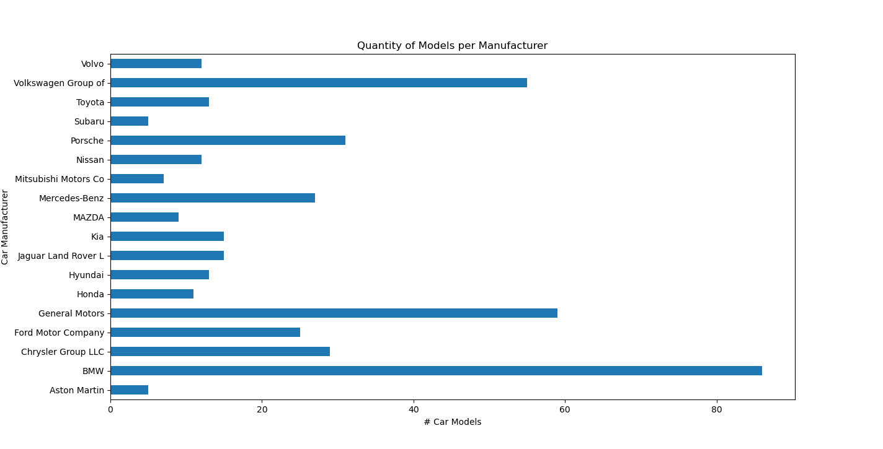
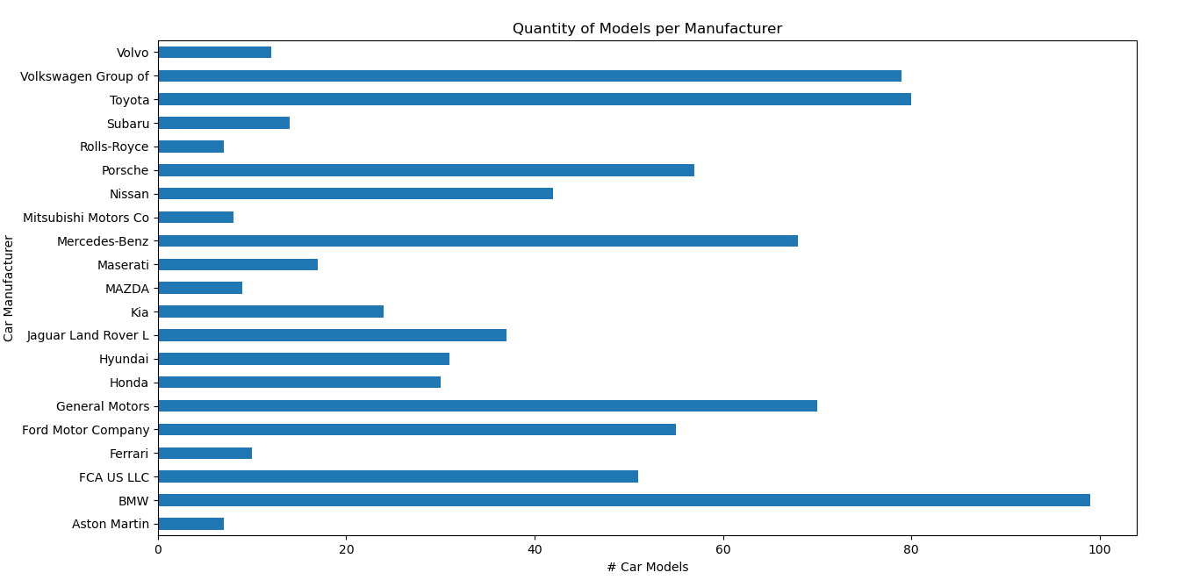
QUESTION 1: FIND THE CAR MANUFACTURER, WHICH CONTAINS MOST QUANTITY OF CAR MODELS.
2023
2015

Slide 5
QUESTION 2: FIND THE TOP AVERAGE FUEL ECONOMY FOR THE CITY AND HIGHWAY DRIVING.
2015
Car Model: 'Ford Fusion Hybrid Fwd',
Average Fuel Economy: 42.5
2023
Car Model: 'Toyota Prius',
Average Fuel Economy': 56.5

Slide 6
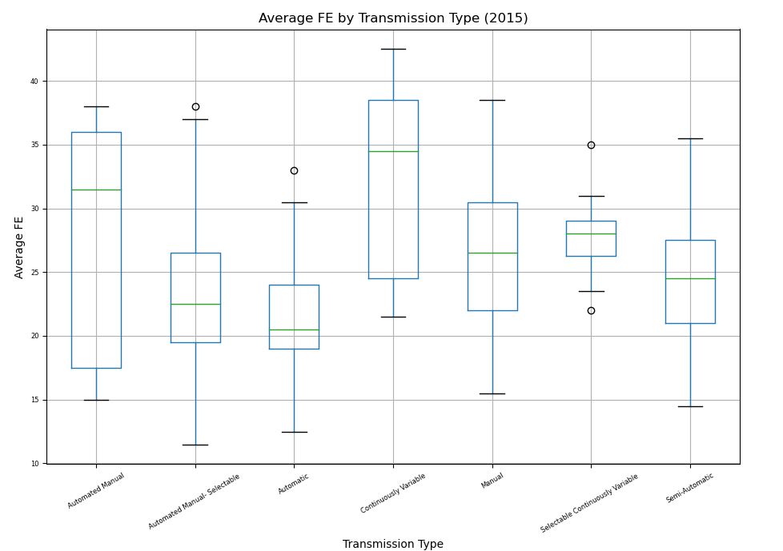
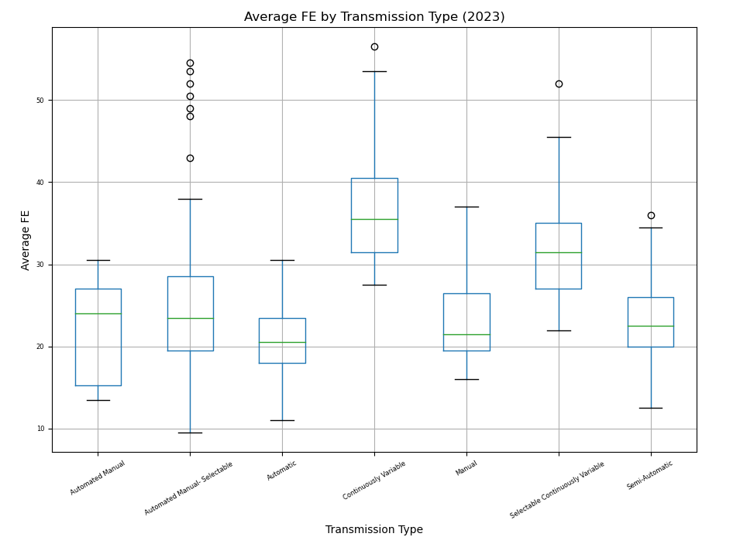
QUESTION 3: FIND GOOD AND BAD AVERAGE FUEL ECONOMY CARS FROM ALL TRANSMISSION TYPES.

Slide 7
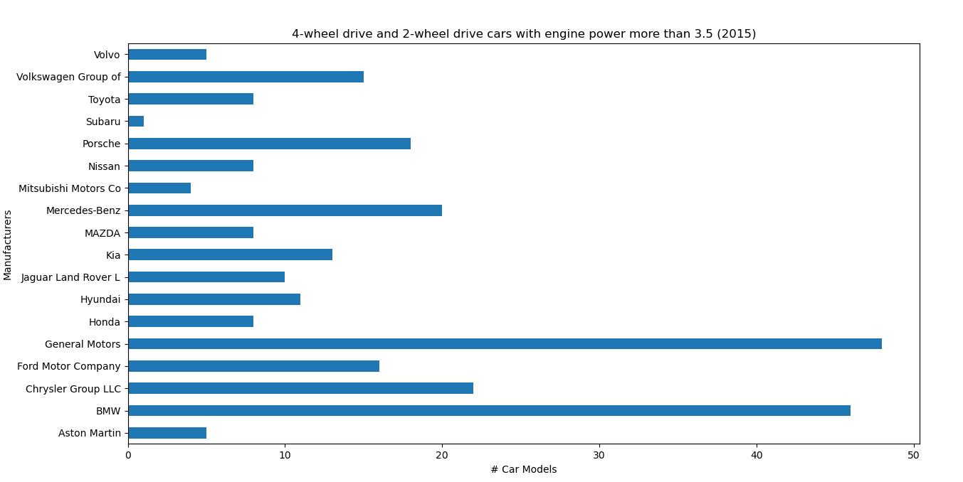
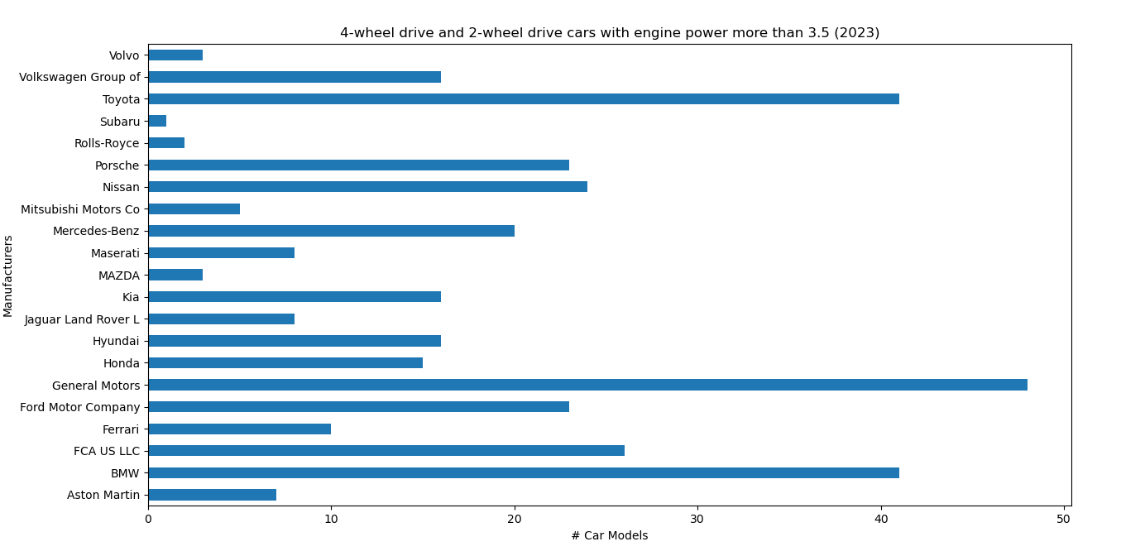
QUESTION 4: FIND CAR MANUFACTURERS, WHICH HAVE 4WD (4-WHEEL DRIVE) AND 2WD (2-WHEEL DRIVE) WITH ENGINE POWER IS MORE THAN 3.5.

Slide 8
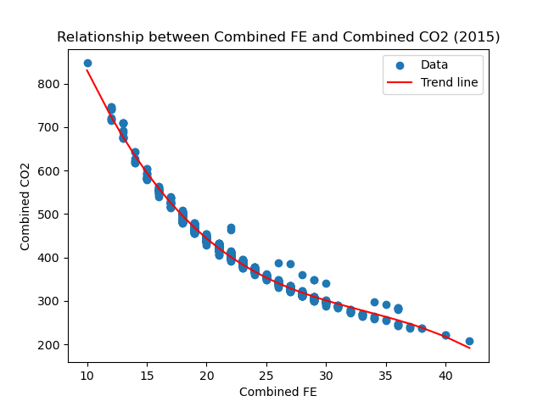
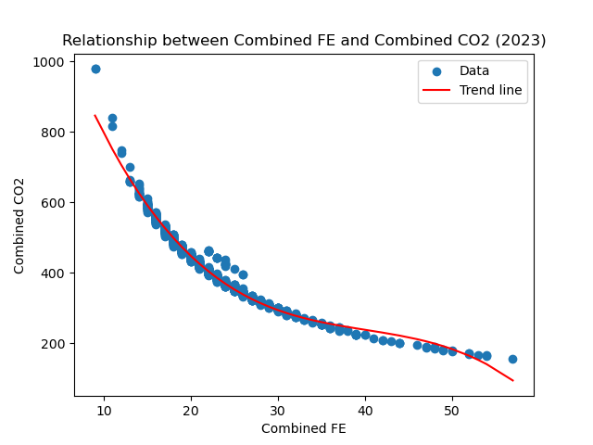
QUESTION 5: IS THERE A RELATIONSHIP BETWEEN COMBINED FE AND COMBINED CO2?

Slide 9
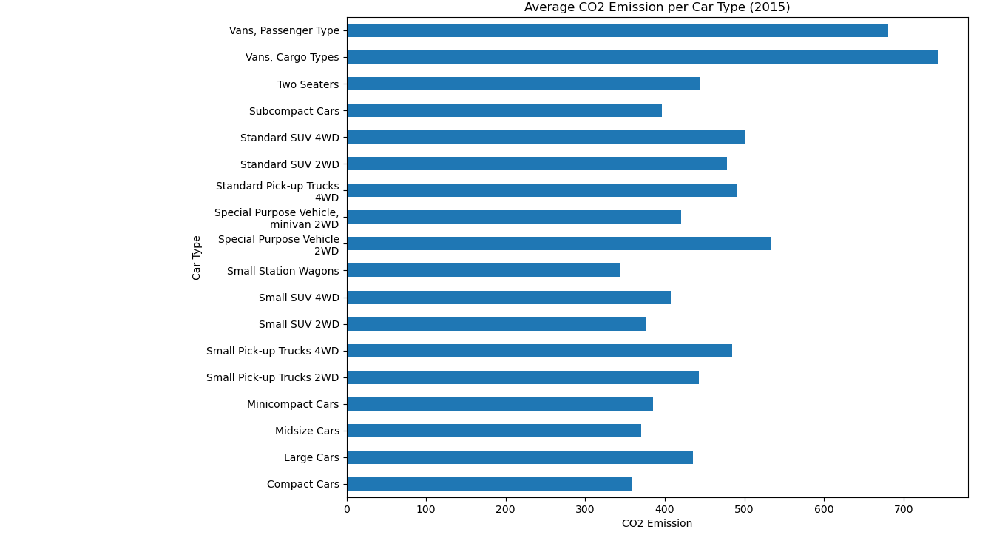
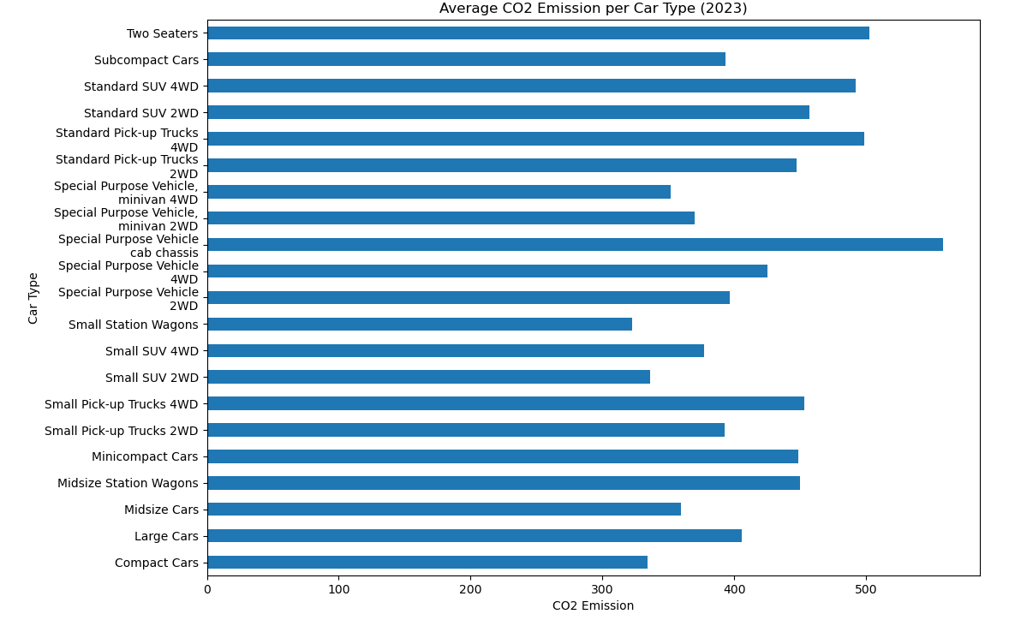
QUESTION 6: HOW MUCH CO2 ON AVERAGE IS EMITTED FOR EACH CAR TYPE?

Slide 10
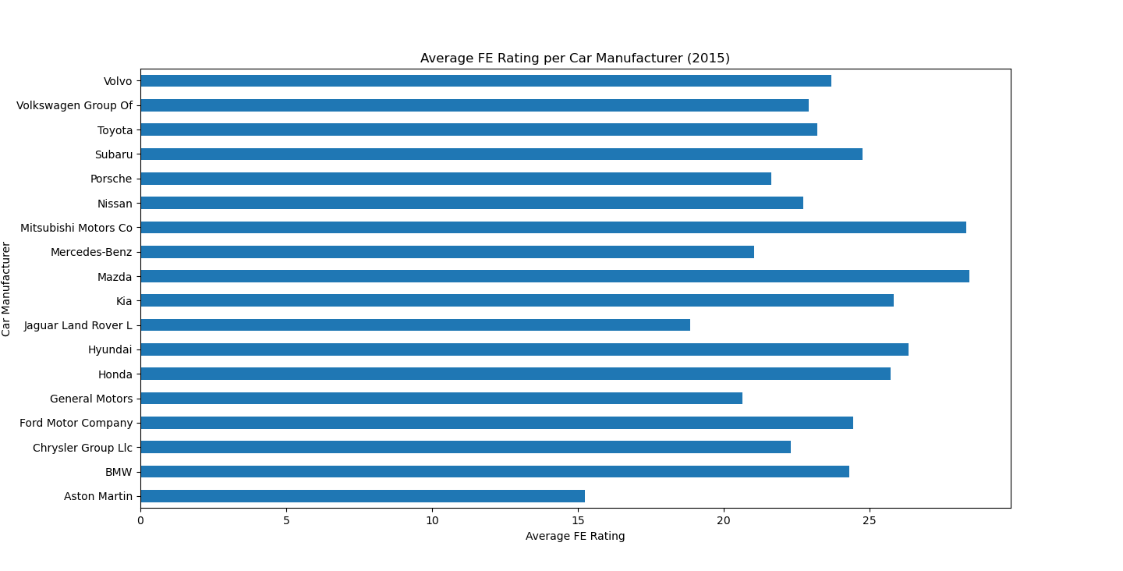
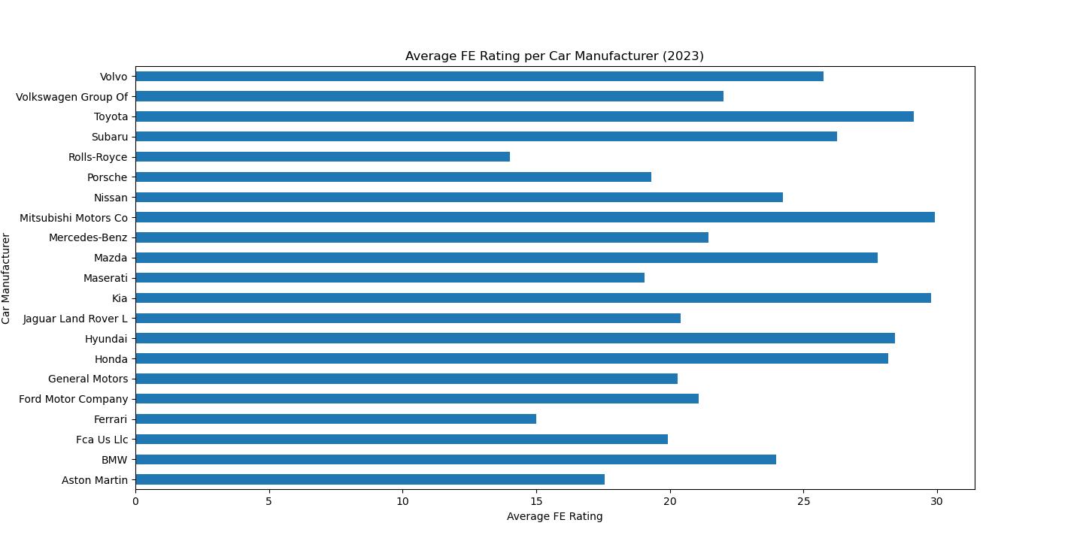
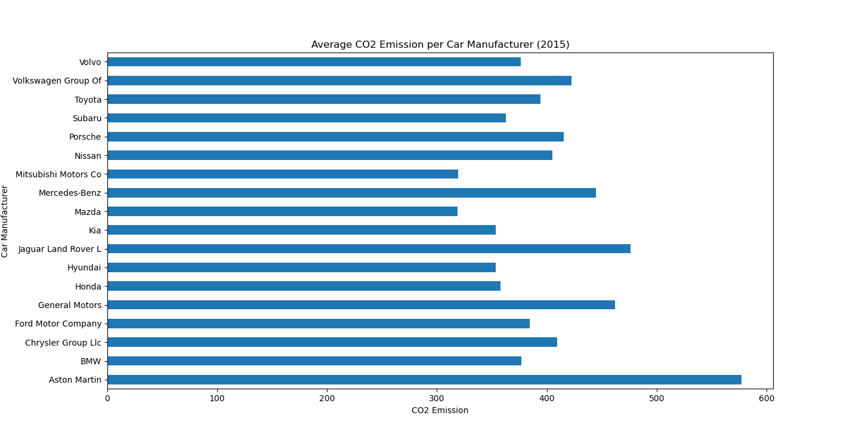
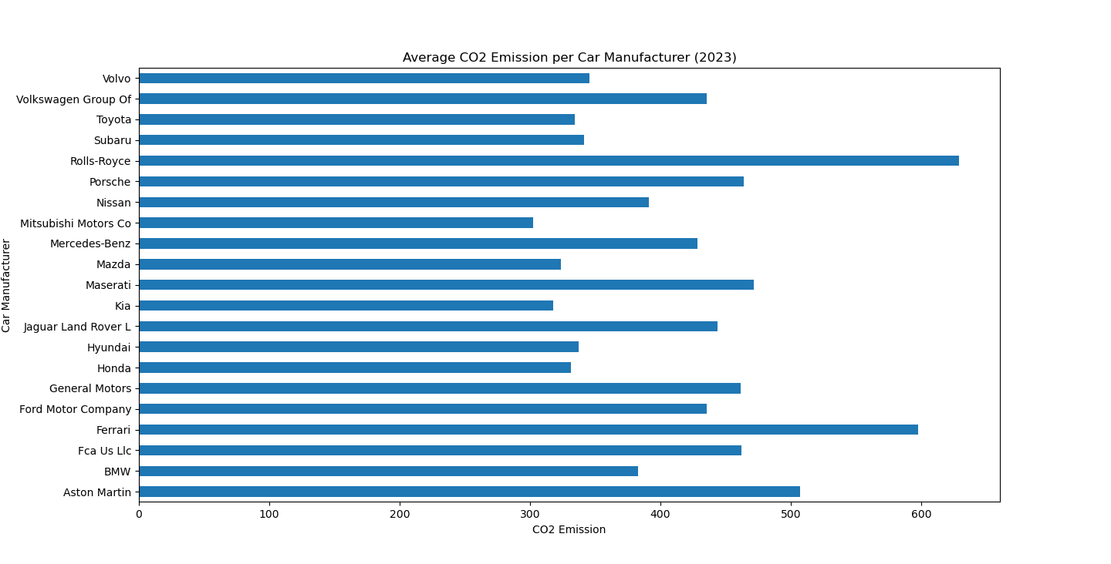
QUESTION 7: WHAT'S THE AVERAGE RATING AND CO2 FOR EACH CAR MANUFACTURER?

Slide 11
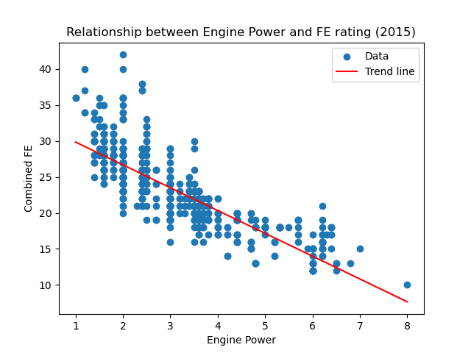
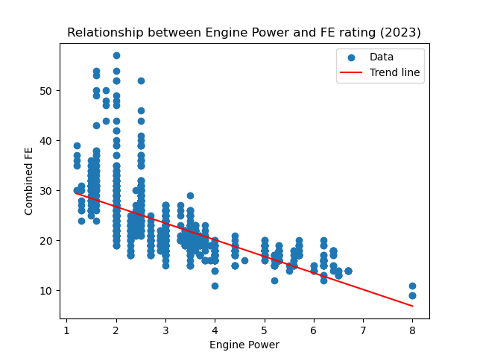
QUESTION 8: IS THERE A RELATIONSHIP BETWEEN ENGINE POWER AND FE RATING?

Slide 12
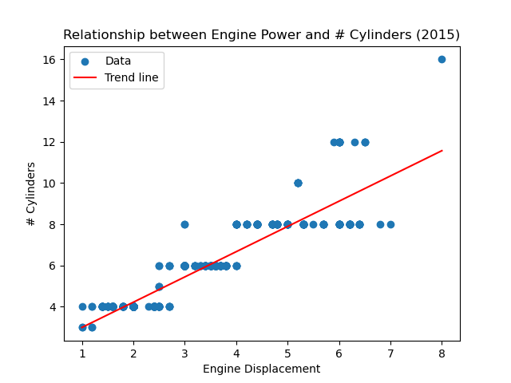
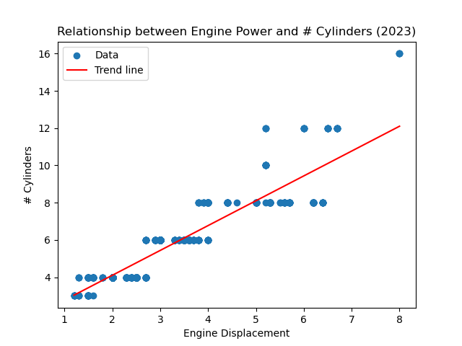
QUESTION 9: IS THERE A RELATIONSHIP BETWEEN ENGINE POWER AND # CYLINDERS?

Slide 13

OVERTIME TRENDS

Slide 14
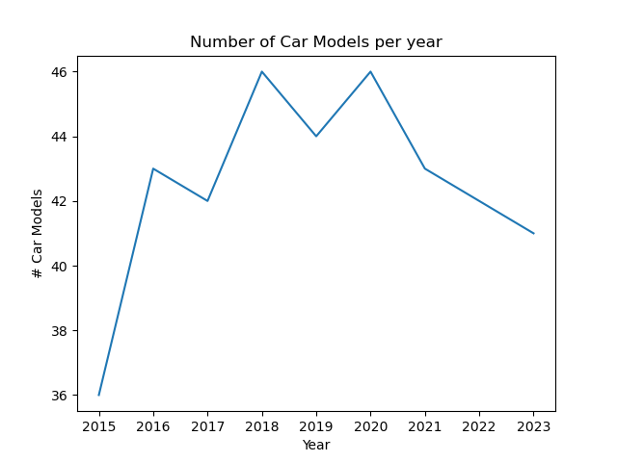
QUESTION 1: FIND THE QUANTITY OF CAR MODELS EACH YEAR.

Slide 15
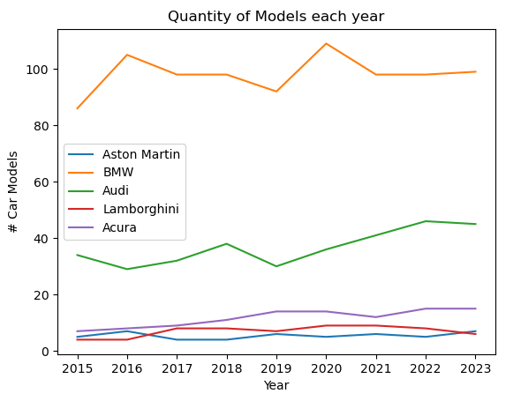
QUESTION 2: FIND THE QUANTITY OF CAR MODELS FOR DIFFERENT MANUFACTURERS EACH YEAR.

Slide 16
QUESTION 3: FIND THE CAR MODELS WITH THE BEST AND WORST FE RATINGS EACH YEAR.
Year | Best FE |  | Worst FE
 | Manufacturer | FE Rating | Manufacturer | FE Rating
2015 | Ford | 42 | Bugatti | 10
2016 | Toyota | 56 | Ferrari North America, Inc | 12
2017 | Hyundai Motor Company | 58 | Mercedes-Benz | 11
2018 | Hyundai Motor Company | 58 | Mercedes-Benz | 11
2019 | Hyundai Motor Company | 58 | Bugatti | 11
2020 | Hyundai Motor Company | 58 | Bugatti | 10
2021 | Hyundai Motor Company | 59 | Bugatti | 10
2022 | Hyundai Motor Company | 59 | Bugatti | 9
2023 | Toyota | 57 | Bugatti | 9

Slide 17
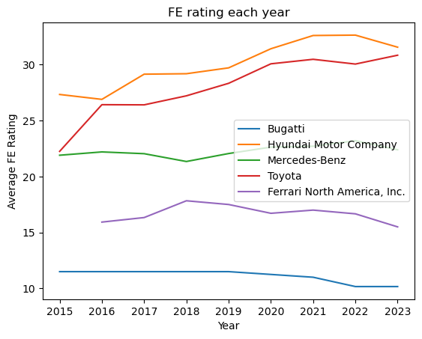
QUESTION 4: FIND THE FE RATING FOR DIFFERENT MANUFACTURERS EACH YEAR.

