Slide 1
AUTOMOBILE ANALYSIS
Sarah Aisagbon

Slide 2
Agenda
We will be comparing 2015 with 2023.
Then, we will looking at trends over the whole period.

Slide 3
2015 vs 2023

Slide 4
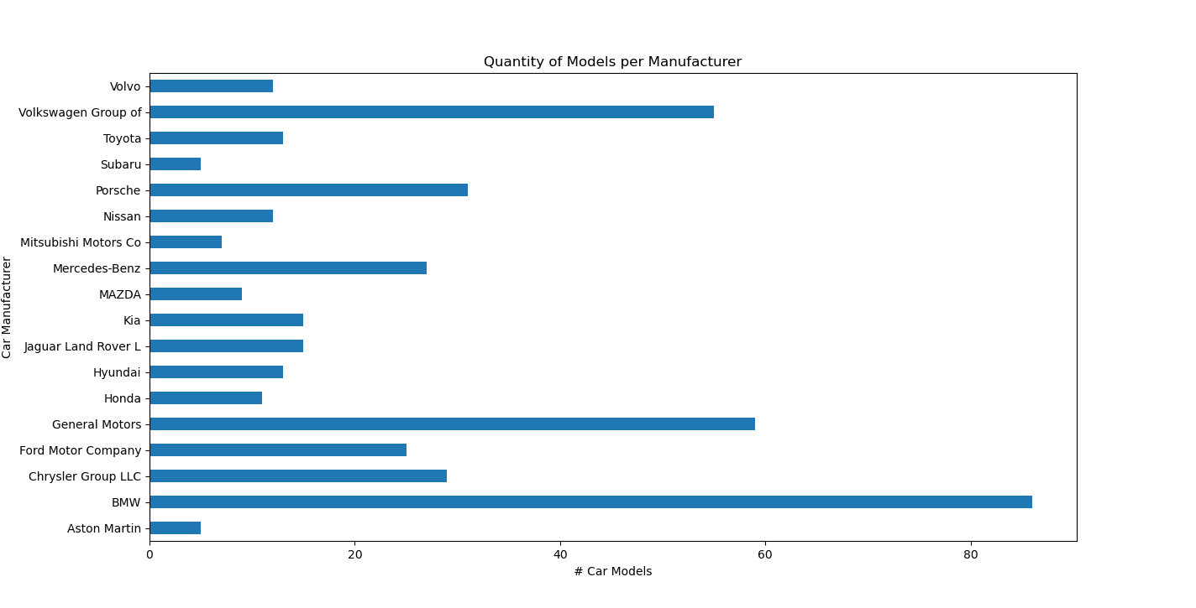
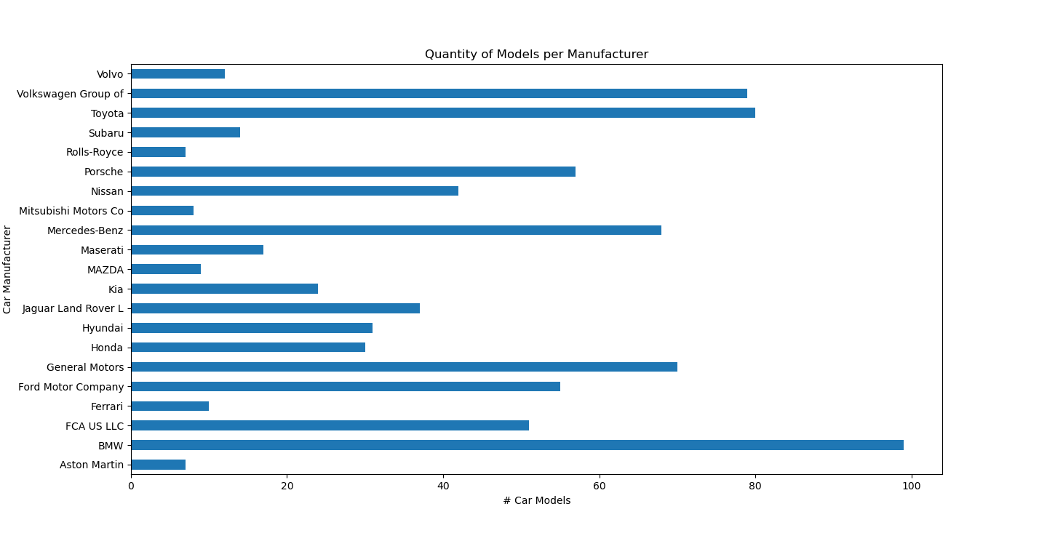
Question 1: Find the car manufacturer, which contains most quantity of car models.
2015
2023

Slide 5
QUESTION 2: FIND THE TOP AVERAGE FUEL ECONOMY FOR THE CITY AND HIGHWAY DRIVING.
2015
Car Model: 'Ford Fusion Hybrid Fwd',
Average Fuel Economy: 42.5
2023
Car Model: 'Toyota Prius',
Average Fuel Economy': 56.5

Slide 6
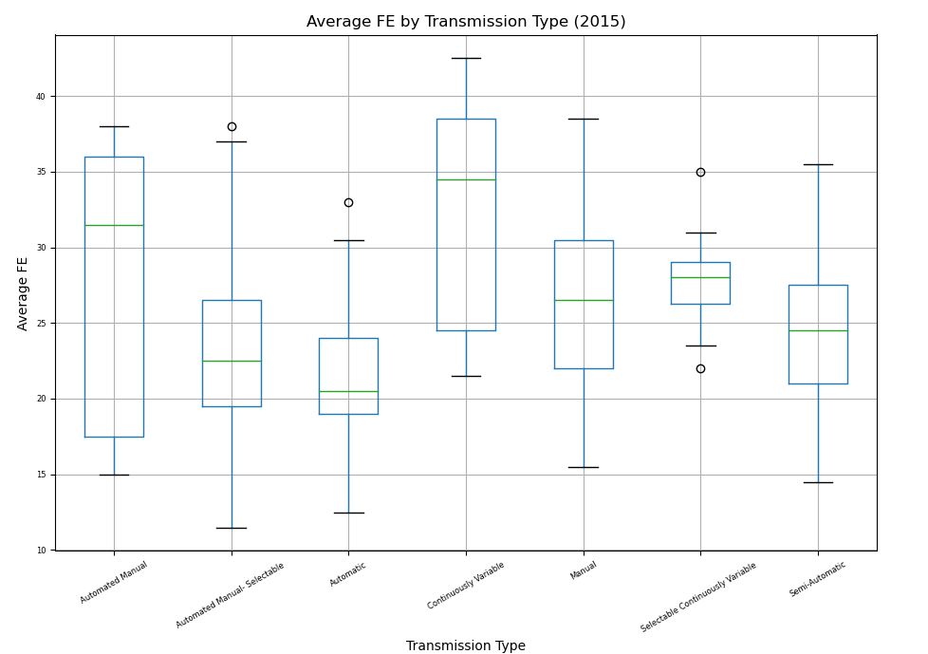
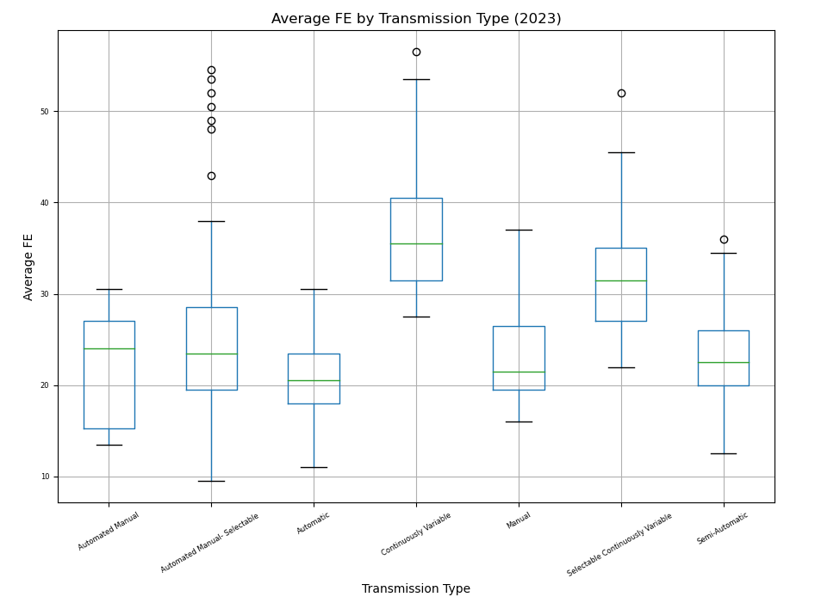
Question 3: Find good and bad average fuel economy cars from all transmission types.

Slide 7
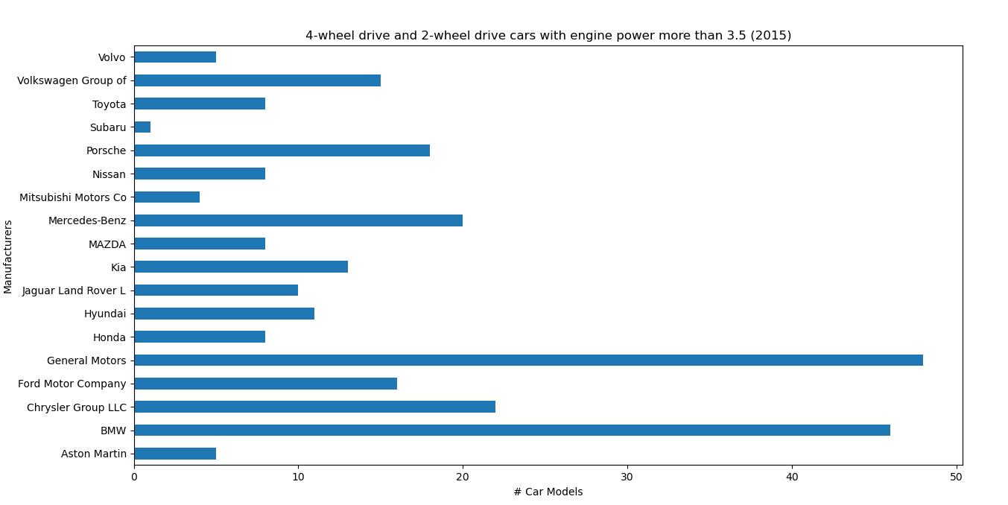
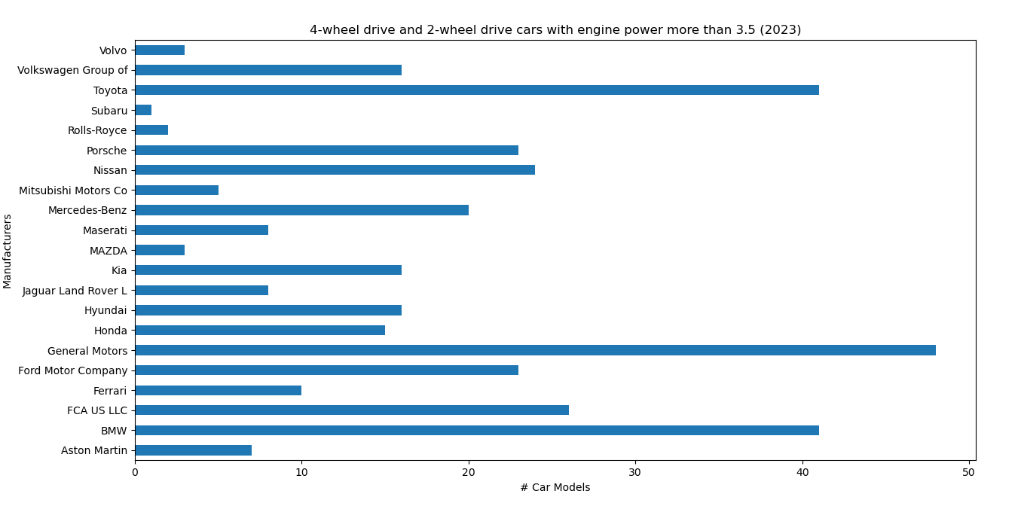
Question 4: Find car manufacturers, which have 4WD (4-wheel drive) and 2WD (2-wheel drive) with engine power is more than 3.5.

Slide 8
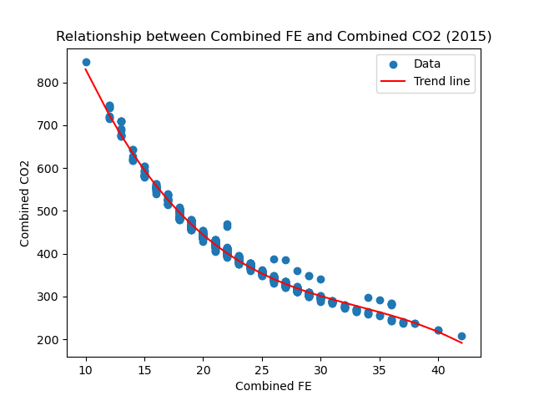
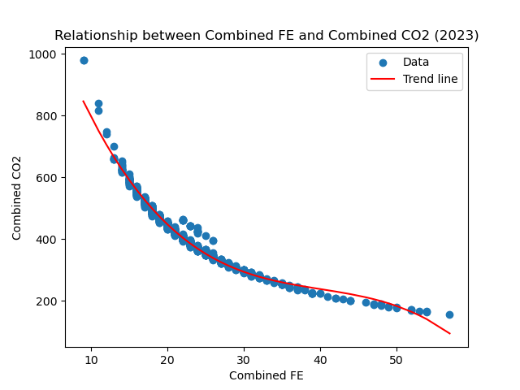
Question 5: Is there a relationship between Combined FE and Combined CO2

Slide 9
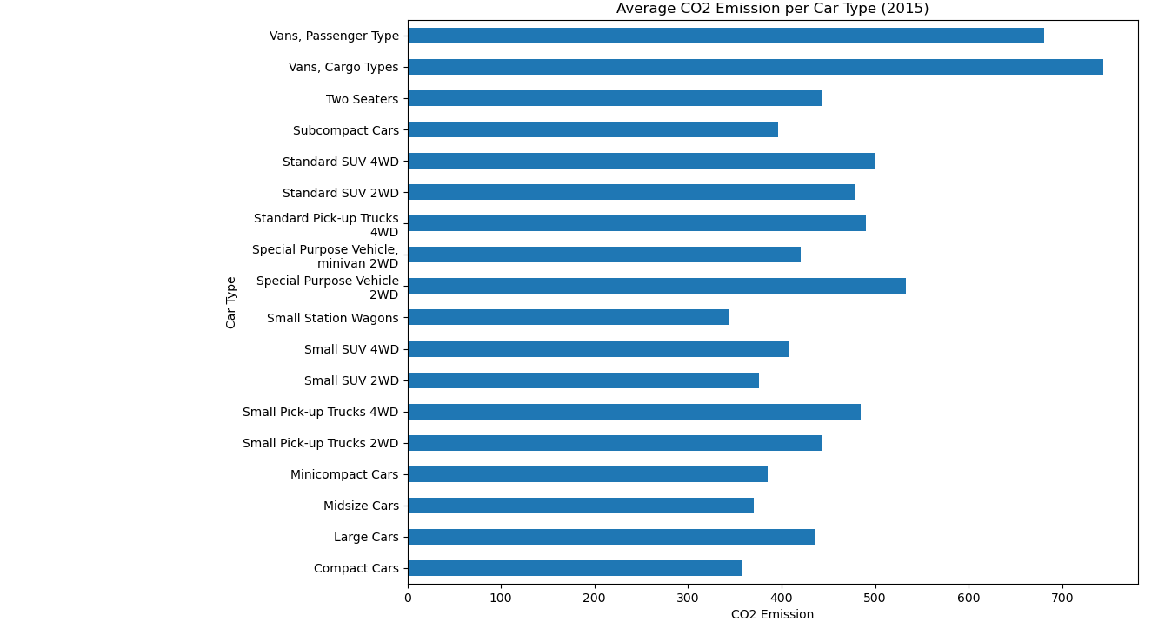
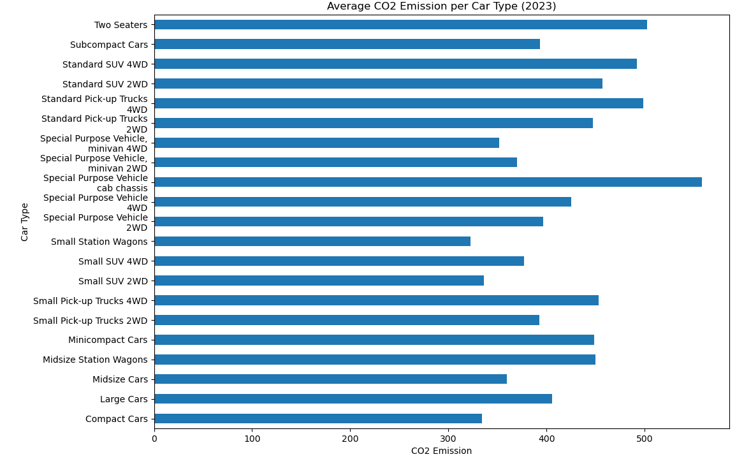
Question 6: How much CO2 on average is emitted for each car type?

Slide 10
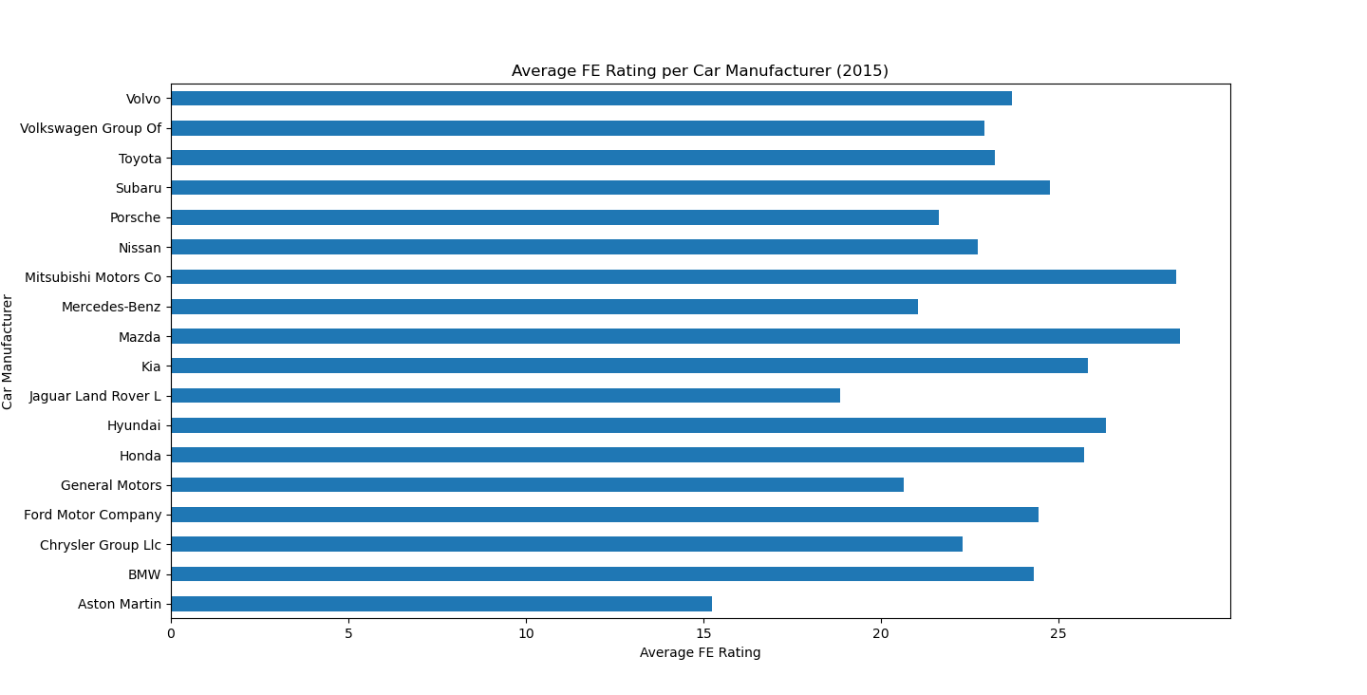
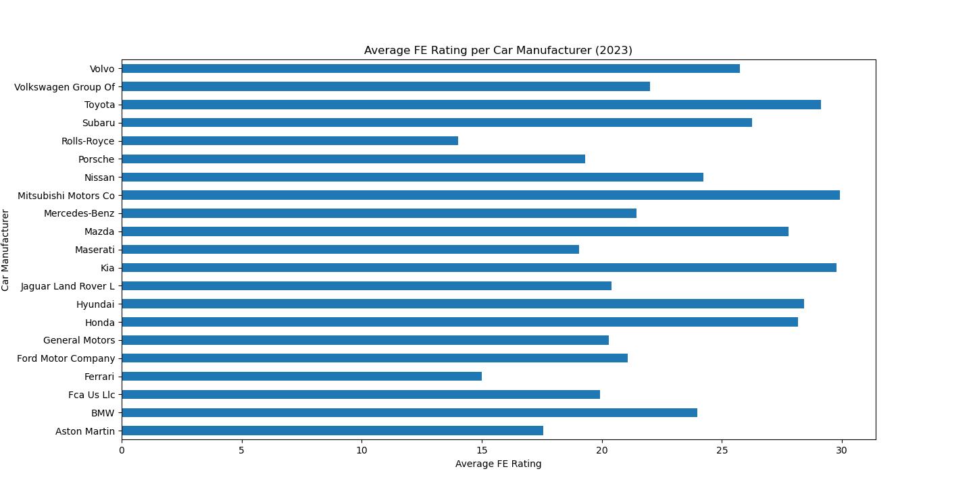
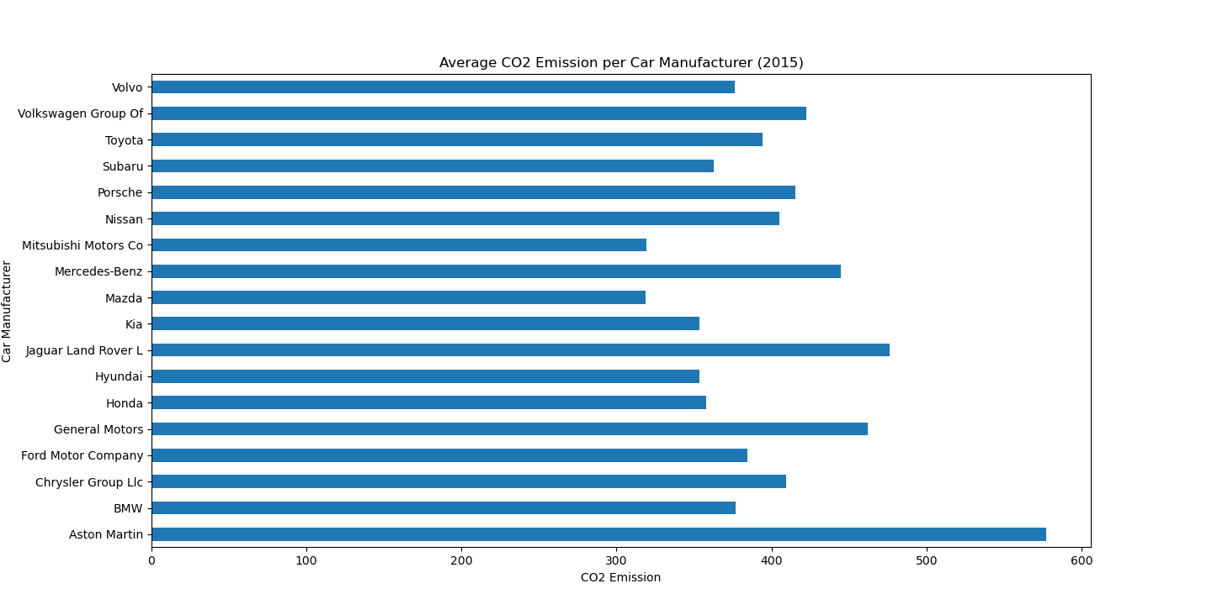
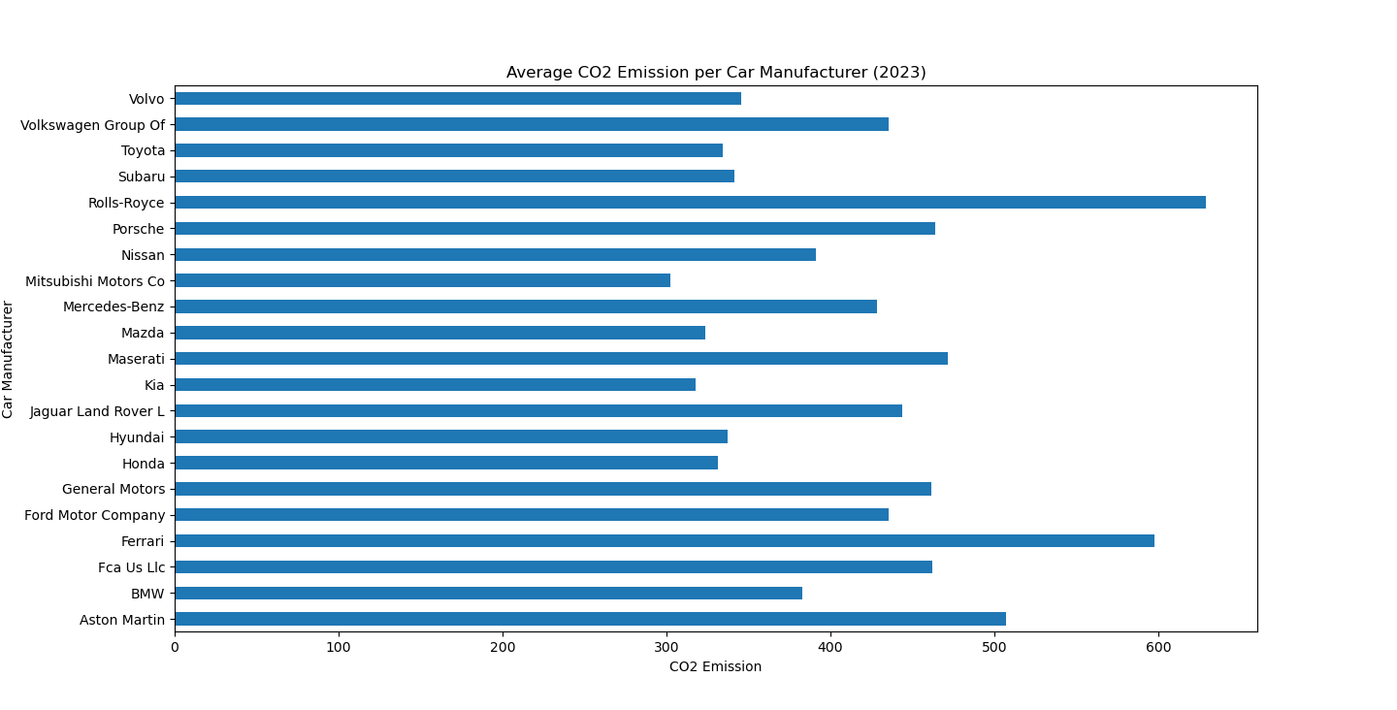
Question 7: What's the average rating and CO2 for each car manufacturer?

Slide 11
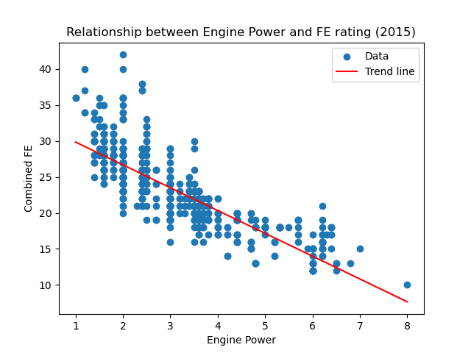
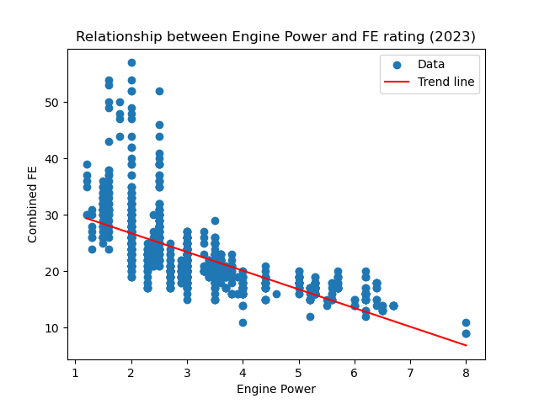
Question 8: Is there a relationship between Engine Power and FE rating?

Slide 12
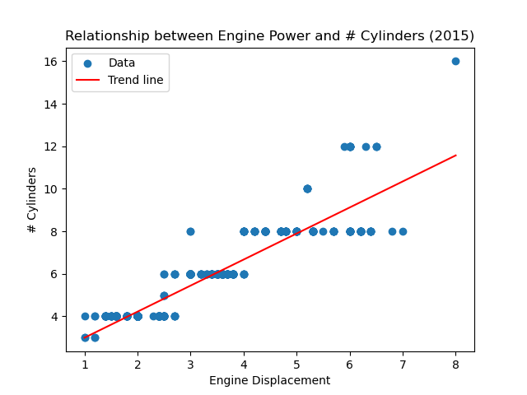
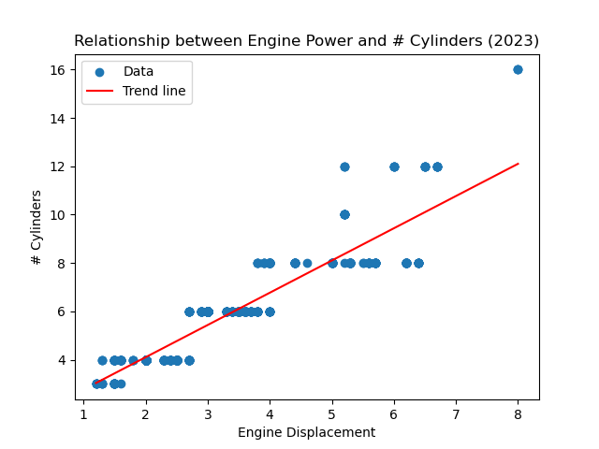
Question 9: Is there a relationship between Engine Power and # Cylinders?

Slide 13
Overtime trends

Slide 14
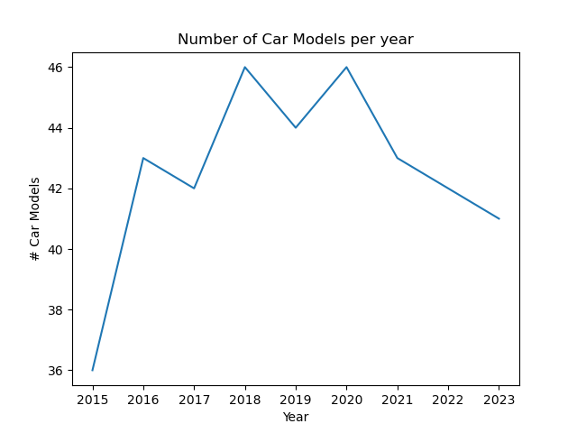
Question 1: Find the quantity of car models each year.

Slide 15
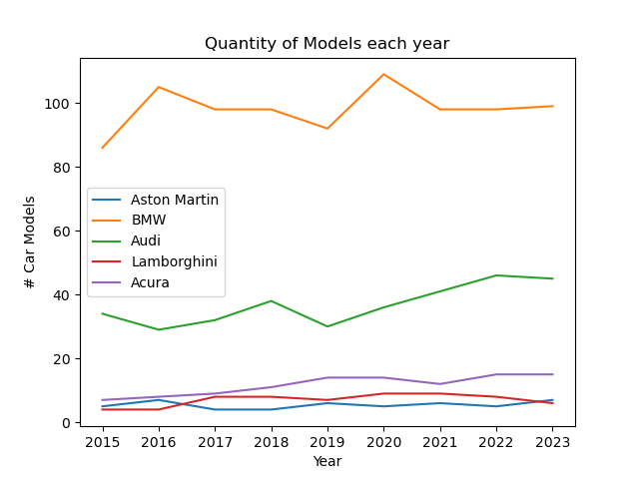
Question 2: Find the quantity of car models for different manufacturers each year.

Slide 16
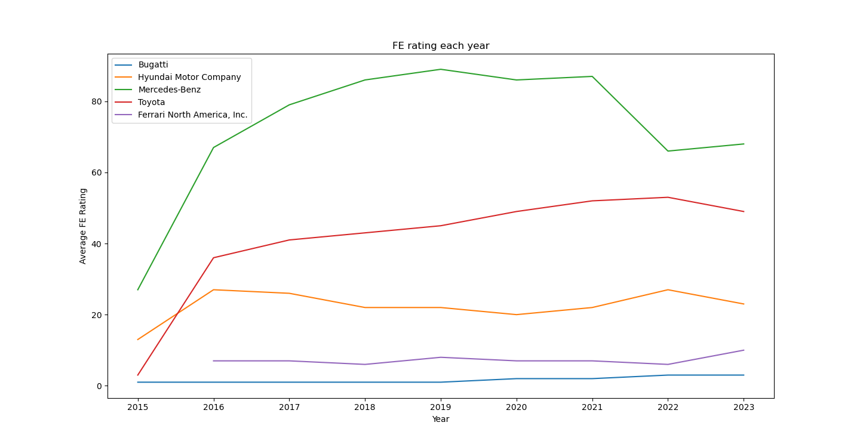
Question 3: Find the FE rating for different manufacturers each year.

