Slide 1

Demo and Q&A
Send your questions to guides@alphasoftware.com

Slide 2

Alpha Launch
Mobile Apps without the App Store

Slide 3
App Store Publishing Workflow
Build your App with Ionic Appflow or Cordova CLI
Sign up for the Apple Developer Program
Create certificate and provision files
Create your App Store listing
Upload your App
Submit your App for Review
Configure Cordova Build settings

Slide 4
App Store Drawbacks
Requires accounts for services, like Apple Developer Program or Ionic AppFlow
Approval process takes time
Lots of hoops to jump through
Your app can be denied
Required for every update

Slide 5
Alpha Launch
Skip the App Store
Deploy and test quickly
No extra accounts required

Slide 6
Caveats
Alpha Software Branded
Can only use plug-ins included in Alpha Launch
Your app(s) will NOT be discoverable in the App Stores
All of the above can be solved with a custom Alpha Launch Deployment

Slide 7
Alpha Launch Checklist
Add an Exit button
Create a test.a5w page
Publish your Project to the Application Server
Get your test.a5w page URL
Configure your Alpha Launch App
Set your Server URL
Choose a Download Location
Application Server or Amazon S3
Generate & save a QR Page
Publish Alpha Launch assets

Slide 8
Add an Exit Button
You must have a button in your app that runs this code:
if (A5.shell) {
A5.shell.exitComponent();
}

Slide 9
Create an .A5W test page
Create a basic .a5w page called "test.a5w"
Consider this step is required if you can't answer this question:
"What is your Server URL"

Slide 10
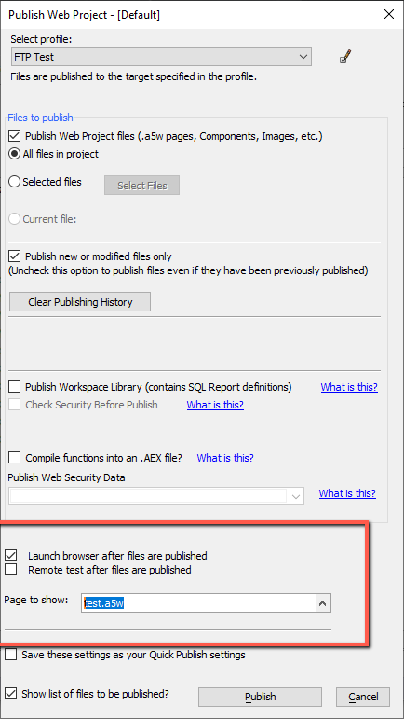
Publish to the Application Server
Publish your Project to your Alpha Anywhere Application Server
Don't forget to configure your published Connection Strings
Launch the test.a5w page after publish

Slide 11
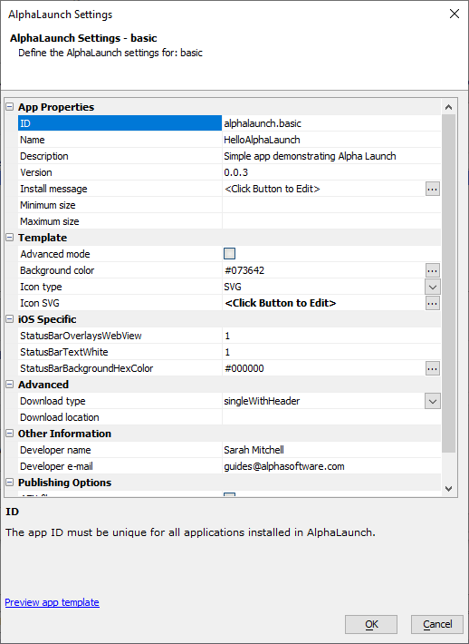
Configure your Alpha Launch App
ID
App Name
Description
Version
Background color
Icon type & Icon
Download type
Developer name
Developer e-mail
Additional assets to include in Fileset

Slide 12
Additional assets to include in Fileset
Embedded Components
External JavaScript
External Sass, CSS
Style Tweaks, Custom Web Themes
Web Fonts
Etc.

Slide 13
Publish to Alpha Launch
Select your Publish Profile
Set your Server URL
Specify your Download Location
Generate a QR Code Page
Publish

Slide 14
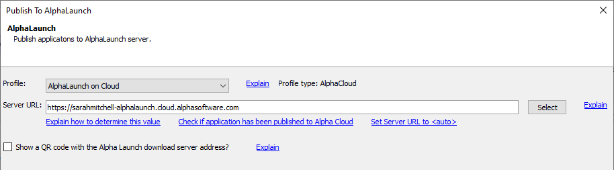
Select your Publish Profile

Slide 15
Set your Server URL

Slide 16
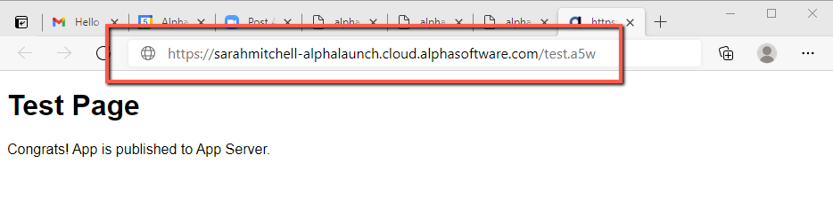
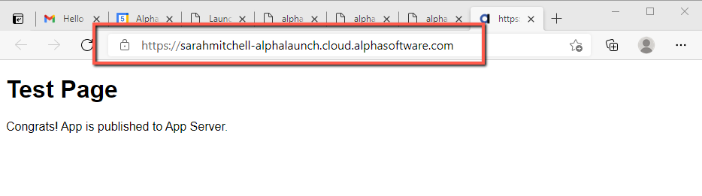
Copy your test.a5w URL

Slide 17
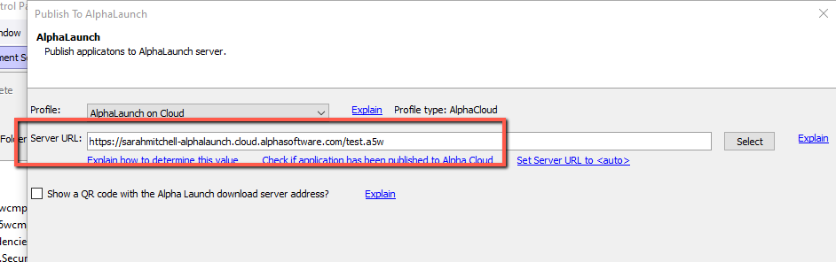
Paste the test.a5w URL in Server URL

Slide 18

Delete "test.a5w" from the path

Slide 19
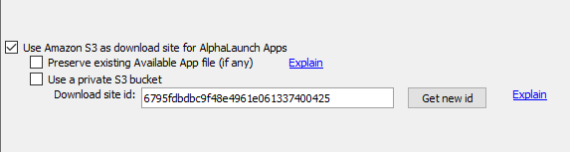
Download Locations
Your Application Server
Our Amazon S3 Bucket
Your Amazon S3 Bucket

Slide 20
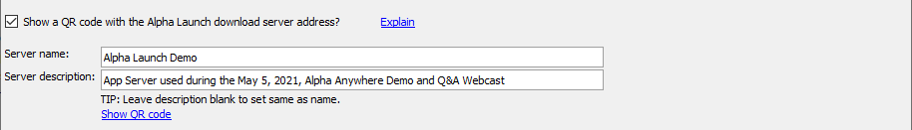
Create a Server QR Code

Slide 21
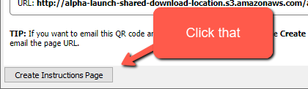
Save the QR Page

Slide 22
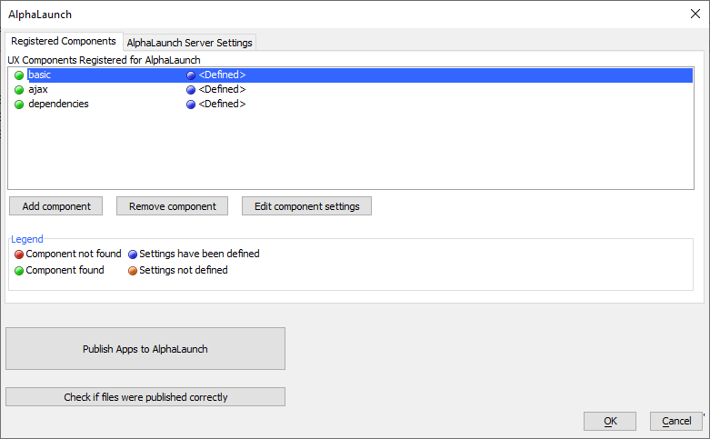
Publish your Apps

Slide 23
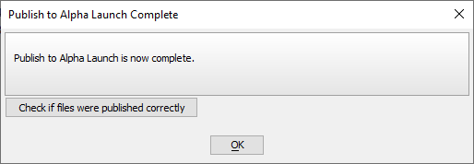
Verify Publish
Click the "Check if files were published correctly" button.

Slide 24
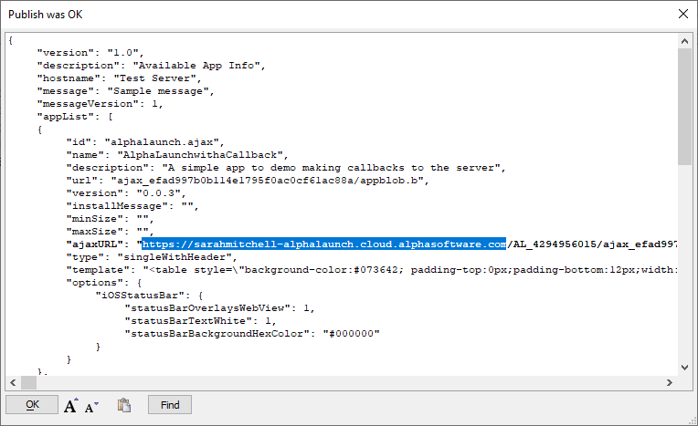
Verify Publish

Slide 25
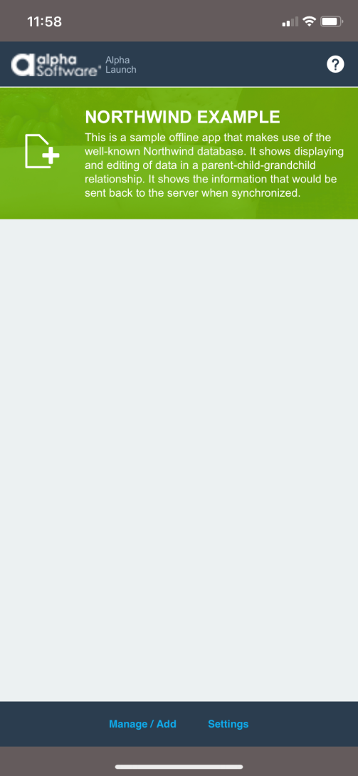
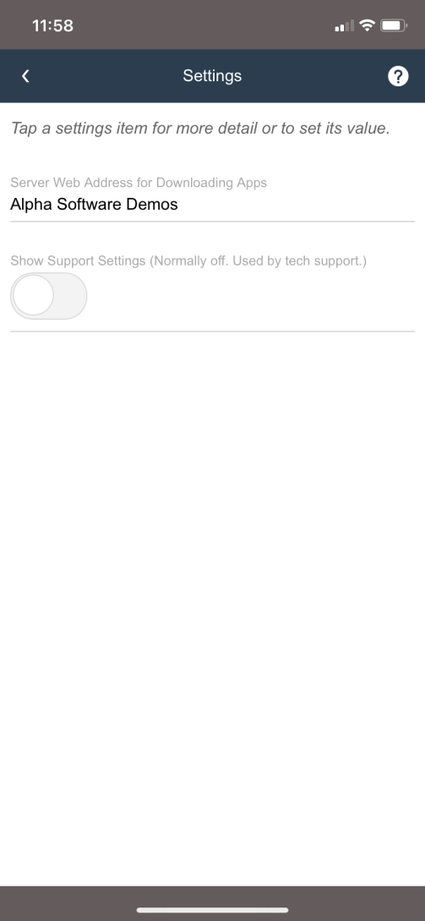
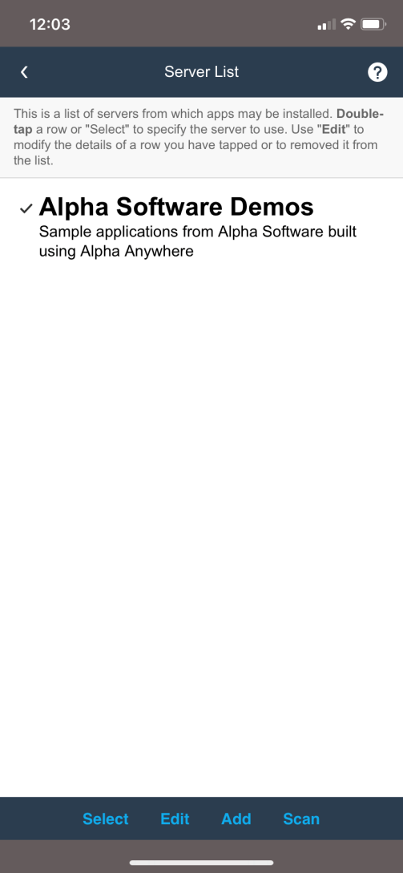
Add your Server to Alpha Launch

Slide 26
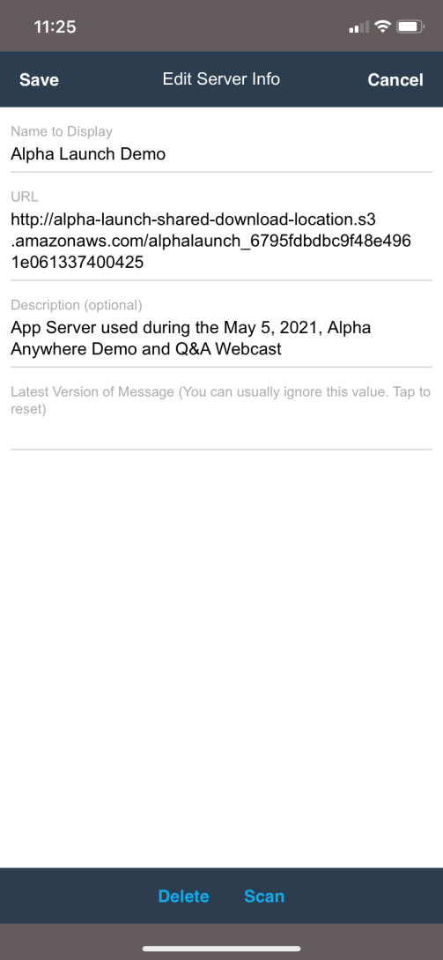
Add your Server to Alpha Launch

Slide 27
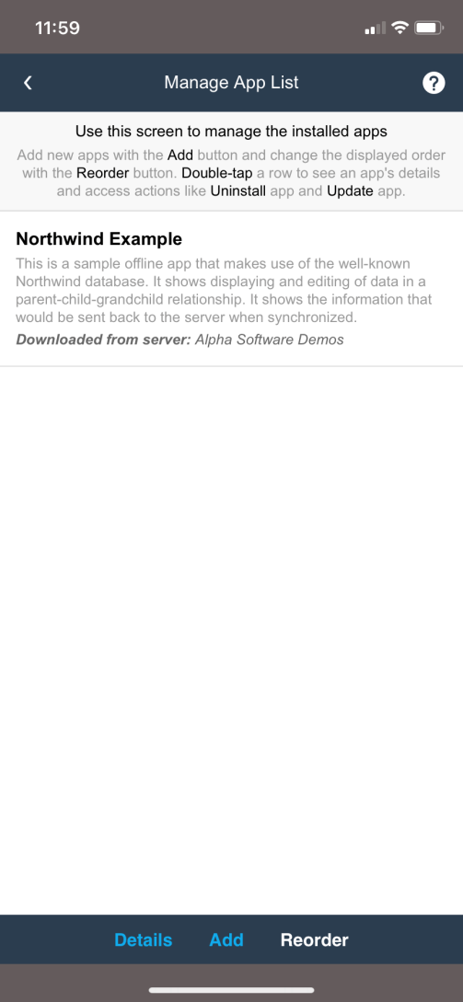
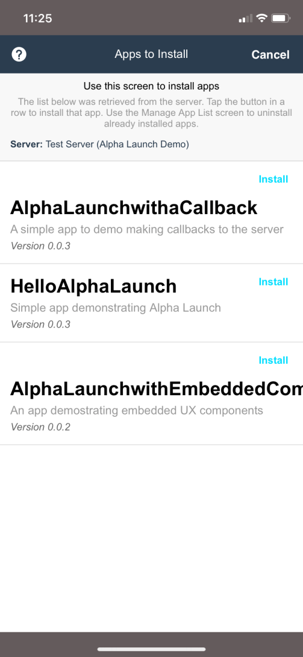
Install your Apps

Slide 28
Common Mistakes
Forgot "http://" or "https://" in server URL
Server URL is wrong
Didn't publish to the webroot on Server
Forgot to configure connection strings
Forgot the Exit App button

