Slide 1

Demo and Q&A
Send your questions to guides@alphasoftware.com

Slide 2
Alpha Shell
An app for testing components in a mobile environment

Slide 3
What is Alpha Shell
iOS and Android (soon!) app
A wrapper app for loading UX Components on a mobile device
Downloads and runs UX component on a mobile device
Includes Cordova Plugins!

Slide 4
What can you do?
Test your UX component(s) on mobile
Run components published by other developers on mobile
Demo your app to clients

Slide 5
Limitations
UX must be Published to a server, such as Alpha Cloud
No Custom Web Themes - components will use Alpha theme
No Custom Plugins
Won't work Offline

Slide 6
Alpha Shell Checklist
Build a UX
Publish to the Application Server
Generate QR Code
Add the Server
Add the Component
Try it out!

Slide 7
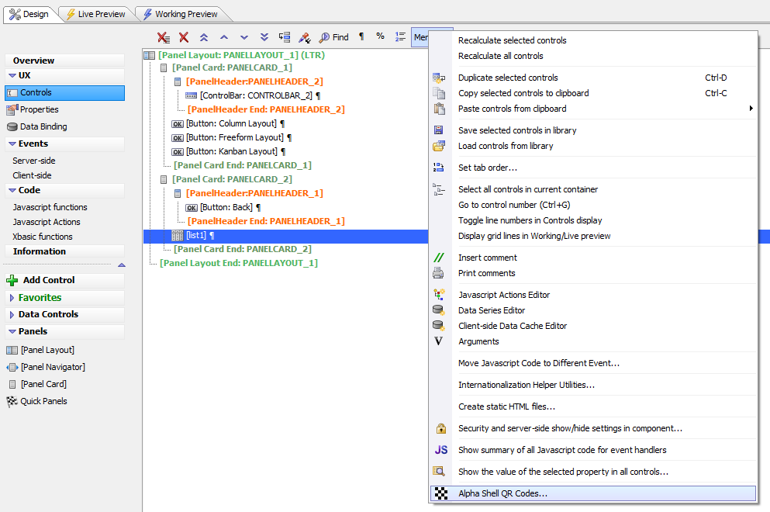
Generating a QR Code

Slide 8
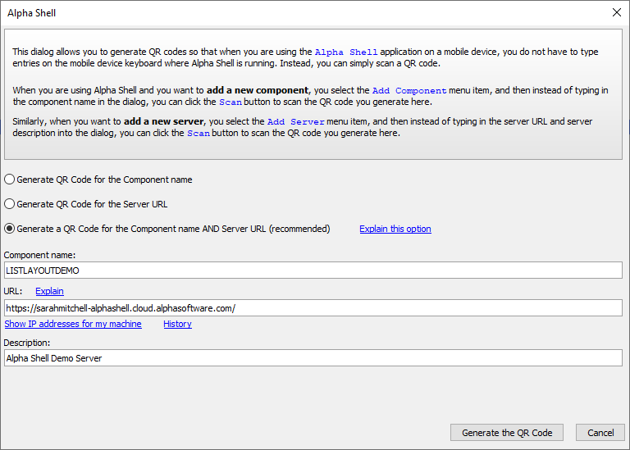
Generating a QR Code

Slide 9
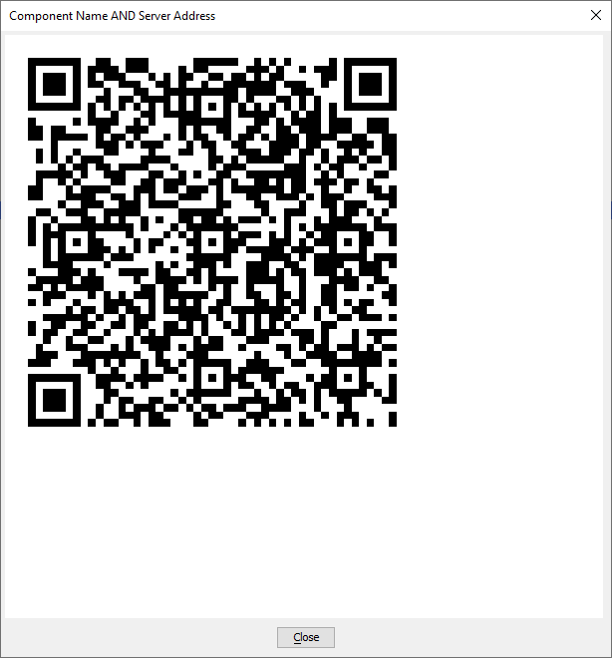
Generating a QR Code

Slide 10
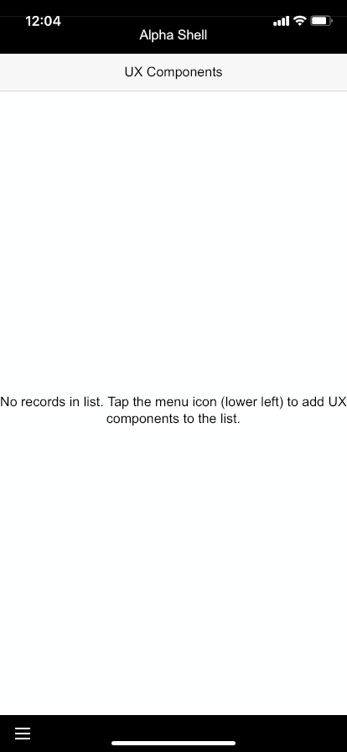
Add a Server
Launch Alpha Shell

Slide 11
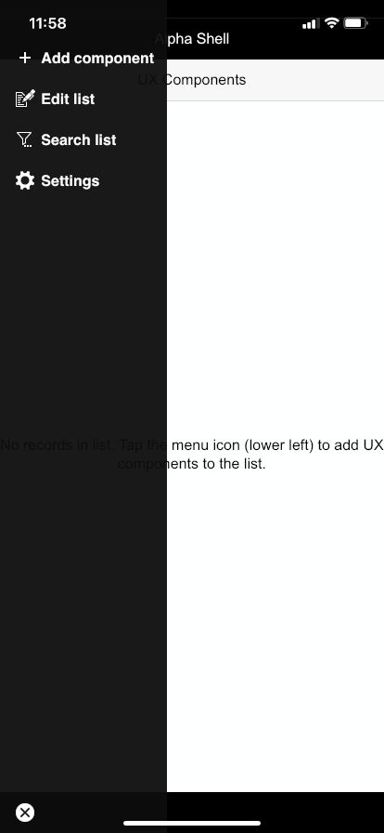
Add a Server
Open menu and select Settings

Slide 12
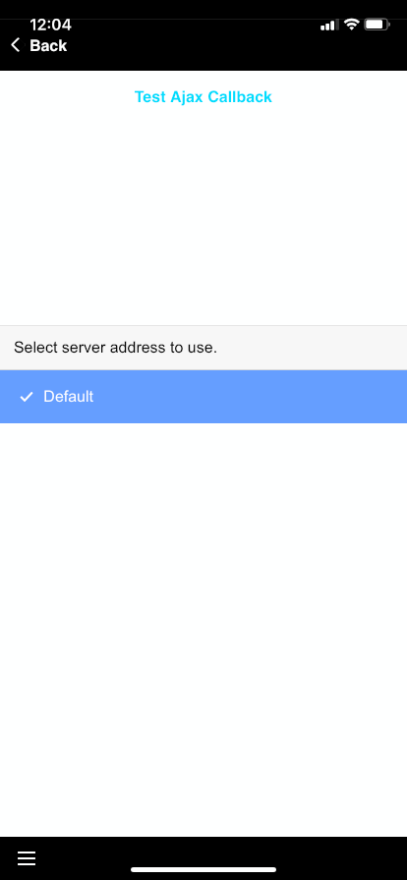
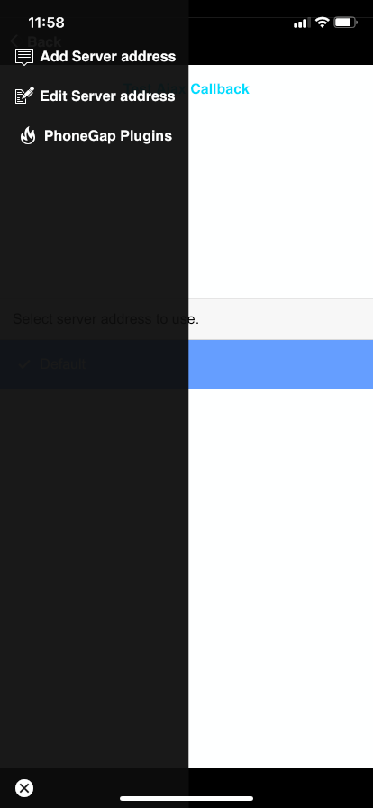
Add a Server
Open menu and select Add Server address

Slide 13
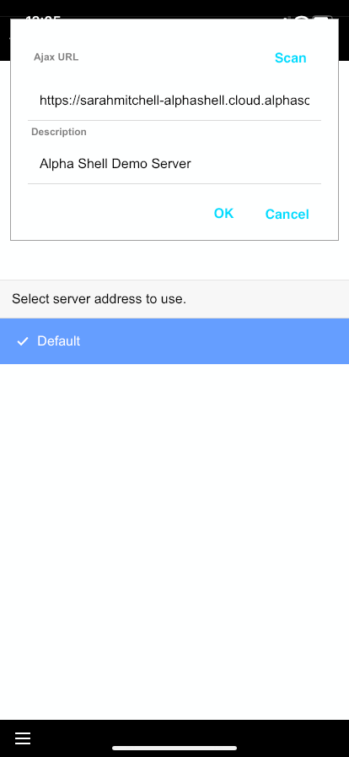
Add a Server
Tap Scan to scan the QR Code to add the server

Slide 14
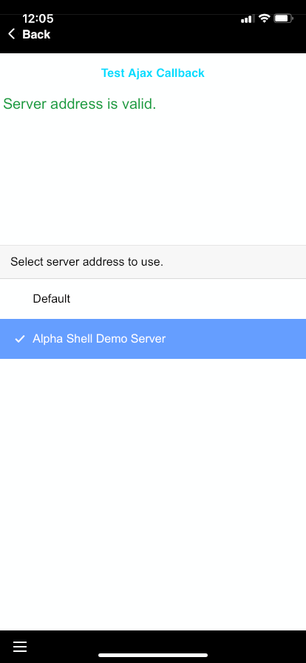
Add a Server
With your sever selected, verify the server address with the Test Ajax Callback button

Slide 15
Add a Component
Return to the main app screen and open the menu
Tap Add component

Slide 16
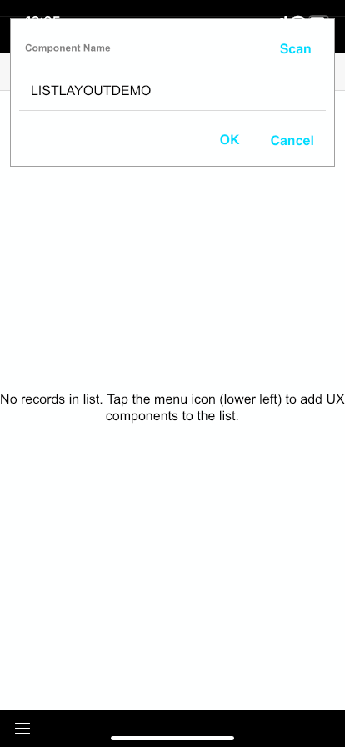
Add a Component
Tap Scan and scan your QR code

Slide 17
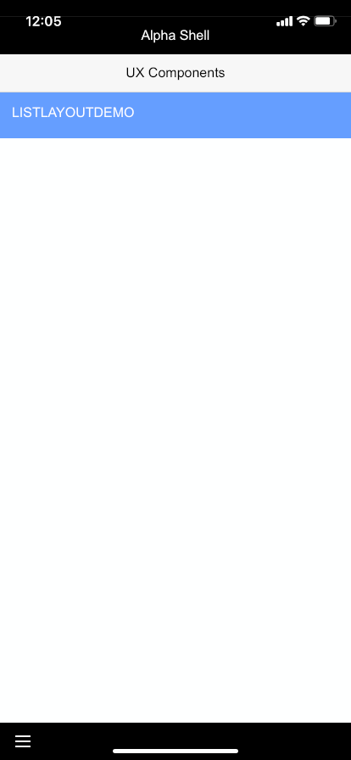
Try it out!
Select your Component from the List

Slide 18
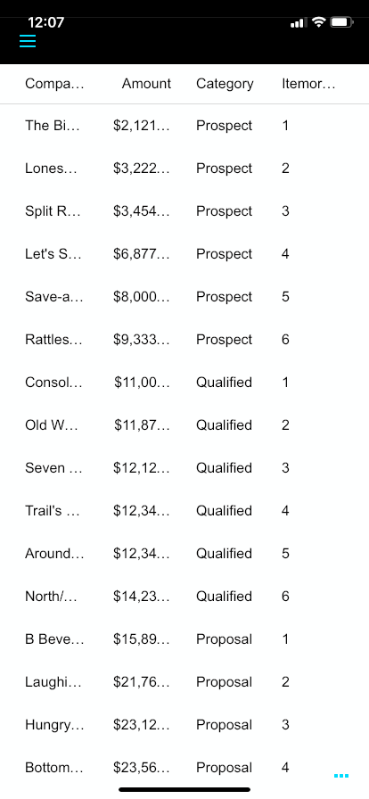
Try it Out!
And test it in Alpha Shell!

Slide 19
Returning to the Main Screen
Tap the three blue dots in the lower right-hand corner

Slide 20
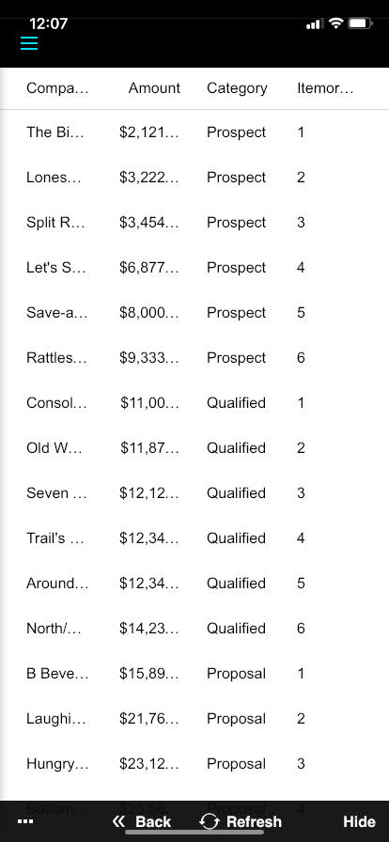
Returning to the Main Screen
Back - Returns to main component list
Other things here:
Refresh - Reloads the component
Hide - Hides this menu
Three dots (left) - exposes options to configure the position of this overlay

Slide 21


Live Demo

