Slide 1
Alpha Anywhere Demo and Q&A

Slide 2
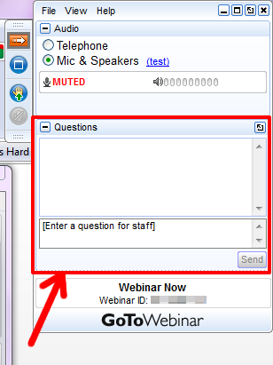
Send us your questions!
guides@alphasoftware.com

Slide 3
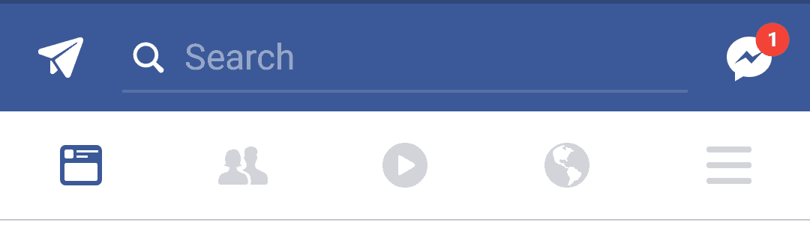
Badge Notifications

Slide 4
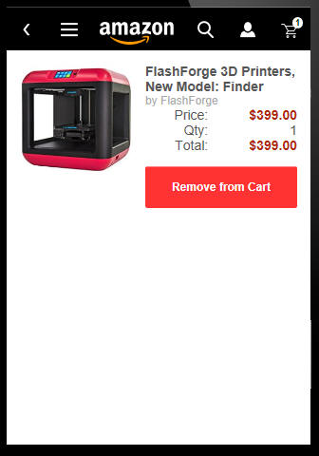

Slide 5
Badge Notifications
Alert the user that something has changed
Unread message
Items in a shopping cart
New feature

Slide 6
Badge Notifications
CSS borders
Applied to an existing object
Using Pseudo classes - :after

Slide 7
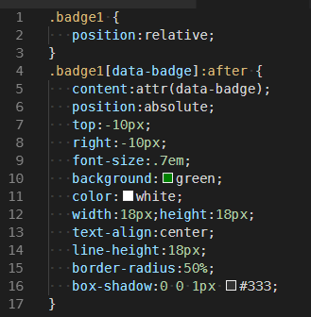
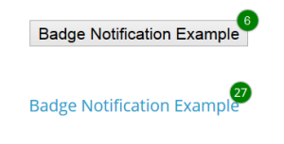
Badge Notifications

Slide 8


Slide 9
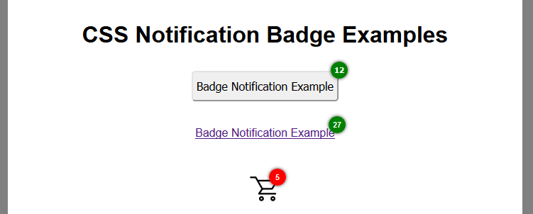
Badge Notifications
https://codepen.io/TheSmitchell/pen/gOOmrZM

Slide 10
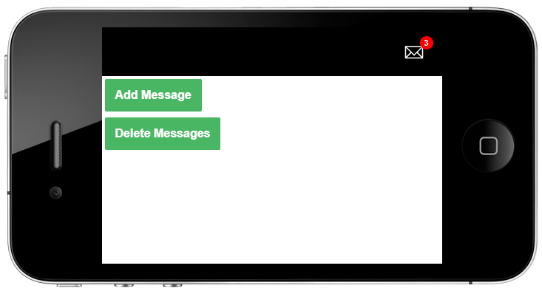
Badge Notification

