Slide 1

Individual-based models & Spatially explicit individual-based models with NetLogoR
21-22 Juin 2021
Sarah Bauduin - Chargée de recherche à l’OFB
Équipe Loup-Lynx, Unité Prédateurs Animaux Déprédateurs et Exotiques

Slide 2
Presenting IBMs

Slide 3
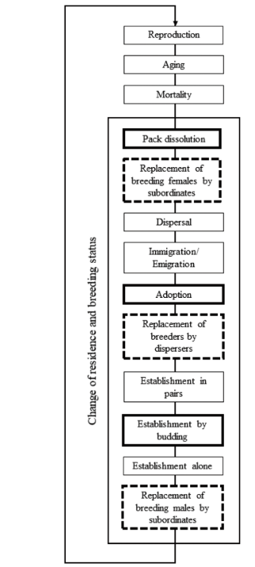
The importance of the diagram
Bauduin et al. 2020

Slide 4
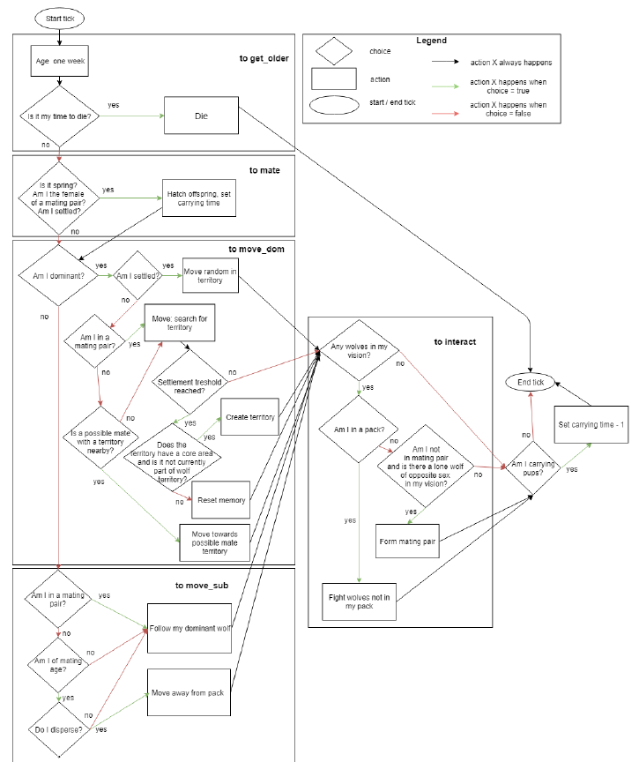
The importance of the diagram
van Vliet and Hofstede, 2019

Slide 5
The importance of the diagram
Helps to describe, explain and understand the model
For yourself now and later and for future users
Helps to code
Usually code blocks are similar to diagram blocks
Helps for later modifications
Helps to write the ODD

Slide 6
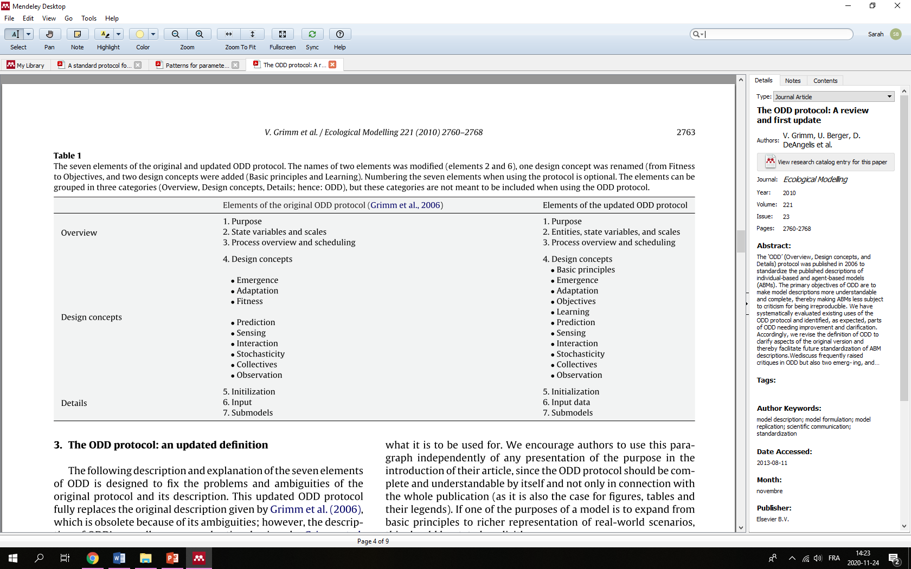
Overview, Design concepts, and Details (ODD)
Grimm et al., 2010

Slide 7
Overview, Design concepts, and Details (ODD)
« Official » format to present IBMs in scientific paper
Short or summarized ODD in Methods
Full ODD in Appendix when long
Helps to describe, explain and understand the model
Appreciated by the readers and IBM community

Slide 8
References
ODD
Grimm V et al. 2006. A standard protocol for describing individual-based and agent-based models. Ecological Modelling 198:115–126.
Grimm V, Berger U, DeAngelis DL, Polhill JG, Giske J, Railsback SF. 2010. The ODD protocol: A review and first update. Ecological Modelling 221:2760–2768.

