Slide 1

Individual-based models & Spatially explicit individual-based models with NetLogoR
21-22 Juin 2021
Sarah Bauduin - Chargée de recherche à l’OFB
Équipe Loup-Lynx, Unité Prédateurs Animaux Déprédateurs et Exotiques

Slide 2
Now it’s your turn!

Slide 3
Exercise 1/3
Use help()
Use previous exercises
Plot can help
Create a population of moving individuals where males and females have a different movement pattern
Create a world of 10 x 10 patches with random values on each patch between 0 and 1
Create a population with 15 males and 15 females
Random locations using randomXYcor()
Color of males = red, color of females = black
Define 2 movement patterns/functions
Movement of females: in an random direction, move 2 patches at the time, in a wrapped world
Movement of males: move to one of the 8 neighboring cells where there is a female on it, otherwise on one of the 8 neighboring cells randomly
What are the cells around the individuals?
On which cells there are females?
If there are several cells with females on it, choose one cell among these ones randomly
If there is one cell with female(s) on it, choose this cell
If there are no females on the cells around, choose one cell randomly
Create a loop of 20 times steps where all females move first then all the males
Use help()
Use help()
Use help()
Use help()
Do the exercise with: 10_ExerciseToDo.R
Exercise solutions: 11_ExerciseSolutions.R

Slide 4
Main steps to build an IBM with NetLogoR
Draw the model diagram to define the workflow and identify the different processes and their relationships.
Create the world in which the agents will evolve with the function createWorld() and assign patch values if necessary. Visualize the world with plot(nameWorld).
Create the turtles (i.e., moving agents) with the function createTurtles(). Visualize the turtles by plotting them on the world with points(nameTurtles).
Create the different processes (i.e., functions affecting the patches and/or turtles) by using the NetLogoR functions, the R functions or some from other packages.
Don’t hesitate to use help() to understand how NetLogoR functions and their arguments work. Don’t hesitate to look at the list of NetLogoR functions to find a function which already does what you want to do.
Test the different processes individually with a small world and a few numbers of turtles to make sure the code is doing what you want it to do.
Plot regularly to make sure the code is doing what you want it to do. Visuals are of great help to spot bugs in model. Also display elements (what’s inside the world and the turtles objects) regularly.
Then, build the main procedure for the model (e.g., with a for-loop or a scheduler function). The functions placed inside the for-loop or the scheduler function will be iterated the number of time steps defined.
Create test units to check if there are some bugs and to locate them easily. Use browser() when debugging.
Visuals can be plotted at each time step and/or at the end when the iterations are over. Plot functions take time to be executed and slow down the model but they are of great help.

Slide 5
Exercise 2/3
Use previous exercises
Use help()
Plot can help
Make reproduction happens when a male meets a female, with the production of one offspring
Define a reproduction function where all females produce one offspring each
Update the sex, breed and color of the offspring
Identify when a male and a female are on a patch together
And keep in memory the ID of these females which will reproduce
Apply the reproduction function in this case
Use the movement loop written before
After the movement, evaluate which females will reproduce (i.e., are on a patch with a male)
If there are reproducing females, apply reproduction
Do the exercise with: 10_ExerciseToDo.R
Exercise solutions: 11_ExerciseSolutions.R

Slide 6
Main steps to build an IBM with NetLogoR
Draw the model diagram to define the workflow and identify the different processes and their relationships.
Create the world in which the agents will evolve with the function createWorld() and assign patch values if necessary. Visualize the world with plot(nameWorld).
Create the turtles (i.e., moving agents) with the function createTurtles(). Visualize the turtles by plotting them on the world with points(nameTurtles).
Create the different processes (i.e., functions affecting the patches and/or turtles) by using the NetLogoR functions, the R functions or some from other packages.
Don’t hesitate to use help() to understand how NetLogoR functions and their arguments work. Don’t hesitate to look at the list of NetLogoR functions to find a function which already does what you want to do.
Test the different processes individually with a small world and a few numbers of turtles to make sure the code is doing what you want it to do.
Plot regularly to make sure the code is doing what you want it to do. Visuals are of great help to spot bugs in model. Also display elements (what’s inside the world and the turtles objects) regularly.
Then, build the main procedure for the model (e.g., with a for-loop or a scheduler function). The functions placed inside the for-loop or the scheduler function will be iterated the number of time steps defined.
Create test units to check if there are some bugs and to locate them easily. Use browser() when debugging.
Visuals can be plotted at each time step and/or at the end when the iterations are over. Plot functions take time to be executed and slow down the model but they are of great help.

Slide 7
Exercise 3/3
Use previous exercises
Use help()
Plot can help
Plot and show the evolution of the population
Plot the world
Plot the individuals at each time step
Add plotting functions after all other functions
Plot males and females with their respective colors
Use Sys.sleep(1) to slow the function
Count the number of individuals, of males and of females at each time step
Increment this vector at each time step
Plot the number of individuals (all, males and females) over time
Plot line color according to the male and female colors
Add a legend
Do the exercise with: 10_ExerciseToDo.R
Exercise solutions: 11_ExerciseSolutions.R

Slide 8
Main steps to build an IBM with NetLogoR
Draw the model diagram to define the workflow and identify the different processes and their relationships.
Create the world in which the agents will evolve with the function createWorld() and assign patch values if necessary. Visualize the world with plot(nameWorld).
Create the turtles (i.e., moving agents) with the function createTurtles(). Visualize the turtles by plotting them on the world with points(nameTurtles).
Create the different processes (i.e., functions affecting the patches and/or turtles) by using the NetLogoR functions, the R functions or some from other packages.
Don’t hesitate to use help() to understand how NetLogoR functions and their arguments work. Don’t hesitate to look at the list of NetLogoR functions to find a function which already does what you want to do.
Test the different processes individually with a small world and a few numbers of turtles to make sure the code is doing what you want it to do.
Plot regularly to make sure the code is doing what you want it to do. Visuals are of great help to spot bugs in model. Also display elements (what’s inside the world and the turtles objects) regularly.
Then, build the main procedure for the model (e.g., with a for-loop or a scheduler function). The functions placed inside the for-loop or the scheduler function will be iterated the number of time steps defined.
Create test units to check if there are some bugs and to locate them easily. Use browser() when debugging.
Visuals can be plotted at each time step and/or at the end when the iterations are over. Plot functions take time to be executed and slow down the model but they are of great help.

Slide 9
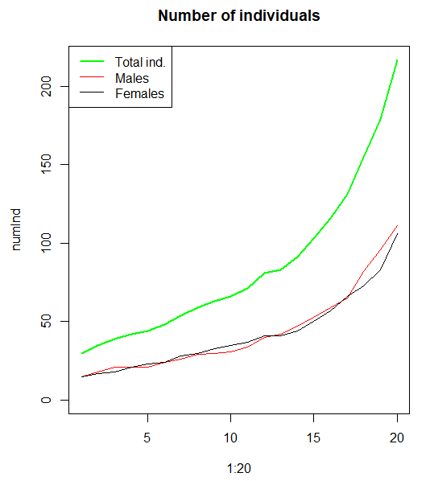
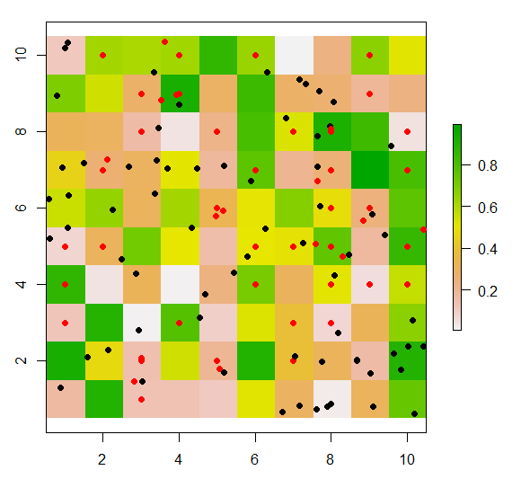
set.seed(1234)
Exercise solutions: 11_ExerciseSolutions.R

