Slide 1
Individual-based models & Spatially explicit individual-based models with NetLogoR
21-22 Juin 2021

Slide 2
Let’s look at a complex model example

Slide 3
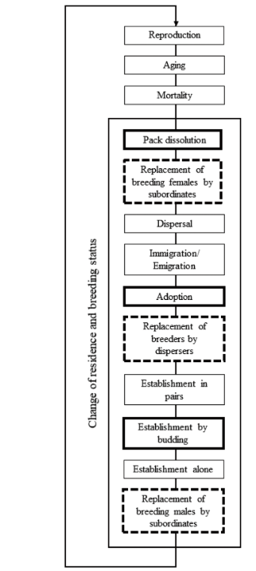

Model code: https://github.com/SarahBauduin/appendix_wolfIBM

Slide 4
Model objective
To simulate the wolf lifecycle while exploring four lesser-known processes
pack dissolution following the loss of a breeder
adoption by existing packs of young dispersers
establishment of new packs through budding
different types of breeder replacement
Model multiple scenarios based on different parameters, similar to a sensitivity analysis, to explore these four processes
Variability among projections reveals processes that most affected wolf population dynamics
Life-cycle traits that require further investigation

Slide 5
File organisation: 3 scripts
initParam.R
run.R
submodels.R

Slide 6

initParam.R
Data on the (initial) wolf population
Number of individuals, sex, age, …
Fictive population but can be an upload of field data
Creation of the initiation population with NetLogoR
createWorld(), createTurtles(), …
Model parameters
Reproduction rate, mortality rates, …

Slide 7
run.R
Call submodels.R
Call initParam.R
Define number of replicates, number of year simulated
Create the output objects over the replicates
Loop over the replicates
Population initialization
Create output objects over the years simulated
Loop over the years
All submodels
Update yearly outputs
Update replicate outputs
Explore results

Slide 8
submodels.R
Load R libraries
Create useful functions (used in submodels)
Define all submodels with unit test
Reproduction
aging
Mortality
Pack dissolution
Replacement of breeding females by subordinates
Dispersal
Immigration
Emigration
Adoption
Replacement of breeders by dispersers
Establishment in pairs
Establishment by budding
Establishment alone
Replacement of breeding males by subordinates

Slide 9
Build submodel
nameFunction <- function(){
return()
}
Start with the basic structure
Build step by step
Add unit test
Test each step with a small world/population
Fill the function arguments and return statement

