Slide 1

Individual-based models & Spatially explicit individual-based models with NetLogoR
21-22 Juin 2021
Sarah Bauduin - Chargée de recherche à l’OFB
Équipe Loup-Lynx, Unité Prédateurs Animaux Déprédateurs et Exotiques

Slide 2
Presenting IBMs

Slide 3
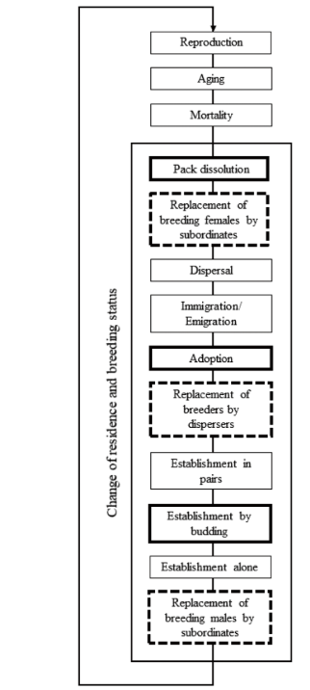
The importance of the diagram
Bauduin et al. 2020

Slide 4
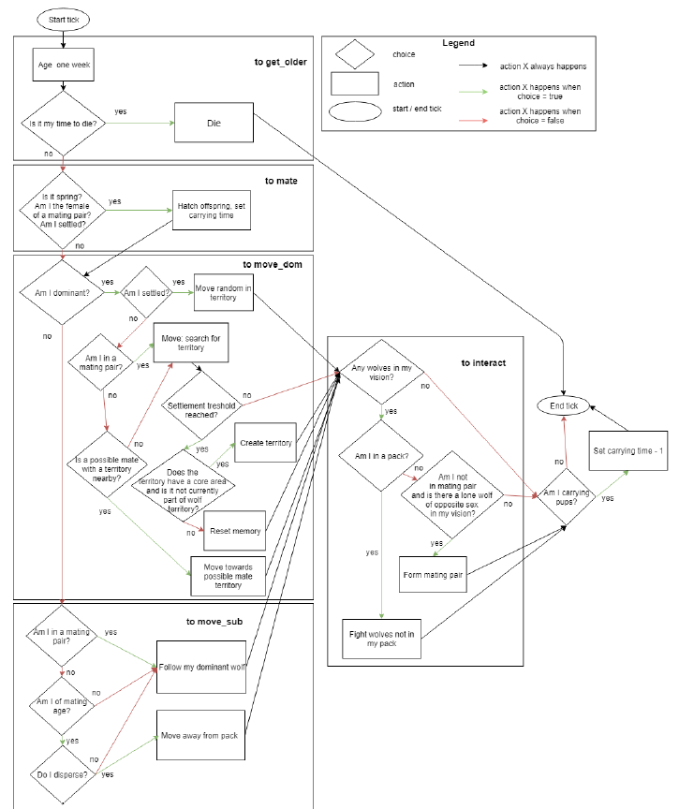
The importance of the diagram
van Vliet and Hofstede, 2019

Slide 5
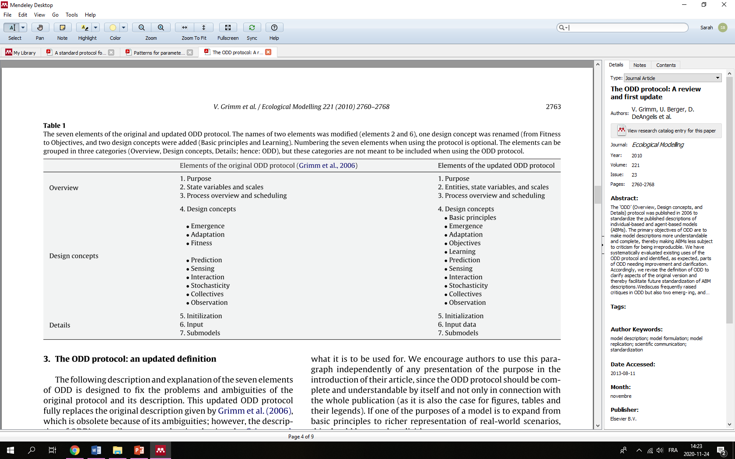
Format to present IBMs in scientific paper
Overview, Design concepts, and Details = ODD
Grimm et al., 2010

Slide 6
References
ODD
Grimm V et al. 2006. A standard protocol for describing individual-based and agent-based models. Ecological Modelling 198:115–126.
Grimm V, Berger U, DeAngelis DL, Polhill JG, Giske J, Railsback SF. 2010. The ODD protocol: A review and first update. Ecological Modelling 221:2760–2768.

